Slide 1

MPCA LAB MINI PROJECT
PROJECT TITLE: Smart Refrigerator
SECTION: E2
STUDENTS NAME: Shailesh R, Raeesa Tansen, Ramit Bathula, Ria Singh
SRN’s: 307, 310, 319, 326

Slide 2
PROBLEM STATEMENT
A user friendly mini fridge which self-regulates the temperature.
Also integrated power saving based on the inventory of the products (water bottles) inside.

Slide 3
INTRODUCTION
We have created a smart refrigerator microcontroller using Arduino UNO. It is simulated on Tinkercad. It is designed like the small fridges in hotels and is a prototype for water bottle units as of now.
It detects the number of water bottles kept inside and displays the subsequent output to the user so that they know if it needs to be restocked or not.

Slide 4
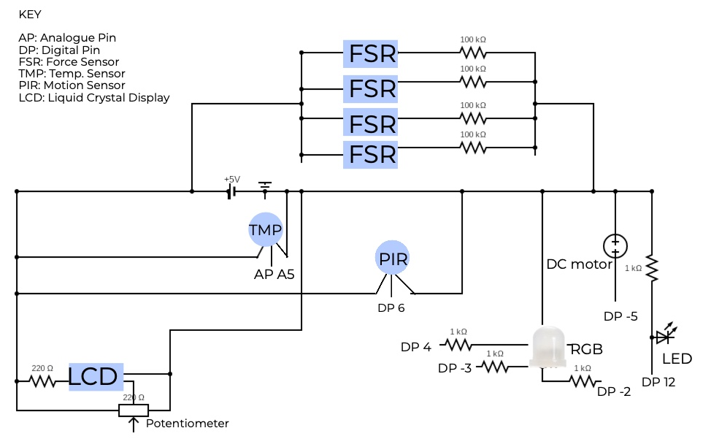
BLOCK DIAGRAM

Slide 5
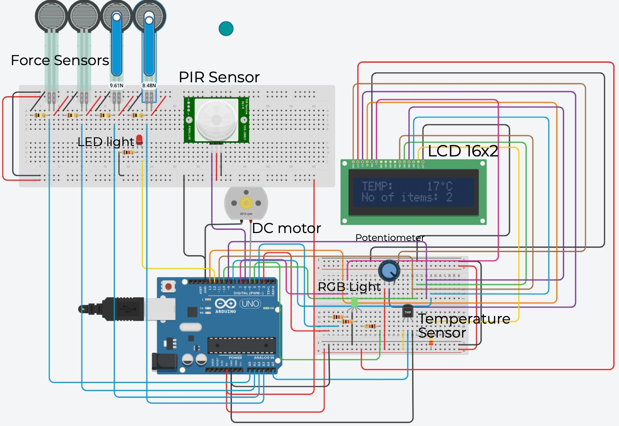
ARDUINO CIRCUIT

Slide 6
REQUIRED COMPONENTS
1 Arduino Uno R3
1 LED RGB
1 Red LED
1 PIR Sensor
1 Temperature Sensor [TMP36]
4 1 kΩ Resistor
1 LCD 16 x 2
1 250 kΩ Potentiometer
1 220 kΩ Resistor
1 DC Motor
4 Force Sensor
4 100 kΩ Resistor

Slide 7
PROJECT DESCRIPTION
The PIR sensor is used to detect whether the fridge has been opened or not, and if it detects any motion, it switches on the LED in the fridge.
If the fridge is empty, the LED is switched off irrespective of whether the PIR detects any motion. The force sensors act as pressure sensors and give us an inventory of how many items are present in the fridge.

Slide 8
PROJECT DESCRIPTION
The DC motor is connected to an internal fan which is used for ventilation and to remove heat from the inside, and the speed is based on the temperature.
The LCD display displays the temperature and the number of items present in the fridge at all times detected by the temperature and force sensors respectively.
The RGB LED light shines either red, green or blue depending on the temperature inside the fridge. (RED - extreme, GREEN - optimum, BLUE - very low).
The potentiometer controls the brightness of the LCD screen by varying the resistance.

Slide 9
APPLICATIONS
FORCE SENSOR
We have used FSR to detect the quantity of water bottles based on the presence of application of their weight. We have included these so that the user can review their inventory without having to actually open the refrigerator and manually count.
PIR MOTION SENSOR
The Passive Infrared Motion sensor is used to detect the presence of the user in front of the refrigerator to regulate the powering of internal lights, which is depicted by an LED light in our tinkercad prototype. Subsequently, if the fridge is empty, the lights remain switched off in order to conserve energy.

Slide 10
APPLICATIONS
TEMPERATURE SENSOR
Depending on the temperature of the refrigerator, the cooling and ventilation system represented by an internal fan connected to a DC motor is induced.
If the temperature is too low, the RGB turns Blue, and the DC motor is reduced to ~1000 rpm.
For optimum temperature, the RGB is Green and the DC motor runs at ~ 2000 rpm-3000 rpm.
If the temperature has risen dramatically, and it is too hot, the RGB turns Red and the DC motor runs at ~4000-5000 rpm.

Slide 11
PROJECT LINK
https://www.tinkercad.com/things/g0oQyuGMDjZ-mpcaprojectv1/editel?sharecode=k8Cn1roxKejHFDiixsEgRVtS1JB290ZQjMeyRHvaPhk

Slide 12
REFERENCES(Website links, Books etc.
https://arduinogetstarted.com/tutorials/arduino-force-sensor
https://www.tutorialspoint.com/arduino/arduino_pir_sensor.htm
https://www.tutorialspoint.com/arduino/arduino_temperature_sensor.htm
https://arduinogetstarted.com/tutorials/arduino-lcd
https://www.instructables.com/How-to-use-an-LCD-displays-Arduino-Tutorial/
https://arduinogetstarted.com/tutorials/arduino-dc-motor
https://create.arduino.cc/projecthub/Guitarman1/displaying-sensor-values-on-lcd-c0c44f
https://www.instructables.com/Interfacing-Force-Sensitive-Resistor-to-Arduino/

Slide 13
THANK YOU

