Slide 1

CMR COLLEGE OF ENGINEERING & TECHNOLOGY
Kandlakoya, Medchal, Hyderabad - 501401
Department of Computer Science and Engineering
Pnuemonia Detection using Deep Learning
Batch No.: 37
Under esteemed guidance of
Ms. P. Sravanthi
Assistant Professor

Slide 2
Outline
Abstract
Introduction
Literature Review - Existing System - Problems in Existing System
Research Objective
Problem Definition
Research Work - Proposed System Architecture - Methods - Comparison of Proposed System with an existing system
Performance Measure
Results
Conclusion
Future Work
References
Notes:
2

Slide 3
Abstract
Notes:
3

Slide 4
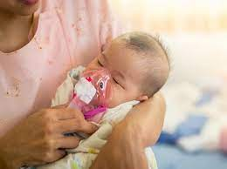
ABSTRACT
Pneumonia causes the death of around 700,000 children every year and affects 7% of the global population. Chest X-rays are primarily used for the diagnosis of this disease.
However, even for a trained radiologist, it is a challenging task to examine chest X-rays.
We develop an algorithm which detects pneumonia from frontal-view chest X-ray images at a level exceeding practicing radiologist

Slide 5
INTRODUCTION
Notes:
5

Slide 6
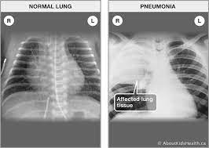
Introduction
Pneumonia poses a significant global health risk, over 4 million premature deaths annually due to air pollution.
Accurate diagnosis traditionally relies on expert review of chest radiographs (CXR) and clinical data.
CXR interpretation is complex due to various lung conditions mimicking pneumonia.
We develop an algorithm which detects pneumonia from frontal-view chest X-ray images at a level exceeding practicing radiologist
Notes:
6

Slide 7
Literature Review
Notes:
7

Slide 8
Comparison table for the existing system
S.No | Authors and Year of publication | Problem Statement | Name of the Proposed solution/Method | Drawback
1 | Sarang Mahajan, 2019 5th International conference for I2CT IEEE | Motive is to develop a model capable of detecting pneumonia as a supplementary means to access radiology diagnostics Dataset: Chest X-ray dataset from Kaggle | 121-layer DenseNet when trained on top of a finely tuned CheXNet model | The proposed model can only detect pneumonia and not its subtypes.
2 | Xhong Gu, Liyan Pan, Huiying Liang, Ran Yang ICMIP '18: Proceedings of the 3rd International Conference on Multimedia and Image Processing | Author used open Japanese society of radiological technology database (JSRT, 241 images) and Montgomery County, Md (MC, 138 images) dataset for detection of lung diseases based on chest X-ray images. | Feature Extraction of InceptionV3 CNN Architecture+ Machine Learning Classifier (SVM) | Most papers are only able to focus on the feature extraction rather than the performance of each classifier. In addition, machine learning algorithms still cannot beat Neural networks in terms of sensitivity.
3 | Ashitosh Tilve; Shrameet Nayak; Saurabh Vernekar2020 International Conference on (ic-ETITE) | Author used dataset from Indiana, Kit, paper focuses on surveying and comparing the detection of lung disease using different computer-aided techniques and suggests a revised model for detecting pneumonia | Artificial Neural Network (ANN) for pneumonia detection. | There is a problem of false disease detection with this model.

Slide 9
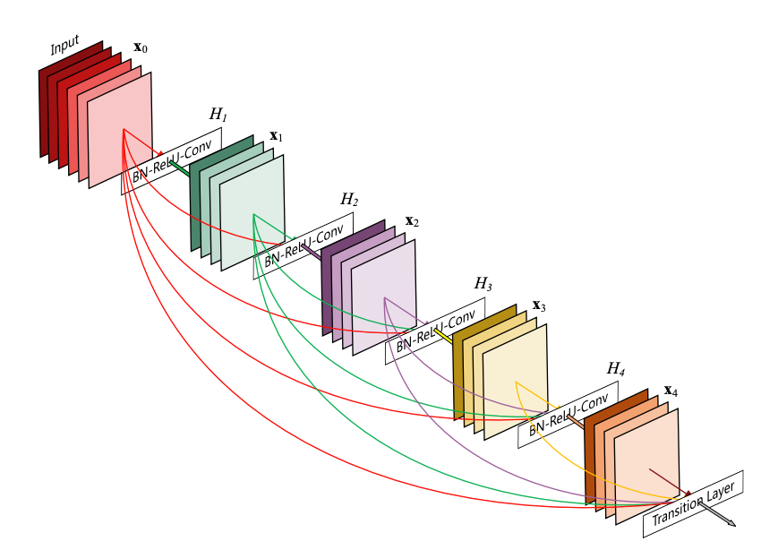
Existing System
DenseNet121 Densenet is a convolutional network where each layer is connected to all other layers that are deeper in the network:
* The first layer is connected to the 2nd, 3rd, 4th etc.
* The second layer is conected to the 3rd, 4th, 5th etc.

Slide 10
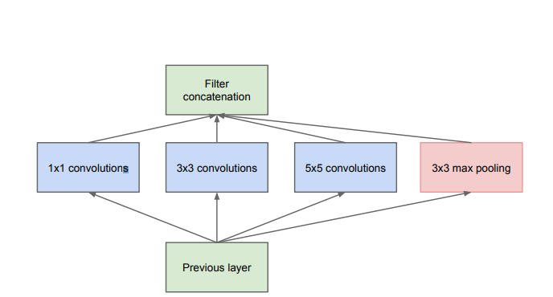
Inception v3
Inception models are a type of deep neural network (DNN) architecture developed by a researcher named Szegedy et al. for the first time in 2014, and the model was named as inception model . The structures of inception models and the conventional CNN model are different from each other in such a way that inception models are inception blocks which means lapping the same input tensor with multiple filters and concatenating their results.

Slide 11
Problems in Existing System :
- Complexity Overhead: Both DenseNet and Inception v3 architectures introduce significant computational complexity, potentially straining resources during training and inference.
- Interpretability Challenges: Understanding the decision-making process of these models is difficult due to their complex architectures, posing challenges for trust and confidence in critical applications such as pneumonia detection.

Slide 12
Research Objective
Notes:
12

Slide 13

Research objective
The primary objective of this study is to develop a deep neural network-based model for pneumonia detection, aimed at overcoming the challenges associated with traditional diagnostic methods.
This model aims to automate and optimize the classification of pneumonia in chest radiographs, improving accuracy and accessibility for early diagnosis, particularly in resource-constrained settings.

Slide 14
Problem Definition
Notes:
14

Slide 15
Problem Definition
Pneumonia is among the most prevalent diseases, and due to lack of experts it is difficult to detect. So, we need to build a machine learning model to detect pneumonia using chest x-rays.

Slide 16
Proposed System

Slide 17
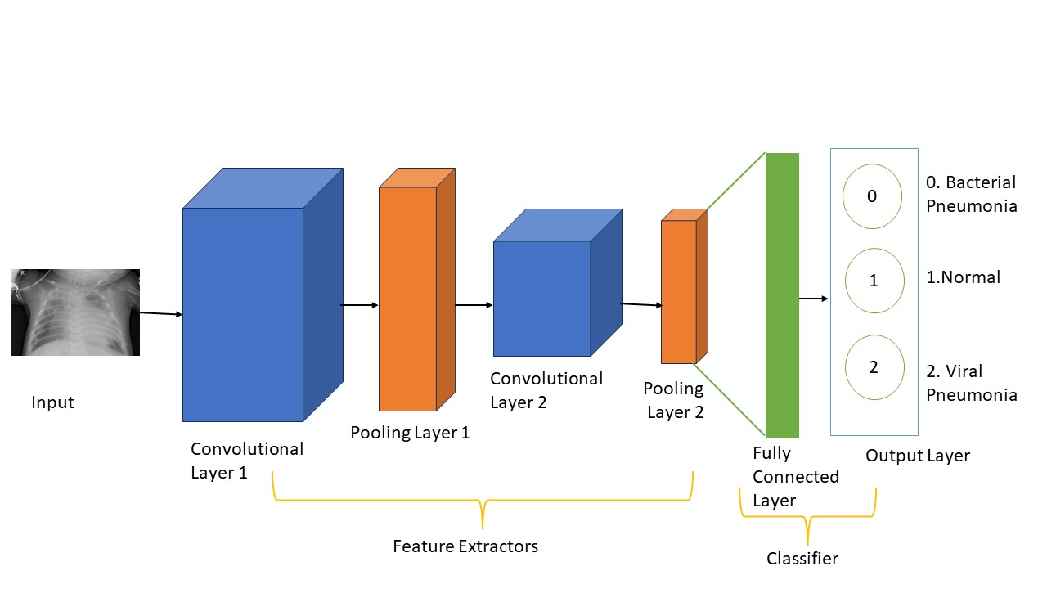
Proposed System Architecture :
The algorithm defines the architecture of the CNN model, which comprises multiple layers for feature extraction and classification. The CNN architecture typically consists of convolutional layers, pooling layers, activation functions, and fully connected layers.
Convolutional layers convolve learnable filters over the input image to extract features such as edges, textures, and patterns

Slide 18
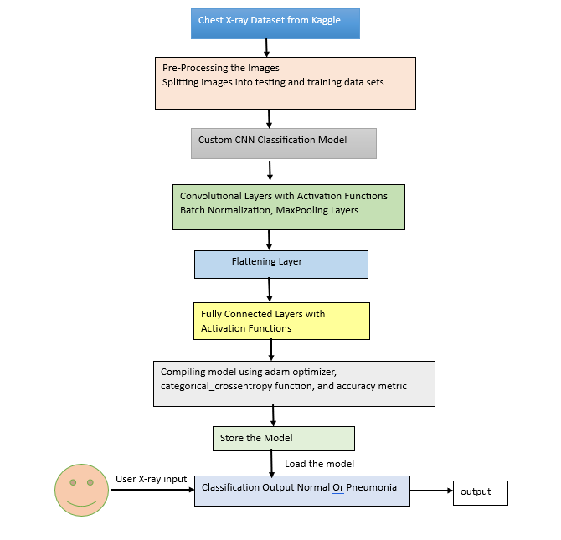
BLOCK DIAGRAM:

Slide 19
Methods :
Utilization of state-of-the-art deep learning techniques, particularly CNNs, for accurate pneumonia detection from chest X-ray images.
Customized CNN architecture comprising convolutional and pooling layers for hierarchical feature extraction, followed by fully connected and output layers for classification.
Data preprocessing involves loading, resizing, normalizing, and augmenting chest X-ray images to enhance model robustness and generalization.
Training procedure employs a labeled dataset and optimization algorithms like SGD or Adam to minimize a predefined loss function iteratively.
Inference process utilizes the trained model for predicting pneumonia presence in new chest X-ray images, evaluated using metrics such as accuracy, sensitivity, specificity, and AUC-ROC.

Slide 20
Convolutional layers convolve learnable filters over the input image to extract features such as edges, textures, and patterns. Mathematically, the output of a convolutional layer l can be represented as: Z^{[l]}=Conv(A^{[l-1]},W^{[l]},b^{[l]}) where A^{[l-1]} is the activation map from the previous layer, W^{[l]} is the weight matrix, b^{[l]} is the bias vector, and Z^{[l]} is the output feature map. Pooling layers reduce the spatial dimensions of the feature maps while retaining the most relevant information. Common pooling operations include max pooling and average pooling, which downsample the feature maps. The output of a pooling layer can be computed as: A^{[l]} = Pooling(Z^{[l]} ) Activation functions introduce non-linearity into the network, enabling it to learn complex relationships in the data. Common activation functions include ReLU (Rectified Linear Unit), sigmoid, and tanh.

Slide 21
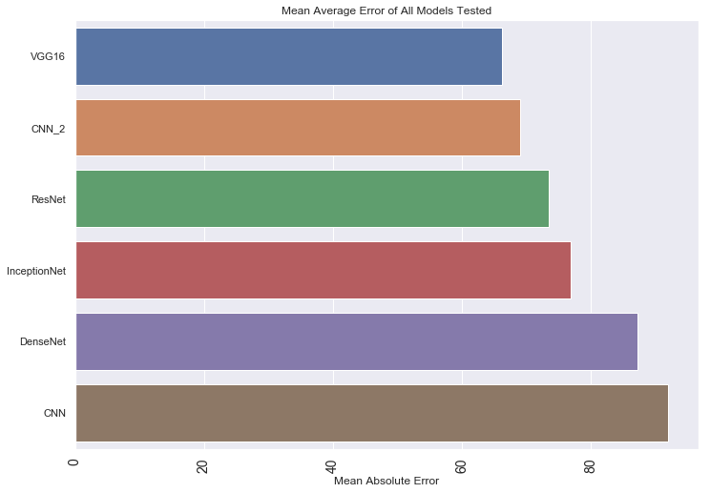
Comparison of Proposed system with an existed system
The existing systems have limitations in handling pneumonia detection,VGG16 processes fixed-sized images and outputs vectors for classification, while Inception-V3 is advanced but complex.
In contrast, our proposed system introduces a novel approach tailored for pneumonia detection. We resize images, use deep learning for segmentation, and employ connected components to identify pneumonia regions accurately.

Slide 22
Performance Measure :

Slide 23
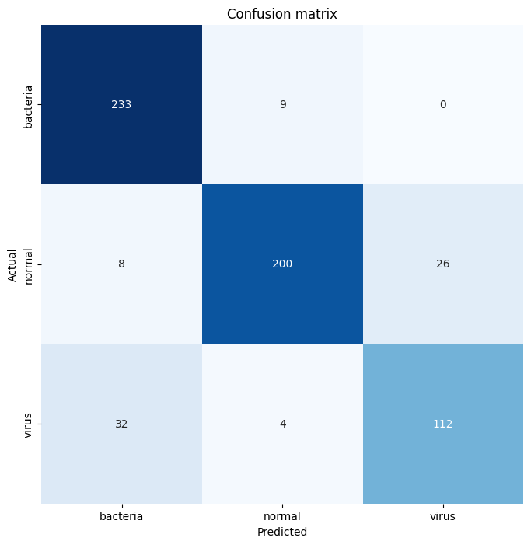
Performance Measure :
The confusion matrix (Figure 3) provides insights into the model's performance across different classes. From the matrix, we observe that the model correctly identified 233 bacterial pneumonia cases out of 242 instances, with only 9 misclassifications. Similarly, for normal pneumonia, the model achieved a high accuracy of 200 out of 234 cases, with only 8 misclassifications. Additionally, the model accurately classified 112 out of
148 viral chest X-ray images, with 32 misclassifications

Slide 24
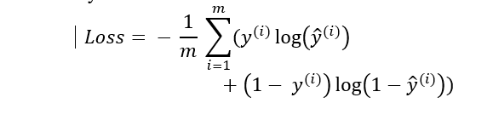
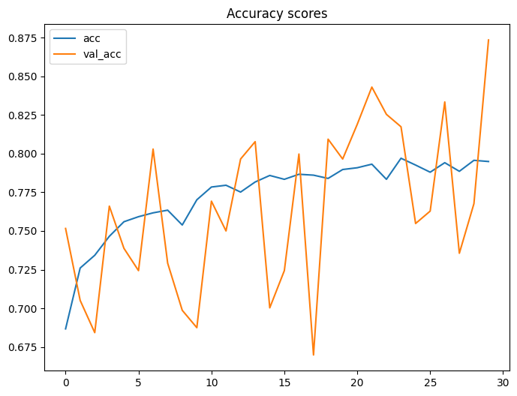
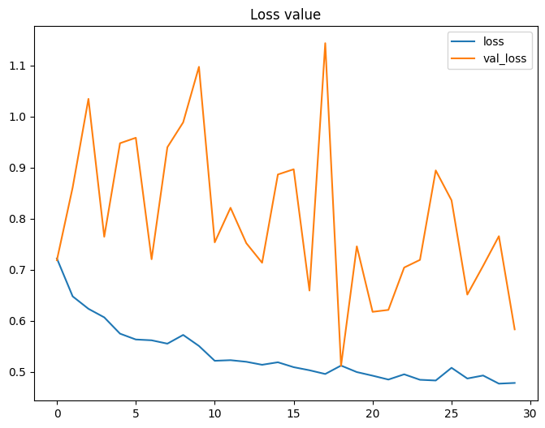
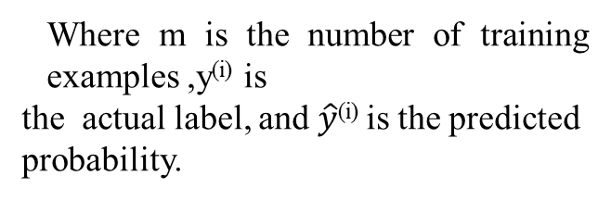
The algorithm defines a suitable loss function to quantify the difference between the predicted and actual labels of the chest X-ray images. For binary classification tasks like pneumonia detection, the binary cross-entropy loss function is commonly used:
Where m is the number of training examples ,y^{(i)} is
the actual label, and $\hat{y}$^{(i)} is the predicted probability.

Slide 25
Results

Slide 26
The overall accuracy of the model, as depicted , is 87.34%.
Accuracy = (True Positives + True Negatives) / (True Positives + True Negatives + False Positives + False Negatives).
This indicates that the model performed well in distinguishing between the different pneumonia categories and normal cases.

Slide 27
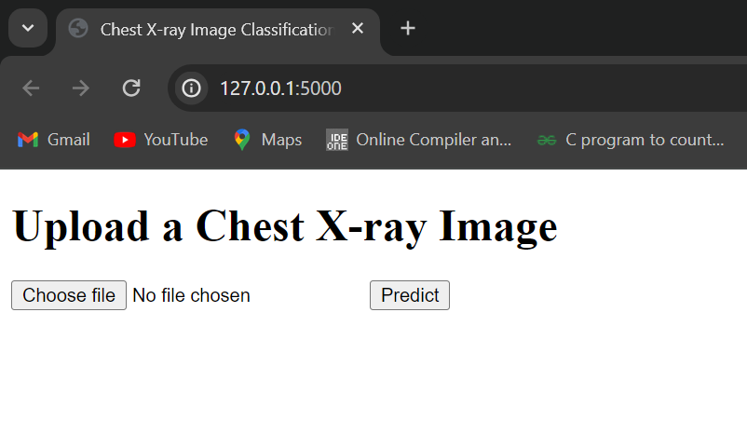
Results
The results of the pneumonia detection model demonstrate its effectiveness in accurately classifying chest X-ray images into three categories: bacterial pneumonia, viral pneumonia, and normal

Slide 28
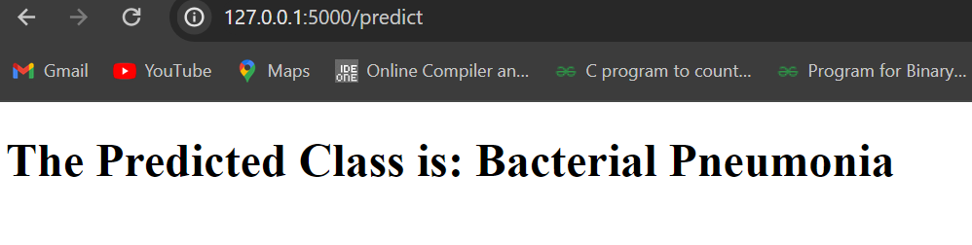
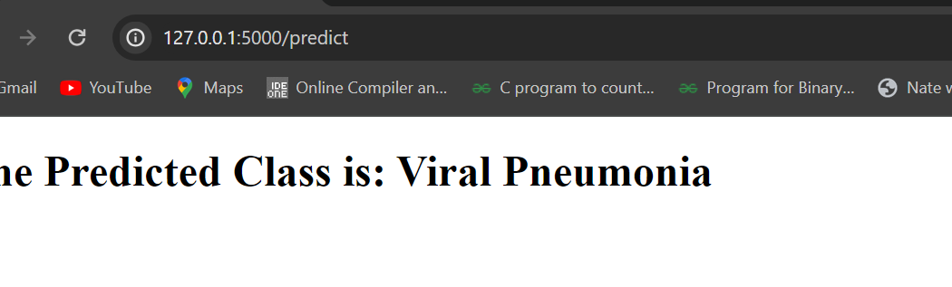


Slide 29
Future Work
Notes:
29

Slide 30
Future work
Development of a deep learning-based pneumonia detection system using convolutional neural networks (CNNs).
Evaluation of the system's performance and accuracy with a diverse dataset of nearly 6000 chest X-ray images.
Integration of the model into a user-friendly web application for real-time diagnosis, ensuring accessibility to a wider audience.
Emphasis on the project's potential to improve early diagnosis, especially in regions with limited access to specialized healthcare resources.

Slide 31
Conclusion
In conclusion, the development of a deep learning-based pneumonia detection system presents a promising approach for improving diagnostic accuracy and efficiency in clinical settings.
Through the utilization of convolutional neural networks and transfer learning techniques, our model demonstrates robust performance in accurately classifying chest X-ray images into categories of normal, bacterial pneumonia, and viral pneumonia.
The integration of advanced machine learning methodologies with medical imaging data holds significant potential for enhancing healthcare outcomes, and accurate diagnosis of pneumonia cases.
Moving forward, continued research and development in this field are crucial for advancing the capabilities of AI-driven diagnostic systems and facilitating their integration into routine clinical practice.

Slide 32
References
- Kaushik, V. S., Nayyar, A. (April 2020). Pneumonia Detection Using Convolutional Neural Networks (CNNs). In Proceedings of the First International Conference on Computing, Communications, and Cyber-Security (IC4S 2019), Duy Tan University. DOI: 10.1007/978-981-15-3369-3_36.
- . Rahman T., Chowdhury M.E., Khandakar A., Islam K.R., Islam K.F., Mahbub Z.B., Kadir M.A., Kashem S. Transfer Learning with Deep Convolutional Neural Network (CNN) for Pneumonia Detection using Chest X-ray.
- Nicholas E Ross, Charles J Pritchard, David M Rubin and Adriano G Duse, "Automated image processing method for the diagnosis and classification of malaria on thin blood smears", Medical and Biological Engineering and Computing, vol. 44, no. 5, 2006.
- Karen Simonyan and Andrew Zisserman, "Very deep convolutional networks for large-scale image recognition", 2014.

Slide 33
Thank You!

