Slide 1
Zhukov Dmitry
Quiz System

Slide 2
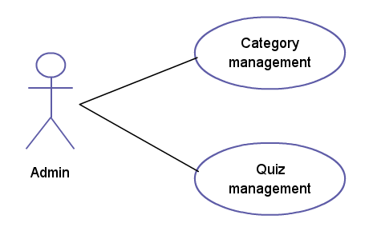
Admin use cases

Slide 3
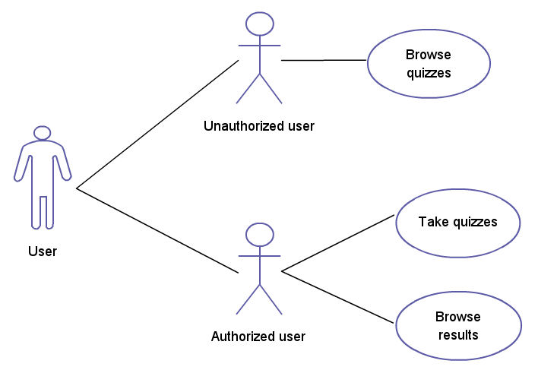
User use cases

Slide 4
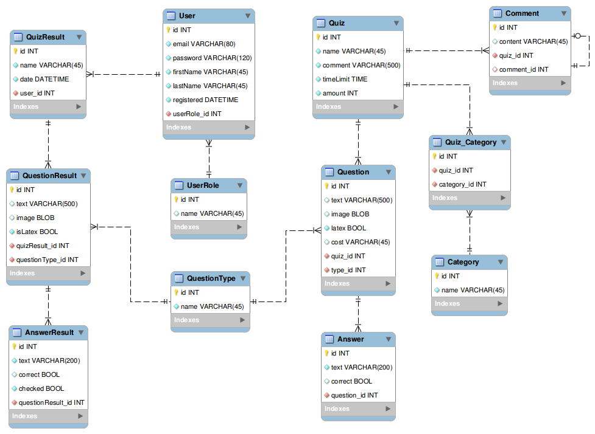
Database schema

