Slide 1
RESTful web API
POST /users/{userLogin} -- Create a new user
GET /users/ -- Find users data
PUT /users/ -- Edit user data
DELETE /users/{userLogin} -- Delete user
POST /groups/{groupSlug} -- Create a new group
GET /groups/ -- Get list of groups
PUT /groups/{groupSlug} -- Rename group
DELETE /groups/{groupSlug} -- Delete group
POST /groups/{groupSlug}/users/ -- Add user into group
DELETE /groups/{groupSlug}/users/ -- Remove user from group
POST /invitations/users/{userLogin}/groups/{groupSlug} -- Create invitation
GET /invitations/ -- Get list of invitations
DELETE /invitations/users/{userLogin}/groups/{groupSlug} -- Delete invitation
POST /groups/{groupSlug}/snote/ -- Create SimpleNotes
GET /groups/{groupSlug}/snote/ -- Get SimpleNotes
GET /snote/ -- Get all SimpleNotes
PUT /snote/{snoteID} -- Edit SimpleNote
DELETE /snote/ -- Delete SimpleNotes
POST /sessions/{userLogin} -- Open session (authentication)

Slide 2
JSON representation
Find users opesation (search body: «john»):
[
{
"login":"muller",
"color":-7290638,
"date":"11 Aug",
"full_name":"John Muller"
},
{
"login":"shtirlitz",
"color":-1581379,
"date":"15 Aug",
"full_name":"John Lennon"
}
]
Create note operation (error):
{
"status":{
"message":"Bad Request",
"code":400
},
"comment":"Title is empty."
}

Slide 3
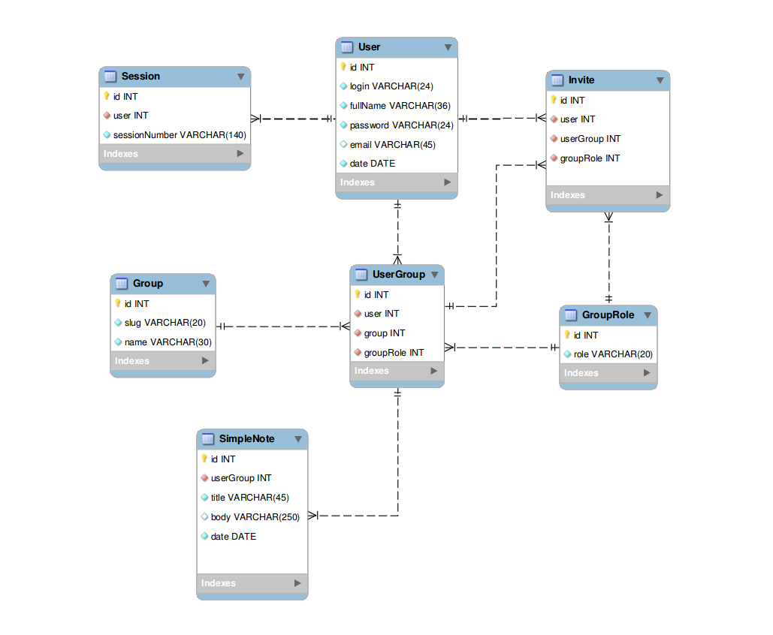
Database schema

Slide 4
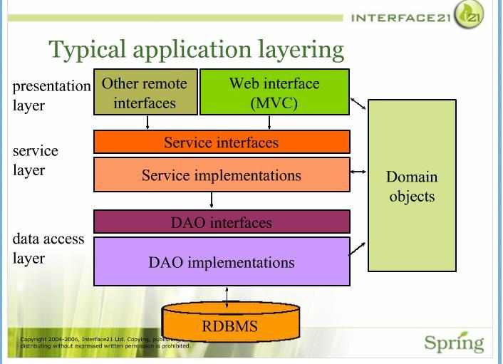
Architecture. Theory

Slide 5
Architecture. Implementation
View
layer
View
HTTP
Presentation
layer
RESTful controllers
Representation
objects
Service interfaces
Domain
objects
Service
layer
Service implementations
DAO interfaces
Data access
layer
DAO implementations
Hibernate

Slide 6
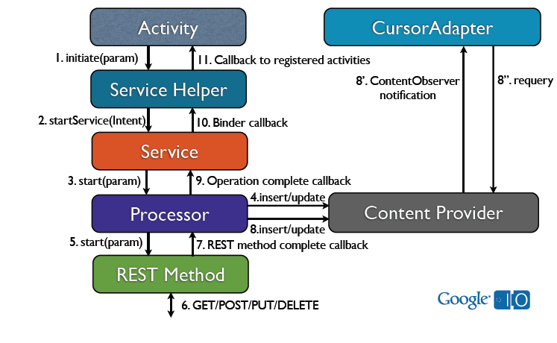
Client architecture. Theory

Slide 7
Client architecture. Implementation
Service
HTTP
Activity
Content provider
SQLite

