Slide 1
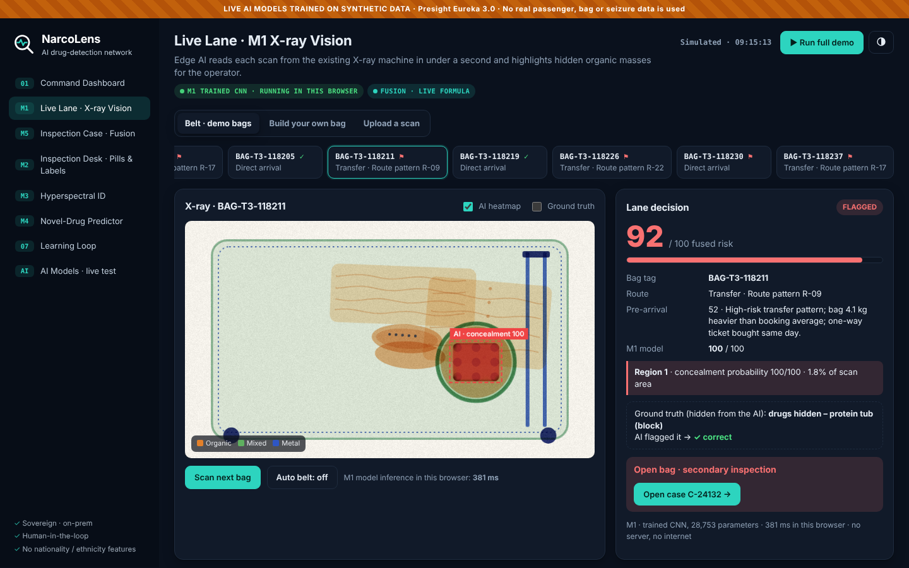
NarcoLens
PRESIGHT EUREKA 3.0 · DEFENSE & POLICING
Turning every UAE customs scanner into an AI drug detector
Software-only
Sovereign · on-prem
Live AI models
Prototype: M1 X-ray Vision flags a dense block hidden inside a protein tub
TRL 4 · Live AI models trained and tested on synthetic data, running in a clickable web prototype
Notes:
NarcoLens is an AI software platform that turns the X-ray scanners and inspection desks UAE customs already owns into one connected drug-detection network.
Theme: Defense & Policing. The idea sits squarely in Presight's verticals: law-enforcement intelligence, investigations and command support for border security.
In one sentence: every bag or parcel gets one digital Inspection Case; five AI modules add evidence to it – X-ray vision, pill and label recognition, hyperspectral substance ID, a novel-drug predictor and a risk-fusion engine – and the officer makes the decision with a clear explanation in front of them.
Three things make it different. First, it is software-only: it plugs into existing scanners from any vendor, so it can be deployed lane by lane without buying new X-ray machines. Second, it is sovereign: it runs on-prem, and sites learn from each other through federated learning without sharing raw images. Third, it identifies the substance itself, through packaging, in minutes – and it predicts new synthetic-drug variants before they are first seized.
We are at TRL 4: the two vision models (M1 X-ray concealment segmentation and M2 tablet imprint classification) are real neural networks, trained on thousands of synthetic scans with pixel-level ground truth and validated on held-out data – M1 detects 100% of drug-carrying test bags with 1.7% false alarms on clean bags, and M2 classifies imprints with 99.8% accuracy. They run live, offline, inside the attached web prototype, where judges can build their own bag, hide drugs anywhere, draw a pill imprint or upload an image.

Slide 2






Smugglers are out-innovating manual screening
1,273
Hidden in plain sight
drug seizures at Dubai's land, sea and air ports in one year
Pills pressed into clothing buttons
Drugs packed inside furniture and door panels
540
Opium mixed into protein powder and shoe linings
drug cases at Dubai airports in nine months (Jan–Sep 2023)
Still found mostly by hand
14M
Operators judge X-ray density by eye, bag after bag
Captagon pills hidden in a single commercial shipment (Feb 2026)
Sniffer-dog teams cover limited hours and lanes
Naming the substance waits days for the lab
Figures from Dubai Customs and press reports, 2023–2026
Notes:
The problem: drug smuggling into the UAE is high-volume and increasingly creative, while detection still depends on people.
Scale, per Dubai Customs figures reported in the press: about 1,273 drug seizures across Dubai's land, sea and air ports in one year (reported 2024), and 540 drug cases at Dubai airports alone between January and September 2023. In February 2026, Dubai Police and Kuwaiti counterparts seized more than 14 million Captagon pills hidden in a commercial shipment.
Concealment keeps evolving: Captagon pressed into clothing buttons (August 2025), drugs inside 651 doors and 432 furniture panels, opium mixed into protein powder and sewn into shoe linings.
How it is found today: X-ray operators interpret density by eye, sniffer-dog teams have limited hours and cannot cover every lane, and confirming what the substance actually is requires a forensic lab, which takes days. Who feels it: customs inspectors and police anti-narcotics units every shift; travellers, through slower and more manual searches. The cost: missed seizures, officer hours spent on false suspicions, and delays in building cases.
Sources: Gulf News, Arabian Business, Dubai Media Office (Dubai Customs figures), The National (Feb 2026, Aug 2025), SCMP (2023).

Slide 3



The gap: detection hasn't kept pace
No AI reads drug X-rays
Chemistry needs a lab
Operators judge density by eye. We found no published system that auto-flags narcotics at UAE checkpoints.
Confirming a substance takes days, so officers act on suspicion alone at the desk.
Synthetic drugs mutate
Parcels are booming
New variants are designed to dodge detection libraries; detection lags behind the first seizure.
E-commerce and "research peptide" shipments grow faster than inspection capacity.
Why now: edge GPUs and hyperspectral cameras are affordable, the UAE is investing in sovereign AI, and customs data is already digital. The missing piece is software that connects it all.
Notes:
Why the problem persists – four gaps.
One: no AI reads drug X-rays. Dubai Customs uses a Smart Risk Engine, X-ray, K9 teams and an AI-linked monitoring system (Siyaj), but in our research we found no published system that automatically flags narcotics in airport X-ray images. The image interpretation is still human.
Two: chemistry needs a lab. Identifying the substance means sending a sample away. That takes days, so the inspection decision at the desk is made on suspicion.
Three: synthetic drugs mutate. Producers tweak chemical structures specifically to evade detection libraries. By the time a variant is in the library, it has already crossed borders.
Four: parcels are booming. E-commerce, courier parcels and so-called research peptides and supplements arrive in volumes that manual inspection cannot match.
Why now: edge GPUs that can run vision models beside a scanner are cheap, hyperspectral cameras have become industrial products, the UAE is investing heavily in sovereign AI, and customs already holds digital scan images and manifests. What is missing is the software layer that connects these into one decision – which is exactly what Presight builds.

Slide 4






NarcoLens: one AI layer, one case per bag
M5 · Pre-arrival risk
M2 · Pills, vials, labels
Route and booking patterns score each bag early
Imprint match, Arabic/English OCR, registry check
INSPECTION CASE
one per bag tag
M5 fuses all evidence
M1 · X-ray Vision
M3 · Hyperspectral ID
Edge AI reads the existing scan in under 1 s
Names the substance through the packaging
Loop · Federated learning
M4 · Novel-drug predictor
Each confirmed seizure retrains every site
Predicts new variants and feeds the M3 library
Notes:
The solution: NarcoLens is a software layer, not new hardware. It sits on top of the scanners, cameras and systems customs already has.
The core idea is the Inspection Case. Every bag, parcel or container gets one case, keyed by its bag tag, airway bill or parcel barcode. Every module writes its evidence to that same case, and the fusion engine (M5) turns the evidence into one explainable score and a recommended action: clear, re-scan or open.
The six building blocks:
- M5 pre-arrival risk: route patterns, booking timing and weight anomalies score each item before it arrives. No nationality or ethnicity is ever used.
- M1 X-ray Vision: edge AI reads the existing scanner image in under a second and highlights hidden organic masses.
- M2 Pills, vials and labels: the officer photographs what they find; AI matches pill imprints, reads Arabic and English labels and checks the product registry.
- M3 Hyperspectral ID: a hyperspectral camera identifies the substance through packaging.
- M4 Novel-drug predictor: predicts spectral fingerprints of new synthetic variants and pushes them into the M3 library.
- The learning loop: every lab-confirmed seizure retrains models at every site through federated learning.
What is new is the combination: vision plus chemistry plus prediction in one case, running on-prem and learning across the whole national network.

Slide 5
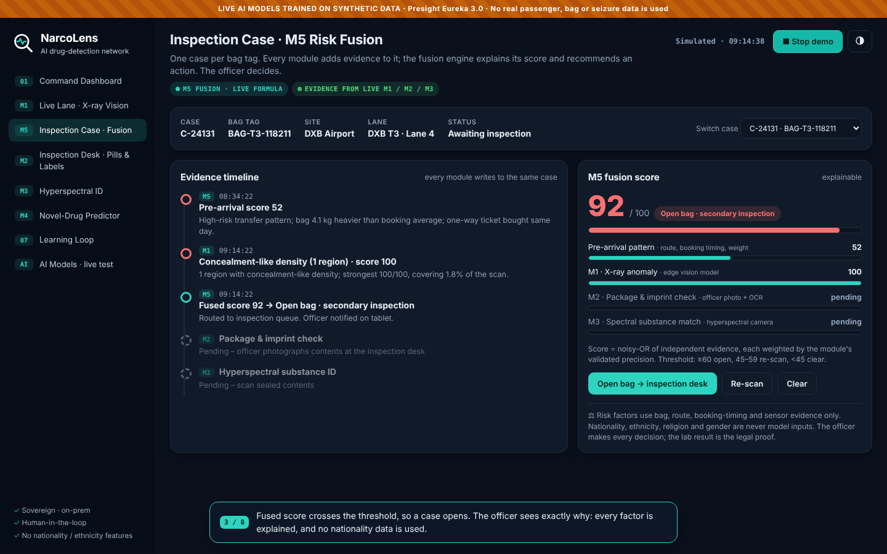

A bag's journey through NarcoLens
1
Before landing · M5
Route and booking pattern score the bag 52/100
2
On the belt · M1
Dense block in a protein tub flagged in 0.4 s (87)
3
Case opened · M5
Fused score 83: open the bag, reasons shown
4
Inspection desk · M2
Label not in registry; Captagon-style imprint
5
Hyperspectral · M3
Amphetamine-type stimulant, 98% match, still sealed
Prototype: every module writes to the same case, and the score explains itself
6
Lab confirms · Loop
Under a minute from belt to substance ID in the demo, and no bag is opened until the evidence justifies it
Seizure confirmed; all 7 sites retrain, no images shared
Notes:
This is the journey the prototype demonstrates, using one simulated bag at DXB Terminal 3.
Step 1 – before landing: M5 gives the bag a pre-arrival score of 52 because of a high-risk transfer route, a same-day one-way ticket and a weight above the booking average. Most bags score low and are never touched.
Step 2 – on the belt: the bag passes the existing X-ray. The edge box runs M1 in about 0.4 seconds and highlights a dense block inside a protein tub, score 87.
Step 3 – case opened: M5 fuses the two pieces of evidence into 83, above the threshold of 60, and recommends opening the bag. The officer sees why.
Step 4 – inspection desk: the officer photographs the tub. M2 reads the label in Arabic and English, finds the brand and batch are not in the MOHAP product registry, and spots tablets with a Captagon-style twin-crescent imprint in an inner pouch.
Step 5 – hyperspectral: M3 identifies amphetamine-type stimulant at 98% spectral match without opening the sealed pouch. Fused score: 99.
Step 6 – the lab confirms, the case closes, and every site in the network retrains locally on the new example – without any image leaving the site.

Slide 6
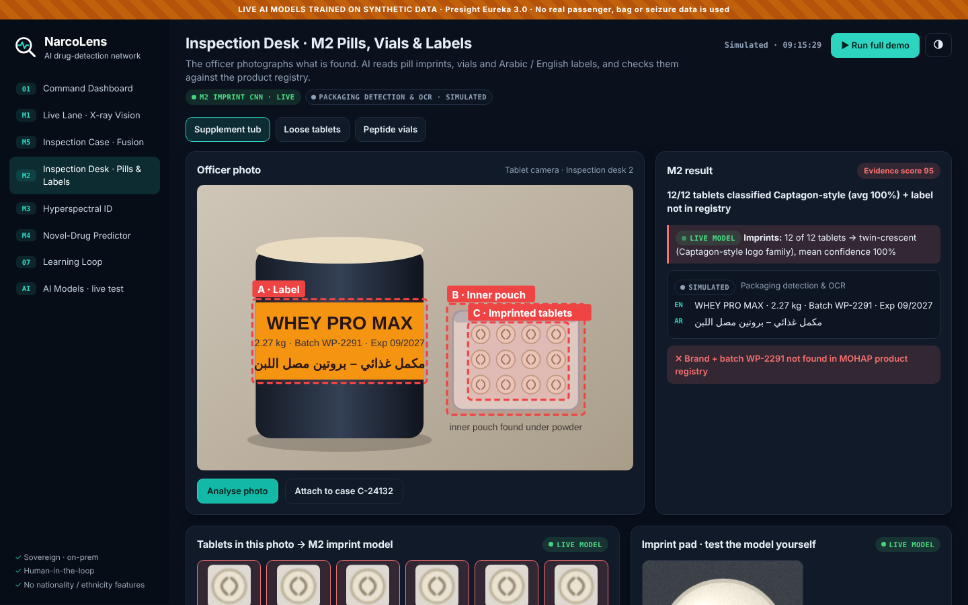

Seeing what's hidden: the vision modules
M1 · X-ray Vision
M2 · Pills, vials and labels
Edge GPU beside the existing scanner, under 1 s per bag
Finds organic masses, hidden cavities, abnormal density
Prototype: trained CNN, 100% recall on unseen bags
Officer photographs what is found on a desk tablet
Matches pill imprints and vials; reads Arabic/English labels
Prototype: imprint CNN, 99.8% accuracy; OCR next
Notes:
The two vision modules – how they work, data and models.
M1 X-ray Vision runs on a small GPU box next to each existing scanner and reads the scanner's image through the DICOS standard, so it works with Smiths, Rapiscan, Nuctech and others. It combines an object detector (RT-DETR or YOLO family) trained on concealment patterns with an anomaly detector (PatchCore) that learns what normal bags look like and flags what does not fit. Dual-energy data separates organic, mixed and metal materials. Output: heatmap, boxes, a reason in plain words and a score, in under a second.
Training data: public X-ray datasets (SIXray, PIDray, OPIXray) for pretraining; historical seizure scans from customs under a data-sharing MoU; and threat-image projection – digitally inserting known drug-packet signatures into clean bag scans – to multiply the training set.
M2 Pills, vials and labels works at the inspection desk. The officer photographs what is found; fine-tuned vision models (ViT/CLIP) match pill imprints – for example Captagon's twin-crescent logo family – vials and packaging, and Arabic-capable OCR reads labels and checks them against the MOHAP product registry. This also covers unregistered peptides and adulterated supplements, a fast-growing category.

Slide 7
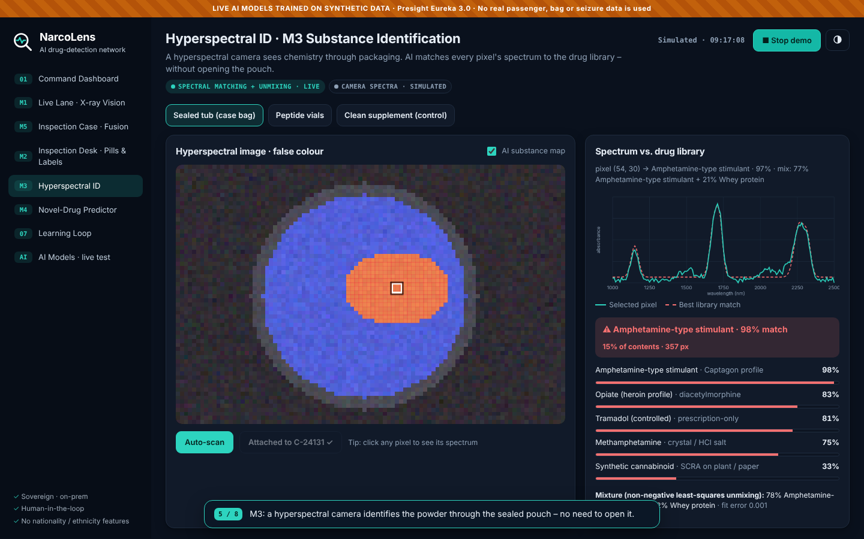

Seeing chemistry: identify, then predict
M3 · Hyperspectral ID
Camera reads ~150 bands from 1,000 to 2,500 nm
Every pixel matched to the drug library
Names the drug without opening the package
M4 · Novel-drug predictor
Graph neural network predicts new variants' spectra
Chemists validate, then it reaches every camera
Recognises a variant before its first seizure
Prototype: M3 finds amphetamine-type powder inside a sealed pouch (98% spectral match)
Notes:
The chemistry modules are what turn suspicion into identification.
M3 Hyperspectral ID: a hyperspectral camera captures around 150 short-wave infrared bands for every pixel. Each substance absorbs light in a characteristic pattern, so every pixel carries a chemical fingerprint. A spectral model (3D-CNN or spectral transformer, with correlation matching as a baseline) compares each pixel's spectrum with a library of drugs, cutting agents and benign look-alikes such as whey protein and sugar. In the prototype, the sealed pouch inside the protein tub is identified as an amphetamine-type stimulant at 98%, while the surrounding powder correctly reads as whey protein. Published research reports around 99% accuracy for smartphone-based Raman classification of drug components under lab conditions; NarcoLens applies the same principle with imaging at the inspection desk. Physical lab testing remains the legal proof.
M4 Novel-drug predictor: synthetic drug producers keep modifying structures. M4 uses a graph neural network to predict the spectrum a new variant would produce, from its drug family's known chemistry, guided by seizure trends and international early-warning feeds. Forensic chemists validate each prediction against reference samples before it is pushed to every camera. The result: a variant can be recognised the first time it appears, not after the first seizure.

Slide 8




Explainable by design, accountable by default
No nationality or ethnicity
M5 fusion: why this bag scored 99
Only bag, route, timing and sensor evidence. Bias audits every quarter.
The officer decides
AI recommends; every search and seizure is a logged human decision.
The lab is the legal proof
AI evidence pack (images, spectra, scores) kept under chain of custody.
Each bar is independent evidence, weighted by the module's validated precision. Thresholds: 60+ open · 45–59 re-scan · under 45 clear.
On-prem and federated
Models train at each site; zero raw images leave a site.
Notes:
Trust is what decides whether a system like this is ever used, so it is built in rather than added later.
Explainable fusion: M5 combines independent pieces of evidence with a noisy-OR model, each weighted by that module's validated precision. The officer sees every bar: here the pre-arrival pattern scored 52, the X-ray anomaly 87, the package and imprint check 90 and the spectral match 98, giving 99 overall and a seizure recommendation. Thresholds are simple and auditable: 60 and above open, 45 to 59 re-scan, below 45 clear. In production the weights would be learned with gradient-boosted models and calibrated per lane, but the explanation stays visible.
Four principles:
1. No nationality, ethnicity, religion or gender is ever a model input. Risk comes from the bag, the route, booking timing and sensor evidence, with quarterly bias audits.
2. The officer decides. AI recommends; every search and seizure is a logged human decision, and overrides become feedback.
3. The lab remains the legal proof. NarcoLens produces an evidence pack – images, spectra, scores – under chain of custody, supporting admissibility.
4. Sovereign by design: everything runs on-prem, and federated learning means no raw image ever leaves the site where it was taken.

Slide 9





Software-only, vendor-agnostic architecture
1 · Edge
2 · Core (on-prem)
3 · Apps
GPU box beside each X-ray/CT scanner and hyperspectral camera
Runs M1 and M3 locally in under 1 s
Reads images via the DICOS standard
Inspection cases and M5 fusion
M4 predictor and drug library
Federated aggregation, model registry, audit log
Overlay on the scanner operator's screen
Officer tablet app at the desk
Command dashboard for supervisors
Integrates with
Any scanner vendor (DICOS) · customs manifest and booking systems · forensic lab systems
Built with
PyTorch · RT-DETR · PatchCore · ViT/CLIP · Arabic OCR · PyTorch Geometric · XGBoost · Flower · Kubernetes · React
Notes:
NarcoLens is a software platform, not an embedded device. Presight cannot and should not modify scanner firmware, so the design deliberately sits alongside vendor equipment. That makes it vendor-agnostic and sellable to any customs agency.
Three layers:
1. Edge: a small GPU computer next to each X-ray/CT scanner and each hyperspectral camera. It reads images using DICOS – the NEMA standard for security-imaging data – runs M1 and M3 in under a second so belts never slow down, and keeps working if the network is interrupted.
2. Core: Presight software running on-prem at the airport or in a government data centre. It holds the inspection cases and the M5 fusion engine, the M4 predictor and drug library, the model registry, the federated-learning aggregator and a complete audit log. Modules communicate over an event bus (Kafka).
3. Apps: an overlay on the scanner operator's screen, a tablet app for officers at the inspection desk, and a command dashboard for supervisors and the command centre.
Integrations: scanner vendors via DICOS or vendor SDKs, customs manifest and booking systems for pre-arrival scoring, and forensic lab systems for confirmed outcomes.
Stack: PyTorch, RT-DETR, PatchCore (Anomalib), ViT/CLIP, Arabic OCR, PyTorch Geometric, XGBoost, Flower for federated learning, MLflow, Kubernetes, FastAPI and React – all deployable fully on-prem.

Slide 10
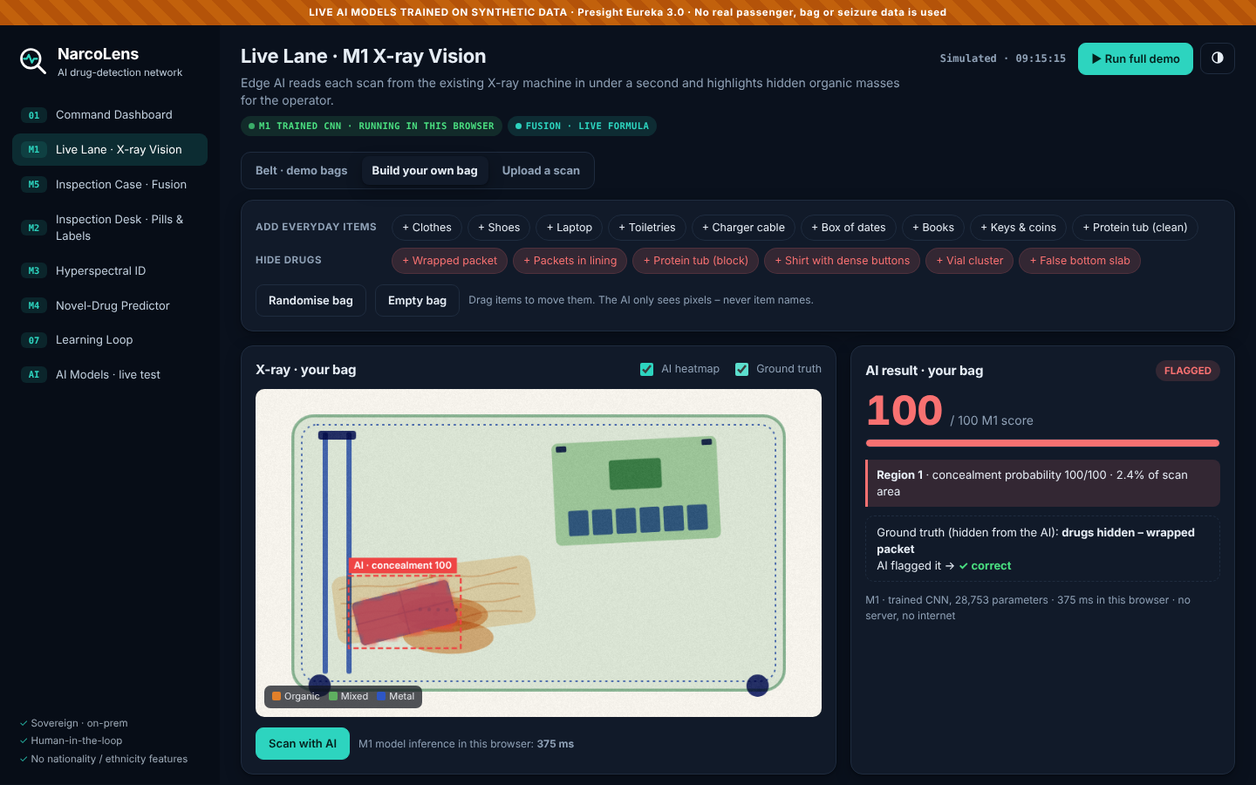
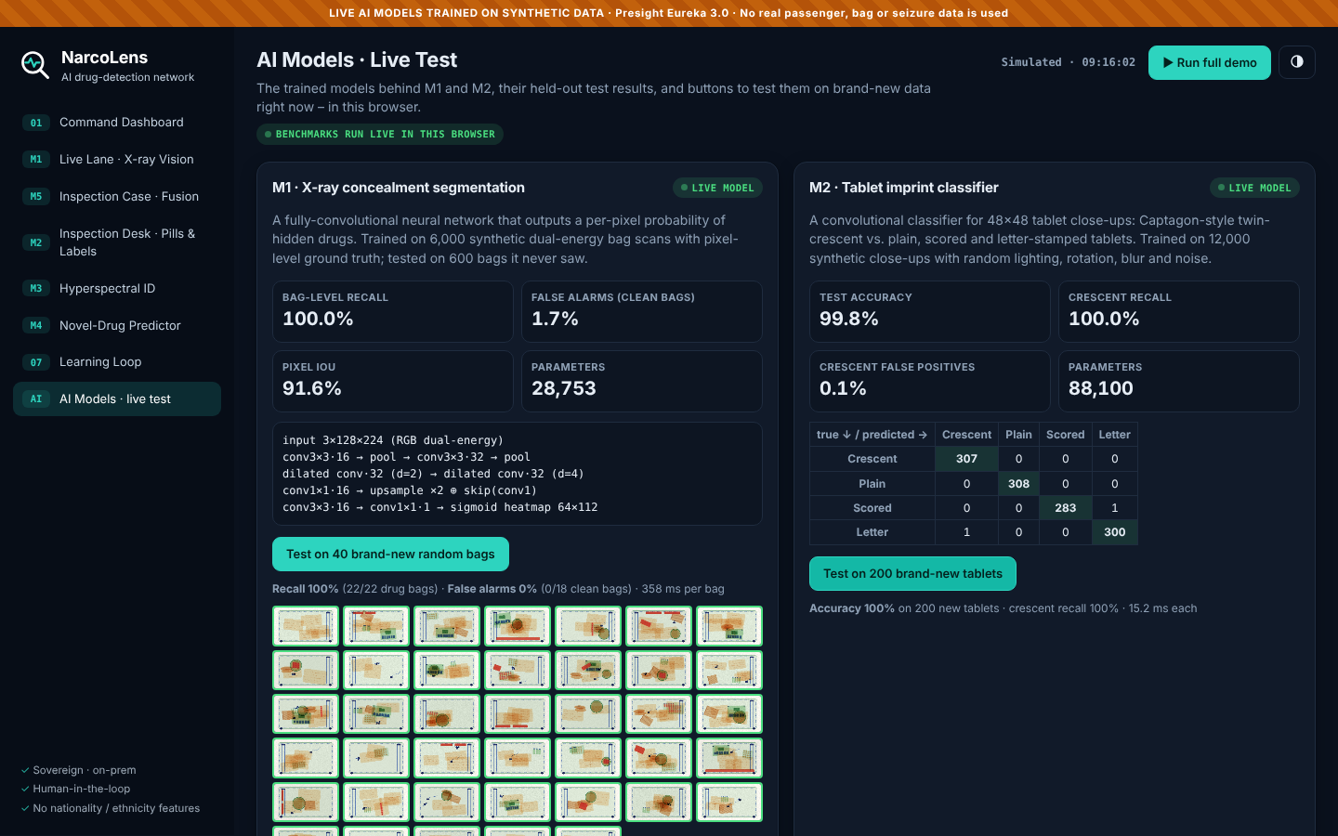
Working prototype with live AI models
100%
M1 recall on unseen bags
1.7%
M1 false alarms, clean bags
99.8%
M2 imprint accuracy
Build a bag, hide drugs anywhere, scan
Draw a pill imprint on the pad
Benchmark on brand-new random bags
Trained on synthetic scans · runs offline in any browser
Bag Builder · AI model cards · Imprint model + pad · Spectral ID
Notes:
The attached prototype runs real, trained AI models – not scripted results.
M1 is a fully-convolutional neural network (28,753 parameters) that outputs a per-pixel probability of hidden drugs in an X-ray scan. M2 is a convolutional classifier for tablet imprints. Both were trained with PyTorch on synthetic data generated by the prototype's own renderer: 6,000 bag scans with pixel-level ground truth (random clutter, hard negatives such as dates, books and clean protein tubs, and 0–2 concealments) and 12,000 tablet close-ups. On held-out data the model never saw, M1 detects 100% of drug-carrying bags with 1.7% false alarms on clean bags (pixel IoU 91.6%), and M2 classifies imprints with 99.8% accuracy. A dependency-free JavaScript runtime, verified against PyTorch, runs both models in the browser in tens of milliseconds – the same pattern as an edge box beside a scanner.
Judges can test the models with inputs we never saw: build their own bag and hide drugs anywhere, upload an image, draw a pill imprint, or press "Test on 40 brand-new random bags" on the AI Models screen. Every screen carries a badge showing what is live and what is simulated (OCR, the hyperspectral sensor, M4 and the federated round are simulated).
Honest scope: synthetic training proves the pipeline and edge inference, not field accuracy; production retrains the same architectures on real customs scans under a data-sharing MoU.
A clickable prototype is attached as a web build (zip). It runs offline in any modern browser with no login, and it is also in the repository.
The fastest way to see it: press "Run full demo" at the top right. It plays one bag through the whole system in about 45 seconds with captions: X-ray flag, inspection case, officer photo analysis, hyperspectral identification, seizure and federated retraining.
Each screen can also be explored by hand from the left menu:
- Live Lane (M1): scan belt bags with the live model and tick "Ground truth" to check its answers; or switch to "Build your own bag" or "Upload a scan".
- Inspection Case (M5): see the evidence timeline and the explained score; open, re-scan, clear or seize.
- Inspection Desk (M2): the live imprint model classifies every tablet in the sample photos; the imprint pad lets judges draw their own.
- Hyperspectral ID (M3): auto-scan, then click any pixel to compare its spectrum with the library. A clean supplement is included as a control.
- Novel-Drug Predictor (M4): run a prediction cycle.
- Learning Loop: retrain the network after a lab confirmation.
- AI Models: model cards, test metrics and live benchmarks.

Slide 11



Expected impact: pilot targets
+30%
Minutes
−40%
≤5%
seizures per 1,000 bags inspected
to identify a substance, vs ~3 days in the lab
operator review time per flagged bag
extra false alarms per lane
Targets to be validated in an 8-week shadow-mode pilot before any live use
Who benefits
Value for Presight
Beyond drugs
Dubai and Abu Dhabi Customs, ICP
Police anti-narcotics units
Honest travellers: fewer manual searches
Sovereign product for UAE border security
Export to GCC customs agencies
Recurring licence and support per site
Weapons and explosives
Counterfeit goods and wildlife trafficking
Undeclared currency and gold
Notes:
Expected impact, stated as pilot targets rather than claims.
- +30% seizures per 1,000 bags inspected: AI attention on every scan, plus fused evidence, means inspections are spent on the right bags.
- Minutes instead of about 3 days to identify a substance at the desk with M2 and M3. The lab still provides legal confirmation, but the operational decision is no longer blind.
- −40% operator review time per flagged bag, because the X-ray overlay shows exactly where to look and why.
- No more than 5% extra false alarms per lane – the guardrail that protects passenger flow.
- And a new measure: synthetic-drug variants recognised before their first seizure in the region, thanks to M4.
Who benefits: Dubai Customs, Abu Dhabi Customs and the Federal Authority for Identity, Citizenship, Customs and Port Security (ICP); Dubai Police and Abu Dhabi Police anti-narcotics units; and honest travellers, who face fewer manual searches.
Value for Presight: a sovereign product for UAE border security that can be exported to GCC customs agencies facing the same Captagon and synthetic-drug flows, with recurring licence and support revenue per site.
Beyond drugs: the same platform – one case, many detectors – extends to weapons and explosives, counterfeit goods, wildlife trafficking and undeclared currency or gold. All targets will be validated in an 8-week shadow-mode pilot before any live use.

Slide 12
Roadmap: shadow-mode pilot to UAE-wide rollout
M0
M3
M6
M9
M12
M15
M18
Discovery and data MoU
MoU
M1 X-ray MVP, shadow mode
DXB T3, one lane
M2 inspection desk app
Months 5–7
M3 hyperspectral + M4
One vendor camera
M5 fusion + federated rollout
Airport, port, post
UAE-wide scale-up, GCC export
Month 15+
Go-live gate after shadow mode: recall ≥90% with ≤5% extra flags
Team at peak ≈ 12: 3 computer-vision engineers · 1 spectroscopy ML scientist · 2 data engineers · 2 MLOps · 2 full-stack · product lead with customs expert · responsible-AI and legal lead
Notes:
Delivery in six phases over roughly 15 to 18 months, with M1 first because it creates value on day one using scanners already installed.
Phase 1, months 1–2: discovery workshops with Dubai Customs, ICP and police anti-narcotics; scanner integration survey; and a data-sharing MoU for historical seizure scans and lab outcomes.
Phase 2, months 3–6: the M1 X-ray MVP running in shadow mode on one lane at DXB Terminal 3. Shadow mode means the AI sees every bag but does not affect any decision; we compare it with officers' outcomes.
Phase 3, months 5–7: the M2 inspection-desk tablet app.
Phase 4, months 7–12: M3 integrated with one hyperspectral camera vendor, a library of 100+ substances, and the first M4 predicted variants validated by forensic chemists.
Phase 5, months 10–15: M5 risk fusion for cargo and postal, and federated rollout across an airport, a seaport and the postal hub.
Phase 6, month 15 onwards: UAE-wide scale-up and productisation for GCC customs.
Go-live gate: no live use until shadow mode shows at least 90% recall on lab-confirmed seizures with no more than 5% additional flags per lane.
Team at peak about 12 people: three computer-vision engineers, a spectroscopy ML scientist, two data engineers, two MLOps engineers, two full-stack engineers, a product lead paired with a customs domain expert, and a responsible-AI and legal lead.

Slide 13



Risks we've designed for
Risk | How NarcoLens handles it
Little labelled drug X-ray data | Threat-image projection, public X-ray pretraining, active learning from officer feedback
False alarms slow the queues | Shadow mode first; per-lane thresholds; officers see only top-risk bags
Closed scanner formats | DICOS standard; early partnership with one or two scanner vendors
Profiling and bias | No nationality or ethnicity features; quarterly bias audits; full audit log
Evidence in court | AI only flags; the lab test stays the legal proof; explainable heatmaps and chain of custody
Why Presight
Sovereign, on-prem AI for UAE government is our core business
Big-data analytics for public safety and investigations
In-house talent across computer vision, Arabic NLP and MLOps
Notes:
The main risks, and how the design already handles them.
Data scarcity: there is little labelled X-ray data of drugs. We pretrain on public X-ray datasets, use threat-image projection to synthesise realistic concealments in clean scans, and use active learning so every officer confirmation or override becomes training data.
False alarms: an AI that flags too much slows queues and loses officers' trust. That is why we start in shadow mode, tune thresholds per lane, show officers only the highest-risk items, and hold a hard go-live gate.
Closed scanner formats: we use DICOS, the NEMA security-imaging standard, and will partner early with one or two scanner vendors for SDK access.
Profiling and bias: nationality, ethnicity, religion and gender are excluded as inputs by design, with quarterly bias audits and a full audit log reviewable by the authority.
Evidence in court: NarcoLens only flags and recommends. The forensic lab test remains the legal proof, and every AI output is explainable and stored under chain of custody.
Why Presight: sovereign, on-prem AI for UAE government is Presight's core business; the company already works in big-data analytics for public safety and investigations; and it has in-house talent across computer vision, Arabic NLP and MLOps to build NarcoLens without depending on foreign vendors for the intelligence layer.

Slide 14
The team and the ask
Team
Our ask
[Name · Role · Department]
1
An ELT sponsor
to champion NarcoLens with UAE border agencies
[Name · Role · Department]
2
An introduction to Dubai Customs and ICP
[Name · Role · Department]
to agree a data-sharing MoU for historical scans
[Name · Role · Department]
3
A 3-month shadow-mode pilot
[Name · Role · Department]
on one DXB Terminal 3 lane, with no impact on passengers
Up to 5 Presight employees
One seizure at DXB should make every UAE border smarter.
Notes:
The team: [fill in names, roles and departments – up to five Presight employees].
Our ask is deliberately small and concrete.
1. An ELT sponsor to champion NarcoLens with UAE border agencies and help position it within Presight's public-safety portfolio.
2. An introduction to Dubai Customs and the Federal Authority for Identity, Citizenship, Customs and Port Security (ICP) to agree a data-sharing MoU covering historical seizure scans and lab outcomes. Data access is the single biggest accelerator for this project.
3. A three-month shadow-mode pilot on one DXB Terminal 3 lane. In shadow mode the AI sees every bag but does not change any decision, so there is zero impact on passengers while we measure recall and false-alarm rates against officers' real outcomes.
If the pilot meets the go-live gate – at least 90% recall with no more than 5% extra flags – the path is clear: add the desk and hyperspectral modules, then scale across the UAE's airports, seaports and postal hubs, and then offer it to GCC customs.
The closing thought: today, every seizure teaches one officer something. With NarcoLens, one seizure at DXB makes every UAE border smarter.

