Slide 1
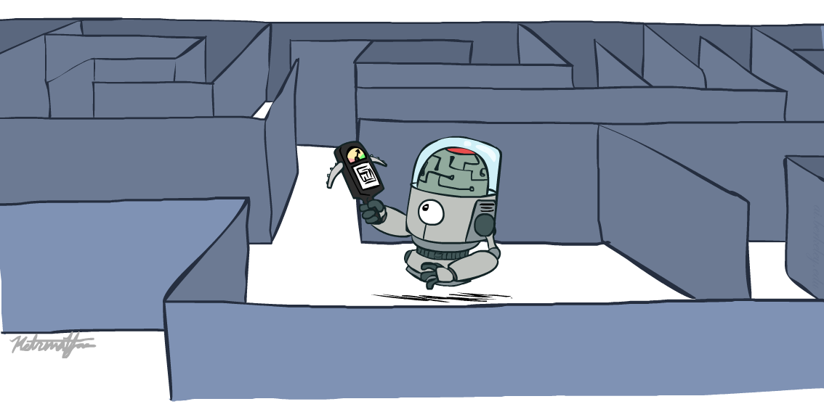
CS 188: Artificial Intelligence
Informed Search
Instructors: Dan Klein and Pieter Abbeel
University of California, Berkeley
[These slides were created by Dan Klein and Pieter Abbeel for CS188 Intro to AI at UC Berkeley. All CS188 materials are available at http://ai.berkeley.edu.]
Notes:
Please retain proper attribution, including the reference to ai.berkeley.edu. Thanks!

Slide 2

Today
Informed Search
Heuristics
Greedy Search
A* Search
Graph Search

Slide 3
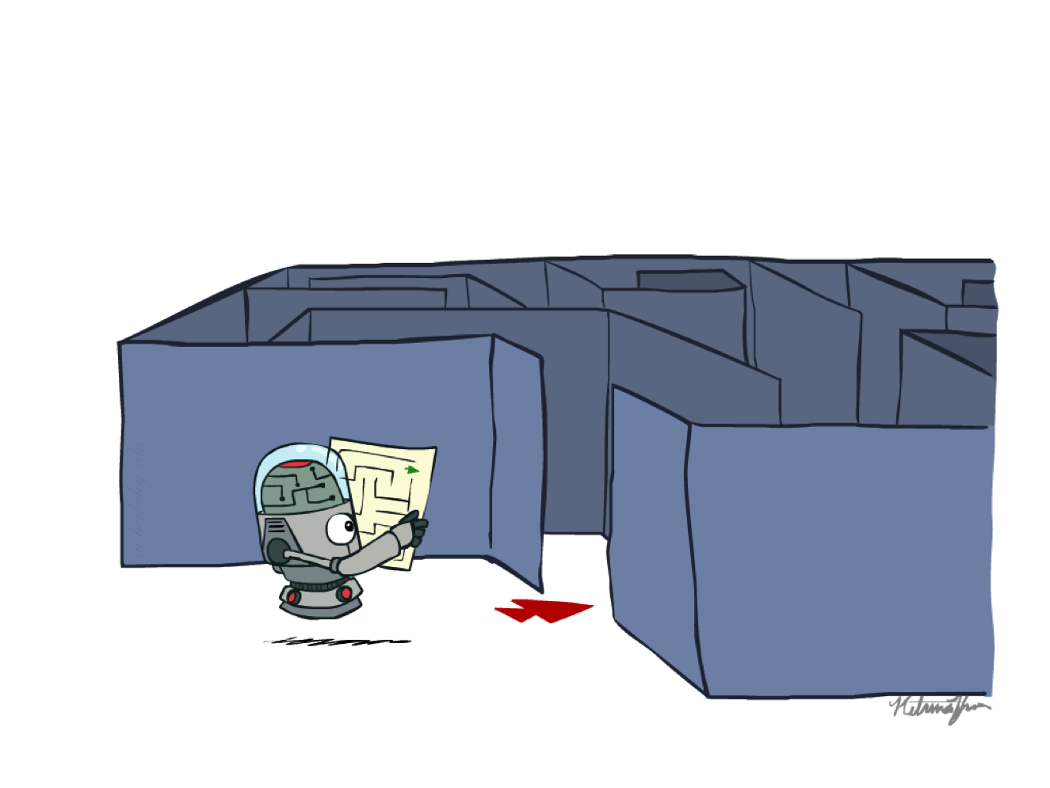
Recap: Search

Slide 4
Recap: Search
Search problem:
States (configurations of the world)
Actions and costs
Successor function (world dynamics)
Start state and goal test
Search tree:
Nodes: represent plans for reaching states
Plans have costs (sum of action costs)
Search algorithm:
Systematically builds a search tree
Chooses an ordering of the fringe (unexplored nodes)
Optimal: finds least-cost plans

Slide 5
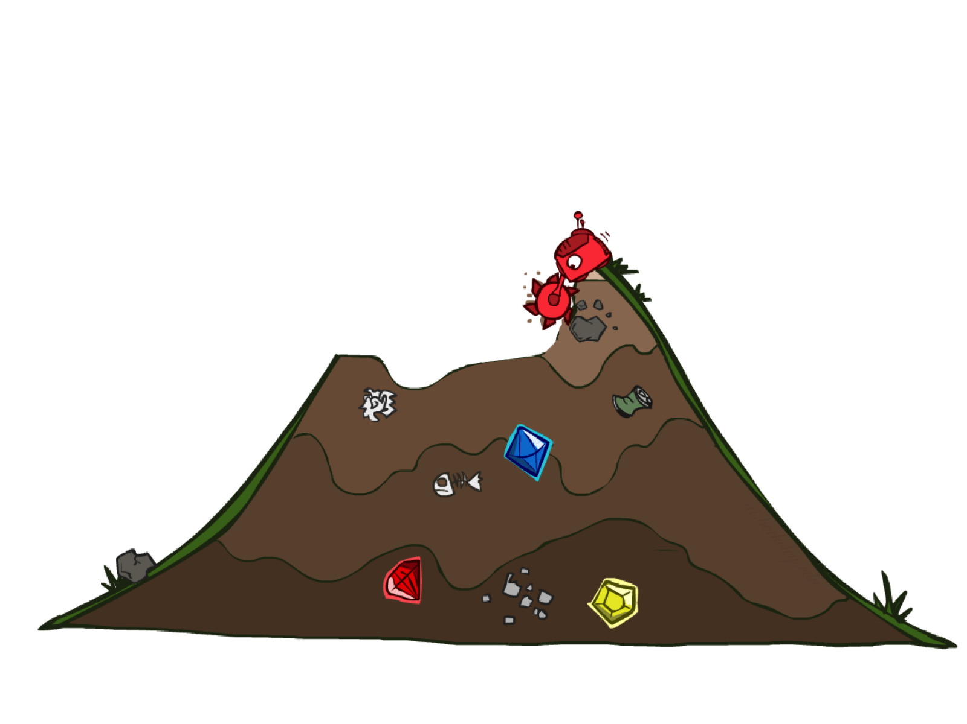
Uninformed Search

Slide 6
Uniform Cost Search
Strategy: expand lowest path cost
The good: UCS is complete and optimal!
The bad:
Explores options in every “direction”
No information about goal location
c ≤ 1
…
c ≤ 2
c ≤ 3
Start
Goal
[Demo: contours UCS empty (L3D1)]
[Demo: contours UCS pacman small maze (L3D3)]

Slide 7

Informed Search

Slide 8
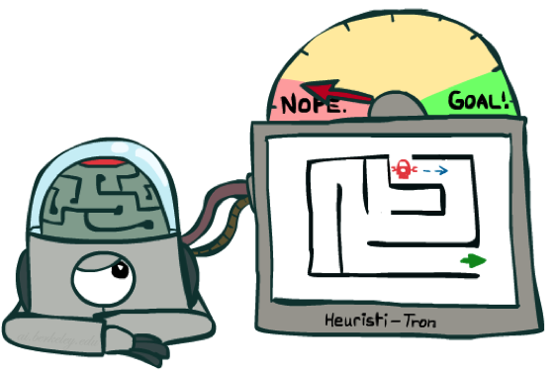
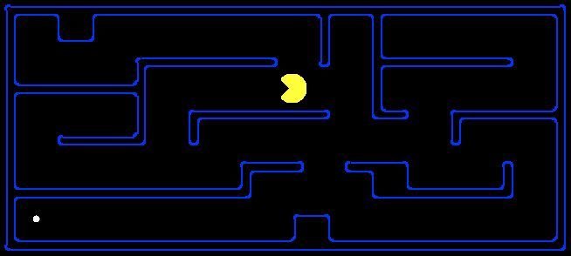
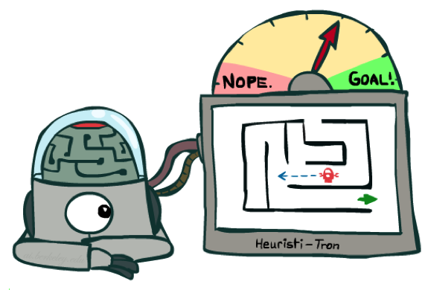
Search Heuristics
A heuristic is:
A function that estimates how close a state is to a goal
Designed for a particular search problem
Examples: Manhattan distance, Euclidean distance for pathing
10
5
11.2

Slide 9
Example: Heuristic Function
h(x)

Slide 10
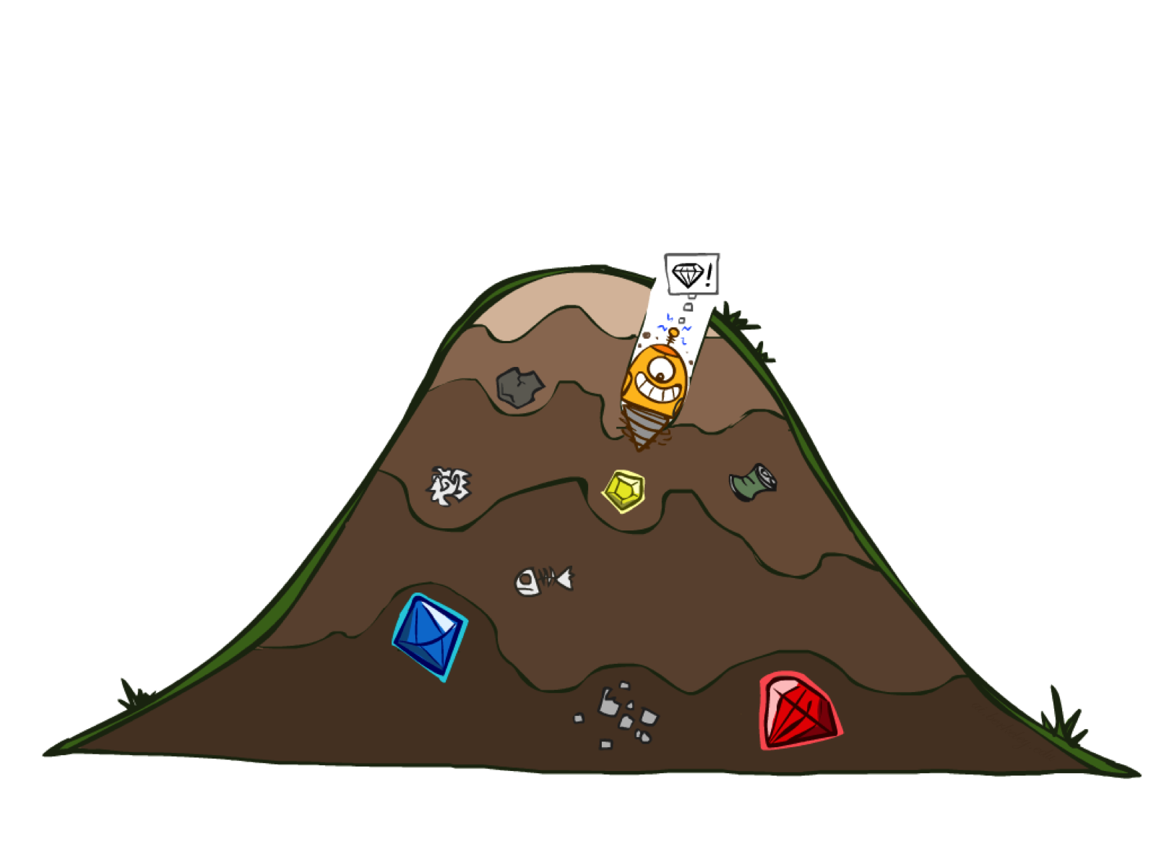
Greedy Search

Slide 11
Example: Heuristic Function
h(x)

Slide 12

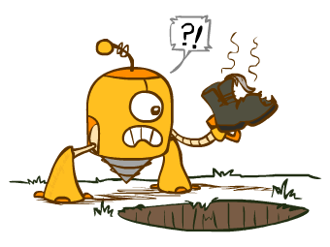
Greedy Search
Expand the node that seems closest…
What can go wrong?

Slide 13
Greedy Search
b
Strategy: expand a node that you think is closest to a goal state
Heuristic: estimate of distance to nearest goal for each state
A common case:
Best-first takes you straight to the (wrong) goal
Worst-case: like a badly-guided DFS
…
b
…
[Demo: contours greedy empty (L3D1)]
[Demo: contours greedy pacman small maze (L3D4)]
Notes:
For any search problem, you know the goal. Now, you have an idea of how far away you are from the goal.

Slide 14
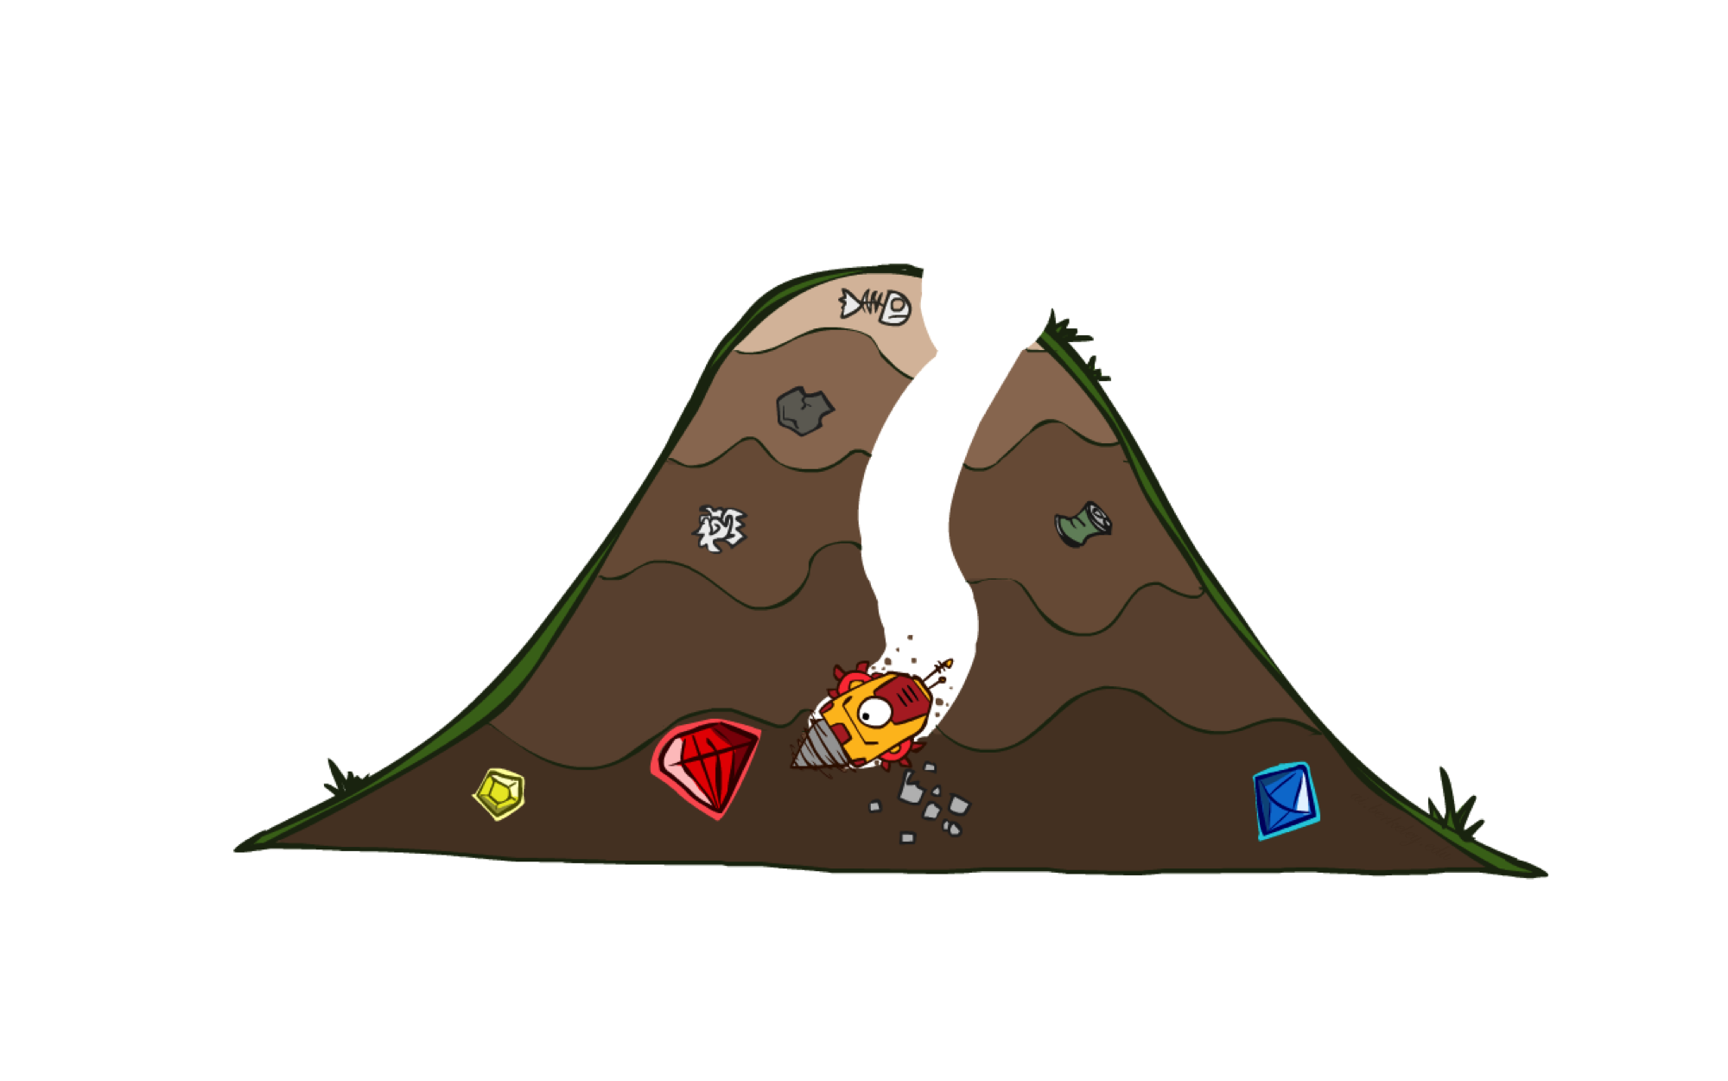
A* Search

Slide 15
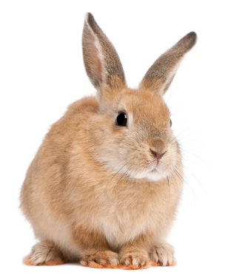
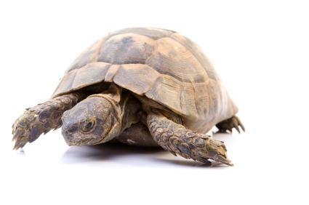

A* Search
UCS
Greedy
A*
Notes:
Notes: these images licensed from iStockphoto for UC Berkeley use.

Slide 16
Combining UCS and Greedy
Uniform-cost orders by path cost, or backward cost g(n)
Greedy orders by goal proximity, or forward cost h(n)
A* Search orders by the sum: f(n) = g(n) + h(n)
8
g = 0 h=6
S
e
h=1
g = 1 h=5
a
1
1
3
2
g = 2 h=6
g = 9 h=1
S
a
d
G
b
d
g = 4 h=2
e
h=6
1
h=5
h=2
h=0
1
g = 3 h=7
g = 6 h=0
g = 10 h=2
c
b
c
G
d
h=7
h=6
g = 12 h=0
G
Example: Teg Grenager

Slide 17
When should A* terminate?
Should we stop when we enqueue a goal?
No: only stop when we dequeue a goal
h = 2
A
2
2
S
h = 3
h = 0
G
2
B
3
h = 1

Slide 18
Is A* Optimal?
h = 6
1
A
3
S
h = 7
G
h = 0
5
What went wrong?
Actual bad goal cost < estimated good goal cost
We need estimates to be less than actual costs!

Slide 19
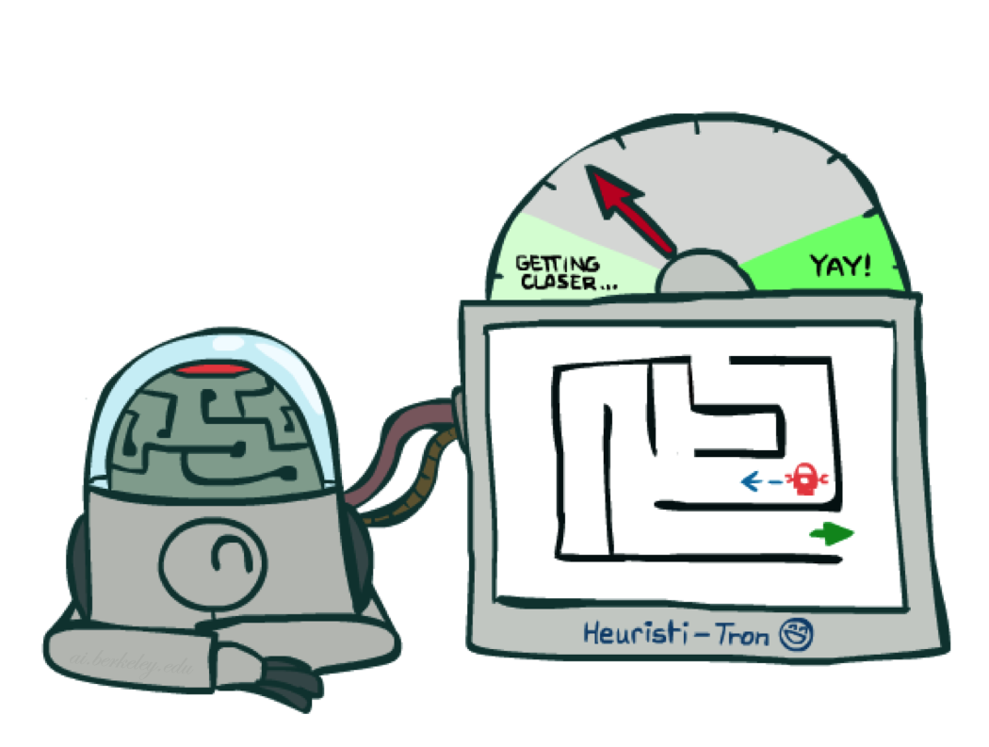
Admissible Heuristics

Slide 20
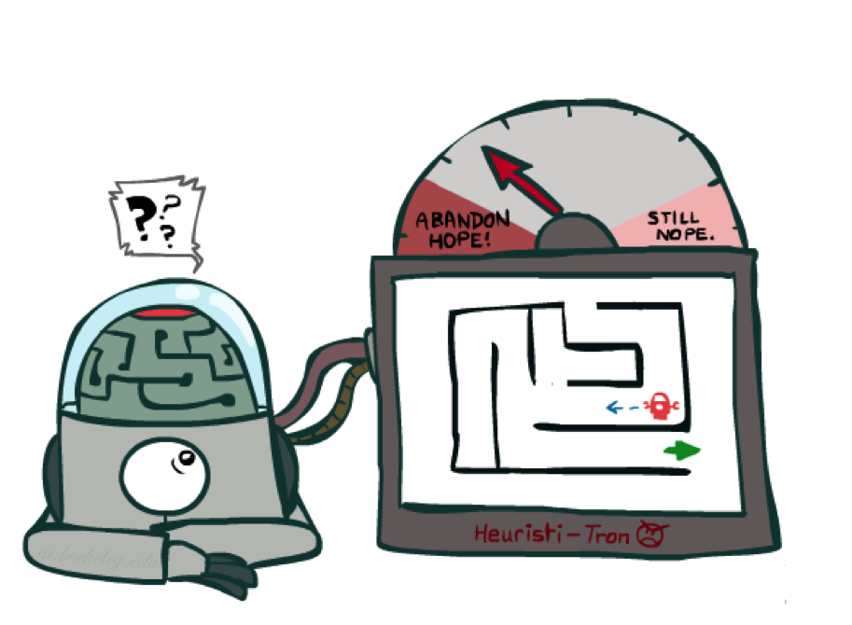
Idea: Admissibility
Inadmissible (pessimistic) heuristics break optimality by trapping good plans on the fringe
Admissible (optimistic) heuristics slow down bad plans but never outweigh true costs

Slide 21

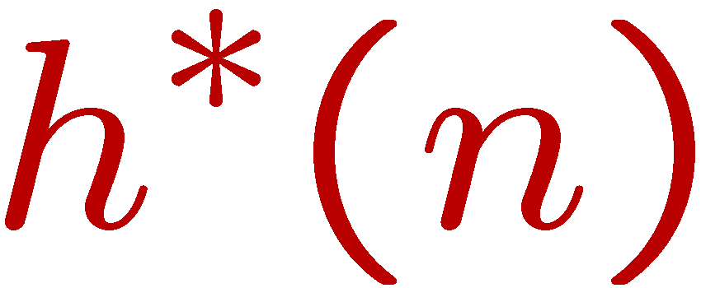
Admissible Heuristics
A heuristic h is admissible (optimistic) if:
where is the true cost to a nearest goal
Examples:
Coming up with admissible heuristics is most of what’s involved in using A* in practice.
4
15

Slide 22
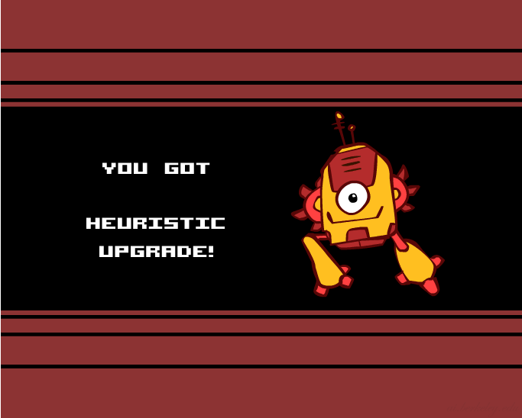
Creating Heuristics

Slide 23
Creating Admissible Heuristics
Most of the work in solving hard search problems optimally is in coming up with admissible heuristics
Often, admissible heuristics are solutions to relaxed problems, where new actions are available
Inadmissible heuristics are often useful too
366
15

Slide 24
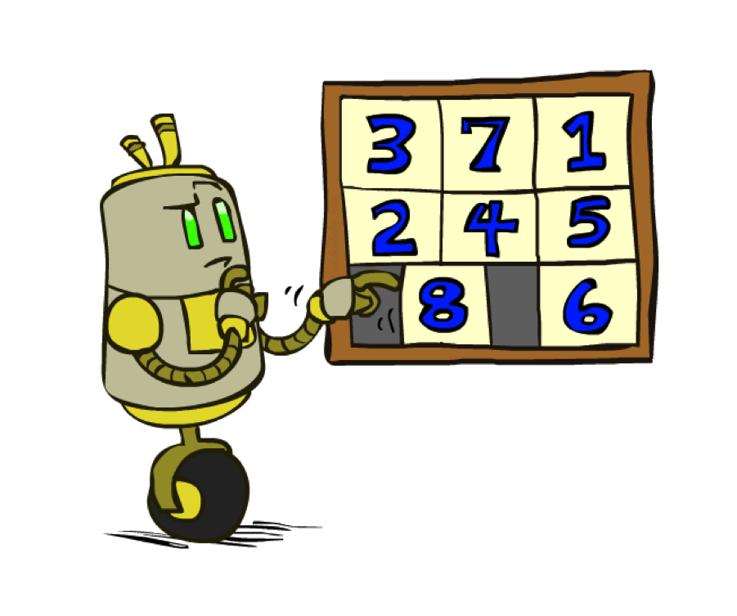
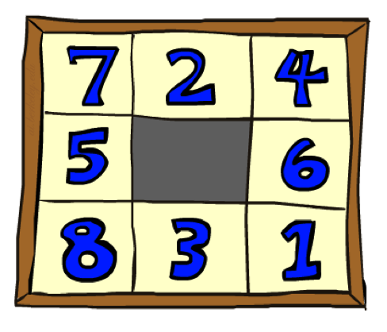
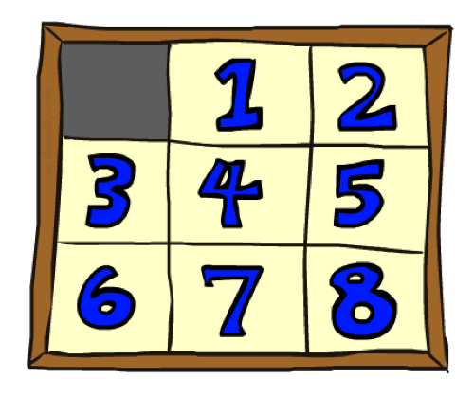
Example: 8 Puzzle
Start State
Actions
Goal State
What are the states?
How many states?
What are the actions?
How many successors from the start state?
What should the costs be?

Slide 25
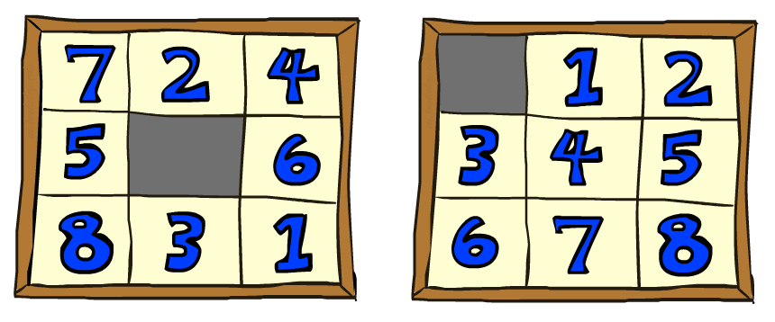
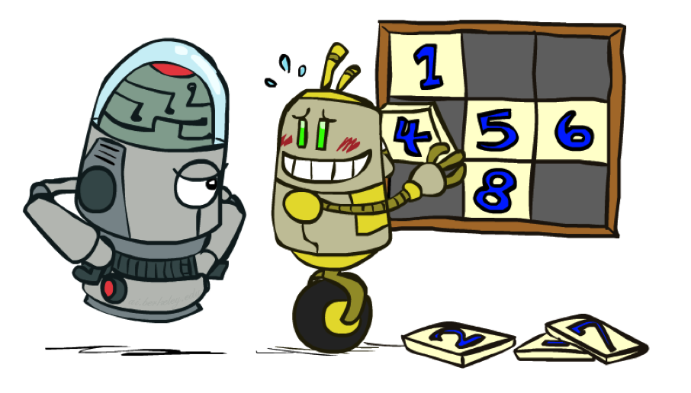
8 Puzzle I
Heuristic: Number of tiles misplaced
Why is it admissible?
h(start) =
This is a relaxed-problem heuristic
8
Start State
Goal State
 | Average nodes expanded when the optimal path has…
 | …4 steps | …8 steps | …12 steps
UCS | 112 | 6,300 | 3.6 x 10⁶
TILES | 13 | 39 | 227
Statistics from Andrew Moore

Slide 26
8 Puzzle II
What if we had an easier 8-puzzle where any tile could slide any direction at any time, ignoring other tiles?
Total Manhattan distance
Why is it admissible?
h(start) =
Start State
Goal State
 | Average nodes expanded when the optimal path has…
 | …4 steps | …8 steps | …12 steps
TILES | 13 | 39 | 227
MANHATTAN | 12 | 25 | 73
3 + 1 + 2 + … = 18

Slide 27
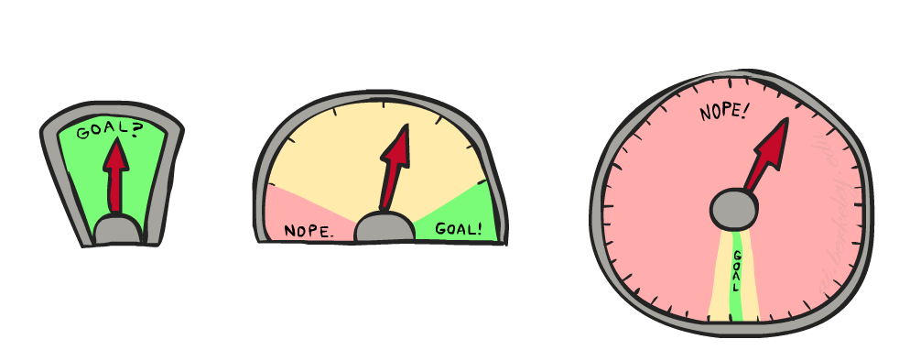
8 Puzzle III
How about using the actual cost as a heuristic?
Would it be admissible?
Would we save on nodes expanded?
What’s wrong with it?
With A*: a trade-off between quality of estimate and work per node
As heuristics get closer to the true cost, you will expand fewer nodes but usually do more work per node to compute the heuristic itself

Slide 28
Semi-Lattice of Heuristics

Slide 29







Trivial Heuristics, Dominance
Dominance: h_{a} ≥ h_{c} if
Heuristics form a semi-lattice:
Max of admissible heuristics is admissible
Trivial heuristics
Bottom of lattice is the zero heuristic (what does this give us?)
Top of lattice is the exact heuristic
Notes:
Semi-lattice: x <= y <-> x = x ^ y

Slide 30
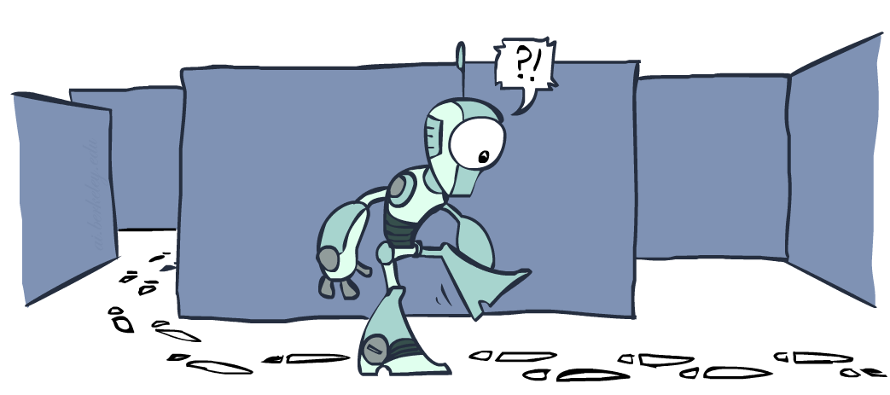
Graph Search

Slide 31
Tree Search: Extra Work!
Failure to detect repeated states can cause exponentially more work.
State Graph
Search Tree

Slide 32
Graph Search
In BFS, for example, we shouldn’t bother expanding the circled nodes (why?)
S
d
e
p
b
c
e
h
r
q
a
a
h
r
p
q
f
p
q
f
q
c
G
q
c
G
a
a

Slide 33
Graph Search
Idea: never expand a state twice
How to implement:
Tree search + set of expanded states (“closed set”)
Expand the search tree node-by-node, but…
Before expanding a node, check to make sure its state has never been expanded before
If not new, skip it, if new add to closed set
Important: store the closed set as a set, not a list
Can graph search wreck completeness? Why/why not?
How about optimality?

Slide 34
A* Graph Search Gone Wrong?
State space graph
Search tree
A
S (0+2)
1
S
1
C
h=4
h=1
A (1+4)
B (1+1)
h=2
1
2
B
3
C (2+1)
C (3+1)
h=1
G
G (5+0)
G (6+0)
h=0

Slide 35
Consistency of Heuristics
Main idea: estimated heuristic costs ≤ actual costs
Admissibility: heuristic cost ≤ actual cost to goal
h(A) ≤ actual cost from A to G
Consistency: heuristic “arc” cost ≤ actual cost for each arc
h(A) – h(C) ≤ cost(A to C)
Consequences of consistency:
The f value along a path never decreases
h(A) ≤ cost(A to C) + h(C)
A* graph search is optimal
A
1
C
h=4
h=1
h=2
3
G

Slide 36

Optimality of A* Graph Search

Slide 37
Optimality of A* Graph Search
Sketch: consider what A* does with a consistent heuristic:
Fact 1: In tree search, A* expands nodes in increasing total f value (f-contours)
Fact 2: For every state s, nodes that reach s optimally are expanded before nodes that reach s suboptimally
Result: A* graph search is optimal
…
f ≤ 1
f ≤ 2
f ≤ 3

Slide 38
Optimality
Tree search:
A* is optimal if heuristic is admissible
UCS is a special case (h = 0)
Graph search:
A* optimal if heuristic is consistent
UCS optimal (h = 0 is consistent)
Consistency implies admissibility
In general, most natural admissible heuristics tend to be consistent, especially if from relaxed problems

Slide 39

A*: Summary

Slide 40

A*: Summary
A* uses both backward costs and (estimates of) forward costs
A* is optimal with admissible / consistent heuristics
Heuristic design is key: often use relaxed problems

