Slide 1
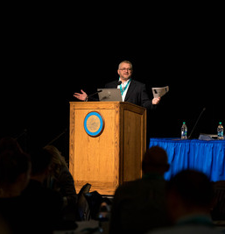
Creating an R Package from Scratch
Riaz Khan
MS, Statistics, South Dakota State University
2020 SDSU Data Science Symposium
February 10-11, 2020

Slide 2
Riaz Khan
BSc, EE, Bangladesh University of Engineering & Technology (2011)
MS, EE, South Dakota State University (2016)
MS, Statistics, South Dakota State University (2018)
Primary author of package ROCit
https://cran.r-project.org/web/packages/ROCit/index.html
Co-author of package Rprofet
https://cran.r-project.org/web/packages/Rprofet/index.html
Current work involves:
Data analysis
Statistical modeling
Creating an R Package from Scratch
2020 SDSU Data Science Symposium, Feb 10-11, 2020

Slide 3
R package
Fundamental unit of sharable code
Bundles code, documentation, example data, vignette together
As of 2/8/2020, there are 15,356 packages available on CRAN
Repositories:
CRAN
Bioconductor
GitHub
Creating an R Package from Scratch
2020 SDSU Data Science Symposium, Feb 10-11, 2020

Slide 4
Creating own package-- resources
Creating R Packages: A Tutorial (CRAN)
https://cran.r-project.org/doc/contrib/Leisch-CreatingPackages.pdf
R packages by Hadley Wickham
http://r-pkgs.had.co.nz/
Creating an R Package from Scratch
2020 SDSU Data Science Symposium, Feb 10-11, 2020

Slide 5
Topics
System preparation
Build first package with Rstudio
Package metadata
Own function with documentation
S3 method
External data
Package dependency
Package testing
Package release
https://github.com/riazakhan94/straightline
Workflow.pdf/ Workflow.docx
Creating an R Package from Scratch
2020 SDSU Data Science Symposium, Feb 10-11, 2020

Slide 6
System preparation
Install the latest version of R and RStudio:
R (3.6.2): https://cran.r-project.org/
RStudio (1.2.5033): https://rstudio.com/products/rstudio/download/#download
Install the following packages:
devtools
roxygen2
testthat
knitr
Creating an R Package from Scratch
2020 SDSU Data Science Symposium, Feb 10-11, 2020

Slide 7
System preparation
Get updated version of devtools from GitHub:
devtools::install_github("r-lib/devtools")
Depending on the system, a C compiler may be required. If required:
For windows, install Rtools https://cran.r-project.org/bin/windows/Rtools/
For Mac, get Xcode (available for free in the App Store)
See if the system is ready
devtools::install_github("r-lib/devtools")
Creating an R Package from Scratch
2020 SDSU Data Science Symposium, Feb 10-11, 2020

Slide 8
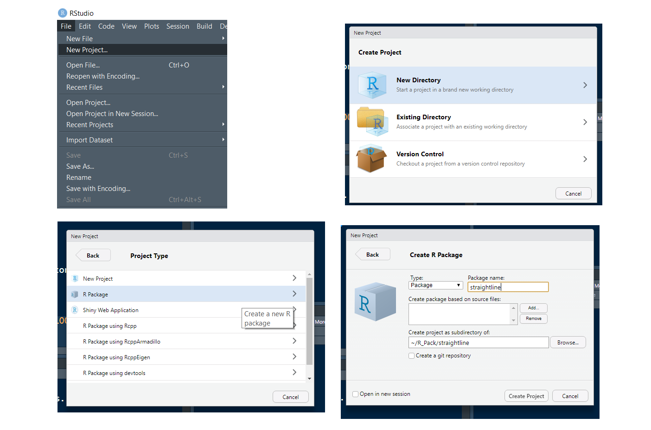
System preparation
Creating an R Package from Scratch
2020 SDSU Data Science Symposium, Feb 10-11, 2020

Slide 9
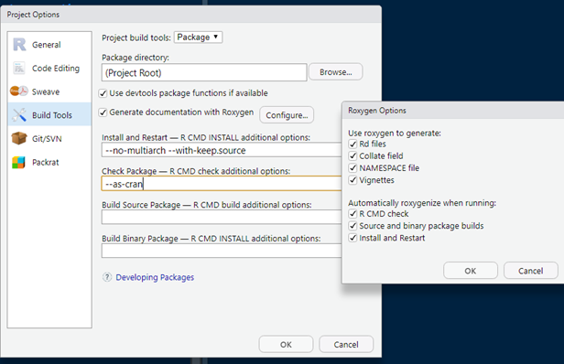
System preparation
Creating an R Package from Scratch
2020 SDSU Data Science Symposium, Feb 10-11, 2020

Slide 10
Build and check package
Throughout the development, it is recommended to check the package frequently
Build: Ctrl+Shift+B
Check: Ctrl+Shift+E
The goal is to get 0 error, 0 warning, 0 note
Creating an R Package from Scratch
2020 SDSU Data Science Symposium, Feb 10-11, 2020

Slide 11
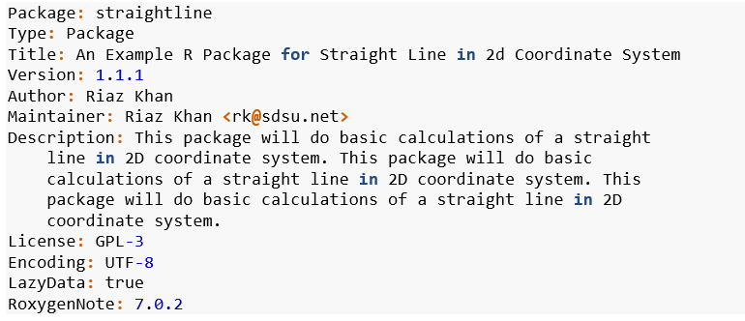
Package description
Example:
Creating an R Package from Scratch
2020 SDSU Data Science Symposium, Feb 10-11, 2020

Slide 12
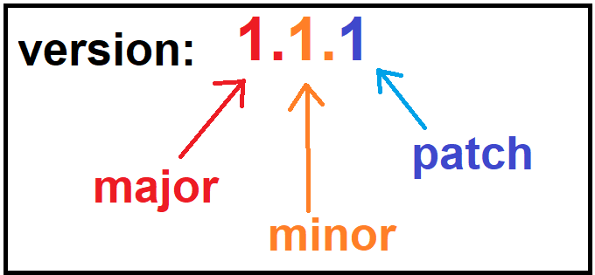
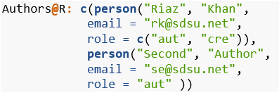
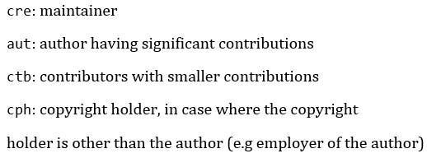
Package description
Package version
License
MIT
GPLE-2, GPL-3
Multiple authors
Creating an R Package from Scratch
2020 SDSU Data Science Symposium, Feb 10-11, 2020

Slide 13
Package documentation
Functions and documentations live in different folders
~\R and ~\man folders
.R and .Rd files
Possible to use roxygen to auto create the .Rd files
Roxygen tags
@title, @param, @description, @return, @examples etc.
Creating an R Package from Scratch
2020 SDSU Data Science Symposium, Feb 10-11, 2020

Slide 14
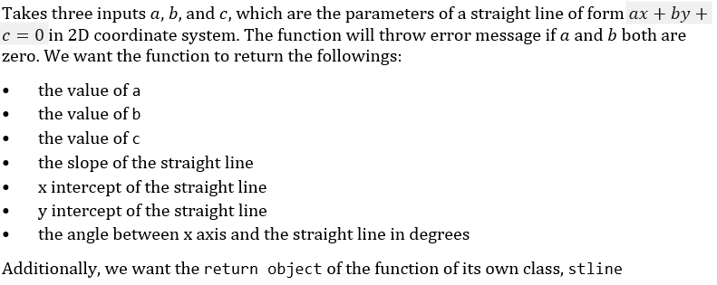
Function straighten
Creating an R Package from Scratch
2020 SDSU Data Science Symposium, Feb 10-11, 2020

Slide 15
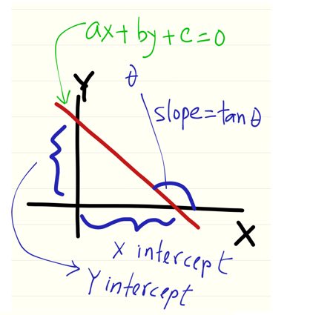
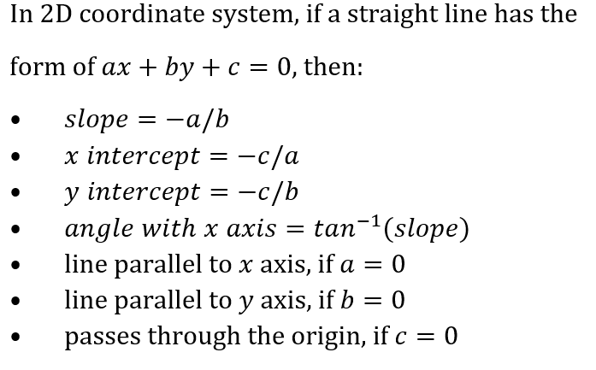
Straight line 101
Creating an R Package from Scratch
2020 SDSU Data Science Symposium, Feb 10-11, 2020

Slide 16
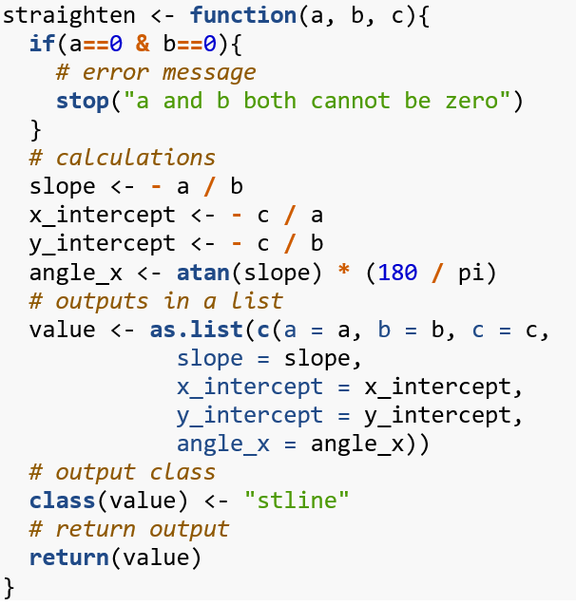
Function straighten
Creating an R Package from Scratch
2020 SDSU Data Science Symposium, Feb 10-11, 2020

Slide 17
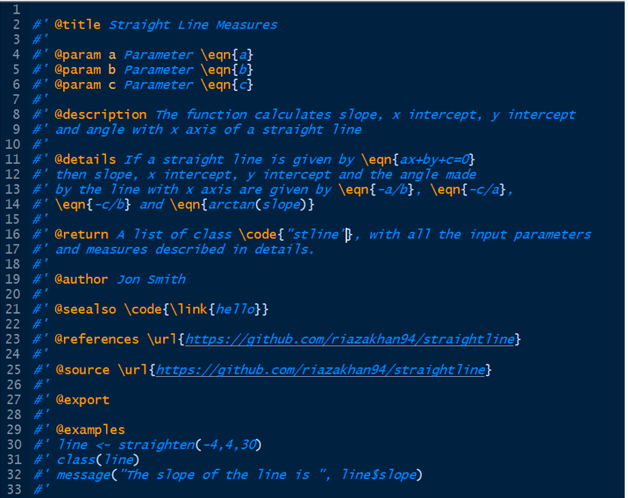
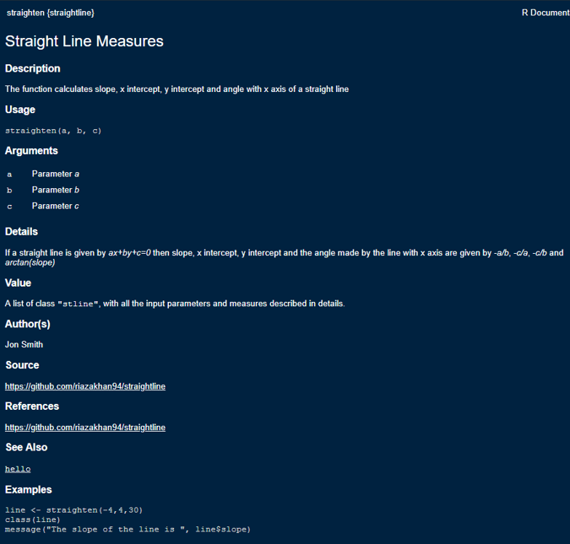
Function documentation
Creating an R Package from Scratch
2020 SDSU Data Science Symposium, Feb 10-11, 2020

Slide 18
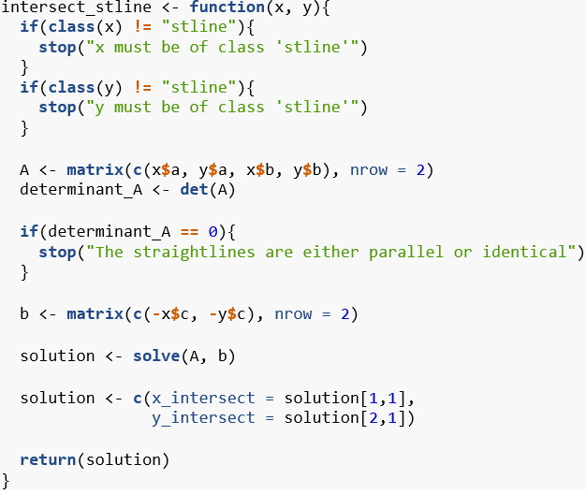
Function intersection_stline
Creating an R Package from Scratch
2020 SDSU Data Science Symposium, Feb 10-11, 2020

Slide 19
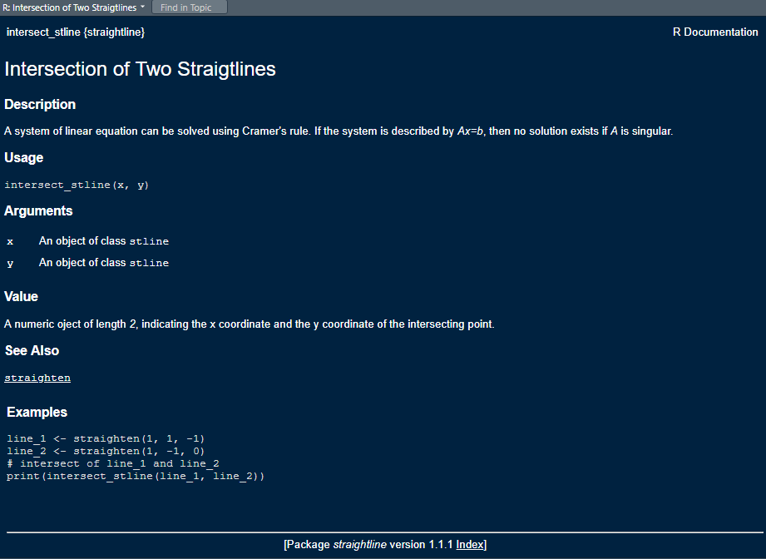
Function intersection_stline
Creating an R Package from Scratch
2020 SDSU Data Science Symposium, Feb 10-11, 2020

Slide 20
Coding style- best practices
Lower case recommended for function and object, with efficient use of underscore (_)
There should be spaces before and after all infix operators (e.g: +, -, *, /, =, ==, <-, ->)
Space after comma, not before
Use of <- for assignment (not =)
Spelling out TRUE and FALSE, as opposed to just using T and F
Opening curly brace followed by a new line
Closing curly brace gets its own line
Exception: use of else
Limited number of characters per line
Use of unique name to avoid conflicts
Proper indentations for easy understanding
For indentation, select the code block, then Code > Reindent Lines
Creating an R Package from Scratch
2020 SDSU Data Science Symposium, Feb 10-11, 2020

Slide 21
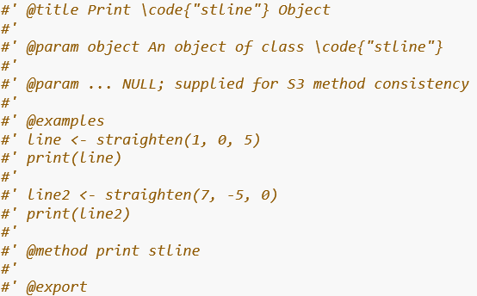
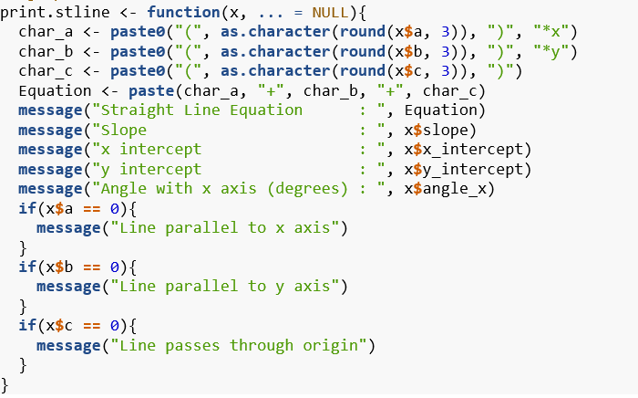
S3 method: print for class stline
Creating an R Package from Scratch
2020 SDSU Data Science Symposium, Feb 10-11, 2020

Slide 22
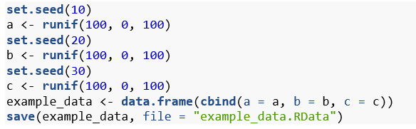
External data
External data lives in the ~/data folder, with extension .RData
Data can be saved in .RData format using save
Creating an R Package from Scratch
2020 SDSU Data Science Symposium, Feb 10-11, 2020

Slide 23
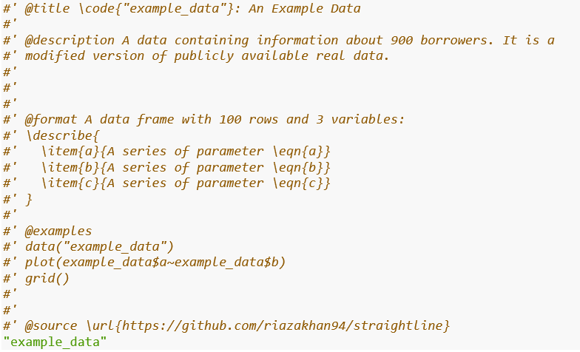
External data
Creating an R Package from Scratch
2020 SDSU Data Science Symposium, Feb 10-11, 2020

Slide 24
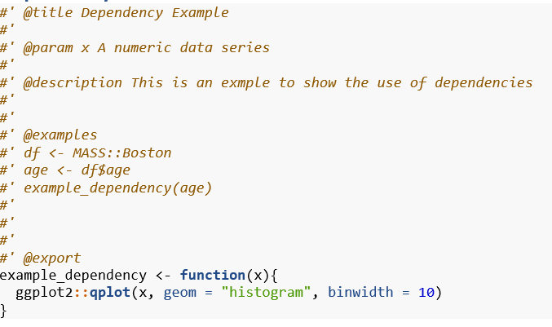
Dependency
Creating an R Package from Scratch
2020 SDSU Data Science Symposium, Feb 10-11, 2020

Slide 25

Vignette
Inclusion of package vignette recommended.
Long guide of the package
What is does
How to use
Markdown file
In the vignettes folder
To create:
create a folder called vignette and create an Rmd file (for example, stline.Rmd)
add knitr and rmarkdown to the Suggests field in DESCRIPTION
add VignetteBuilder field in the DESCRIPTION
Creating an R Package from Scratch
2020 SDSU Data Science Symposium, Feb 10-11, 2020

Slide 26
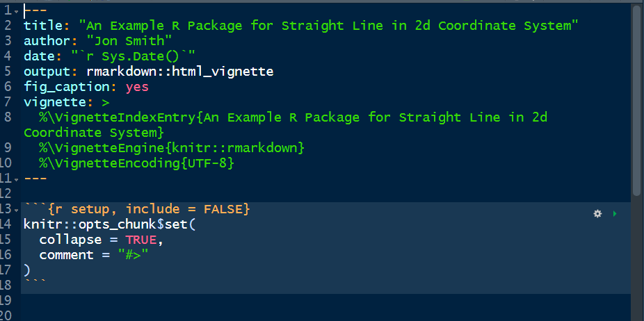
Vignette
Creating an R Package from Scratch
2020 SDSU Data Science Symposium, Feb 10-11, 2020

Slide 27
Testing
Automated tests are useful for robust code, provides all the tests in an organized way. To set up:
Make a ~/tests/testthat folder
Add testthat to the Suggests field of DESCRIPTION
Make a ~/tests/testthat.R file
A test lives in the ~/tests/testthat directory. All files must start with test. Tests in ~/tests/testthat.R file are checked during the package check.
Creating an R Package from Scratch
2020 SDSU Data Science Symposium, Feb 10-11, 2020

Slide 28
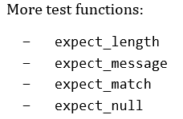
Testing
Creating an R Package from Scratch
2020 SDSU Data Science Symposium, Feb 10-11, 2020

Slide 29
README and NEWS files
README is usually aimed for the new users.
README should contain some high- level information about the package and how to use the package.
README has extension .md.
Possible to use R Markdown (.Rmd) to create the .md file.
Aimed for the old users.
Brief description of changes made in the new version
Creating an R Package from Scratch
2020 SDSU Data Science Symposium, Feb 10-11, 2020

Slide 30
Package release
Run devtools::release()
Iterative process
Creating an R Package from Scratch
2020 SDSU Data Science Symposium, Feb 10-11, 2020

