Slide 1
Presentation of Search Key word Performance
Presenter : Riaz Khan
Date : Apr 6th, 2022
Audience : Adobe Team

Slide 2
Business Use Case
The very well-known electronic retail company xyz sells their products in below two ways.
Instore
Online
The client needs to know what search engine getting used most frequently by customers and what “key word” they are searching and how much revenue the company getting for that searched item.

Slide 3
Requirements
Below are the list of the requirements.
The output should display what search engine, what key word used , and how much total revenue generated.
The output file should have header with the below details.
Search Engine Domain Search Keyword Revenue
3. The output file name should follow the below naming convention.
[Date]_SearchKeywordPerformance.tab
Date format should be YYYY-mm-dd (i.e. 2009-10-08)
4. The Program should take the input file as argument.
5. The output data should be Tab delimiter.
6. The data in output file should be in descending order.

Slide 4
Design approach
The below are the steps which were performed to get the final output.
Deep Analysis on input data elements. Understood how can we use each element to get desired output.
Identified what services in AWS I should use.
Identified what python libraries can be used.
Developed a program
Unit tested the program

Slide 5
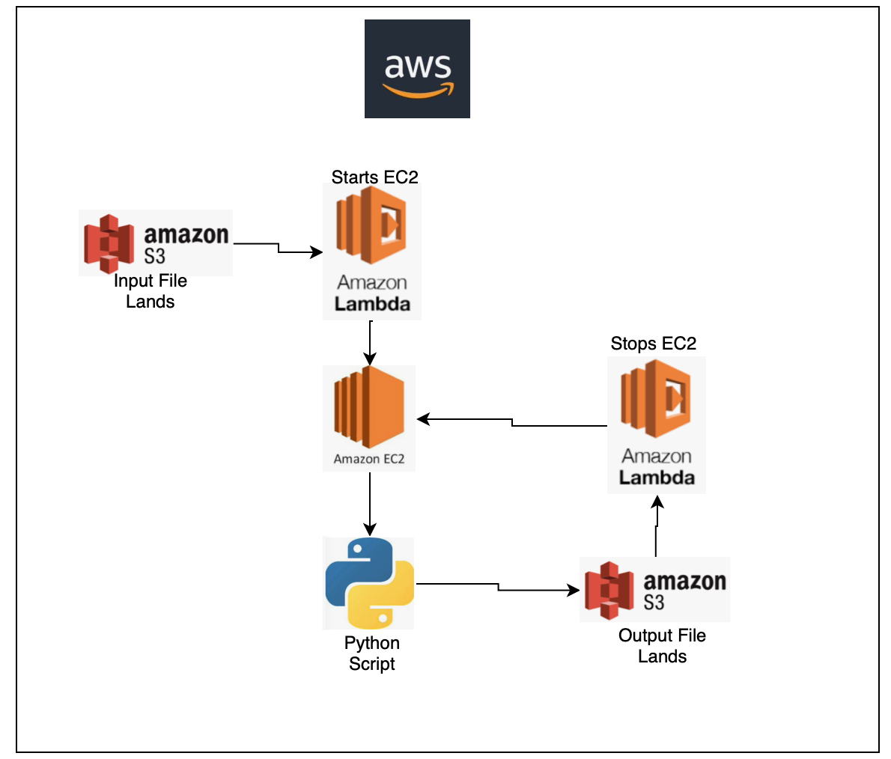
AWS Architecture
Below are the series of the steps preformatted automatically in AWS.
The Input file lands in S3 bucket
Triggers Lambda to start EC2 instance
Once EC2 starts Python program runs on EC2 instance
Output file will be landed in S3
Lambda triggers , it stops EC2 instance
Below are the programs for start and stop EC2 clusters.
lambda_stop_ec2.py
lambda_start_ec2.py
Notes:
Highlight differences between Original Enctr System and LCR system.
Highlight MAO-002 and MAO-004 differences

Slide 6


Why EC2 ?
What’s the reason to choose run python program on EC2 over Lambda and EMR.
Lambda : The AWS lambda is really useful for light weight job execution. It has a time limit 15 mins. If any jobs takes over 15 mins it will automatically aborted. Our input file is over 10 GB . The lambda doesn’t support in this case.
EMR: This is costly service, and this is really useful when you have to process of huge amount of dataset with transformation logics. Our requirement is not about transformations its about processing the data. So EMR doesn’t support in this case.
EC2: Its easy to start and stop and these is no time limit of execution of python code. Our requirement really suits to this service.
Notes:
Highlight differences between Original Enctr System and LCR system.
Highlight MAO-002 and MAO-004 differences

Slide 7
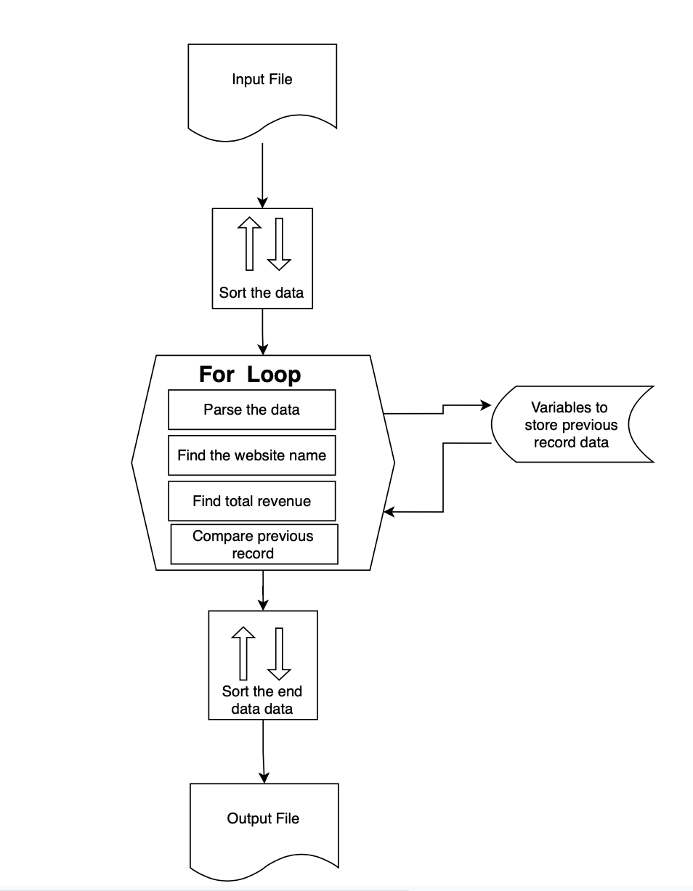
Python Program Flowchart
Program Name : SearchKeywordPerformance.py
Below are the series of the steps preformatted in Python program
python program reads the S3 file
Data will be sorted based on ip_address data_time
The for loop starts
In For loops, we the parse the data, find website name, total revenue, and we compare the previous records to carry forward the website name
The final output data will be sorted on revenue .
Output file will be saved on S3
Notes:
Highlight differences between Original Enctr System and LCR system.
Highlight MAO-002 and MAO-004 differences

Slide 8
Python Libraries
Below are the list libraries used and its use
urllib.parse
This library is used to find the website name, searched key
Example: This library gives takes the below value gives www.google.com as website and Ipod as searched key.
http://www.google.com/search?hl=en&client=firefox-a&rls=org.mozilla%3Aen-US%3Aofficial&hs=ZzP&q=Ipod&aq=f&oq=&aqi=
Boto3
Used to write the data to s3
Logging
This library saves the logs to log file
smart_open
This helps to read the data line by line.
Notes:
Highlight differences between Original Enctr System and LCR system.
Highlight MAO-002 and MAO-004 differences

Slide 9
Other conditions considered
This python program supports all search engines. Below of are few of them.
Google
Microsoft Bing
Yahoo
Baidu
Yandex
DuckDuckGo
Ask.com
Ecosia
Aol.com
Internet Archive
Notes:
Highlight differences between Original Enctr System and LCR system.
Highlight MAO-002 and MAO-004 differences

Slide 10
Logging
The python program also take cares of saving the logs in appropriate format. Below is the example of log data.
2022-04-05 18:39:25,691 INFO Program started
2022-04-05 18:39:25,691 INFO Arguments read successfully
2022-04-05 18:39:25,691 INFO Read the input file successfully
2022-04-05 18:39:25,704 INFO Records sorted on ip_address and date_time successfully
2022-04-05 18:39:25,704 INFO Processing of each record started
2022-04-05 18:39:25,707 INFO Processing of each record completed successfully
2022-04-05 18:39:25,707 INFO Final output sorted successfully on Revenue
2022-04-05 18:39:25,708 INFO Data written to a file - 2022-04-05_SearchKeywordPerformance.tab
2022-04-05 18:39:25,708 INFO Program completed successfully!
Notes:
Highlight differences between Original Enctr System and LCR system.
Highlight MAO-002 and MAO-004 differences

Slide 11
Output
Below is the sample output file along with data.
File Name: 2022-04-05_SearchKeywordPerformance.tab
Search Engine Domain Search Keyword Revenue
bing.com Phone 1100
bing.com Zune 500
google.com Ipod 290
Notes:
Highlight differences between Original Enctr System and LCR system.
Highlight MAO-002 and MAO-004 differences

Slide 12

Questions

