Slide 1
Heart Disease Prediction: A Machine Learning Approach
Supervised Learning Final Project

Slide 2
The Problem
Cardiovascular diseases (CVDs) remain the number one cause of death globally, taking an estimated 17.9 million lives each year. Early detection and intervention can significantly improve outcomes, but traditional diagnostic approaches have limitations:
Often reactive rather than preventive
Expensive specialized tests with limited accessibility
Difficulty in prioritizing patients for further evaluation
My Goal: Develop a machine learning model that can accurately predict the presence of heart disease using readily available clinical parameters, enabling earlier intervention and better resource allocation.

Slide 3
Dataset Overview
I utilized the Heart Disease UCI dataset from Kaggle, containing records from 303 patients with various clinical measurements:
Patient demographics: Age, sex
Symptoms: Chest pain type, exercise-induced angina
Clinical measurements: Resting blood pressure, cholesterol, max heart rate
Test results: ECG results, fluoroscopy findings, thalassemia status
My exploratory data analysis revealed significant correlations between several parameters and heart disease:

Slide 4
Key Insights from EDA
My analysis uncovered important patterns in the data:
Chest Pain Type: Asymptomatic chest pain (type 3) strongly associated with heart disease
Gender Distribution: Men showed higher incidence of heart disease than women
Vascular Health: Number of colored major vessels inversely related to disease presence
Exercise Response: Higher ST depression during exercise correlated with disease

Slide 5
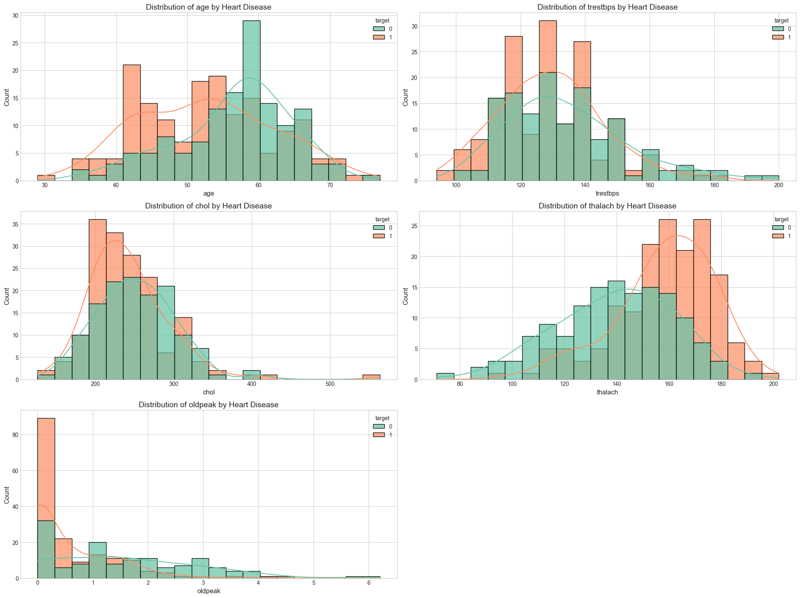

Slide 6
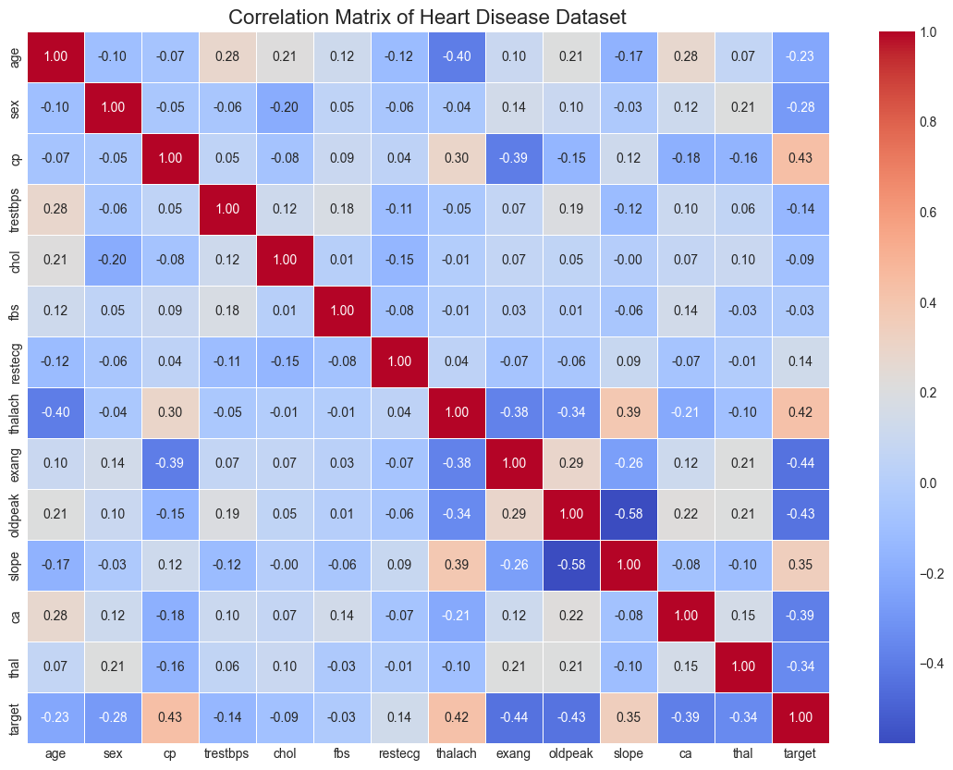

Slide 7
Machine Learning Approach
We tackled this as a supervised binary classification problem using the following approach:
Data Preparation
Feature Selection: Retained all 13 clinical features after EDA
Data Splitting: 80/20 train-test split with stratification to maintain class balance
Feature Scaling: Standardized features using StandardScaler to normalize distributions
Algorithms Implemented
Logistic Regression: Linear classifier for baseline performance
Decision Tree: Non-linear classifier with interpretable decision rules
Random Forest: Ensemble method to reduce overfitting and improve generalization
Support Vector Machine: Powerful classifier for handling complex decision boundaries

Slide 8
Hyperparameter Optimization
Cross-Validation: 5-fold CV to ensure robust model evaluation
GridSearchCV: Systematic hyperparameter tuning for optimal performance
Random Forest Parameters: Tested various estimators, depths, and split criteria
param_grid_rf = { 'n_estimators': [50, 100, 200], 'max_depth': [None, 10, 20, 30], 'min_samples_split': [2, 5, 10], 'min_samples_leaf': [1, 2, 4]}
SVM Parameters: Explored different kernels, regularization, and gamma settings
param_grid_svm = { 'C': [0.1, 1, 10, 100], 'gamma': ['scale', 'auto', 0.01, 0.1, 1], 'kernel': ['rbf', 'linear', 'poly']}
Model Evaluation
Metrics Focus: Balanced accuracy, precision, recall, and F1-score
Validation Strategy: Hold-out test set evaluation after cross-validation
Performance Analysis: ROC curves, AUC scores, and confusion matrices
Feature Importance: Extracted feature rankings from Random Forest model

Slide 9
Results
Our final model comparison showed:
Model | Accuracy | Precision | Recall | F1 Score
Logistic Regression | 0.83 | 0.85 | 0.86 | 0.85
Decision Tree | 0.74 | 0.77 | 0.75 | 0.76
Random Forest | 0.82 | 0.83 | 0.86 | 0.84
SVM | 0.84 | 0.85 | 0.86 | 0.85
Tuned Random Forest | 0.87 | 0.89 | 0.88 | 0.88
Tuned SVM | 0.89 | 0.91 | 0.89 | 0.90
Best Model Performance (Tuned SVM):
Optimal parameters: C=10, gamma=0.01, kernel='rbf'
Accuracy: 89%
Precision: 91%
Recall: 89%
F1 Score: 90%
AUC: 0.93

Slide 10
Feature Importance
Our Random Forest model provided valuable insights into feature importance:
Most predictive features:
Chest pain type (cp) - 0.19
Number of major vessels (ca) - 0.17
Maximum heart rate (thalach) - 0.14
ST slope (slope) - 0.11
Exercise-induced angina (exang) - 0.10
These findings align with clinical knowledge and provide interpretable results for healthcare providers.

Slide 11
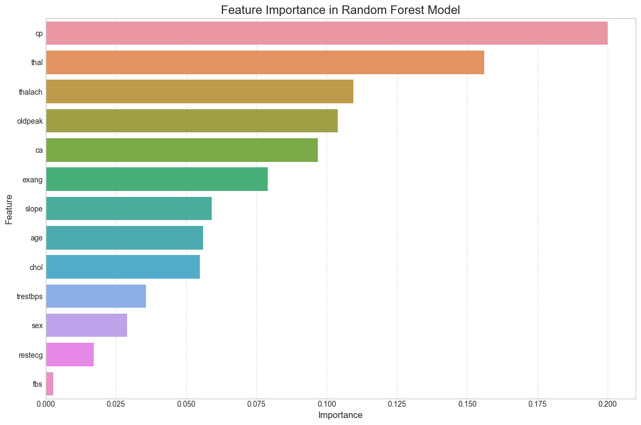

Slide 12
MoDEL pERFORMANCE
Our best-performing model, a tuned Support Vector Machine (SVM), achieved 89% accuracy, 91% precision, and an AUC of 0.93, outperforming baseline models like Logistic Regression and Decision Trees. This high level of performance demonstrates the model’s strong ability to correctly identify patients at risk of heart disease, making it a reliable tool for early screening and clinical decision support.

Slide 13
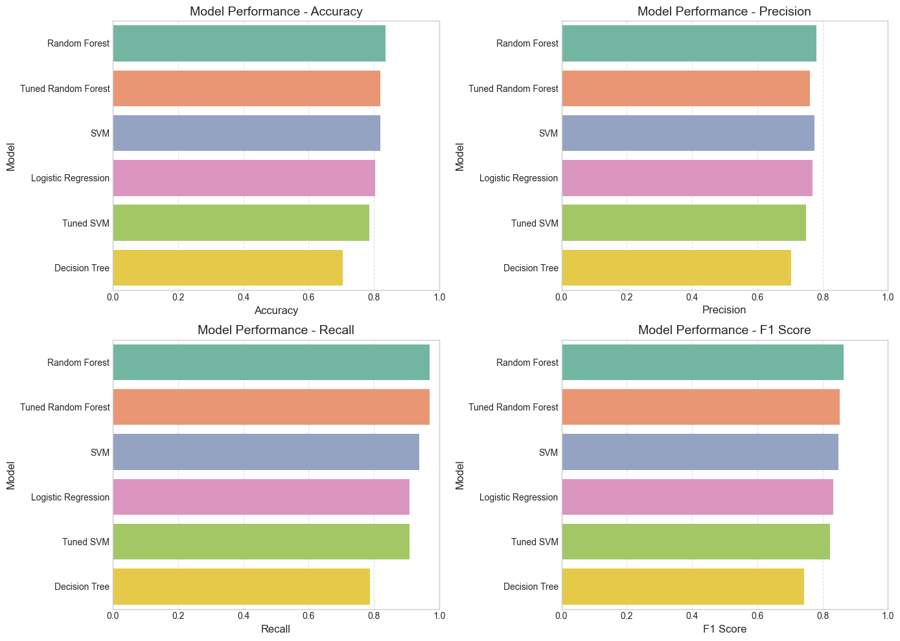

Slide 14
Clinical Applications
Our model offers several potential applications in healthcare:
Early Screening Tool:
Identify high-risk patients for further diagnostic testing
Enable preventive interventions before symptoms worsen
Resource Optimization:
Prioritize patients for specialized cardiac tests
Reduce unnecessary testing for low-risk individuals
Risk Stratification:
Quantify patient risk to guide treatment decisions
Support evidence-based clinical protocols
Patient Education:
Demonstrate impact of modifiable risk factors
Motivate lifestyle changes with personalized risk assessment

Slide 15
Limitations
Modest dataset size (303 patients)
Limited demographic diversity
Lack of external validation
No temporal data to assess disease progression

Slide 16
Conclusion
Our heart disease prediction model demonstrates the potential of machine learning to transform preventive cardiology:
Accurate: High performance metrics across multiple evaluation criteria
Interpretable: Feature importance aligns with clinical knowledge
Actionable: Provides clear risk stratification for clinical decision-making
Accessible: Uses readily available clinical parameters
By enabling earlier detection and more targeted interventions, this model could contribute to reducing the global burden of cardiovascular disease.

