Slide 1


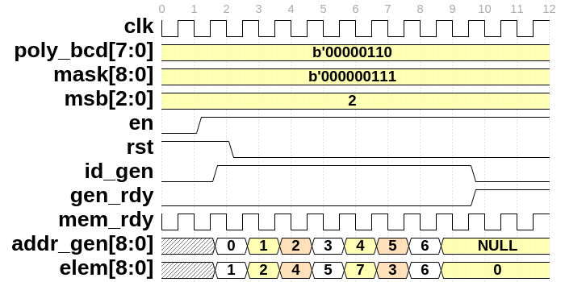
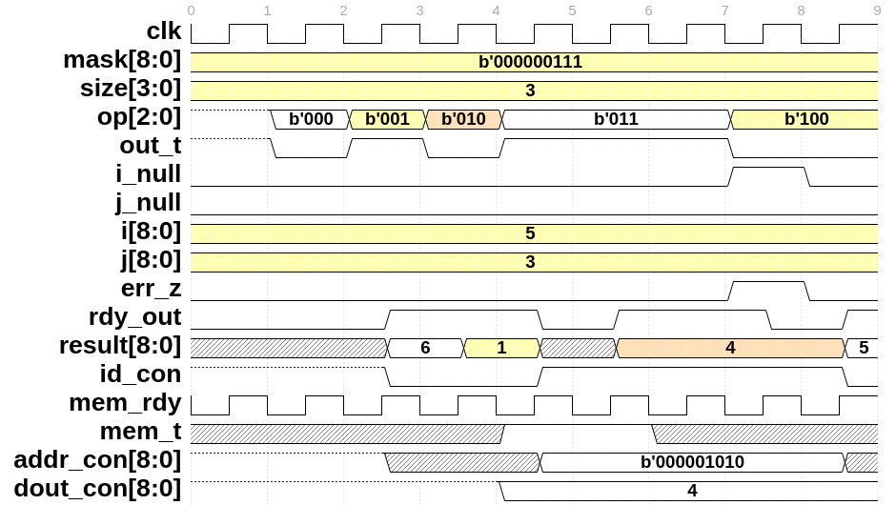
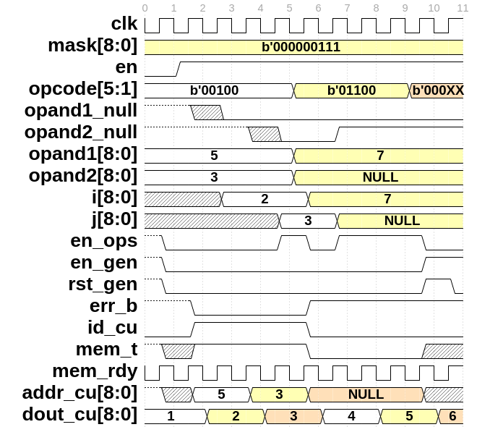
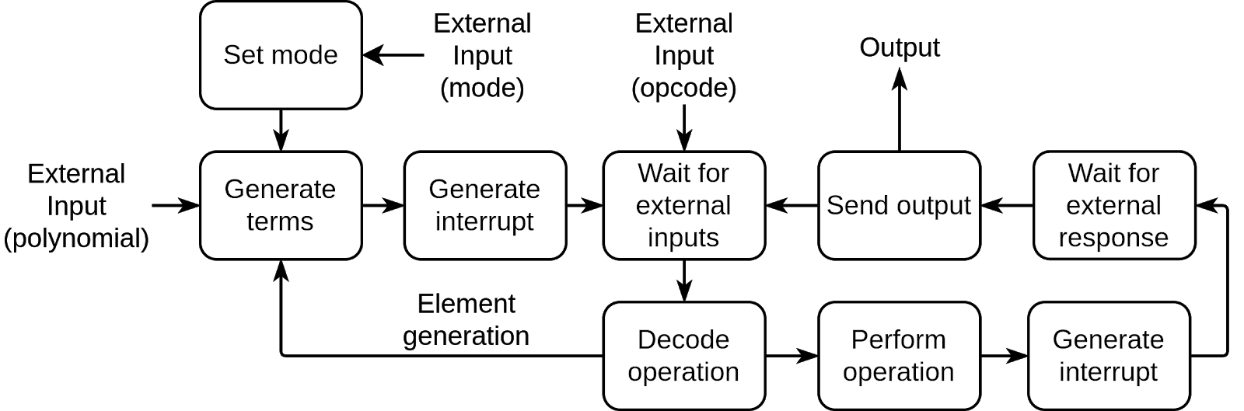
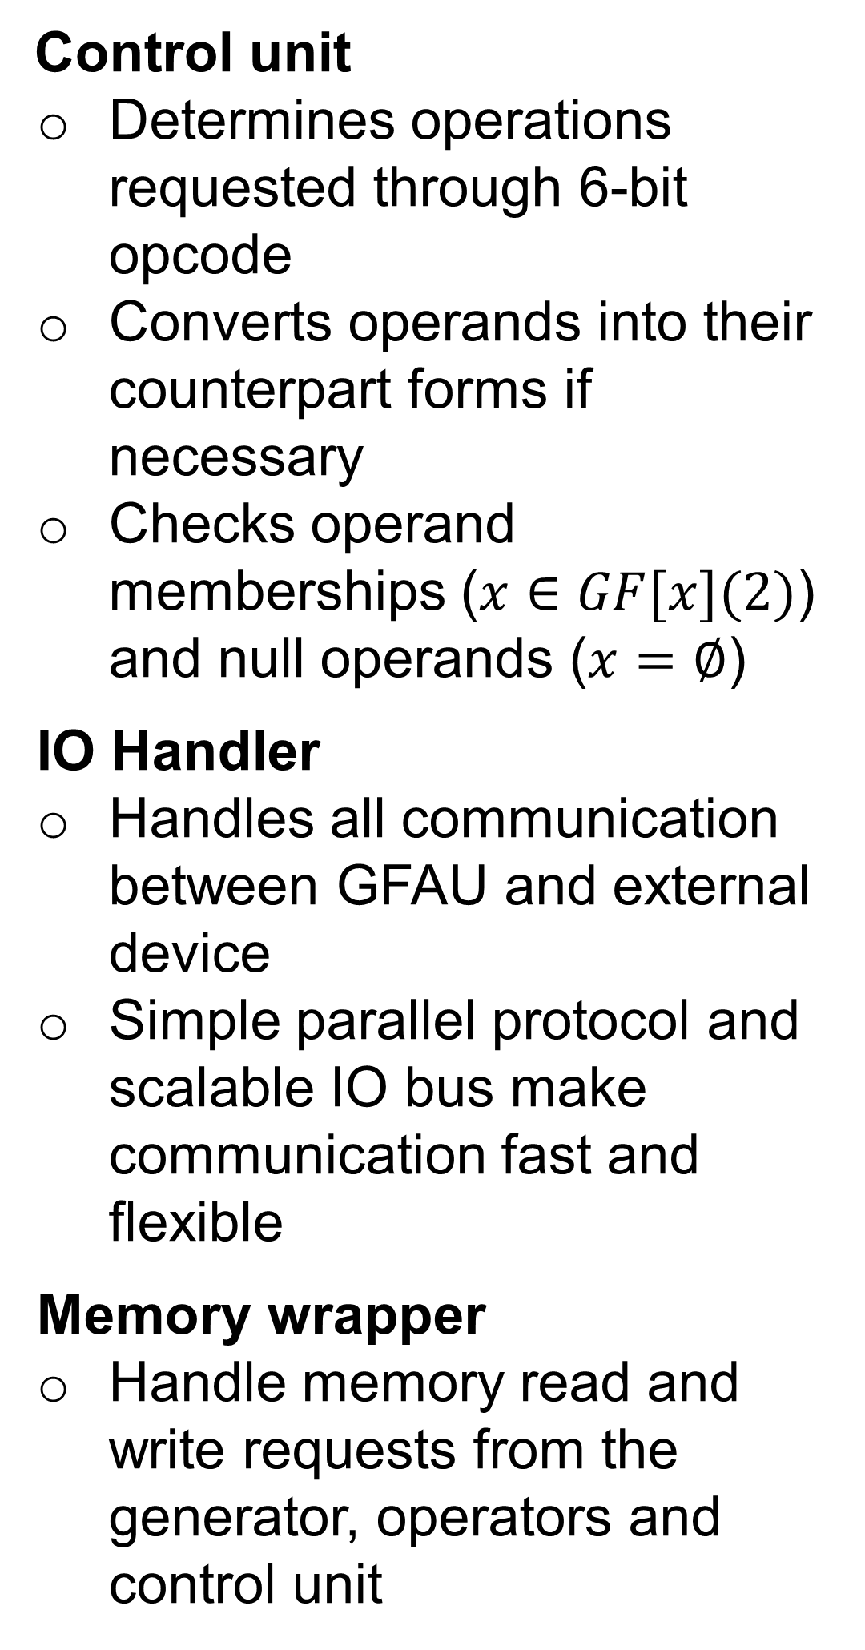
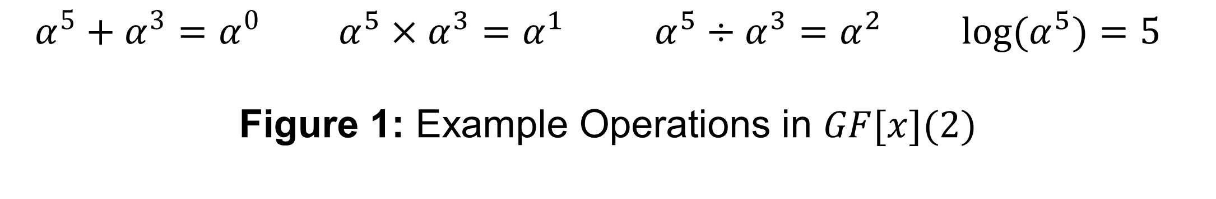
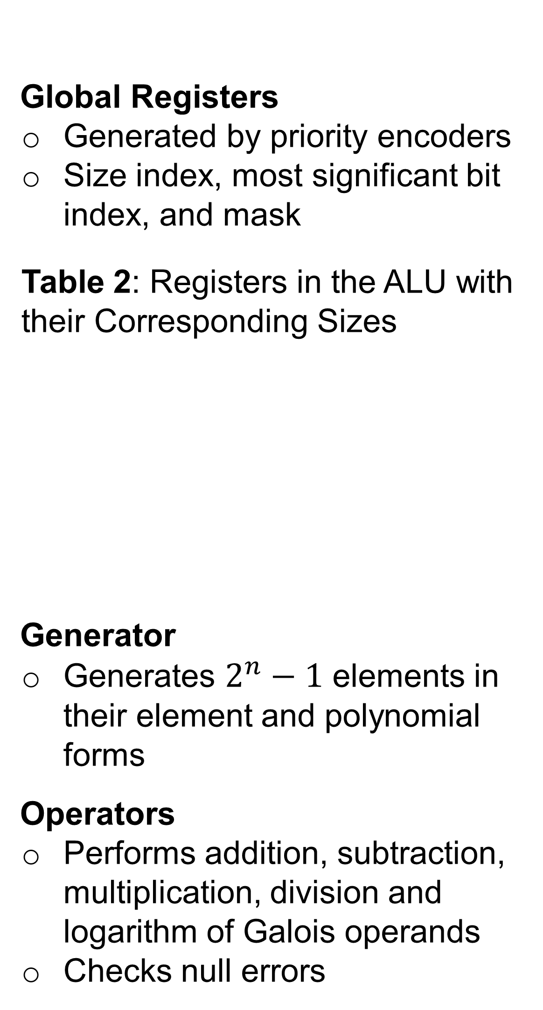
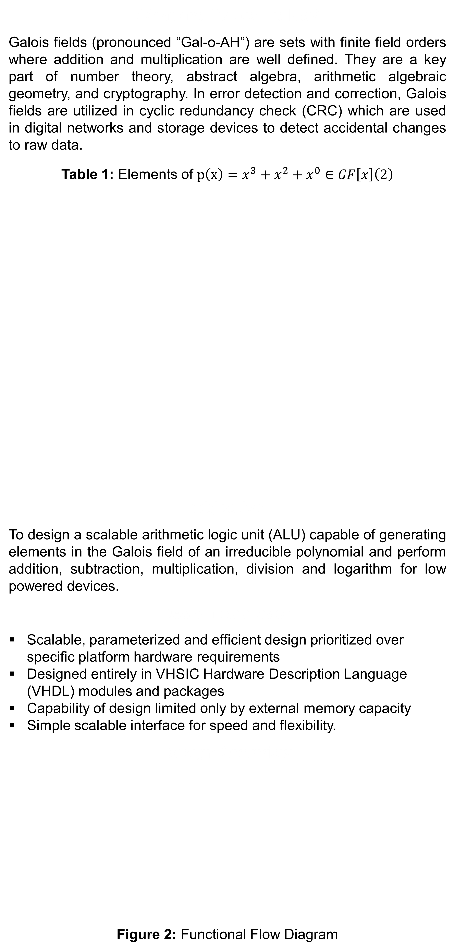
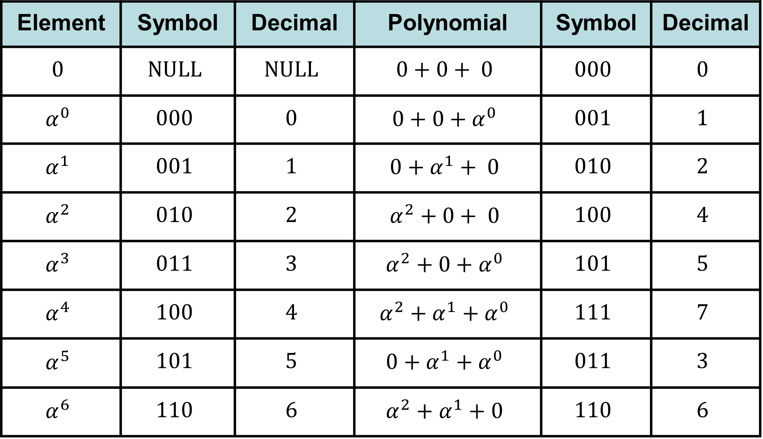
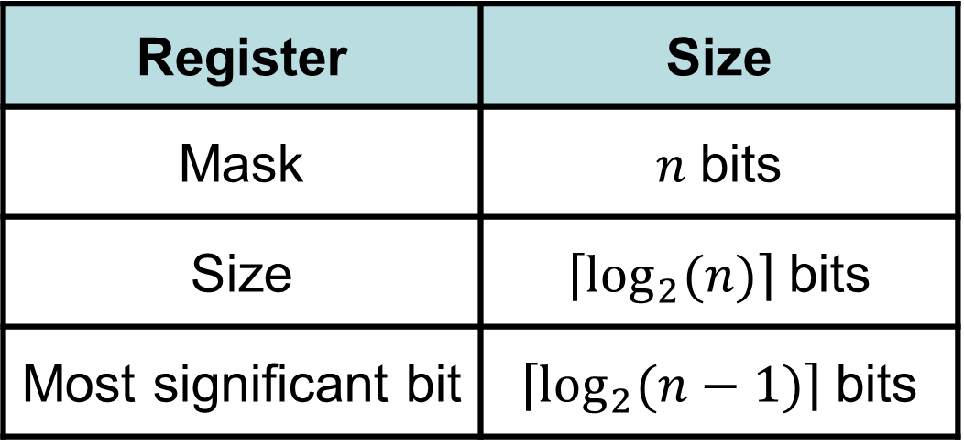
Galois Field Arithmetic Unit (GFAU)
Sabbir Ahmed, Jeffrey Osazuwa, Howard To, Brian Weber, Dr. E.F. Charles LaBerge
Department of Computer Science and Electrical Engineering, University of Maryland, Baltimore County
What are Galois Fields?
Galois fields (pronounced “Gal-o-AH”) are sets with finite field orders where addition and multiplication are well defined. They are a key part of number theory, abstract algebra, arithmetic algebraic geometry, and cryptography. In error detection and correction, Galois fields are utilized in cyclic redundancy check (CRC) which are used in digital networks and storage devices to detect accidental changes to raw data.
Table 1: Elements of $p\left(x\right)=x^{3}+x^{2}+x^{0}∈GF\left[x\right]\left(2\right)$
Objective
To design a scalable arithmetic logic unit (ALU) capable of generating elements in the Galois field of an irreducible polynomial and perform addition, subtraction, multiplication, division and logarithm for low powered devices.
Design Approach
Scalable, parameterized and efficient design prioritized over specific platform hardware requirements
Designed entirely in VHSIC Hardware Description Language (VHDL) modules and packages
Capability of design limited only by external memory capacity
Simple scalable interface for speed and flexibility.
Design Overview
Figure 2: Functional Flow Diagram
Modules
Global Registers
Generated by priority encoders
Size index, most significant bit index, and mask
Table 2: Registers in the ALU with their Corresponding Sizes
Generator
Generates $2^{n}−1$ elements in their element and polynomial forms
Operators
Performs addition, subtraction, multiplication, division and logarithm of Galois operands
Checks null errors
Results
Conclusion
The GFAU achieved the objectives with minimal hardware usage. The design was parameterized to be both scalable and inexpensive enough to interface with microcontrollers. Future improvements may include: generate the multiplicative inverse of an element, check if input polynomials are primitive in linear time, and further optimize the overall hardware usage.
Control unit
Determines operations requested through 6-bit opcode
Converts operands into their counterpart forms if necessary
Checks operand memberships ($x∈GF[x](2)$) and null operands ($x=∅$)
IO Handler
Handles all communication between GFAU and external device
Simple parallel protocol and scalable IO bus make communication fast and flexible
Memory wrapper
Handle memory read and write requests from the generator, operators and control unit
a
b
Register | Size
Mask | $n$ bits
Size | $\left\lceil \log_{2}{(n)}\right\rceil$ bits
Most significant bit | $\left\lceil \log_{2}{(n−1)}\right\rceil$ bits
c
Figure 4: Waveforms generated by the high-level modules. (a) The elements and their corresponding memory addresses. (b) The addition, multiplication, division and logarithm of the operands. (c) The opcode determined the operation selected and checked for nulls and conversions.
Element | Symbol | Decimal | Polynomial | Symbol | Decimal
$$0$$ | $$NULL$$ | $$NULL$$ | $$0+0+ 0$$ | $$000$$ | $$0$$
$$α^{0}$$ | $$000$$ | $$0$$ | $$0+0+α^{0}$$ | $$001$$ | $$1$$
$$α^{1}$$ | $$001$$ | $$1$$ | $$0+α^{1}+ 0$$ | $$010$$ | $$2$$
$$α^{2}$$ | $$010$$ | $$2$$ | $$α^{2}+0+ 0$$ | $$100$$ | $$4$$
$$α^{3}$$ | $$011$$ | $$3$$ | $$α^{2}+0+α^{0}$$ | $$101$$ | $$5$$
$$α^{4}$$ | $$100$$ | $$4$$ | $$α^{2}+α^{1}+α^{0}$$ | $$111$$ | $$7$$
$$α^{5}$$ | $$101$$ | $$5$$ | $$0+α^{1}+α^{0}$$ | $$011$$ | $$3$$
$$α^{6}$$ | $$110$$ | $$6$$ | $$α^{2}+α^{1}+0$$ | $$110$$ | $$6$$
$α^{5}+α^{3}=α^{0}$ $α^{5}×α^{3}=α^{1}$ $α^{5}÷α^{3}=α^{2}$ ${log(α}^{5})=5$
Figure 1: Example Operations in $GF[x](2)$
n is the Highest Degree

