Slide 1

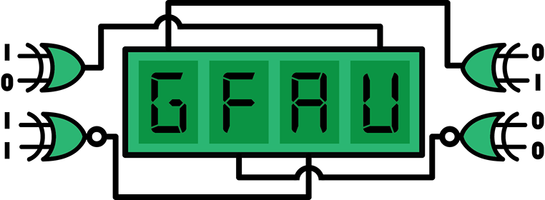
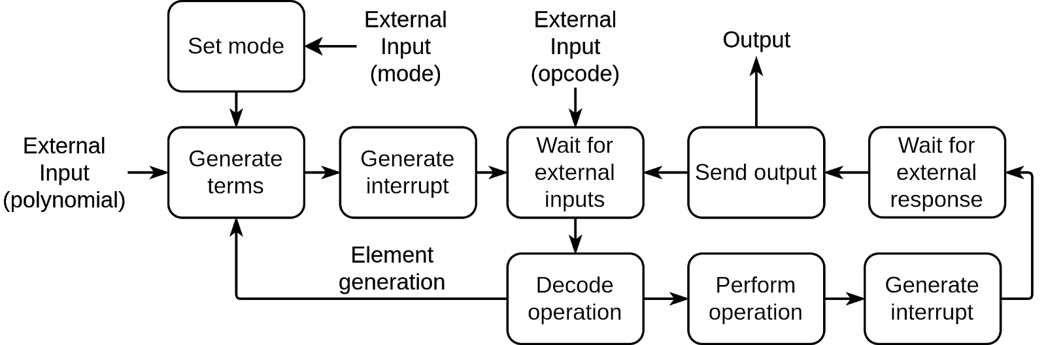
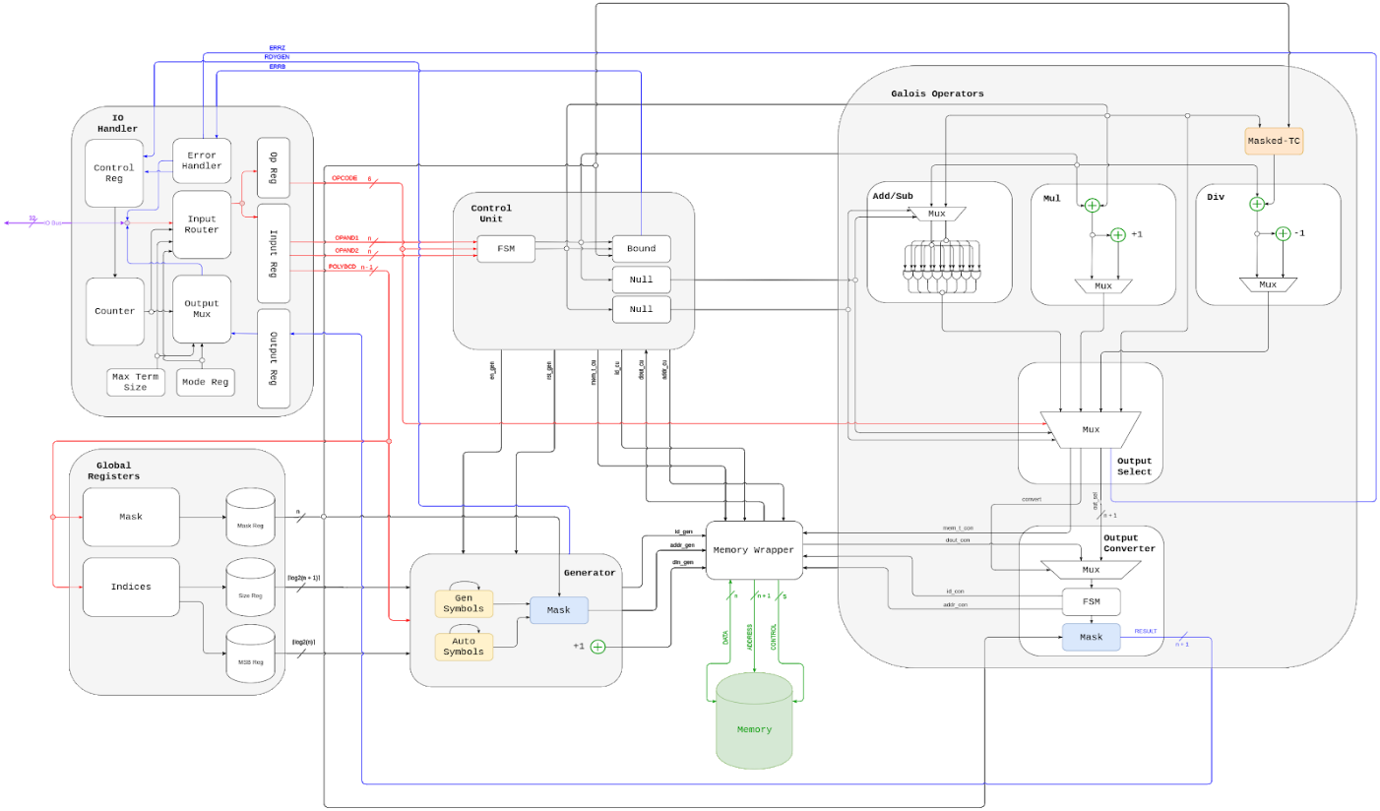






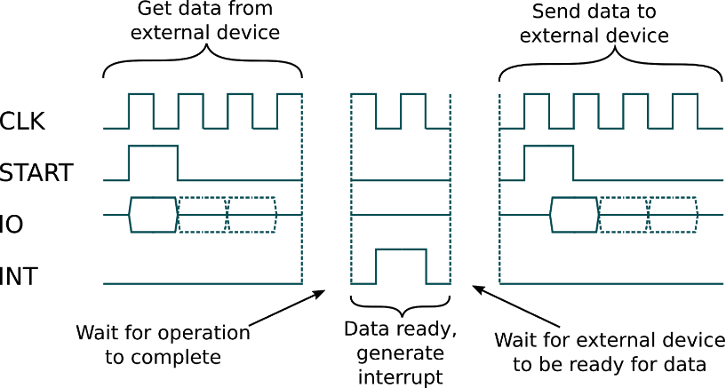
Galois Field Arithmetic Unit (GFAU)
Sabbir Ahmed, Jeffrey Osazuwa, Howard To, Brian Weber, Dr. E.F. Charles LaBerge
Department of Computer Science and Electrical Engineering, University of Maryland, Baltimore County
Title Here
Results
What are Galois Fields?
A field with a finite number of elements, Galois fields are a key part of number theory, abstract algebra, arithmetic algebraic geometry, and cryptography. In error detection and correction, Galois fields are utilized in cyclic redundancy check (CRC) which are used in digital networks and storage devices to detect accidental changes to raw data.
Table 1: Elements of x³ + x² + x⁰
Figure 1: Operations of elements of x³ + x² + x⁰
Objective
To design a scalable arithmetic logic unit (ALU) capable of generating elements in the Galois field of an irreducible polynomial and perform addition, subtraction, multiplication, division and logarithm for low powered devices.
Design Approach
Scalable, parameterized and efficient design prioritized over specific platform hardware requirements
Designed entirely in VHSIC Hardware Description Language (VHDL) modules and packages
Capability of design limited only by external memory capacity
Interface <BRIAN>
Prototype Design Specification
Budget under $400.
Cost of large scale production less than $1 per chip
Area of less than 24 in²
Design Overview
Figure 3: Functional Flow Diagram
Figure 4: High Level Block Schematic
Modules
Global Registers
Generated by priority encoders
Size index, most significant bit index, and mask
Generator
Generates elements in their element and polynomial forms
Alerts the user when process is complete
Operators
Performs addition, subtraction, multiplication, division and logarithm of Galois operands
Checks null errors
Control unit
Determines operations requested through 6-bit opcode
Converts operands into their counterpart forms if necessary
Checks operand memberships and null operands
IO Handler
Handles all communication between GFAU and external device
Asychronous parallel protocol and scalable IO bus make communication fast and flexible
Memory wrapper
Handle memory read and write requests from the generator, operators and control unit
Element | Symbol | Decimal | Polynomial | Symbol | Decimal
0 | NULL | NULL | 0 + 0 + 0 | 000 | 0
x⁰ | 000 | 0 | 0 + 0 + x⁰ | 001 | 1
x¹ | 001 | 1 | 0 + x¹ + 0 | 010 | 2
x² | 010 | 2 | x² + 0 + 0 | 100 | 4
x³ | 011 | 3 | x² + 0 + x⁰ | 101 | 5
x⁴ | 100 | 4 | x² + x¹ + x⁰ | 111 | 7
x⁵ | 101 | 5 | 0 + x¹ + x⁰ | 011 | 3
x⁶ | 110 | 6 | x² + x¹ + 0 | 110 | 6
Conclusion

