Slide 1
Emotion Extraction From Lyrics
Sabbir Ahmed

Slide 2
Disclaimer
Examples contain morbid topics, including self harm and violence
The source and generated datasets contain terms that may be considered vulgar and offensive
Labeling or quantifying moods, emotions and music genres is extremely subjective

Slide 3
Spotify
Mood-specific playlists
Manually curated by staff
Constantly updated to incorporate new music
Spotify Web API has audio features that can suggest mood
Acousticness
Danceability
Energy
Valence
And more…
Notes:
My goal is to avoid audio features and attempt to categorize the moods based solely on lyrics

Slide 4
Lyrics Matter Too
“Pumped Up Kicks” by Foster The People
Production
Pop chords
Upbeat melody
Joyous and cheerful tone
Lyrical Content
Homicidal thoughts of a young boy with access to a gun

Slide 5
Sentiment Analysis
Pros
Ranges between [-1, 1]
Widely researched
Widely used
Recommender systems
Opinion mining
Product feedback analysis
Cons
One-dimensional

Slide 6
Songs as Documents
NLP on lyrics face additional challenges
Context is very important
Don’t stop for stopwords
Repetition, repetition, repetition
Punctuations
Songwriting directions
Adlibs

Slide 7
Emotion Classification
Very subjective
Hard to quantify or classify
Cultural differences need to be considered
Notes:
Almost leaning towards fields in philosophy

Slide 8
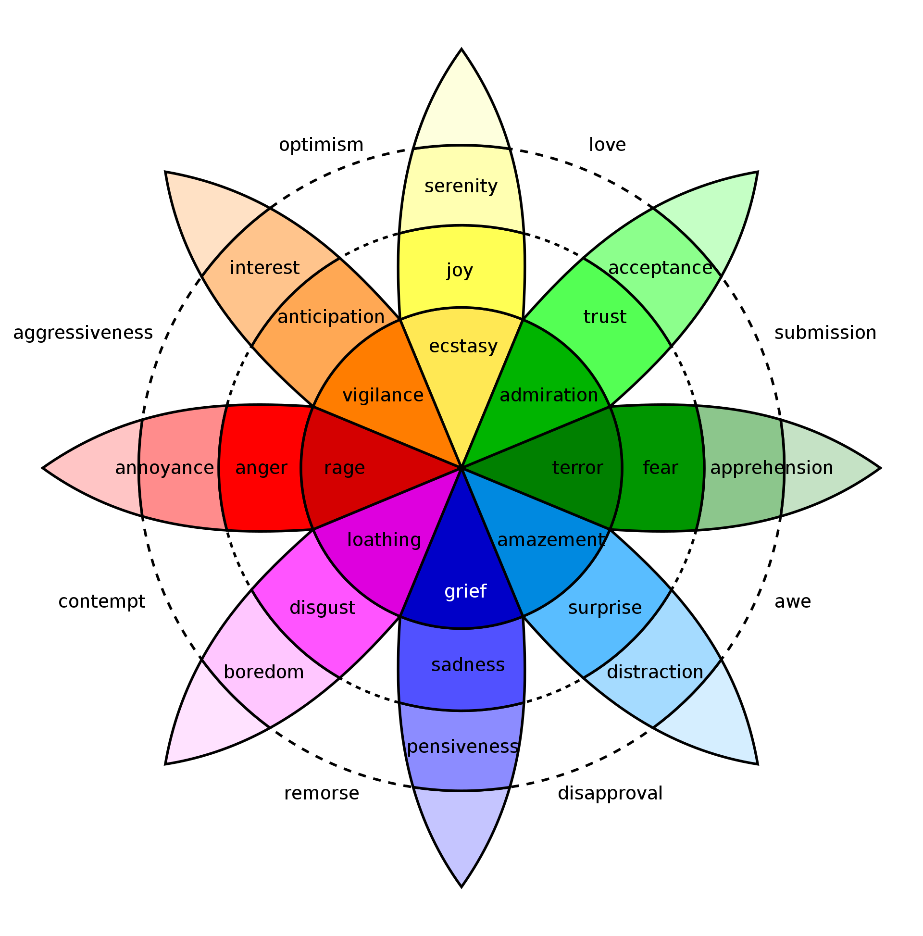
Plutchik’s Model
Concentric circles where inner circles are more basic and outer circles more complex
Outer circles are also formed by blending the inner circle emotions
Anger, disgust, sadness, surprise, fear, trust, joy, anticipation

Slide 9
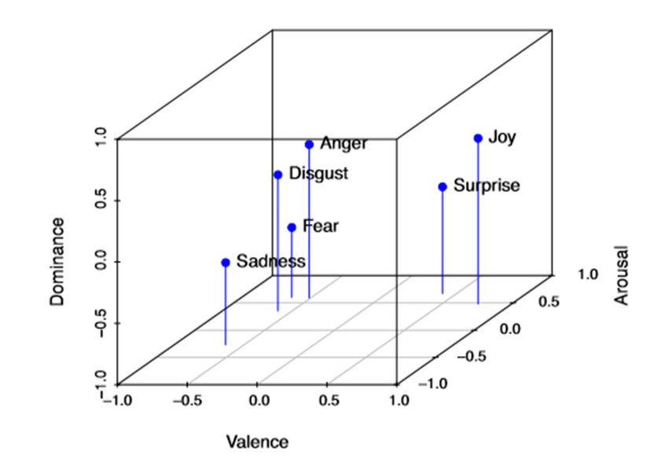
VAD Emotional State Model
Valence
pleasant or unpleasant
Arousal
how energized or soporific
Dominance
controlling and dominant versus controlled or submissive

Slide 10
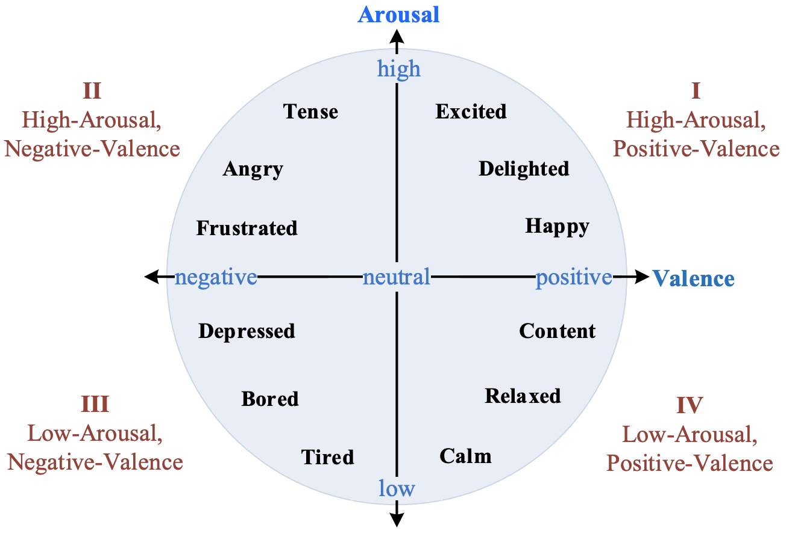
VA Emotional State Model
Quadrants
Excitement
Anger
Sadness
Joy

Slide 11
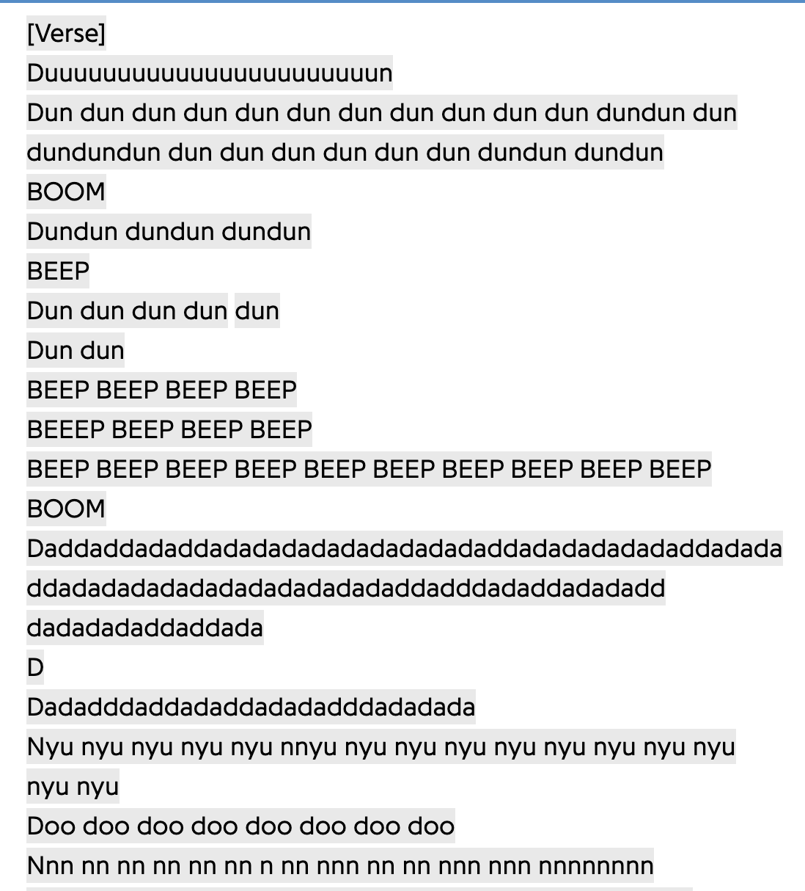
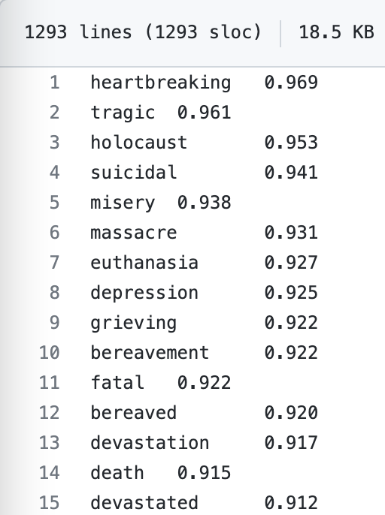
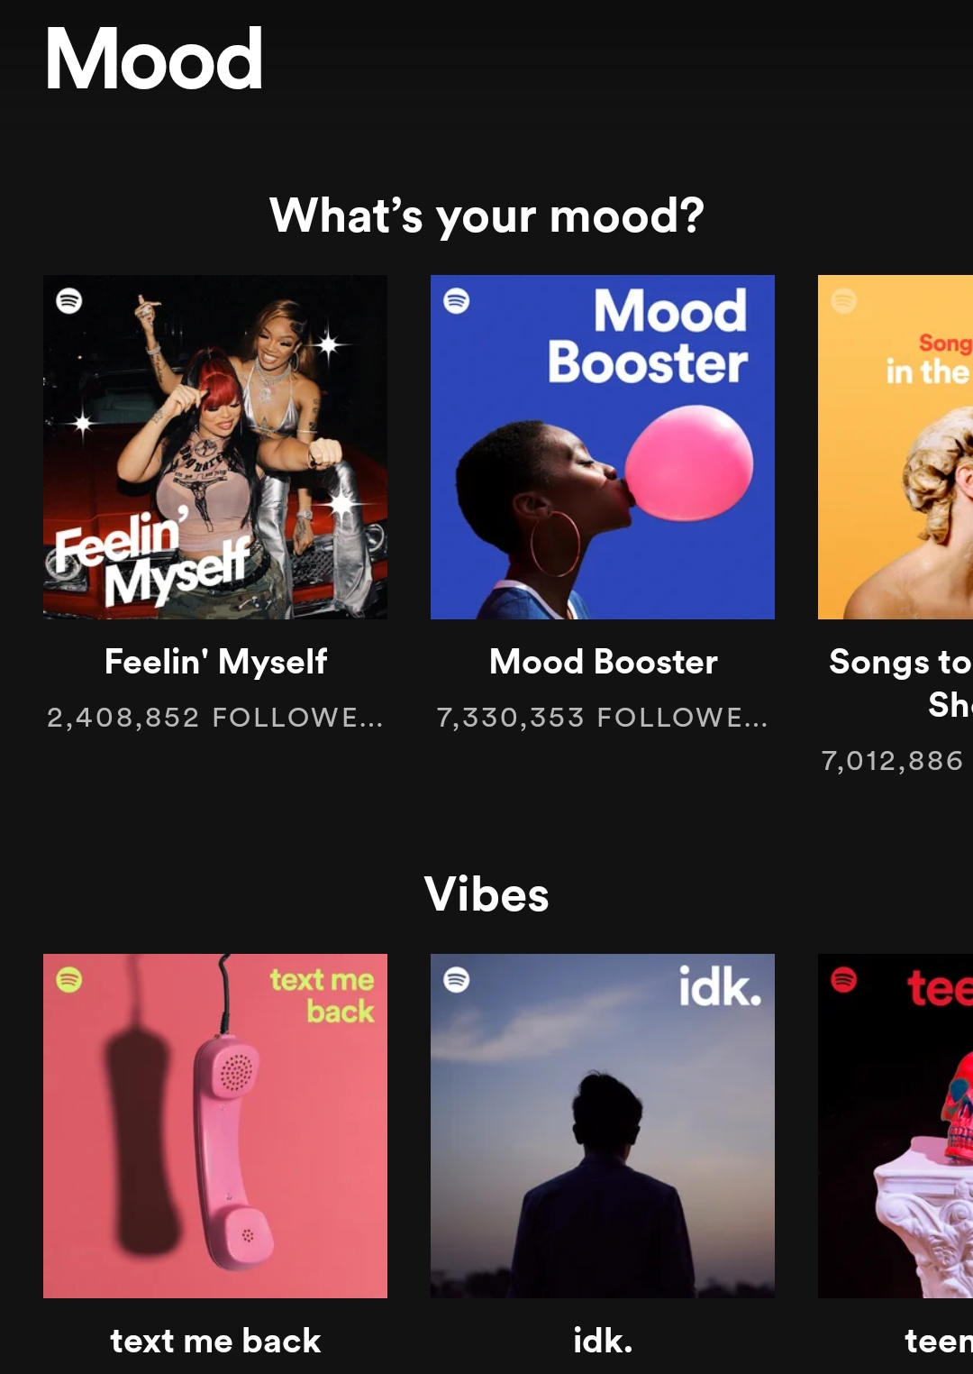
Source Datasets
Playlist data
Spotify
Lyrics
Various web sources
NRC VAD Lexicon
NRC Emotion Intensity Lexicon
NRC Word-Emotion Association Lexicon
NRC Valence, Arousal, and Dominance Lexicon

Slide 12
Generated Dataset
Randomly picked top playlists curated by Spotify
Tracks can appear in multiple playlists
Lyrics and emotion lexicons are normalized as 1-gram tokens
Scores are based on sums of emotion intensities and frequencies of word associations

Slide 13
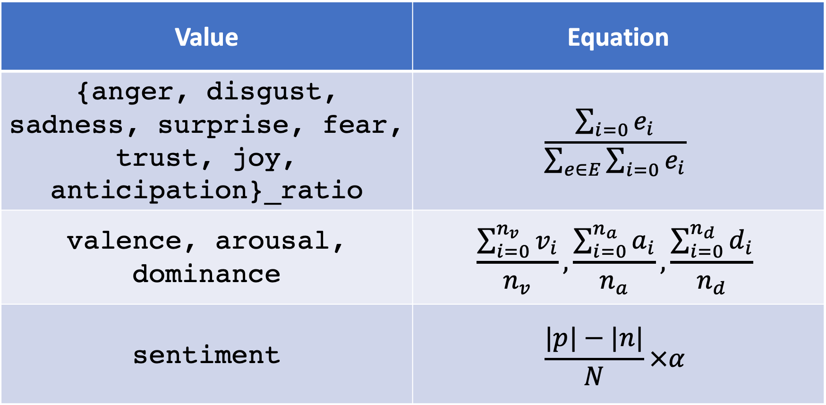
Scores
Value | Equation
{anger, disgust, sadness, surprise, fear, trust, joy, anticipation}_ratio | $$\frac{\sum_{i=0}{e_{i}}}{\sum_{e∈E}{\sum_{i=0}{e_{i}}}}$$
valence, arousal, dominance | $$\frac{\sum_{i=0}^{n_{v}}{v_{i}}}{n_{v}},\frac{\sum_{i=0}^{n_{a}}{a_{i}}}{n_{a}},\frac{\sum_{i=0}^{n_{d}}{d_{i}}}{n_{d}}$$
sentiment | $$\frac{|p|−|n|}{N}×α$$

Slide 14
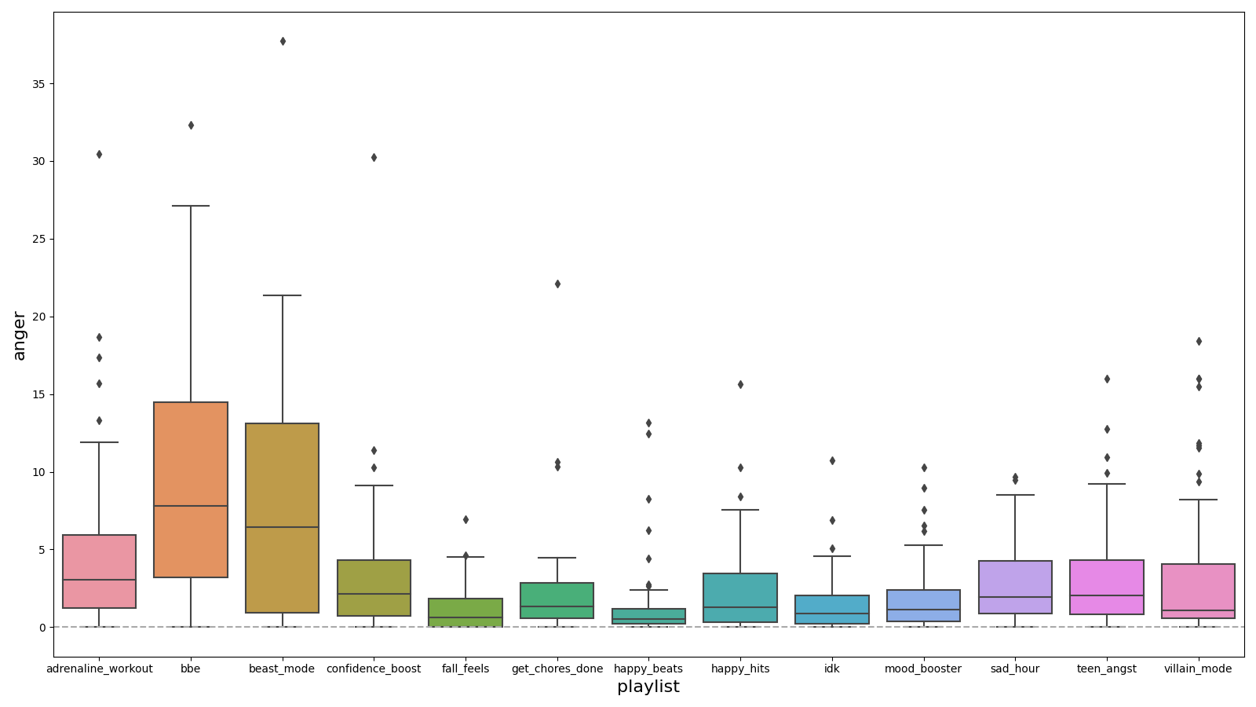
anger

Slide 15
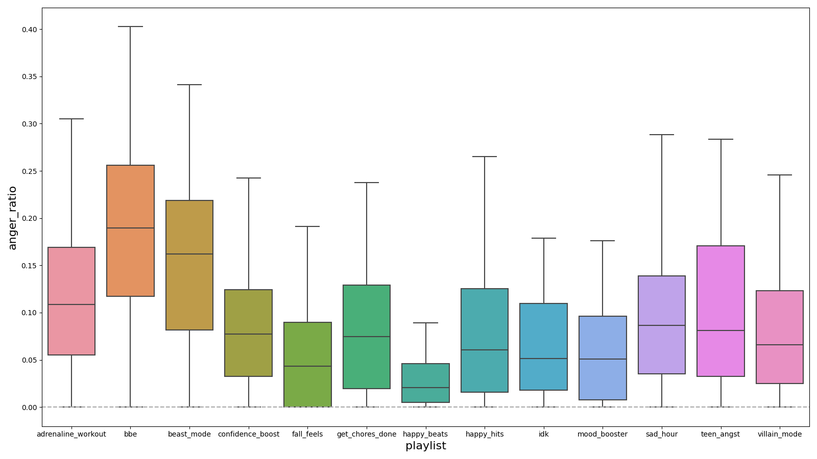
anger_ratio

Slide 16
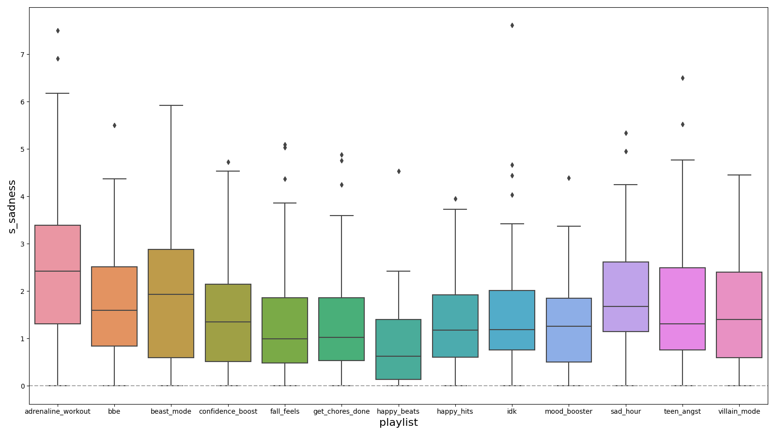
sadness with stop words removed

Slide 17
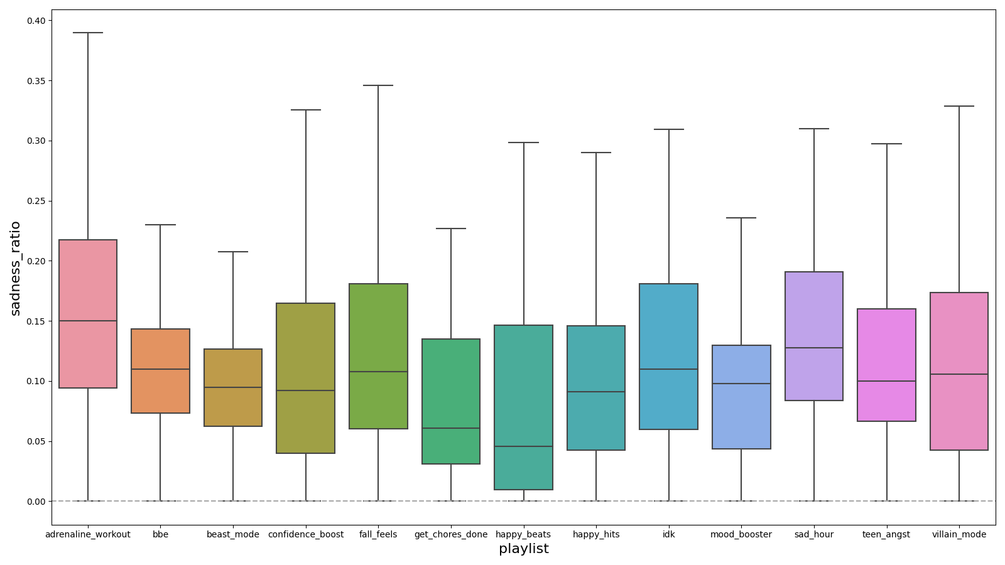
sadness_ratio

Slide 18
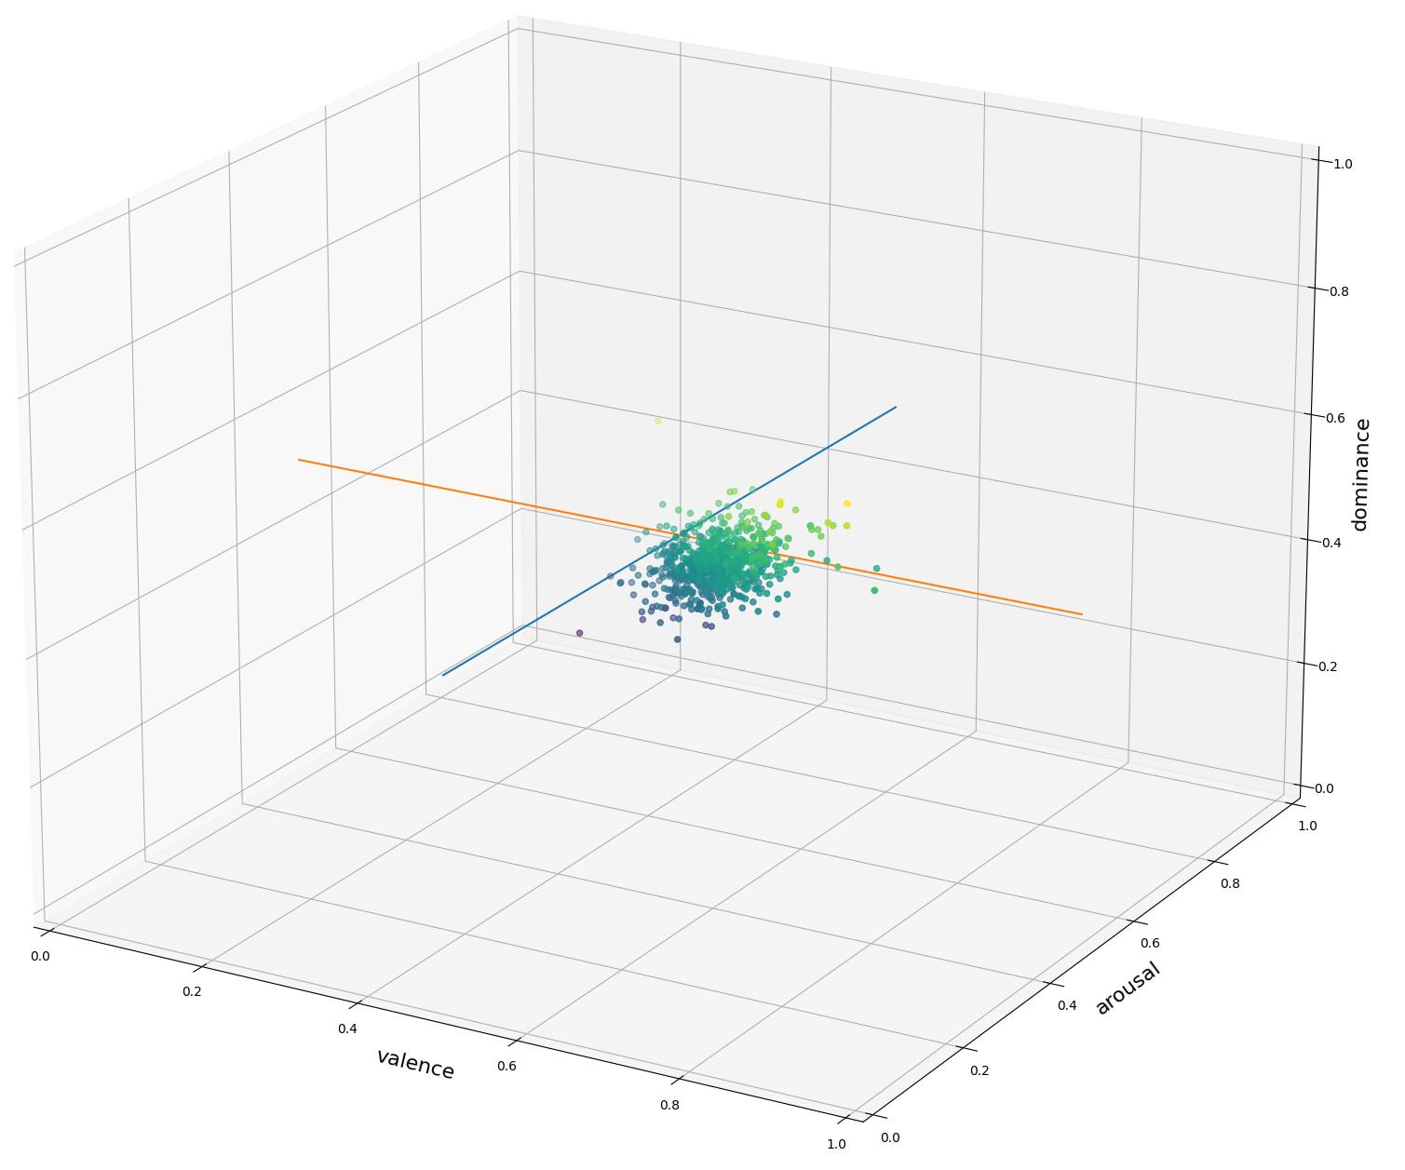
Valence vs Arousal vs Dominance

Slide 19
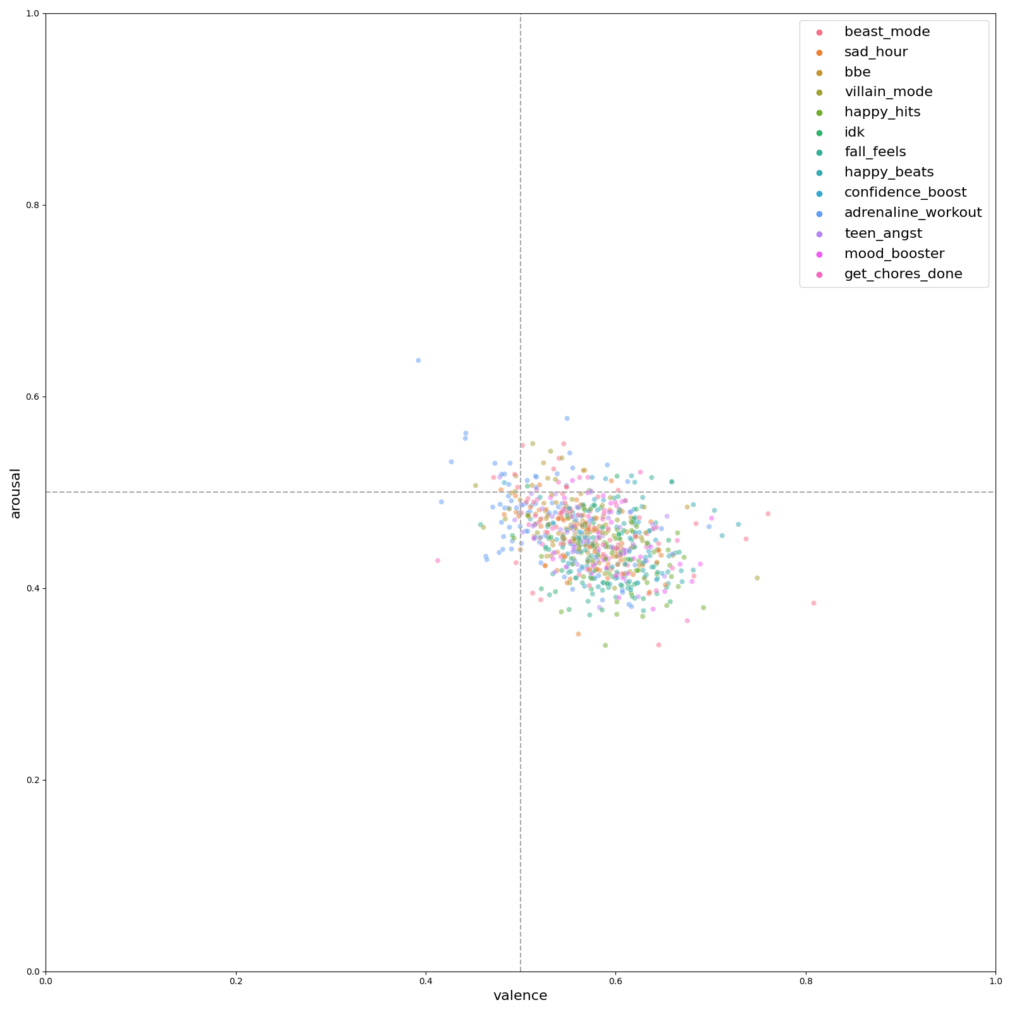
Valence vs Arousal

Slide 20
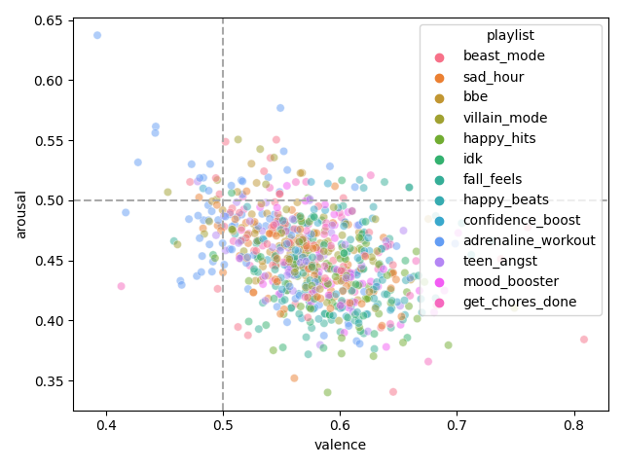
Valence vs Arousal

Slide 21
wheel_playlist
Systematically classify tracks into one of the 8 emotions from Plutchik’s wheel
Track qualified for the playlist if its emotion ratio was above the median

Slide 22
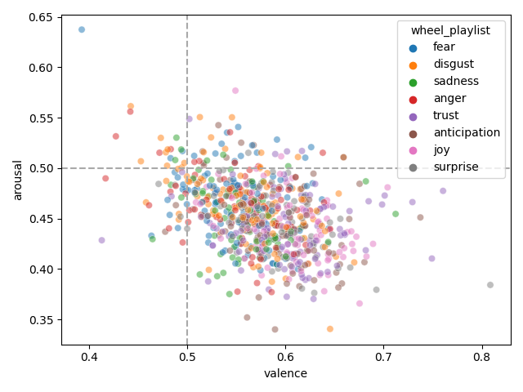
Valence vs Arousal

Slide 23
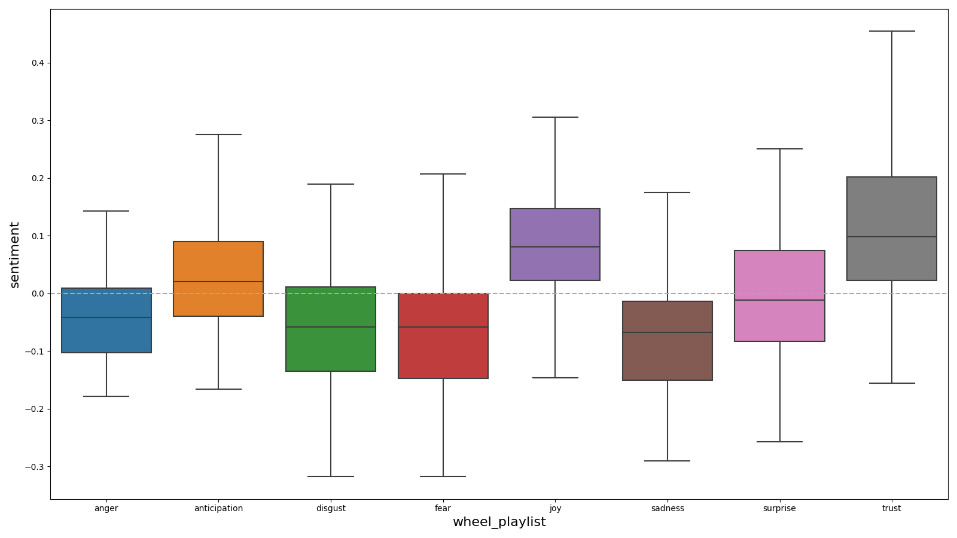
Sentiment score over wheel_playlist

Slide 24
Future Work

Slide 25
References
Mohammad, S. M. (2018). Obtaining Reliable Human Ratings of Valence, Arousal, and Dominance for 20,000 English Words. Proceedings of The Annual Conference of the Association for Computational Linguistics (ACL). Melbourne, Australia.
Mohammad, S. M. (2018). Word Affect Intensities. Proceedings of the 11th Edition of the Language Resources and Evaluation Conference (LREC-2018). Miyazaki, Japan.

