Slide 1
PokemonVsNature
Description. User picks location and date within a 5 day span. Hits search and populates list of pokemon choices based off the weather at said location, then chooses which types of pokemon to battle. then submits to battle computer generated pokemon
Pick your location
Type in Location
Weather Forecast
Click to populate
Date1
Date2
Date3
Date4
Date5
Pokemon choices
Click to populate
Poke1
Poke2
Poke3
Poke4
Poke5
Poke6
Let’s Battle

Slide 2
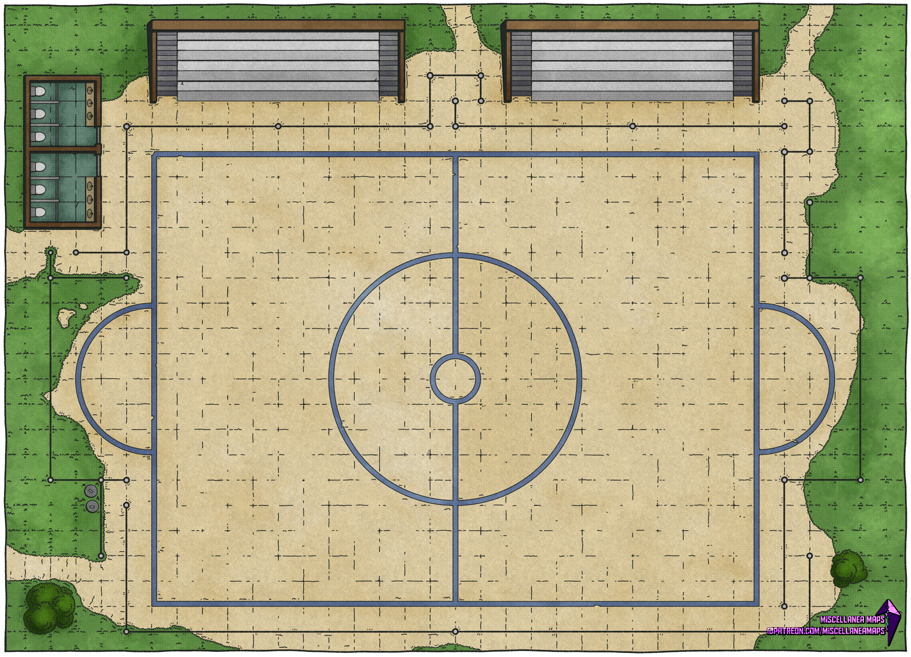


Wins:
Losses:
Wins:
Losses:
Weather
Battle Scene
User Pokemon
Computer Pokemon

