Slide 1
Sentiment Analysis of Amazon Reviews
Ribhu Kaul
Registration no. 0001079285

Slide 2
Summary of the project…
Automatically extract the reviews from amazon.com website for a product.
Pre-process the reviews (cleaning, tokenization and vectorization).
Conduct sentiment analysis using 2 methods (TextBob and BERT) and compare the results.
Topic modelling

Slide 3
Extracting Reviews…
Setup WebDriver: Initialize the Firefox WebDriver with geckodriver, allows Selenium to control the Firefox browser programmatically.
Define get_reviews Function: Takes the driver object and finds all review elements on the current page.
Extracts the review title and body from each review element and returns a list of dictionaries with the extracted data.

Slide 4
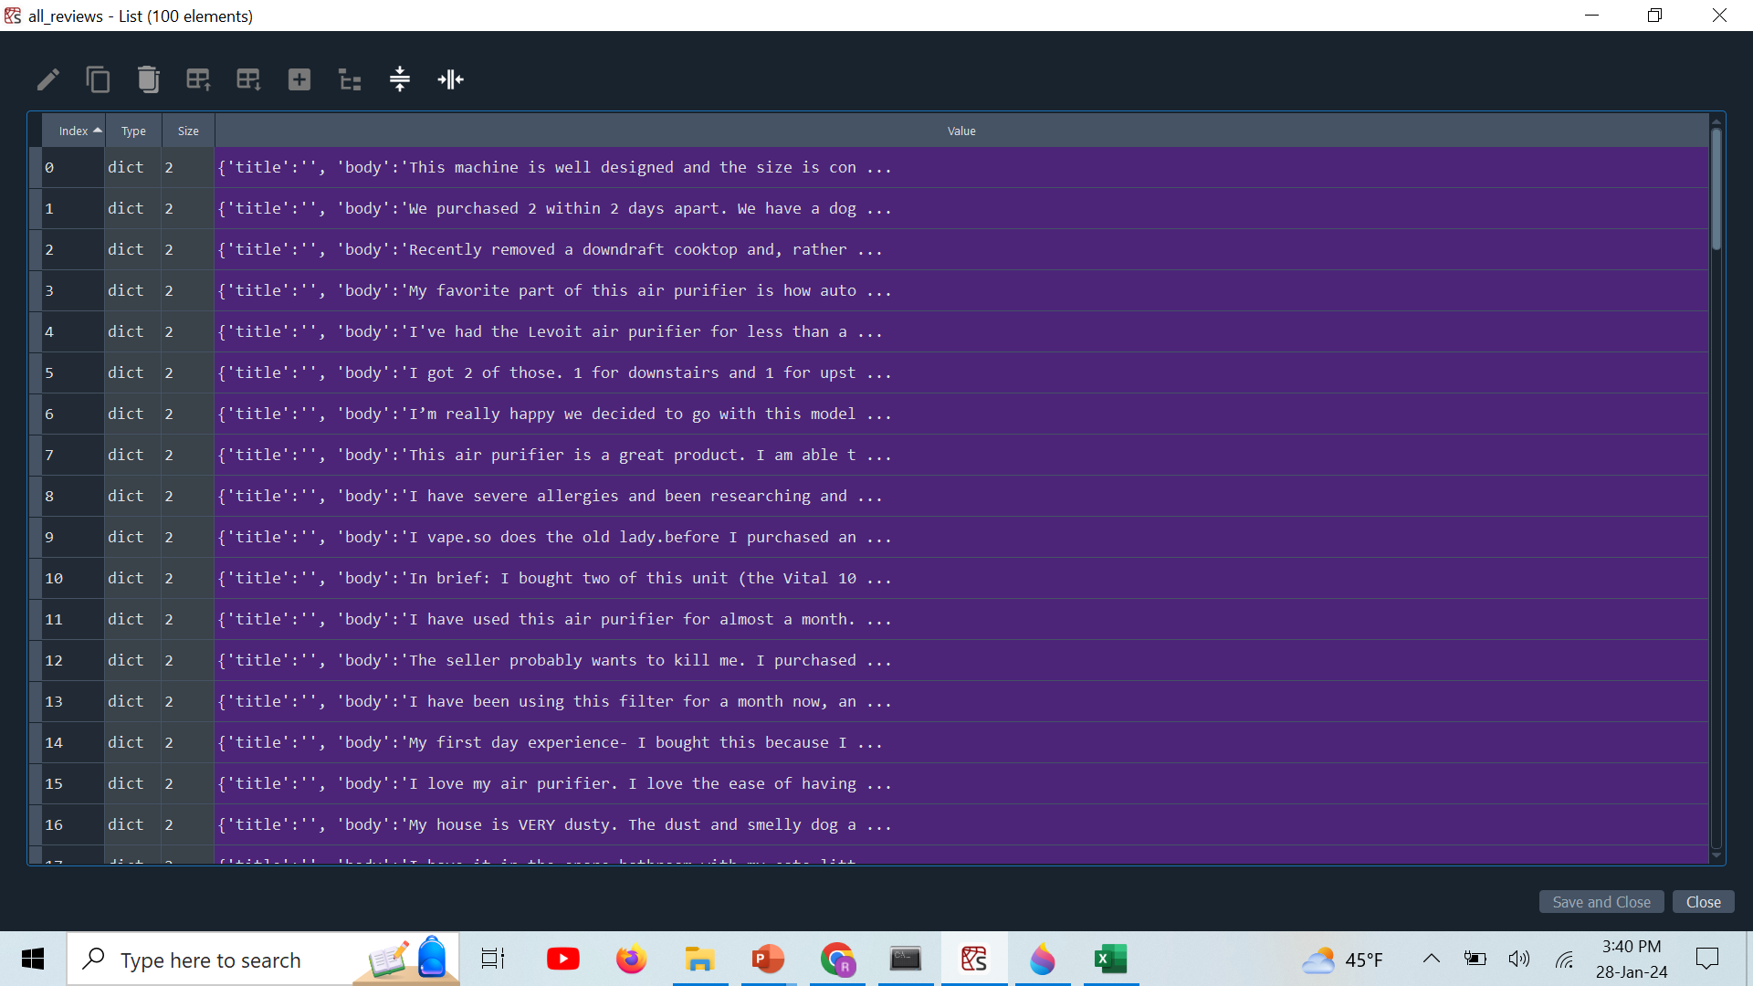
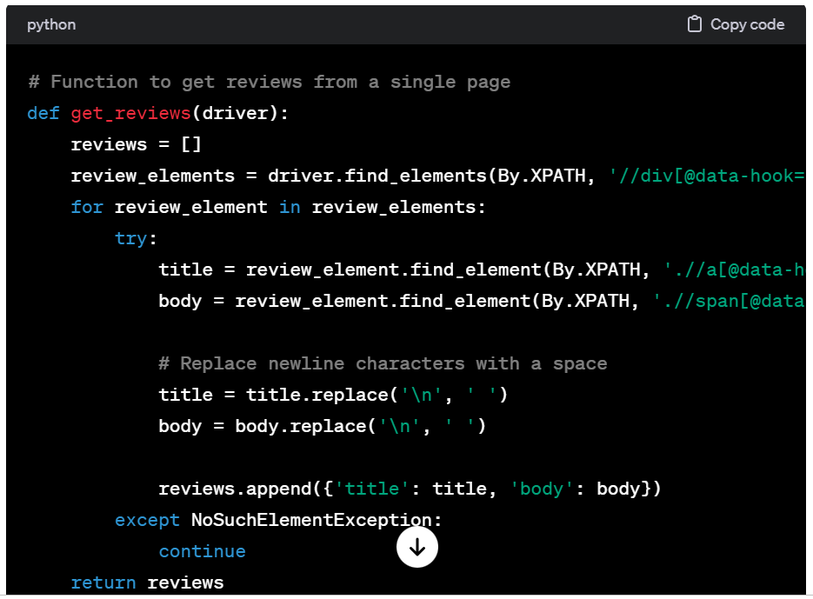
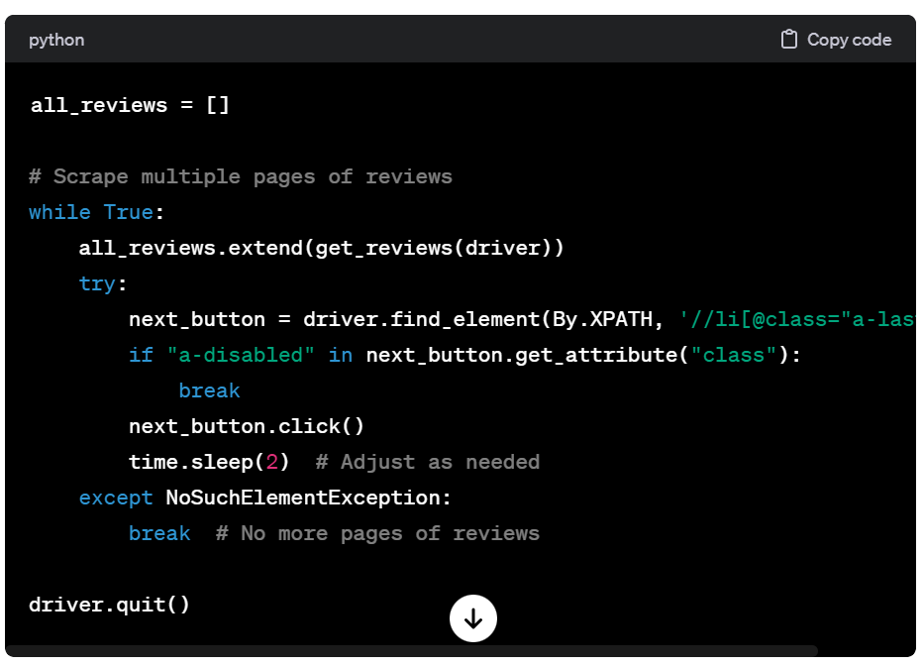
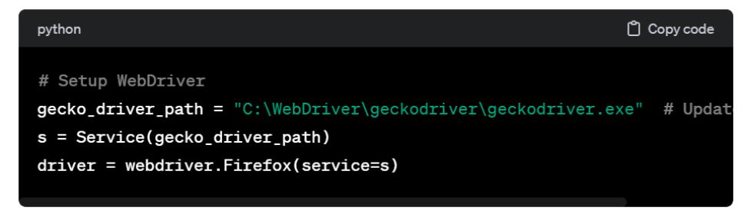
Extracting Reviews…
Extracting Reviews…

Slide 5
Text Cleaning…
Download Stopwords Dataset: Stop-words dataset downloaded from NLTK using nltk.download ('stopwords’)
The clean_text function is defined to clean the text of each review-
Converting text to lowercase.
Removing URLs starting with 'http' or 'www'.
Removing punctuation using regular expressions.
Removing digits.
Replacing multiple consecutive spaces with a single space.
Stripping leading and trailing spaces.
Stopwords are common words in a language (e.g., "the," "and," "is") that are removed from text data

Slide 6
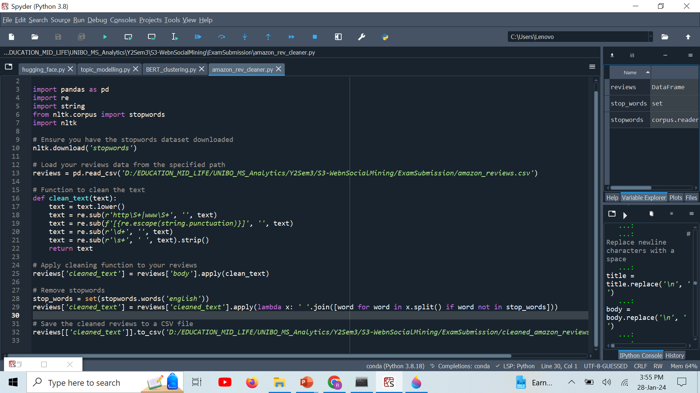

Slide 7
Tokenization…
Word Tokenization- text is divided into words or word-like units.
For example, the sentence "Tokenization is important." would be tokenized into three tokens: "Tokenization," "is," and "important.“ (using NLTK's word_tokenize function.)

Slide 8
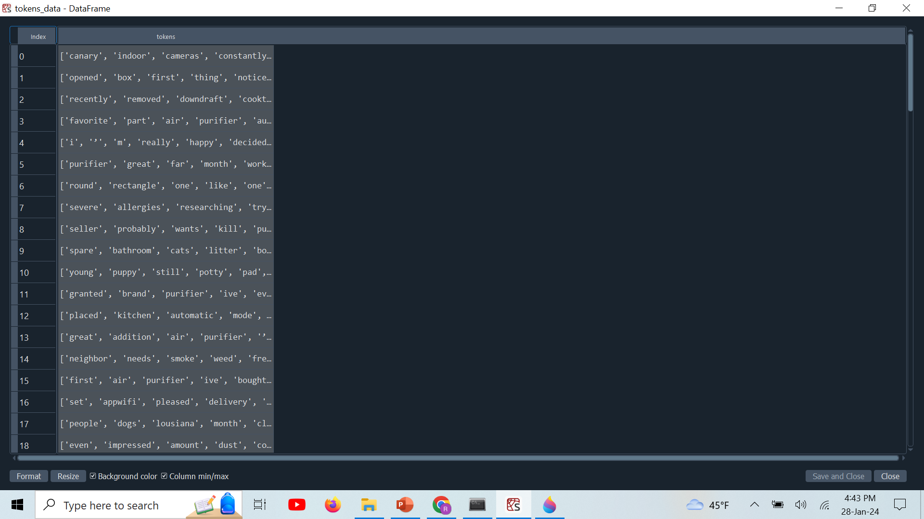
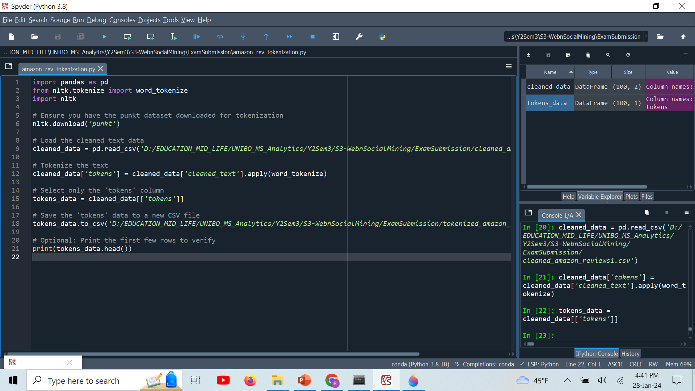
Tokenization…

Slide 9
TF-IDF Vectorization…
TF-IDF (Term Frequency-Inverse Document Frequency): A numerical statistic that reflects the importance of a word or term in a document relative to a collection of documents.
Term Frequency (TF): Represents how frequently a term (word) occurs in a document. A higher TF value => a term is more important in the documentTF(t, d) = (Number of times term "t" appears in document "d") / (Total number of terms in document "d") .
Inverse Document Frequency (IDF): Measures the rarity of a term across all documents in the corpus. A higher IDF value => a term is less common and more uniqueIDF(t) = log(N / (1 + DF(t))) .
TF-IDF Score: TF-IDF = TF * IDF

Slide 10
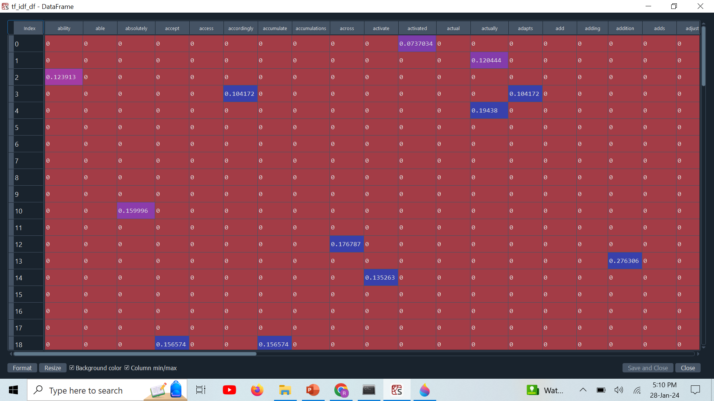
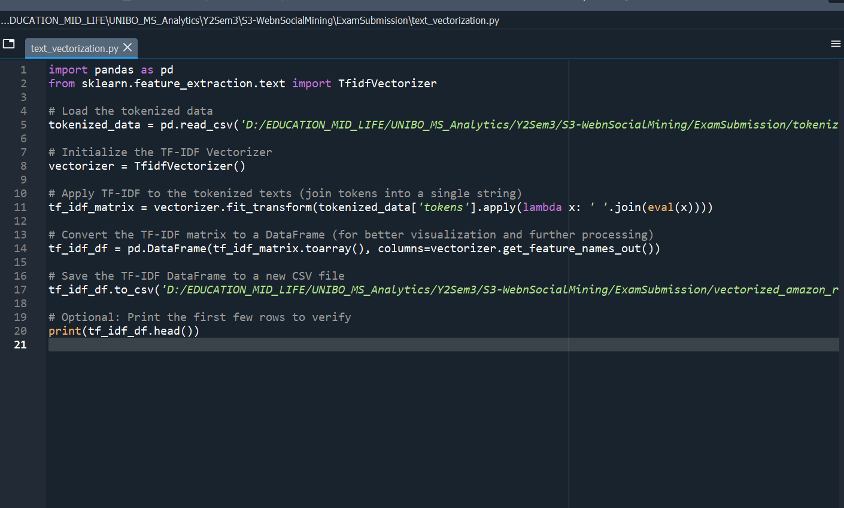
Text Vectorization…

Slide 11
Sentiment Analysis, Model 1: TextBob

Slide 12
Sentiment Analysis (TextBlob)…
TextBlob is a Python library that provides a simple API for processing textual data.
It is built on top of other natural language processing (NLP) libraries, such as NLTK (Natural Language Toolkit) and Pattern and offers a convenient and user-friendly way to perform various text analysis tasks.
TextBlob is designed to be beginner-friendly and is widely used for tasks like sentiment analysis, part-of-speech tagging, text classification, translation, and more.

Slide 13
TextBlob…
can automatically tokenize the text
can tag words in a text with their parts of speech (e.g., noun, verb, adjective), e.g., blob.tags
can extract noun phrases from text, e.g., blob.noun_phrases
provides a straightforward way to perform sentiment analysis, e.g., blob.sentiment
supports translation between languages, e.g., blob.translate(to='fr’)
can correct spelling mistakes in text, e.g., blob.correct()

Slide 14
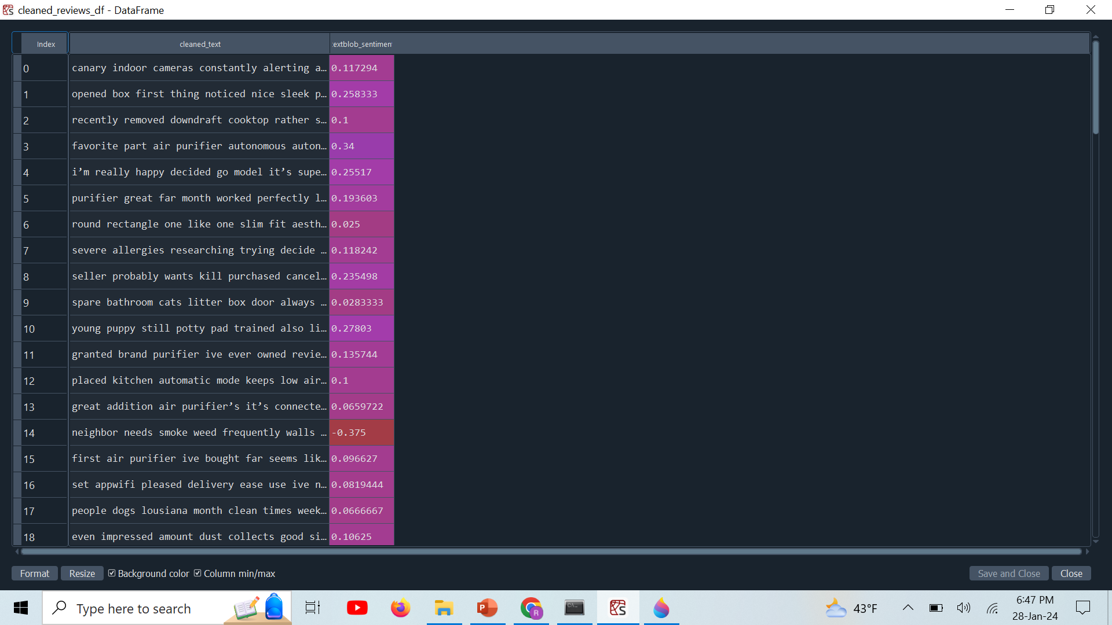
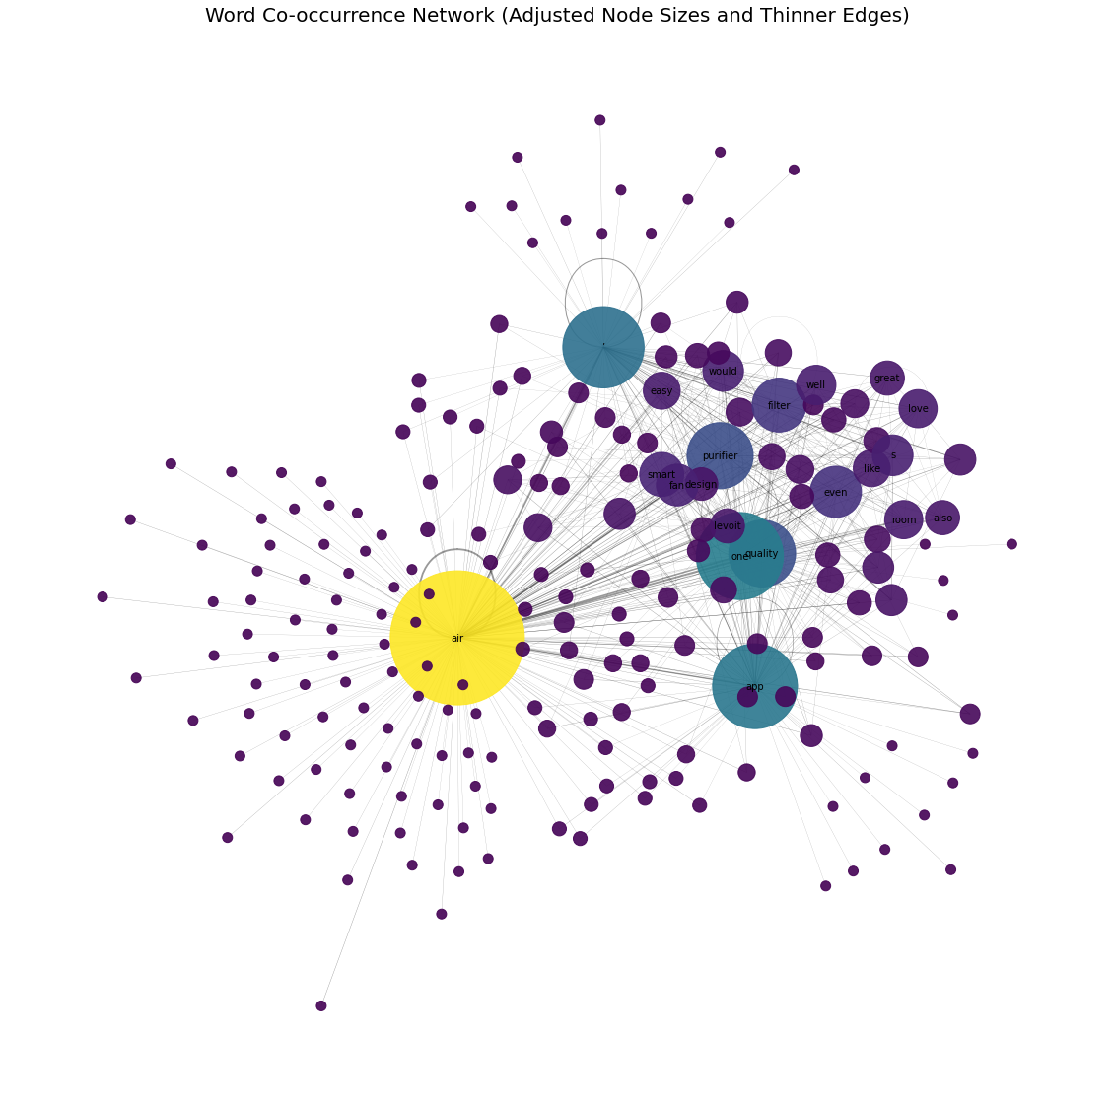
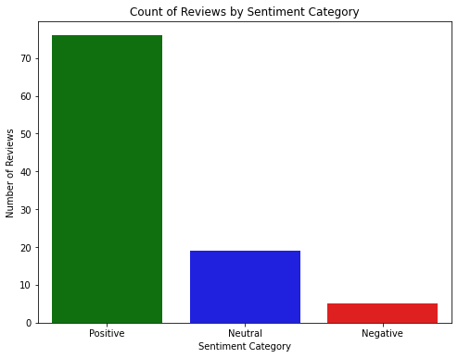
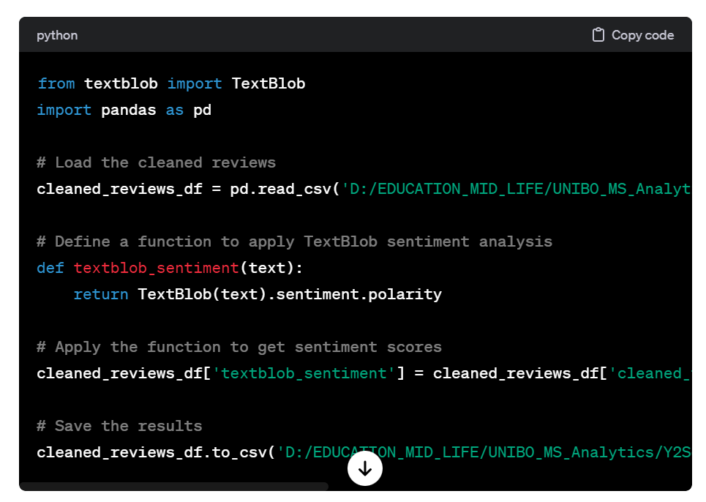
Sentiment Analysis (TextBlob)…

Slide 15
Topic Modelling

Slide 16
Topic Modelling…
Topic modeling is a technique in natural language processing (NLP) and machine learning used to automatically identify topics or themes within a collection of documents (text corpus).
It's a form of unsupervised learning, helps uncover the underlying structure of a large text dataset by grouping similar documents together based on the topics they discuss.
The primary goal of topic modeling is to discover hidden patterns and gain insights into the content of textual data without prior knowledge of the topics.

Slide 17
Topic Modelling-Latent Dirichlet Allocation
LDA assumes that documents are mixtures of topics, and topics are mixtures of words.
The model attempts to reverse engineer this process to uncover the topics and their word distributions in the corpus.
E-step (Expectation Step): In this step, LDA calculates the probability of each word in a document being assigned to a particular topic, given the current state of the model.
M-step (Maximization Step): LDA updates the topic-word and document-topic distributions based on the assignments made in the E-step.

Slide 18
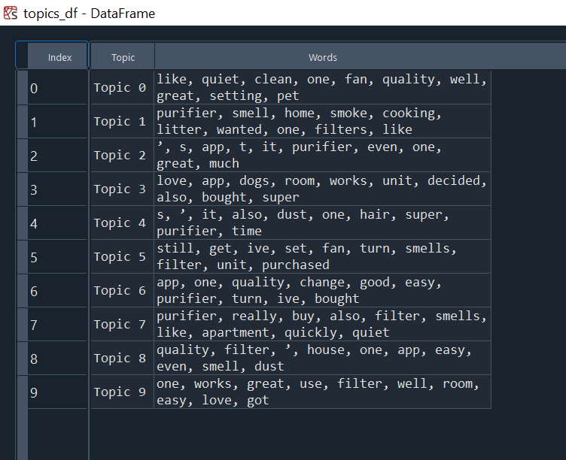
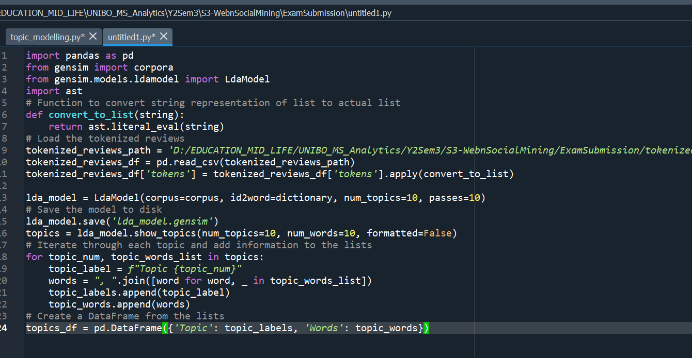
Topic Modelling-Latent Dirichlet Allocation

Slide 19
Sentiment Analysis, Model 2: Bidirectional Encoder Representations from Transformers

Slide 20
Sentiment Analysis (BERT)…
state-of-the-art natural language processing (NLP) model developed by Google's AI Research division (Google AI)
a pre-trained transformer model designed to understand the context and relationships between words in a sentence.
It learns bidirectional representations of text, meaning it considers both the left and right context of each word in a sequence

Slide 21
Sentiment Analysis (BERT)…
BERT is pre-trained on a massive corpus of text data, enabling it to learn rich, contextualized representations
excels at capturing complex language patterns, context, sarcasm, and sentiment expressed through long-range dependencies in text

Slide 22
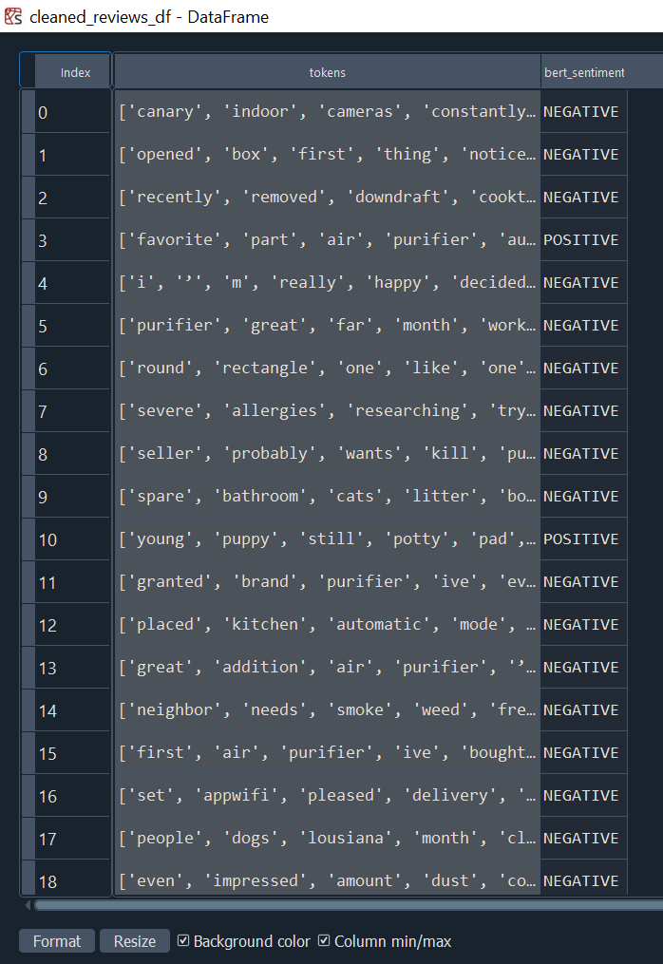
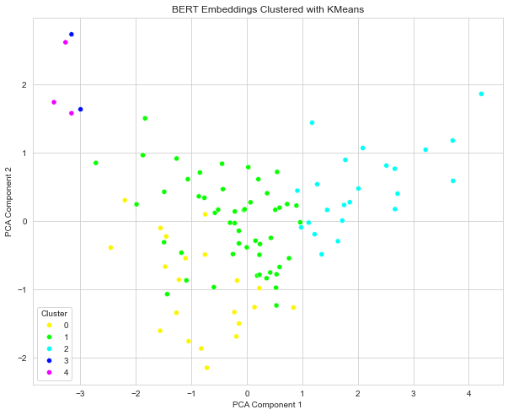
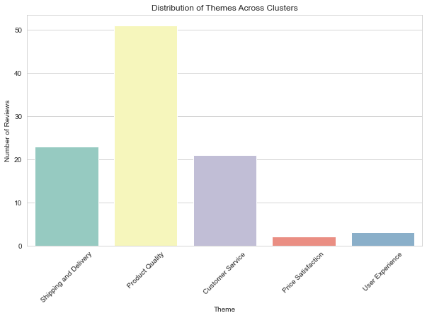
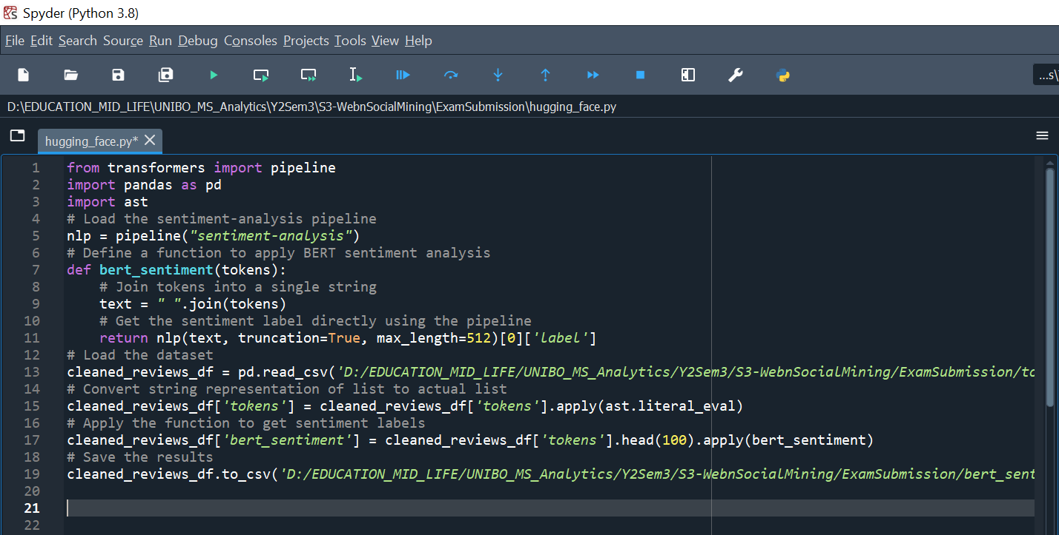
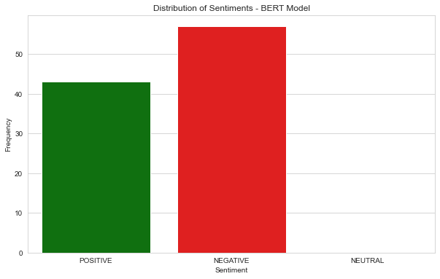
Sentiment Analysis (BERT)…

Slide 23
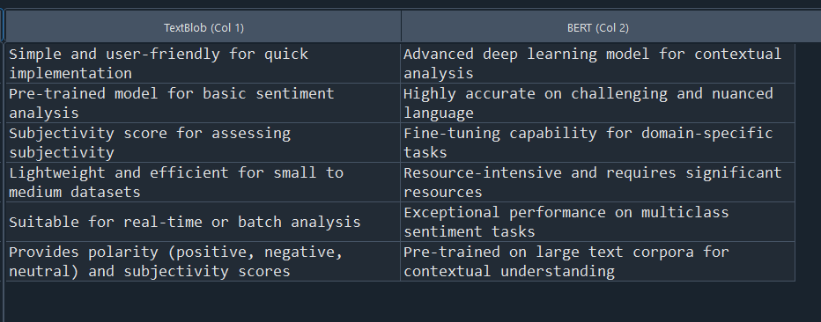
TextBox Vs BERT…

Slide 24
END
THANK YOU

