Slide 1




Slide 2

Facial Expression Recognition Model
Pattern Recognition Model using CNNs with FER-2013 Dataset
Name :- Ribhu Bhushan Tiwari
SAP ID :- 590011166
Batch :- B2
Submitted To :- Dr. Roohi Sille

Slide 3
Features of the Model
Uses CNN (Convolutional Neural Network) for high accuracy
Trained on FER-2013 dataset (Facial Expression Recognition)
Recognizes 7 emotions:
Angry, Disgust, Fear, Happy, Neutral, Sad, Surprise
Uses OpenCV for real-time face detection

Slide 4
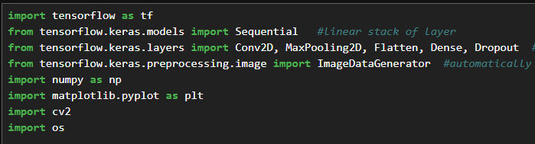
Step 1: Install Required Libraries
Ensure these libraries are installed:
pip install tensorflow keras opencv-python numpy matplotlib pandas scikit-learn

Slide 5
Step 2: Load Required Libraries
import tensorflow as tf
from tensorflow.keras.models import Sequential
from tensorflow.keras.layers import Conv2D, MaxPooling2D, Flatten, Dense, Dropout
import cv2, numpy as np, matplotlib.pyplot as plt

Slide 6

Step 3: Load & Preprocess FER-2013 Dataset
Download FER-2013 dataset from Kaggle and preprocess the images.
Use ImageDataGenerator for training and validation data generators.

Slide 7
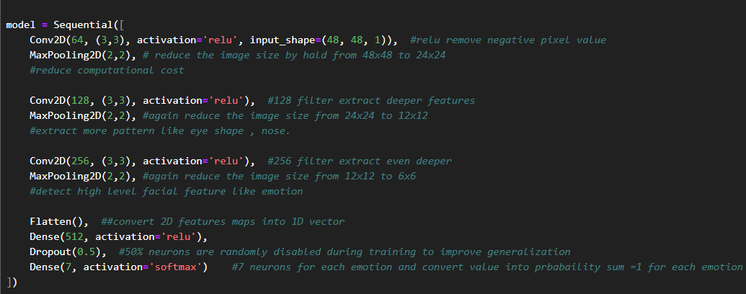
Step 4: Build the CNN Model
Define the CNN model using Conv2D, MaxPooling2D, Flatten, and Dense layers.
Use dropout regularization to prevent overfitting.

Slide 8
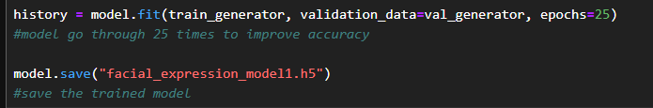
Step 5: Train the Model
Train the model using the train_generator and validate it with val_generator.
Save the trained model to 'facial_expression_model.h5'.

Slide 9

Step 6: Evaluate the Model
Evaluate the model on the validation set and print the accuracy.

Slide 10
Step 7: Real-Time Emotion Detection
Use OpenCV to capture video from the webcam.
Detect faces, preprocess the images, and predict emotions using the trained model.
Display the emotion label in real-time.

Slide 11
Results & Accuracy
Validation Accuracy: ~70-75%
Recognizes 7 emotions in real-time
Can be improved with more layers, dropout tuning, and more data augmentation

Slide 12
Conclusion
This model can be further optimized by tuning hyperparameters.
Deployment of the model as a web app can be done using Flask or FastAPI.

