Slide 1
Common Loss Functions in ML
Prof. Surender Varma, SOCS, UPES

Slide 2
Understanding Loss Functions in ML
Introduction
Mean Squared Error (MSE)
Mean Absolute Error (MAE)
Huber Loss
RMSE
Binary Cross-Entropy Loss (Log Loss)
Categorical Cross-Entropy Loss
Sparse Categorical Cross-Entropy Loss
Hinge Loss (SVM Loss)
Triplet Loss
Focal Loss
KL Divergence Loss
Choosing the Right Loss Function

Slide 3
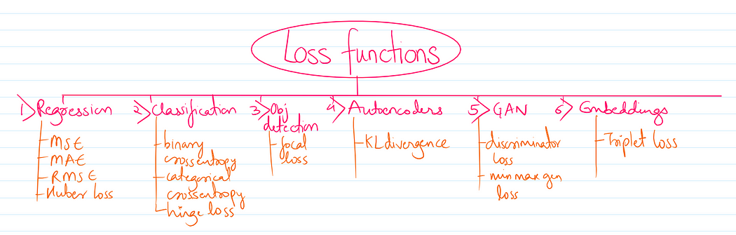

Slide 4
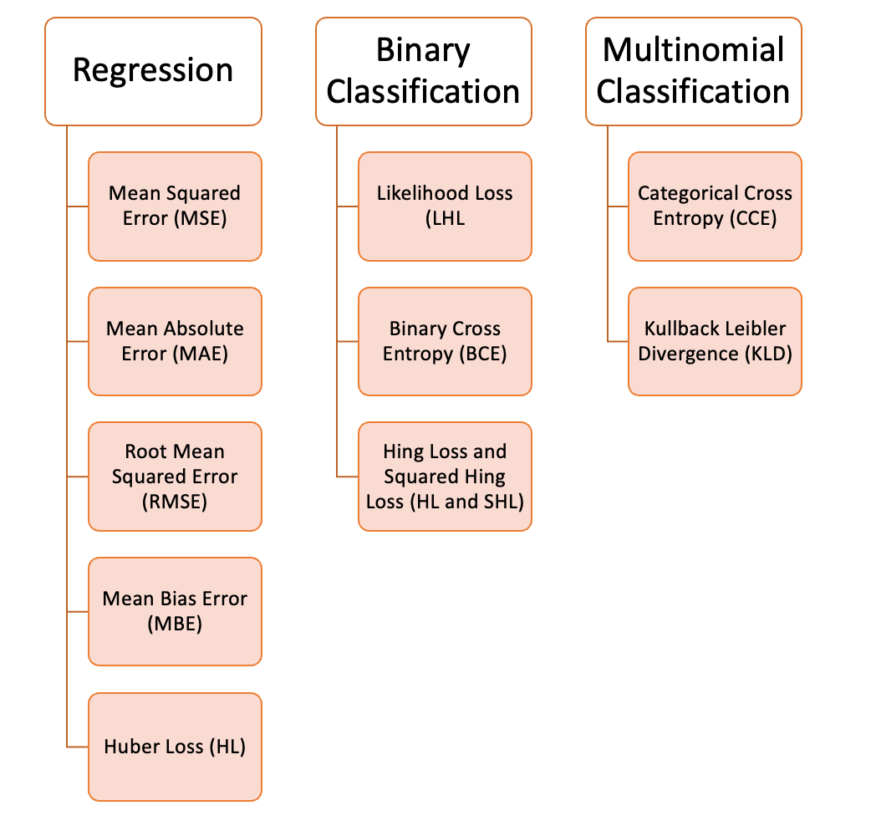

Slide 5
Introduction
Role in Model Training: Loss functions quantify model performance, guiding optimization processes to enhance predictive accuracy during training.
Task-Specific Selection: Selecting the correct loss function can significantly impact convergence rates and overall model efficacy for tasks.
Influence on Generalization: The chosen loss function affects how well a model generalizes to unseen data, impacting long-term effectiveness.

Slide 6

Mean Squared Error (MSE)
Definition of MSE: Mean Squared Error quantifies the average squared difference between predicted and actual values in predictions.
MSE Formula: The formula for MSE is represented as:
Applications and Sensitivity: Commonly applied in regression tasks, MSE's sensitivity to outliers can skew performance evaluation metrics.

Slide 7

Mean Absolute Error (MAE)
Mean Absolute Error Defined: MAE measures the average absolute difference between actual and predicted values, providing a clear error metric.
MAE Formula: The formula for Mean Absolute Error is MAE = (1/n) Σ |y_i - ŷ_i|, encapsulating its calculation.
Robustness and Applications: MAE's robustness to outliers makes it ideal for regression tasks where extreme values may distort results.

Slide 8
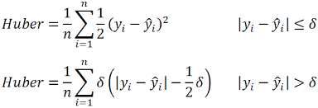
Huber Loss
Definition of Huber Loss: Huber Loss is a combination of MSE and MAE, handling outliers using a threshold parameter delta.
Applications of Huber Loss: Widely used in regression tasks within robust statistical modeling frameworks where noise is prevalent.
Comparison with MSE and MAE: Outperforms MSE in presence of outliers, yet retains smoothness advantages over MAE’s abrupt error changes.

Slide 9
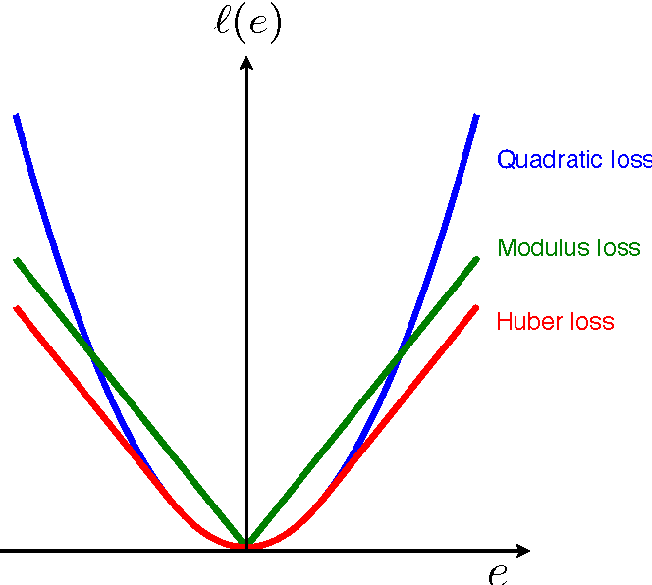
Plots of MSE, MAE, Huber

Slide 10
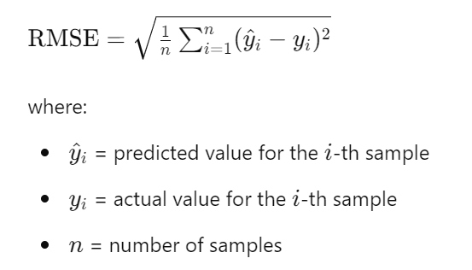
Root mean square error

Slide 11
Major Advantage:
1) RMSE is a smooth, continuous function that is differentiable, which is useful for optimization algorithms that rely on gradient-based methods.
2) Has the same unit of measurement as inputs.
Major Disadvantages of RMSE
Sensitivity to Outliers:
Due to the squaring of errors, just like MSE, RMSE is also highly sensitive to outliers. A few large errors can disproportionately affect the RMSE, potentially leading to a misrepresentation of model performance if outliers are not representative of the general data distribution.

Slide 12
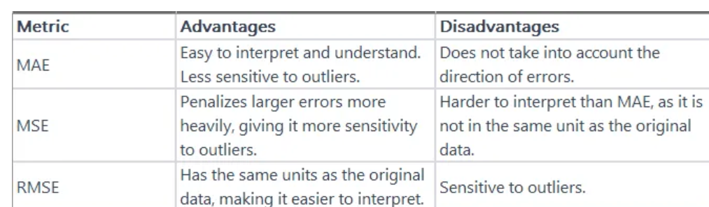

Slide 13
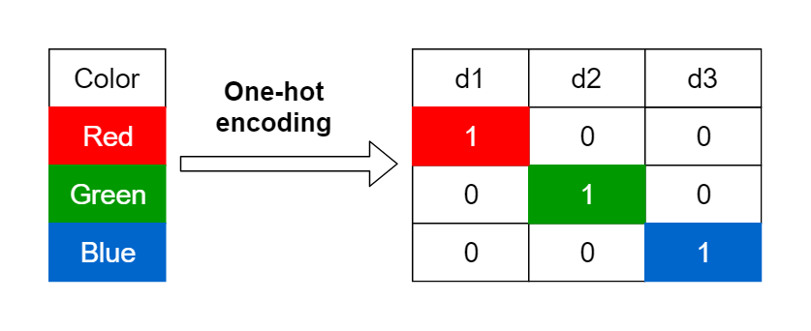
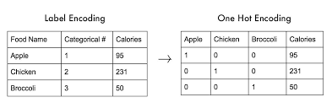
One-Hot-Encoding: Examples

Slide 14
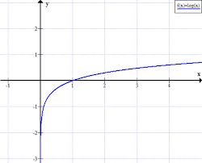
Why Logarithm?: The logarithm is used to measure how confident the model is about the correct class. If the probability is high (close to 1), the log value will be close to 0, resulting in a low loss. Conversely, if the probability is low, the log value will be a large negative number, resulting in a high loss.

Slide 15
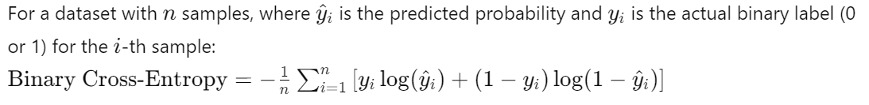
Binary Cross-Entropy Loss (Log Loss)
Definition of Binary Cross-Entropy: Binary Cross-Entropy quantifies the dissimilarity between true labels and predicted probabilities in binary classification.
Binary Cross-Entropy Formula:
Applications and Limitations: Used for binary classification tasks, it struggles with imbalanced datasets, influencing performance evaluation metrics.

Slide 16
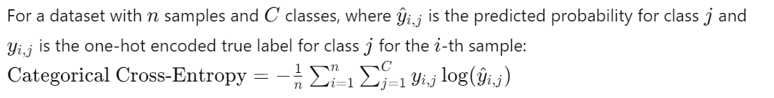
Categorical Cross-Entropy Loss
Categorical Cross-Entropy Overview: Measures performance in multi-class classification, facilitating evaluation of models predicting class probabilities.
Formula Representation:
Applications and Challenges: Utilized in image recognition and NLP tasks, its complexity can hinder interpretability and increase computational load.

Slide 17
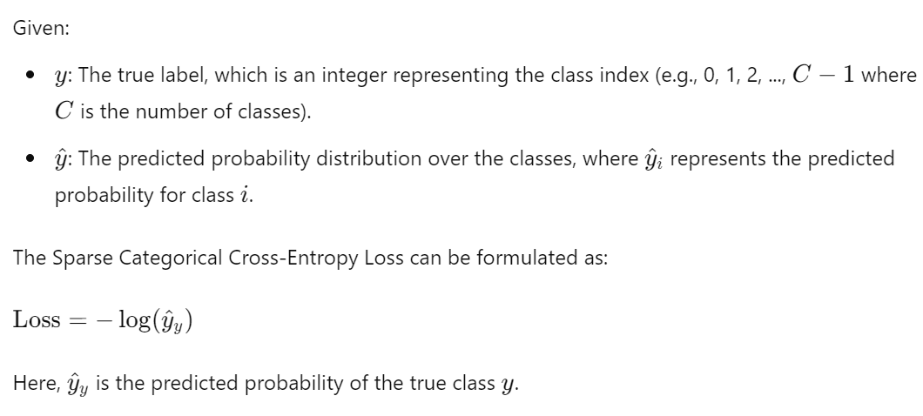
Sparse Categorical Cross-Entropy Loss
Definition of Sparse Categorical Cross-Entropy: Sparse Categorical Cross-Entropy Loss quantifies the difference between true integer labels and predicted class probabilities.
It's particularly useful in scenarios where the target labels are provided as integers rather than one-hot encoded vectors.
Formula for Sparse Categorical Cross-Entropy
Applications and Advantages: Ideal for multi-class tasks with integer labels, reducing memory usage, and simplifying training complexity effectively.

Slide 18
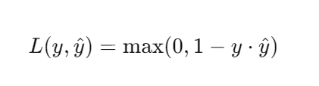
Hinge Loss (SVM Loss)
Hinge Loss Definition: Hinge Loss captures the maximum margin principle, particularly effective for training Support Vector Machines (SVMs).
Hinge Loss Formula:
Advantages and Limitations: While promoting margins, Hinge Loss can be sensitive to noise and lacks differentiability at zero boundaries.

Slide 19
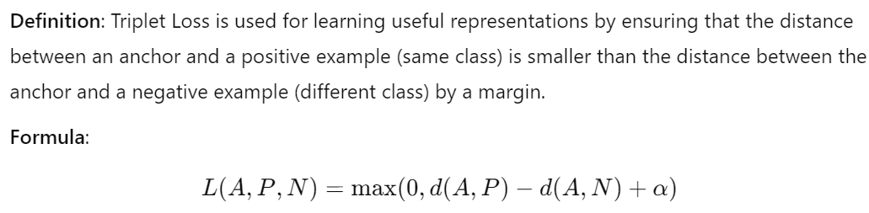
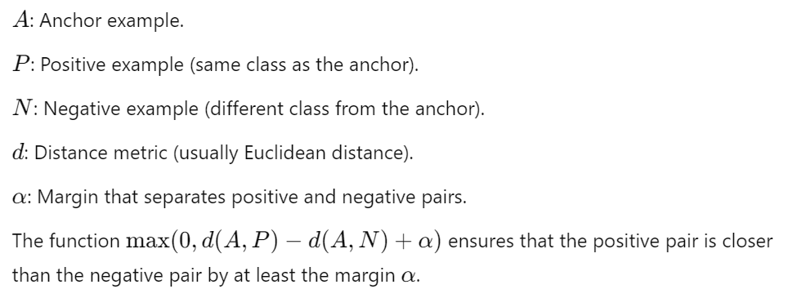
Triplet Loss
Triplet Loss: Triplet loss minimizes the distance between an anchor and positive while maximizing anchor-negative separation.

Slide 20
Triplet Loss Application
Applications in Face Recognition: Primarily used in face recognition, enhancing identity verification by structuring embeddings into distinct clusters.

Slide 21
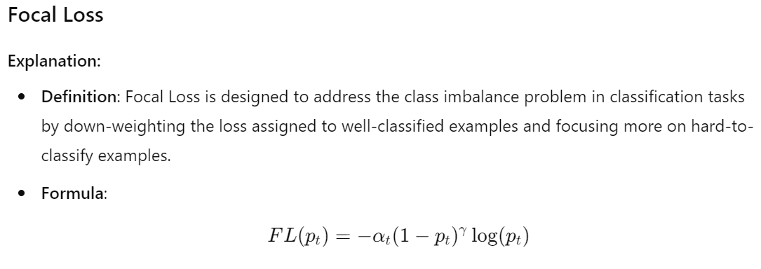
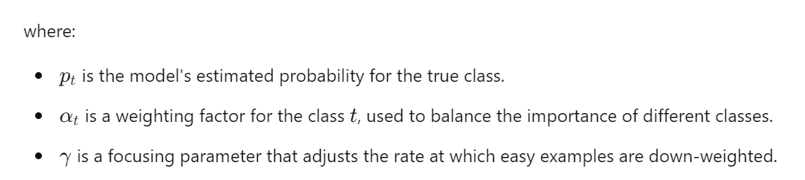
Focal Loss

Slide 22
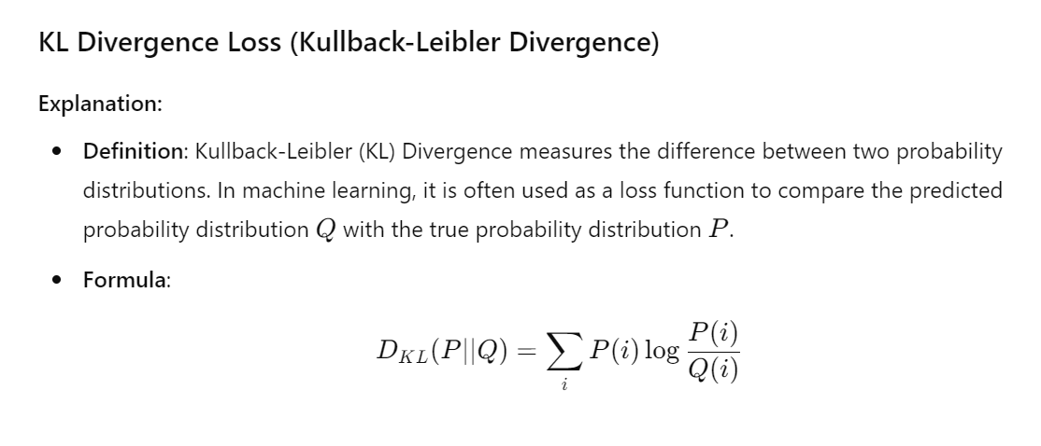
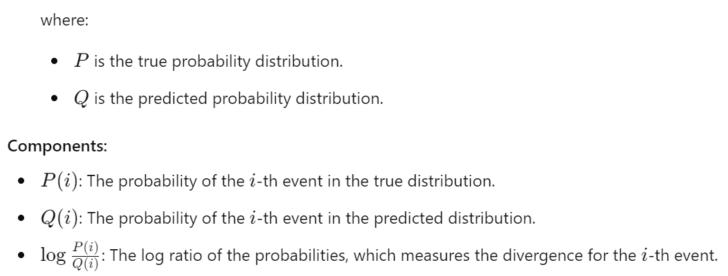

Slide 23
Choosing the Right Loss Function
Consider Problem Type: Choosing a loss function depends on whether the problem is regression, classification, or ranking based tasks
1
Outlier Sensitivity: Evaluate the chosen loss function's robustness against outliers to prevent distortion of model accuracy metrics.
2
Expected Output Characteristics: Understand output requirements such as probability distributions to appropriately select and tailor the loss function.
3

Slide 24
Summary
Loss functions in machine learning measure how well a machine learning model's predictions match the actual outcomes. They are essential for training models, as they guide the optimization process by quantifying prediction errors.
Choosing the right loss function depends on the problem type, the nature of the data, and the desired properties of the model's predictions.
Regression tasks often use MSE, MAE, or Huber Loss.
Classification tasks commonly use Binary Cross-Entropy for binary problems and Categorical Cross-Entropy for multi-class problems.
Specialized tasks might use Hinge Loss, KL Divergence, or Cosine Similarity based on specific needs.
Current Research: Deep Neural Network optimizations through innovative loss function designs tailored to specific applications.

