Slide 1
All About Data Handling From ML Perspective
Prof. Surender Varma, SOCS, UPES

Slide 2
Unit2: Data Handling
1. Data Collection
2. Data Cleaning
Handling Missing Data
Handling Outlier Data
Data Normalization
Statistical Interpolation of Data
3. Data Transformation
Feature Scaling
[Normalisation, Standadization]
Feature Encoding
Log Transform
Power Transform
4. Feature Engineering
5. Data Splitting
6. Handling of Imbalanced Data
Over Sampling and Undersampling
7. Feature Selection
8. Data Reduction
Dimensionality reduction,
feature selection
LDA, PCA
9. Data Augmentation
10. Data Storage

Slide 3
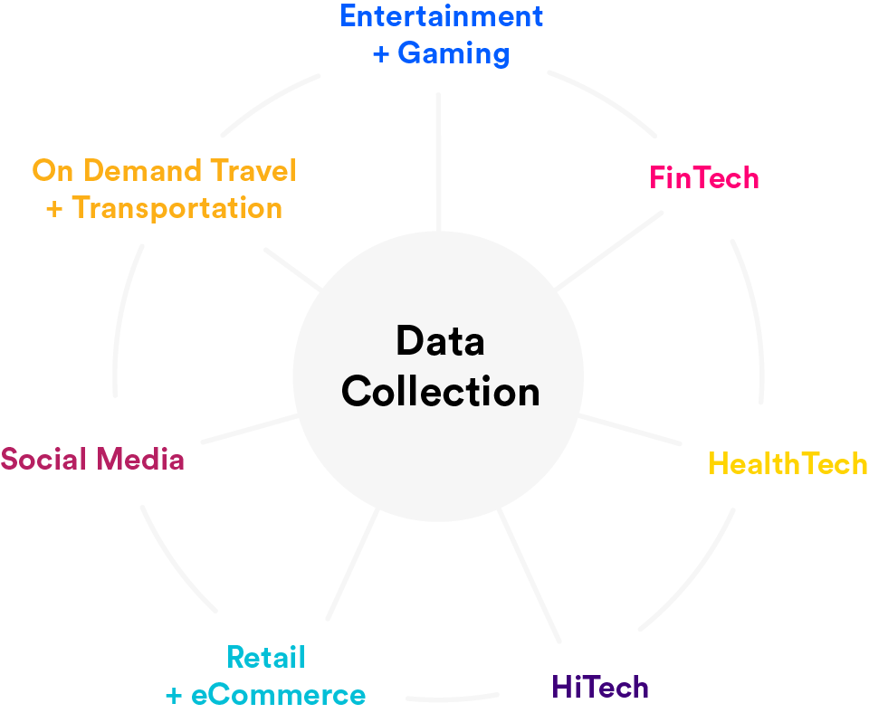
1. Data Collection
Identify Data Sources: Determine the sources from where the data will be collected (databases, APIs, web scraping, sensors, etc.).
Gather Data: Collect the data ensuring you have enough examples to train a robust model.

Slide 4
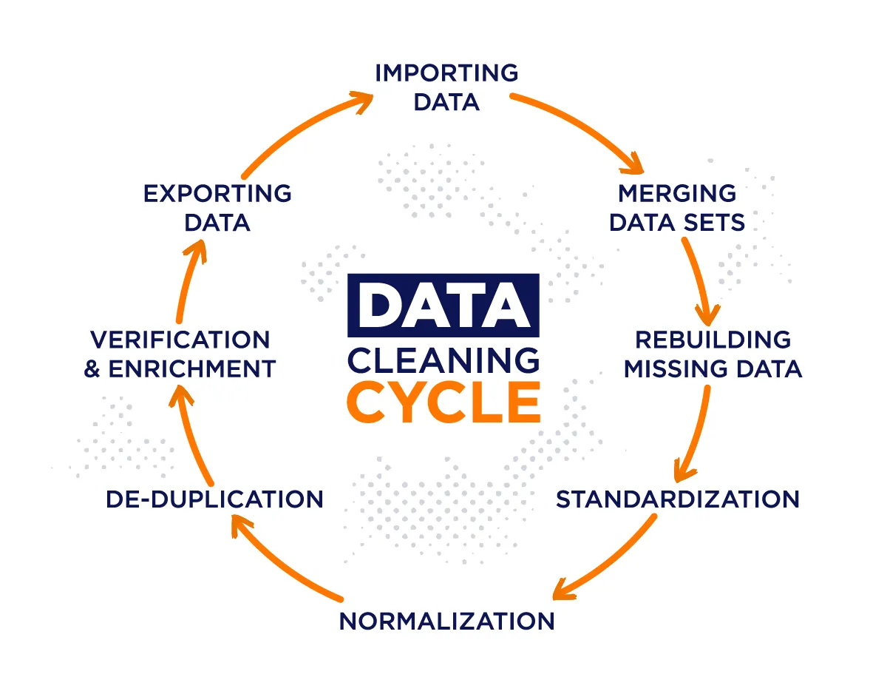
1. Data Cleaning
Remove Duplicates: Eliminate duplicate records to avoid redundancy.
Handle Missing Values: Impute missing values using strategies like mean/median imputation, forward/backward fill, or removing the records/columns with excessive missing values.
Correct Errors: Fix any errors in the data such as incorrect labels, out-of-range values, etc.
Data Cleaning Cycle

Slide 5
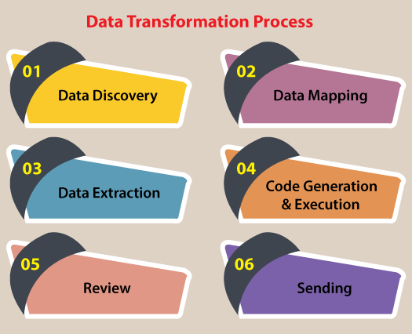
3. Data Transformation
3. Data Transformation
Data transformation refers to the process of changing the format, structure, or values of the data to make it suitable for analysis or modeling. This can involve various techniques to standardize, normalize, or otherwise modify the data.
The main goal is to ensure that the data is in a format that can be effectively utilized by machine learning algorithms.

Slide 6
Common Data Transformation Techniques:
Feature Scaling:
Adjusting the range of numerical features
(e.g., Normalisation, standardization).
Log Transformation:
Applying a logarithmic function to skewed data to reduce skewness.
Power Transformation:
Using transformations like Box-Cox or Yeo-Johnson to stabilize variance and make data more normal-distributed.
Encoding Categorical Variables:
Converting categorical data into numerical formats
(e.g., one-hot encoding, label encoding).

Slide 7
Feature Scaling
Feature Scaling is a technique to standardize the independent features present in the data in a fixed range. It is performed during the data pre-processing to handle highly varying magnitudes or values or units. If feature scaling is not done, then a machine learning algorithm tends to weigh greater values, higher and consider smaller values as the lower values, regardless of the unit of the values.
Normalization: Scale features to a range, typically [0, 1].
Standardization: Transform features to have zero mean and unit variance.

Slide 8
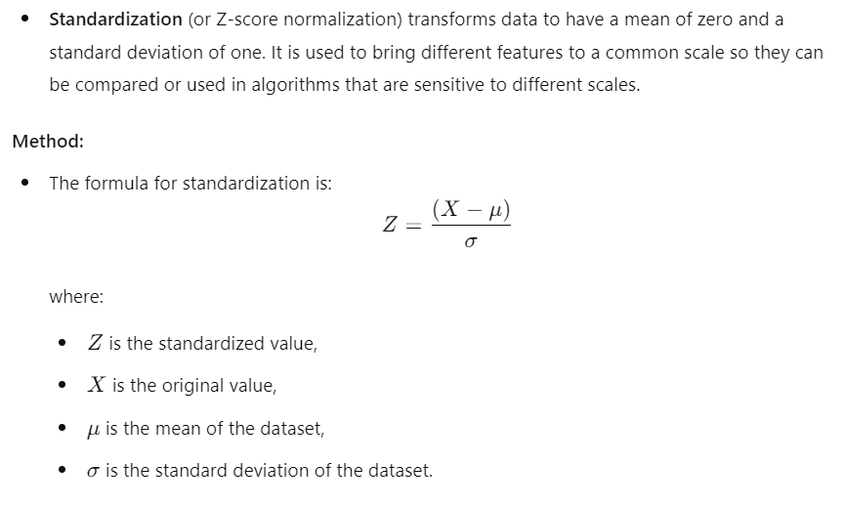
Feature Standardization
Data Standardization

Slide 9
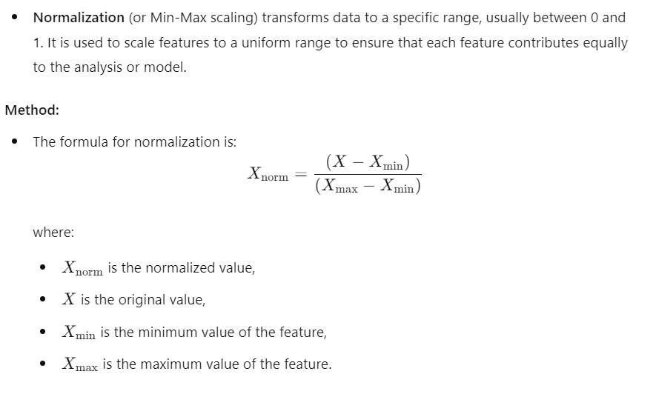
Feature Normalization
Data Normalization

Slide 10
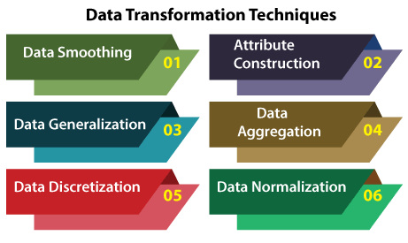
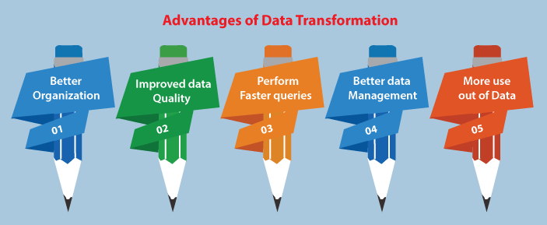
Data Transformation Techniques

Slide 11
4. Feature Engineering
Feature engineering is the process of creating new features or modifying existing ones to better capture the underlying patterns in the data. It involves transforming raw data into a more suitable format for the model. Feature engineering aims to improve the model’s ability to learn from the data and capture complex relationships.
Common Techniques for Feature Engineering
Creating Interaction Features: Generating new features based on the interaction between existing features (e.g., product of two features).
Binning: Converting continuous features into categorical bins (e.g., age ranges).
Polynomial Features: Adding polynomial terms to capture non-linear relationships.
Aggregation: Combining features to create new ones, often used in time series or grouped data.
Domain-Specific Features: Creating features based on domain knowledge or context
(e.g., creating a feature indicating whether a transaction amount is high or low).

Slide 12
Key Difference between Data Transformation and Feature Engineering
Data Transformation:
Focuses on preparing data to be in the right format
and scale for analysis or modeling.
Feature Engineering:
Focuses on creating or modifying features to enhance the
model’s performance and capture important patterns.
Data transformation and feature engineering often overlap.
For instance, feature engineering might involve transforming data
as part of creating new features
(e.g., applying a log transformation to a feature to reduce skewness).
Both processes are crucial for preparing data for machine learning and improving model performance.

Slide 13

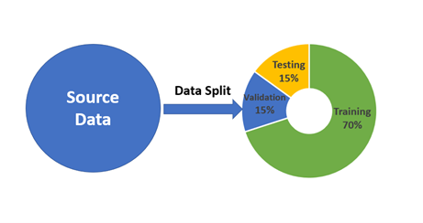
5. Data Splitting
Train-Test Split: Split the data into training and testing sets to evaluate the model's performance on unseen data.
Validation Set: Further split the training data into a training set and a validation set to tune hyperparameters and avoid overfitting.
Cross-Validation: Use k-fold cross-validation to make the best use of the data, especially when you have limited data.

Slide 14
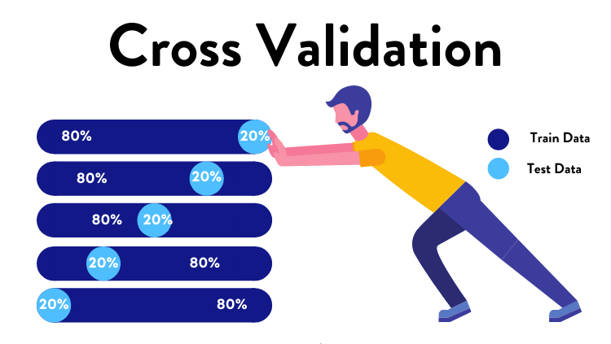
Cross-Validation

Slide 15
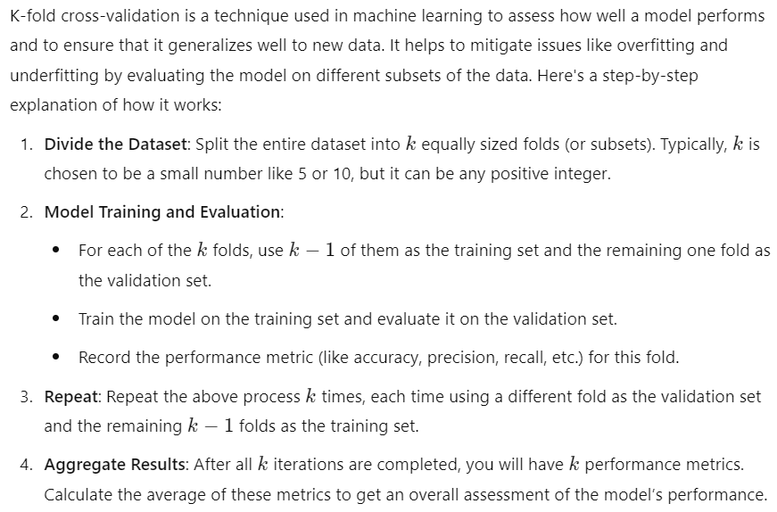
K-Fold Cross-Validation

Slide 16
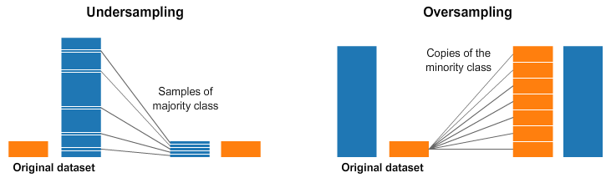
6. Handling imbalanced data
Resampling: Use techniques like oversampling the minority class (e.g., SMOTE) or undersampling the majority class.
Class Weighting: Assign different weights to classes to balance the influence of each class on the model training.

Slide 17
Consequences of Class Imbalance:
Poor Model Performance: Models may become biased towards the majority class, resulting in poor prediction performance for the minority class.
Misleading Accuracy: High accuracy can be misleading if the majority class is overrepresented. For instance, a model might achieve 95% accuracy by simply predicting the majority class all the time.
Inadequate Learning: The model might not learn to recognize the minority class well enough, leading to high false negatives for the minority class.

Slide 18
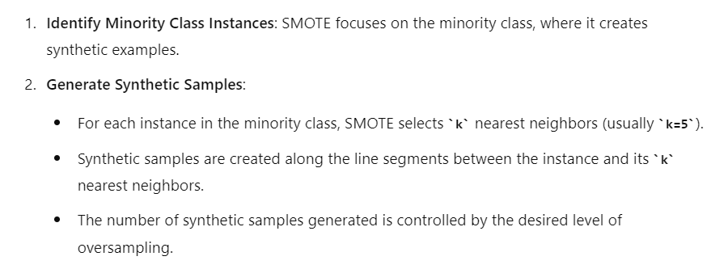
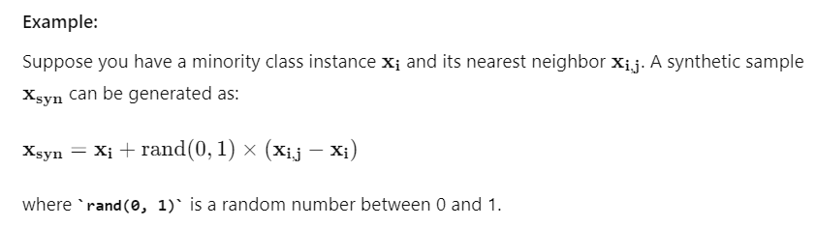
SMOTE Technique
SMOTE (Synthetic Minority Over-sampling Technique) is a popular method used to address class imbalance by generating synthetic samples for the minority class

Slide 19
SMOTE stands for:
Synthetic Minority Oversampling Technique
It is a technique designed by Hall et. al in 2002.
SMOTE is an oversampling method that synthesizes new plausible examples in the minority class.
SMOTE not only increases the size of the training set, it also increases the variety!!
SMOTE currently yields the best results as far as re-sampling and modifying the probabilistic estimate techniques go (Chawla, 2003).
19
Notes:
Random oversampling just
Increases the size of the training data set through repetition of the original examples.
It does not cause any increase in the variety of training examples.
SMOTE not only increases the size of the training data set, it also increases the variety.
SMOTE creates new (artificial) training examples based on the original training examples.
Tomek Links is an undersampling technique
Some techniques combine SMOTE and Tomek Links to create a hybrid technique that uses both Oversampling and Undersampling
For an imbalanced dataset, first SMOTE is applied to create new synthetic minority samples to get a balanced distribution.
SMOTE yields excellent results for many problems

Slide 20
SMOTE’s Informed Oversampling Procedure
For each Minority Sample
Find its k-nearest minority neighbors
Randomly select j of these neighbors
Randomly generate synthetic samples along the lines joining the minority sample and its j selected neighbors
(j depends on the amount of oversampling desired)
For instance, if it sees two examples (of the same class) near each other, it creates a third artificial one, in the middle of the original two.
20
Notes:
https://www.analyticsvidhya.com/blog/2020/10/overcoming-class-imbalance-using-smote-techniques/

Slide 21
SMOTE
Synthetic Minority Oversampling Technique (SMOTE)
Find its k-nearest minority neighbors
Randomly select j of these neighbors
Randomly generate synthetic samples
along the lines joining the minority
sample and its j selected neighbors
21
Notes:
Find its k-nearest minority neighbors
Randomly select j of these neighbors
The newly generated sample resembles and inherits characteristics of its neighbors

Slide 22
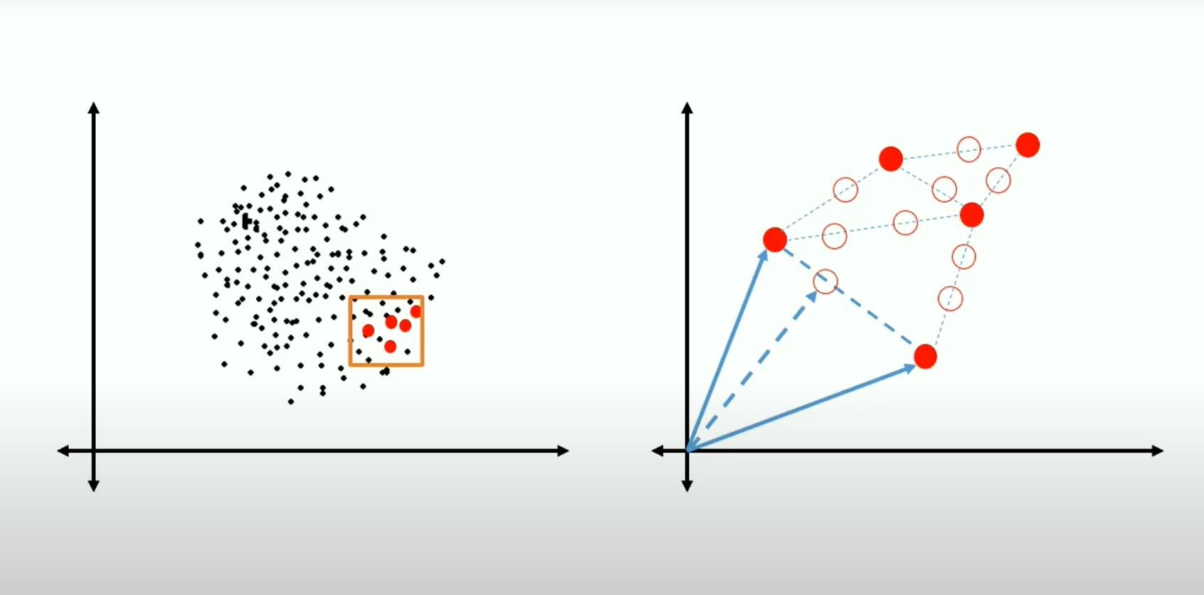
SMOTE
Synthetic minority oversampling technique (SMOTE)
Randomly generate synthetic samples along the lines joining the minority sample and its j selected neighbors
22
Notes:
Find its k-nearest minority neighbors
Randomly select j of these neighbors

Slide 23
SMOTE’s Shortcomings
Overgeneralization
SMOTE’s procedure may blindly generalizes the minority area without regard to the majority class.
It may oversample noisy samples
It may oversample uninformative samples
Lack of Flexibility
The number of synthetic samples generated by SMOTE is fixed in advance, thus not allowing for any flexibility in the re-balancing rate.
It would be nice to increase the minority class just to the right value (i.e., not excessive) to avoid the side affects of unbalanced datasets
23
Notes:
While generating synthetic examples,
SMOTE does not take into consideration neighboring examples can be from other classes.
This can increase the overlapping of classes and can introduce additional noise.
SMOTE is a static procedure and that is why is lacks flexibility

Slide 24
6. Handling Imbalanced Data
Resampling: Use techniques like oversampling the minority class (e.g., SMOTE) or undersampling the majority class.
Class Weighting: Assign different weights to classes to balance the influence of each class on the model training.
7. Feature Selection
Remove Unnecessary Features: Drop features that do not contribute to the model performance.
Use Algorithms: Employ algorithms (like LASSO, Decision Trees) that help in selecting important features.
Correlation Analysis: Remove highly correlated features to reduce multicollinearity.

Slide 25
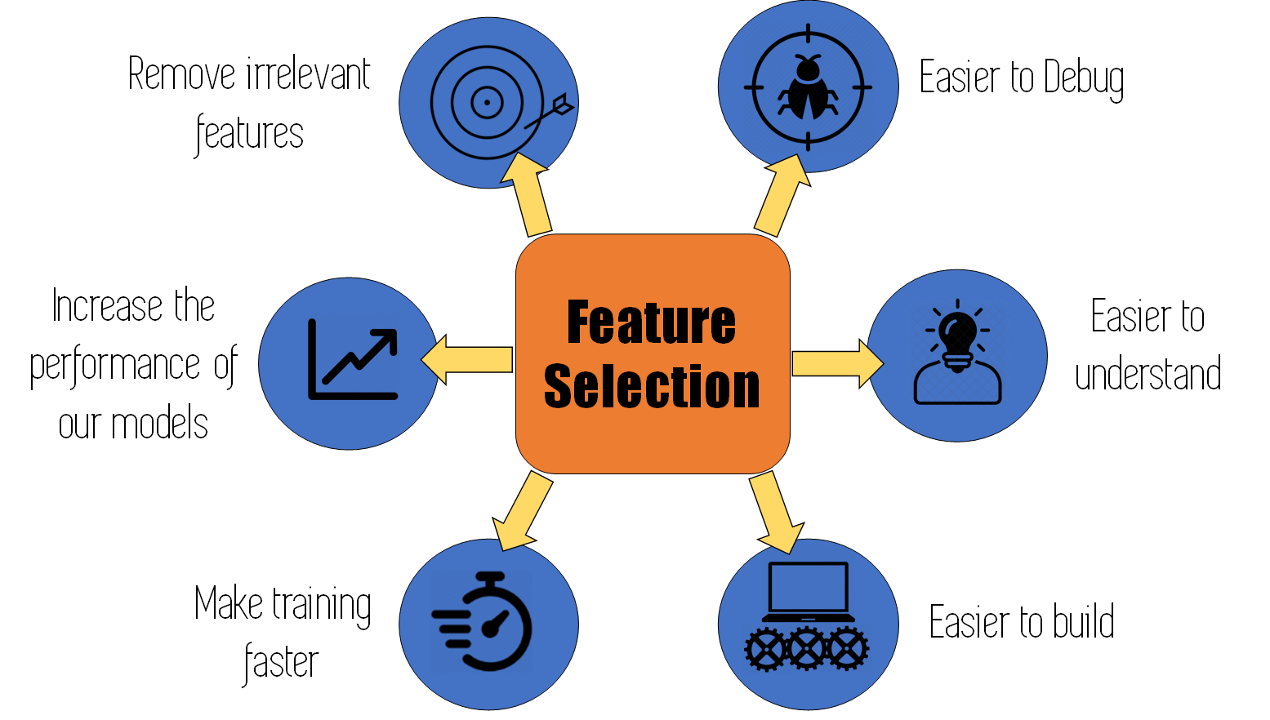
7. Feature Selection
Remove Unnecessary Features: Drop features that do not contribute to the model performance.
Use Algorithms: Employ algorithms (like LASSO, Decision Trees) that help in selecting important features.
Correlation Analysis: Remove highly correlated features to reduce multicollinearity.
Figure 8: Feature Selection

Slide 26
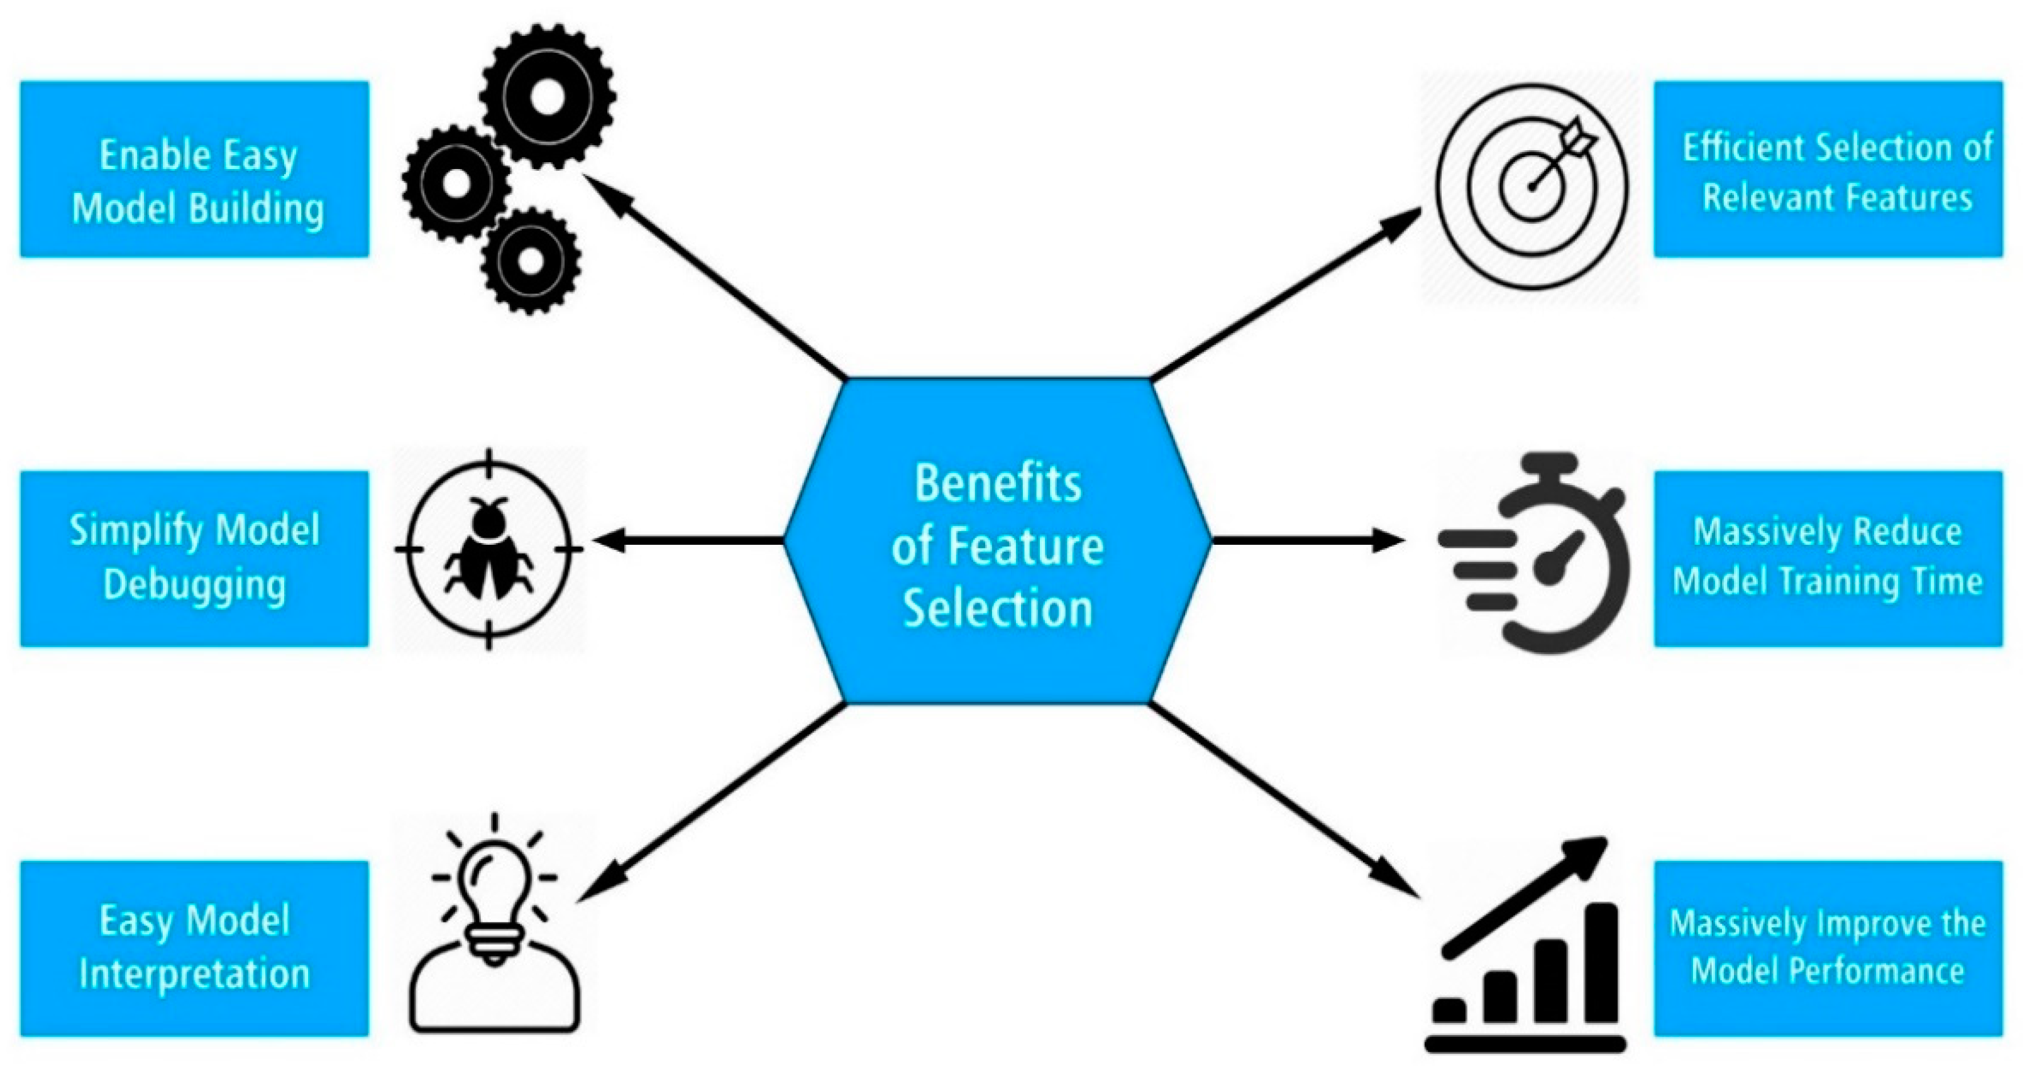
Benefit of Feature Selection

Slide 27
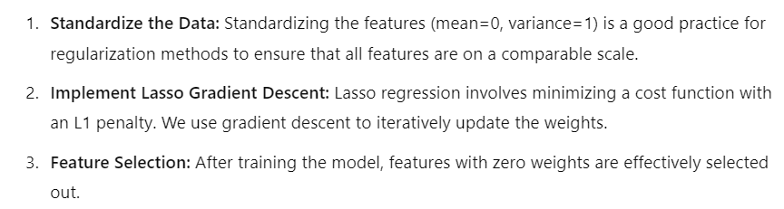
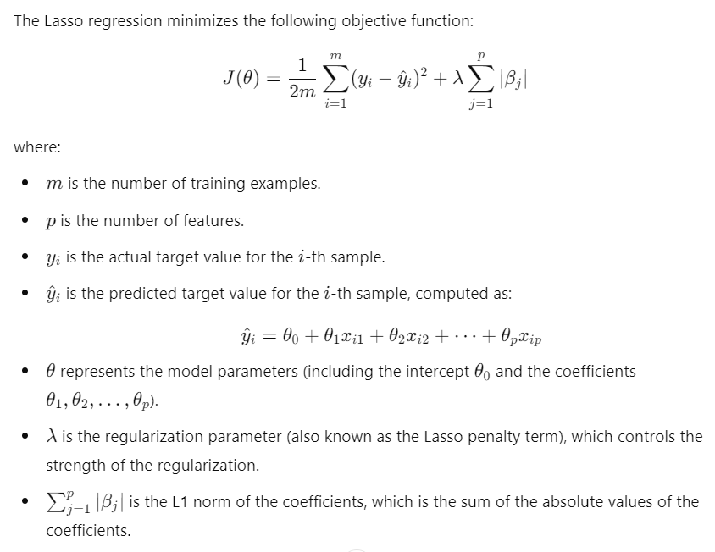
Feature Selection: Lasso

Slide 28
Feature Selection: Decision Trees
Decision trees, as well as tree-based ensemble methods like
Random Forests and Gradient Boosting, provide feature importance scores after training.
These scores indicate how much each feature contributes
to the predictive power of the model.
#Initialise data X and Y
X = data.data
y = data.target
# Initialize and train the decision tree classifier
clf = DecisionTreeClassifier()
clf.fit(X, y)
# Retrieve feature importances
importances = clf.feature_importances_
# Create a DataFrame to display feature importance
feature_names = data.feature_names
importance_df = pd.DataFrame({'Feature': feature_names, 'Importance': importances})
# Sort and display features by importance
importance_df = importance_df.sort_values(by='Importance', ascending=False)
print(importance_df)
Experiment with Scikit-learn:
1) Train Your Decision Tree: Fit a decision tree model to your data.
2) Retrieve Feature Importances: Access the feature_importances_ attribute to get the importance scores.

Slide 29
Feature Selection: Decision Trees
A Decision Tree (DT) defines a hierarchy of rules to make a prediction
Root and internal nodes test rules. Leaf nodes make predictions
Decision Tree (DT) learning is about learning such a tree from labeled data
Root Node
Body
temp.
Warm
Cold
Non-mammal
An Internal Node
A Leaf Node
Gives
birth
Yes
No
Mammal
Non-mammal

Slide 30
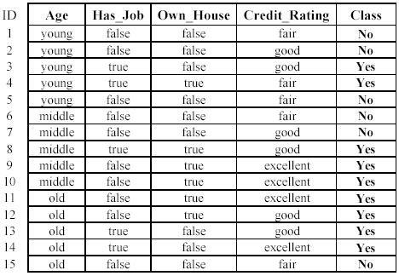
Decision Trees: Example
Loan approval prediction

Slide 31


The basic idea is very simple
Recursively partition the training data into homogeneous regions
Within each group, fit a simple supervised learner (e.g., predict the majority label)
What do you mean by “homogeneous” regions?
Even though the rule within each group is simple, we are able to learn a fairly sophisticated model overall (note in this example, each rule is a simple horizontal/vertical classifier but the overall decision boundary is rather sophisticated)
A homogeneous region will have all (or a majority of) training inputs with the same/similar outputs

Slide 32


Decision Trees for Classification
Test input
5
NO
YES
$$x_{1}>3.5 ?$$
4
NO
YES
NO
YES
3
$$x_{2}>2 ?$$
$$x_{2}>3 ?$$
Feature 2 ($x_{2})$
2
Predict Red
Predict Green
Predict Green
Predict Red
1
1
2
3
4
5
6
Feature 1 ($x_{1})$
Remember: Root node contains all training inputs
Each leaf node receives a subset of training inputs
DT is very efficient at test time: To predict the label of a test point, nearest neighbors will require computing distances from 48 training inputs. DT predicts the label by doing just 2 feature-value comparisons! Way faster!

Slide 33
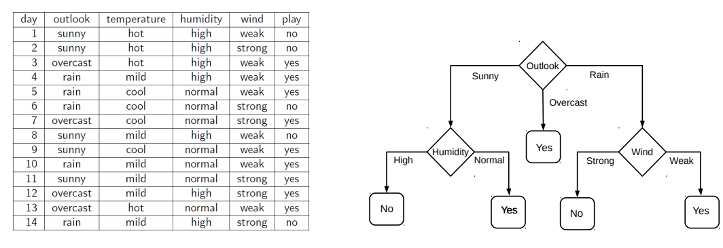
Decision Tree Construction: An Example
Let’s consider the playing Tennis example
Assume each internal node will test the value of one of the features
Question: Why does it make more sense to test the feature “outlook” first?
Answer: Of all the 4 features, it’s the most informative
It has the highest information gain as the root node

Slide 34
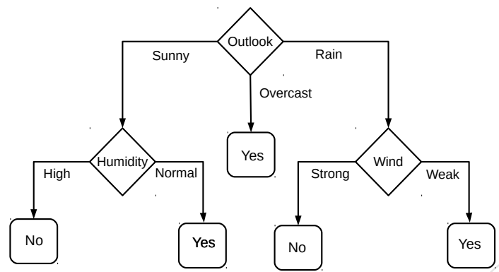
Decision Trees for Classification
Deciding whether to play or not to play Tennis on a Saturday
Each input (Saturday) has 4 categorical features: Outlook, Temp., Humidity, Wind
A binary classification problem (play vs no-play)

Slide 35
Building Decision Trees
Usually, cross-validation can be used to decide size/shape
What should be the size/shape of the DT?
Number of internal and leaf nodes
Branching factor of internal nodes
Depth of the tree
Split criterion at internal nodes
Use another classifier?
Or maybe by doing a simpler test?
What to do at the leaf node? Some options:
Make a constant prediction for each test input reaching there
Use a nearest neighbor based prediction using training inputs at that leaf node
Train and predict using some other sophisticated supervised learner on that node
Usually, constant prediction at leaf nodes used since it will be very fast

Slide 36
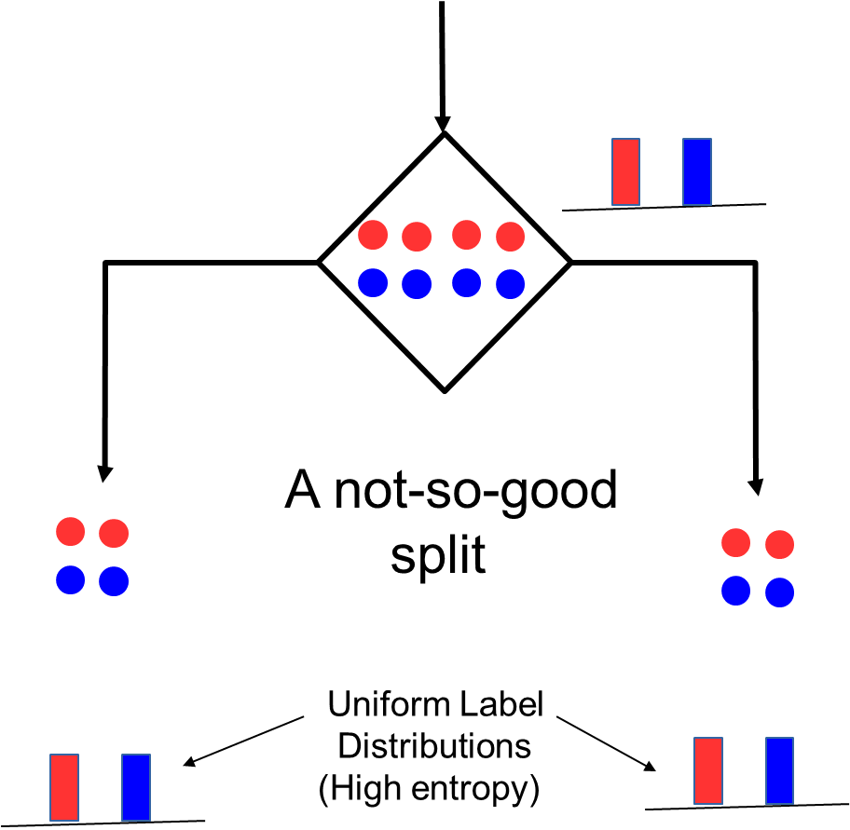
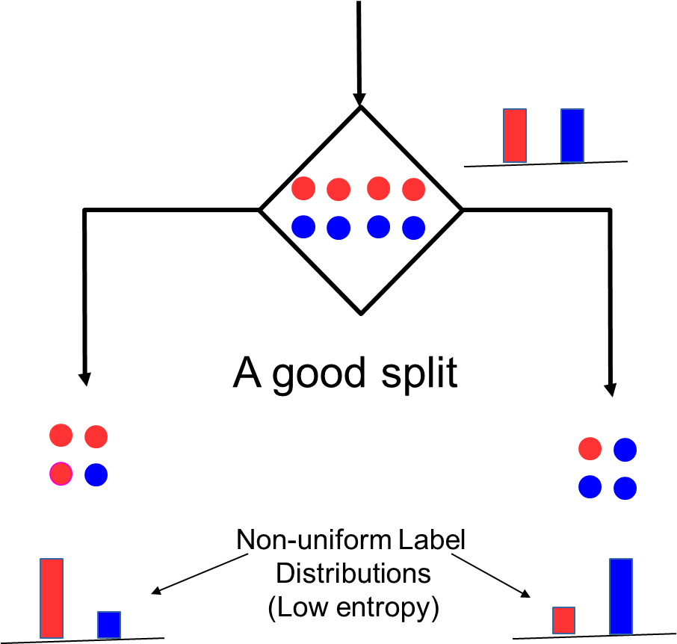
How to Split at Internal Nodes?
Recall that each internal node receives a subset of all the training inputs
Regardless of the criterion, the split should result in as “pure” groups as possible
A pure group means that the majority of the inputs have the same label/output
For classification problems (discrete outputs), entropy is a measure of purity
Low entropy ⇒ high purity (less uniform label distribution)
Splits that give the largest reduction (before split vs after split) in entropy are preferred
(this reduction is also known as “information gain”)

Slide 37
Decision Tree for PlayTennis
Outlook
Sunny
Overcast
Rain
Humidity
Each internal node tests an attribute
High
Normal
Each branch corresponds to an
attribute value node
No
Yes
Each leaf node assigns a classification

Slide 38
Outlook Temperature Humidity Wind PlayTennis
Sunny Hot High Weak
No
Outlook
Sunny
Overcast
Rain
Humidity
Yes
Wind
High
Normal
Strong
Weak
No
Yes
No
Yes

Slide 39
Advantages of decision trees
explicit relationship among features
human interpretable model
Simple computation and inference

Slide 40
Training a decision tree (algorithm ID3)
A ← the “best” decision attribute for next node
Assign A as decision attribute for node
For each value of A create new descendant
Sort training examples to leaf node according to
the attribute value of the branch
If all training examples are perfectly classified (same value of target attribute) stop, else iterate over new leaf nodes.

Slide 41
Which Attribute is ”best”?
[29+,35-]
[29+,35-]
A₁=?
A₂=?
True
False
True
False
[21+, 5-]
[8+, 30-]
[18+, 33-]
[11+, 2-]

Slide 42
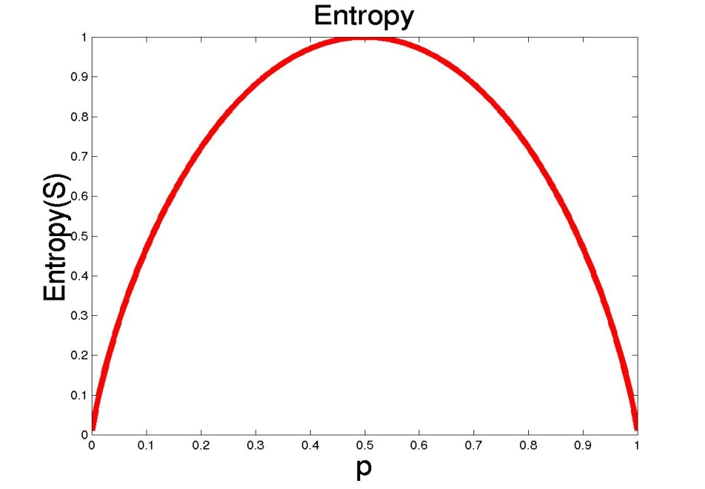
Entropy
S is a sample of training examples
p₊ is the proportion of positive examples
p₋ is the proportion of negative examples
Entropy measures the impurity of S
Entropy(S) = -p₊ log₂ p₊ - p₋ log₂ p₋

Slide 43
Information Gain
Gain(S,A): expected reduction in entropy due to sorting S on attribute A
Gain(S,A)=Entropy(S) - ∑_{v∈values(A)} |S_{v}|/|S| Entropy(S_{v})
Entropy([29+,35-]) = -29/64 log₂ 29/64 – 35/64 log₂ 35/64
= 0.99
[29+,35-]
A₁=?
A₂=?
[29+,35-]
True
False
True
False
[21+, 5-]
[8+, 30-]
[18+, 33-]
[11+, 2-]

Slide 44
Information Gain
Entropy([21+,5-]) = 0.71
Entropy([8+,30-]) = 0.74
Gain(S,A₁)=Entropy(S)
-26/64*Entropy([21+,5-])
-38/64*Entropy([8+,30-])
=0.27
Entropy([18+,33-]) = 0.94
Entropy([8+,30-]) = 0.62
Gain(S,A₂)=Entropy(S)
-51/64*Entropy([18+,33-])
-13/64*Entropy([11+,2-])
=0.12
[29+,35-]
A₁=?
A₂=?
[29+,35-]
True
False
True
False
[21+, 5-]
[8+, 30-]
[18+, 33-]
[11+, 2-]

Slide 45
Training Examples
Day
Outlook
Temp.
Humidity
Wind
Play Tennis
D1
Sunny
Hot
High
Weak
No
D2
Sunny
Hot
High
Strong
No
D3
Overcast
Hot
High
Weak
Yes
D4
Rain
Mild
High
Weak
Yes
D5
Rain
Cool
Normal
Weak
Yes
D6
Rain
Cool
Normal
Strong
No
D7
Overcast
Cool
Normal
Weak
Yes
D8
Sunny
Mild
High
Weak
No
D9
Sunny
Cool
Normal
Weak
Yes
D10
Rain
Mild
Normal
Strong
Yes
D11
Sunny
Mild
Normal
Strong
Yes
D12
Overcast
Mild
High
Strong
Yes
D13
Overcast
Hot
Normal
Weak
Yes
D14
Rain
Mild
High
Strong
No

Slide 46
Selecting the Next Attribute
S=[9+,5-]
E=0.940
S=[9+,5-]
E=0.940
Humidity
Wind
High
Normal
Weak
Strong
[3+, 4-]
[6+, 1-]
[6+, 2-]
[3+, 3-]
E=0.592
E=0.811
E=0.985
E=1.0
Gain(S,Humidity)
=0.940-(7/14)*0.985
– (7/14)*0.592
=0.151
Gain(S,Wind)
=0.940-(8/14)*0.811
– (6/14)*1.0
=0.048

Slide 47
Selecting the Next Attribute
S=[9+,5-]
E=0.940
Outlook
Over
cast
Sunny
Rain
[2+, 3-]
[4+, 0]
[3+, 2-]
E=0.971
E=0.0
E=0.971
Gain(S,Outlook)
=0.940-(5/14)*0.971
-(4/14)*0.0 – (5/14)*0.0971
=0.247

Slide 48
ID3 Algorithm
[D1,D2,…,D14]
[9+,5-]
Outlook
Sunny
Overcast
Rain
S_{sunny}=[D1,D2,D8,D9,D11]
[2+,3-]
[D3,D7,D12,D13]
[4+,0-]
[D4,D5,D6,D10,D14]
[3+,2-]
?
Yes
?
Gain(S_{sunny} , Humidity)=0.970-(3/5)0.0 – 2/5(0.0) = 0.970
Gain(S_{sunny} , Temp.)=0.970-(2/5)0.0 –2/5(1.0)-(1/5)0.0 = 0.570
Gain(S_{sunny} , Wind)=0.970= -(2/5)1.0 – 3/5(0.918) = 0.019

Slide 49
Converting a Tree to Rules
Outlook
Sunny
Overcast
Rain
Humidity
Yes
Wind
High
Normal
Strong
Weak
No
Yes
No
Yes
R₁: If (Outlook=Sunny) ∧ (Humidity=High) Then PlayTennis=No
R₂: If (Outlook=Sunny) ∧ (Humidity=Normal) Then PlayTennis=Yes
R₃: If (Outlook=Overcast) Then PlayTennis=Yes
R₄: If (Outlook=Rain) ∧ (Wind=Strong) Then PlayTennis=No
R₅: If (Outlook=Rain) ∧ (Wind=Weak) Then PlayTennis=Yes

Slide 50
SUMMARY OF DECISION TRESS
We use IG or Ginni index as decision criteria to choose nodes. Attribute with the highest information gain or Lowest Gini Index is typically chosen for the split.
ID3 is one algorithm, to construct a decision tree by selecting attributes that maximize Information Gain, recursively partitioning the dataset, and building nodes for each attribute until a stopping condition is reached.

Slide 51
Here are the common stopping conditions used:
1. All Instances Have the Same Class
If all the instances in a subset SSS belong to the same class, then the subset is homogeneous, and no further splitting
is needed. The node can be assigned the class label of the instances in this subset.
2. No More Attributes to Split On
If there are no more attributes available to split on, then the tree can no longer be expanded based on attributes.
In this case, you may assign the most frequent class in the current subset as the label for that node.
3. Minimum Node Size
If a node reaches a size below a certain threshold (e.g., a minimum number of instances), the node might be assigned
a class label. This helps avoid overfitting by not creating overly specific splits that might not generalize well.
4. Maximum Tree Depth
A predetermined maximum depth of the tree might be set to limit the growth of the tree. This helps in controlling the complexity of the model and prevents overfitting by restricting how deep the tree can grow.
5. Threshold for Information Gain or Gini Index
In some implementations, if the improvement in Information Gain (or reduction in Gini Index) falls below a certain threshold, the splitting process is stopped. This indicates that further splits might not provide significant benefits in terms of classification accuracy.
6. Impurity Below Threshold
If the impurity (Gini Index or entropy) of the dataset after a split falls below a certain threshold, the node might be considered pure enough, and further splitting might be halted.
7. Insufficient Data
If the subset of data at a node is too small (e.g., less than a certain number of examples), it might be impractical to split further. In such cases, the node is assigned a class based on the majority class of the small subset.

Slide 52
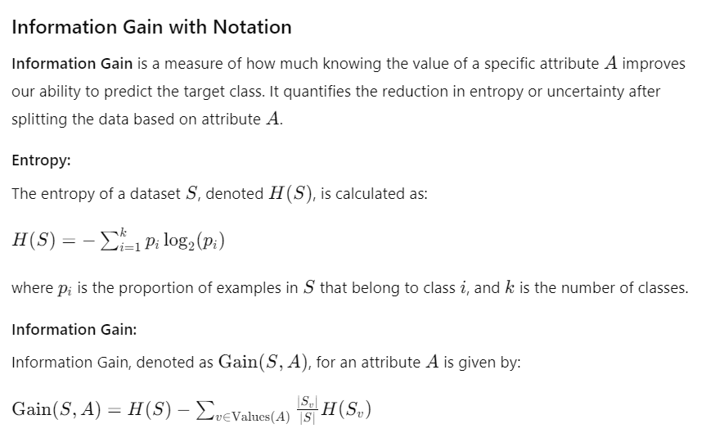
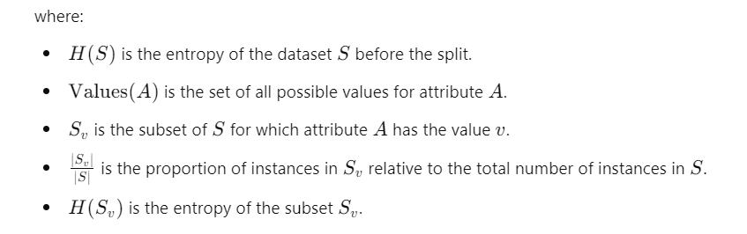
The Information Gain measures the expected reduction in entropy. Entropy measures impurity in the data and information gain measures reduction in impurity in the data. The feature which has minimum impurity will be considered as the root node.

Slide 53
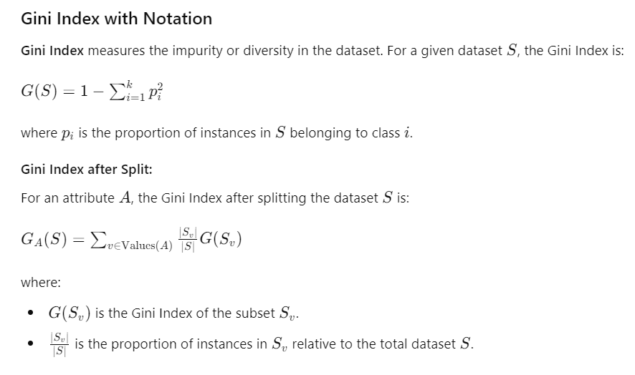

Slide 54
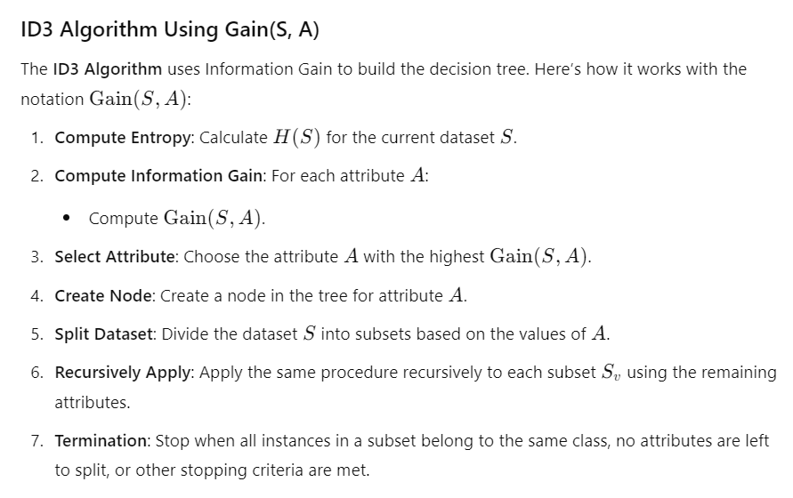

Slide 55
Feature Selection: Decision Trees
How exactly decision trees can be used for feature selection?
Decision Tress quite effective for feature selection due to their ability to handle both categorical and numerical data and their inherent ability to measure the importance of features.
Here’s how:
Feature Importance Scores: Decision trees assign importance scores to each feature based on how well they split the data. Features that lead to better splits (i.e., higher reduction in impurity) are deemed more important. You can use these scores to rank features and select the most important ones.
Recursive Feature Elimination: You can use decision trees in a recursive feature elimination (RFE) approach. This involves iteratively training a decision tree, removing the least important features, and re-evaluating until you reach a desired number of features.
Tree-Based Models: More advanced models like Random Forests and Gradient Boosting Machines, which are ensembles of decision trees, also provide feature importance measures. These models aggregate the importance scores from multiple trees to give a more robust estimate of feature relevance.

Slide 56
9. Data Augmentation
Generate New Data: For image, text, or audio data, create variations of existing data to increase the dataset size.
In machine learning, data augmentation is a common method for manipulating existing data to artificially increase the size of a training dataset. In an attempt to enhance the efficiency and flexibility of machine learning models, data augmentation looks for the boost in the variety and volatility of the training data.
Data augmentation can be especially beneficial when the original set of data is small as it enables the system to learn from a larger and more varied group of samples.
Types of Data Augmentation: Techniques for data augmentation can be used with a variety of data kinds, including time series, text, photos, and audio. Here are a few frequently used methods of data augmentation for image data:
Images can be rotated at different angles and flipped horizontally or vertically to create alternative points of view.

Slide 57
Random cropping and padding: By applying random cropping or padding to the photos, various scales, and translations can be simulated.
Scaling and zooming: The model can manage various item sizes and resolutions by rescaling the photos to different sizes or zooming in and out.
Shearing and perspective transform: Changing an image's shape or perspective can imitate various viewing angles while also introducing deformations.
Color jittering: By adjusting the color characteristics of the images, including their brightness, contrast, saturation, and hue, the model can be made to be more resilient to variations in illumination.
Gaussian noise: By introducing random Gaussian noise to the images, the model's resistance to noisy inputs can be strengthened.

Slide 58
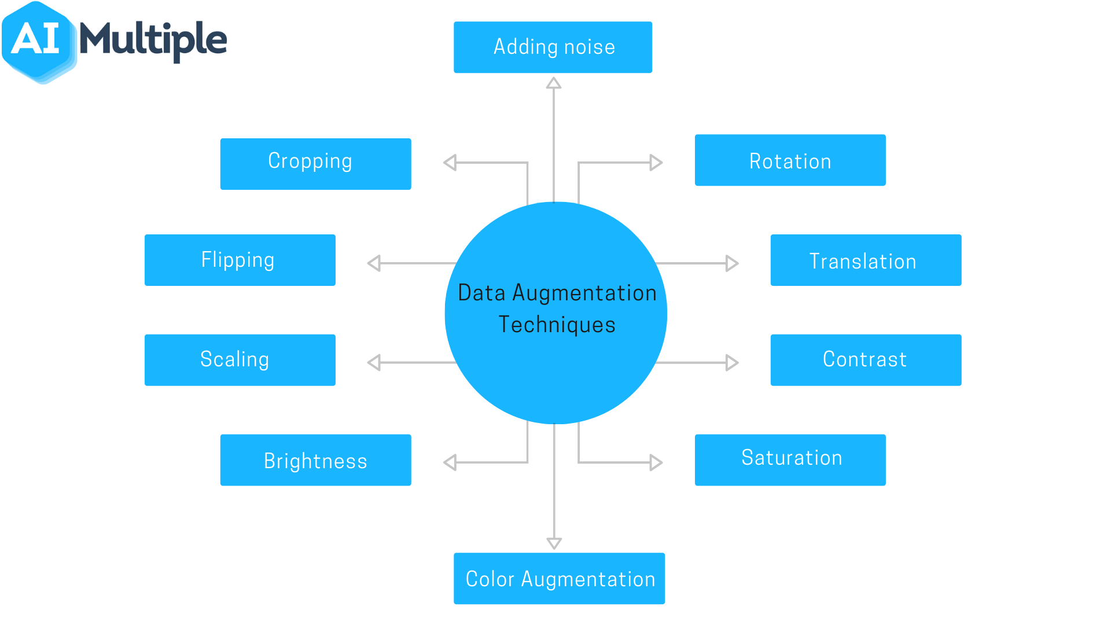
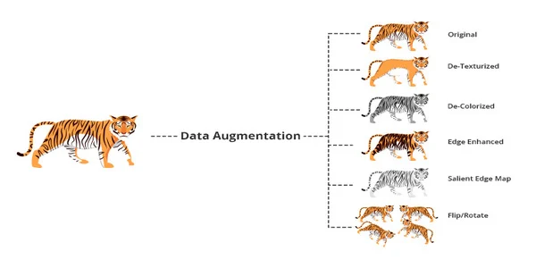
Data Augmentation

Slide 59
10. Data Storage
. Data Storage
Save Cleaned Data: Store the cleaned and preprocessed data in an appropriate format (CSV, HDF5, etc.) for future use.
Document the Process: Keep track of the steps and transformations applied to the data for reproducibility.

Slide 60
Summary
Handling datasets for machine learning feature sets involves a systematic process to prepare data for effective model training and evaluation.
The first step is data collection, where relevant and high-quality data is gathered from various sources such as databases, files, and APIs. Following collection, data cleaning is essential to address missing values, noise, and outliers.
Techniques such as imputation, noise reduction, and outlier detection are employed to enhance data quality. Proper handling of missing values ensures that no significant information is lost, while noise reduction and outlier handling prevent these issues from adversely affecting model performance.
These steps help in creating a reliable and accurate dataset ready for further processing.
The next phase involves data transformation and feature engineering. Normalization or standardization scales the features, ensuring that each one contributes equally to the model's performance. Categorical variables are converted into numerical formats using encoding techniques like one-hot encoding or label encoding.

Slide 61
Summary
Feature engineering plays a crucial role in creating new features or transforming existing ones to better capture the underlying patterns in the data. Additionally, feature selection is performed to identify and retain the most relevant features, reducing the dimensionality of the dataset and improving model efficiency.
This may involve using techniques such as Principal Component Analysis (PCA) or analyzing feature importance. These steps collectively ensure that the dataset is well-prepared, enabling the machine learning model to learn effectively and make accurate predictions.

Slide 62

Reference Material
Machine Learning for Dummies, By John Paul Mueller and Luca Massaron, For Dummies, 2016.
https://www.isanasystems.com/machine-learning-handling-dataset-having-multiple-features/
https://www.altexsoft.com/blog/preparing-your-dataset-for-machine-learning-8-basic-techniques-that-make-your-data-better/
https://www.geeksforgeeks.org/what-is-dataset/

Slide 63
MCQ’s
Which of the following is NOT a typical source for collecting data?
Databases
Files
APIs .
Hyperparameters
Why is normalization important in data preprocessing?
a) To reduce the number of features
b) b) To ensure all features contribute equally to the model
c) To improve the accuracy of the target variable
d) To encode categorical variables
What is the primary goal of feature engineering in machine learning?
a) To select the best model
b) b) To transform raw data into meaningful features
c) To evaluate the model performance
d) To split the data into training and test sets

Slide 64
MCQ’s Answers
Answers
1. d) Hyperparameters
2. b) To ensure all features contribute equally to the model
3. b) To transform raw data into meaningful features
4. c) Dropping duplicate rows
5. b) To improve model performance and reduce overfitting

