Slide 1

ANKARA UNIVERSITY
COMPUTER ENGINEERING
Smart-Shopping
Student Number: 20290078 - 20290947
Student Name SURNAME: Ribhi BISHTAWI – Ibraheem R N HAMDAN
Advisor Name SURNAME: Prof. Enver BAĞCI
January 2024

Slide 2

CONTENTS
1.INTRODUCTION
1.1. Problem Description
1.2. Project Subject
2. LITREATURE
3. MATERIAL and METHOD
3.1. Material
3.2. Method
4. APPLICATION
5. CONCLUSION
RESOURCES

Slide 3
1. INTRODUCTION
1.1. Problem Description
The Changing Landscape of Shopping and Tourism
In a constantly evolving world, the shopping and tourism industry is experiencing rapid changes. New trends and technologies are reshaping the way businesses engage with consumers and deliver experiences.

Slide 4
1. INTRODUCTION Cont.
1.2. Project Subject
Cross-platform application is built with the Flutter framework and seamlessly integrates with Firebase and NodeJS as its backend powerhouse.
The project's goal is to provide a simpler way of operating, flawlessly integrating store management, engaging users, and providing real-time exploration of potential offers.

Slide 5
2. LITERATURE
The primary goal of our project is to enhance the efficiency of businesses, particularly those in the retail sector.
Another goal is to make a user-friendly mobile application that simplifies the entire shopping experience for both the shop owners and consumers.
Also, the project is not just about making shopping easier now but also preparing for future improvements.

Slide 6
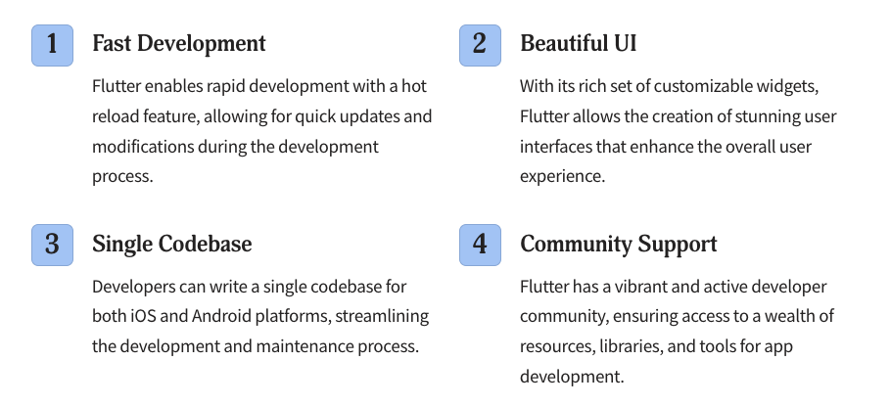
3. MATERIAL and METHOD
3.1. Material
Flutter:

Slide 7
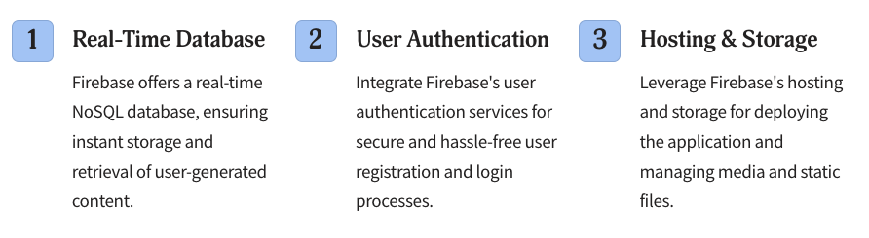
3. MATERIAL and METHOD Cont.
Firebase:

Slide 8
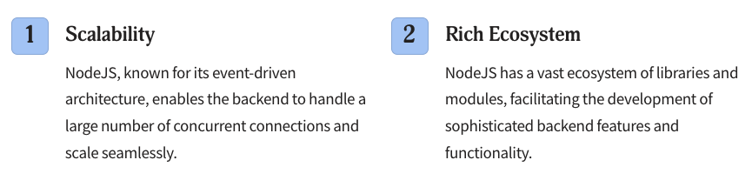
3. MATERIAL and METHOD Cont.
NodeJS:

Slide 9
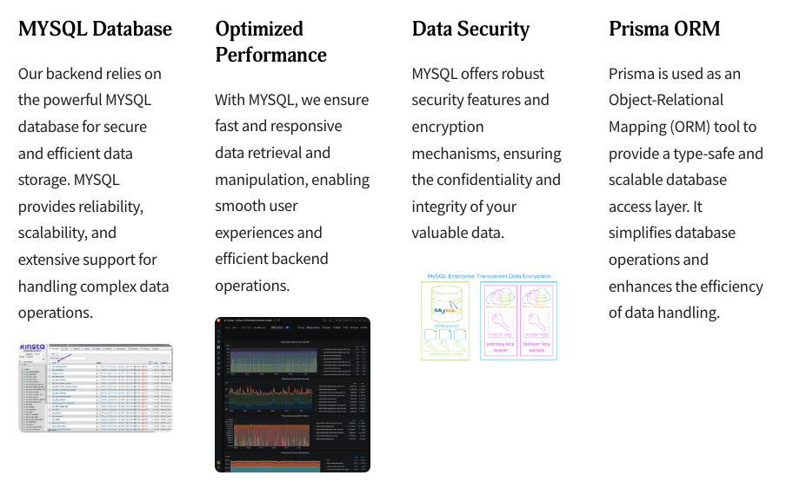
3. MATERIAL and METHOD Cont.
Data Storage:
MYSQL:

Slide 10
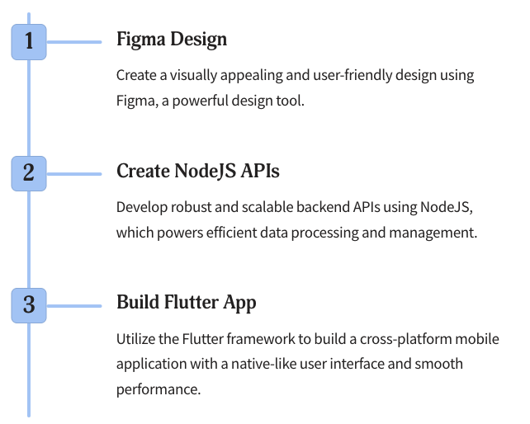
3. MATERIAL and METHOD Cont.
3.2. Method

Slide 11
3. MATERIAL and METHOD Cont.
Authentication
The authentication process in the app was constructed by Firebase. The procedure starts on the app's first page where the users encounter a login interface featuring a text-field for their phone number, a button to initiate login, and an option to sign up.
With Firebase OTP, users enter their phone number to initiate login. Firebase Authentication then sends a One-Time Password (OTP) via SMS, adding an extra layer of security. Users input the received code on the OTP entry page, and upon verification, they gain access to the application.

Slide 12
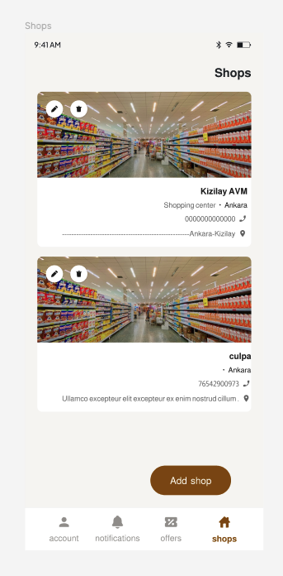
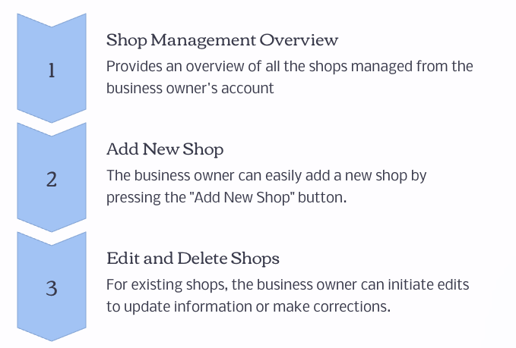
3. MATERIAL and METHOD Cont.
Shops Page

Slide 13
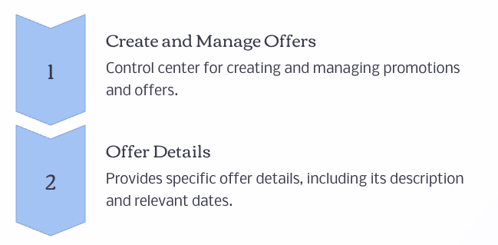
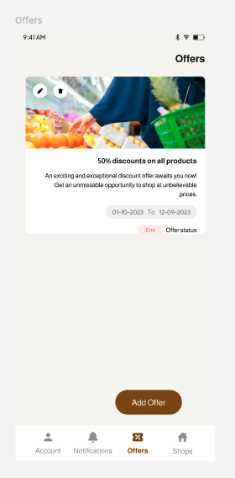
3. MATERIAL and METHOD Cont.
Offers Page

Slide 14
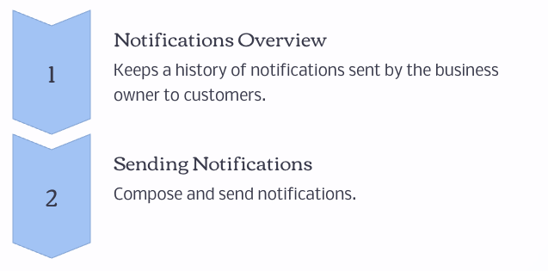
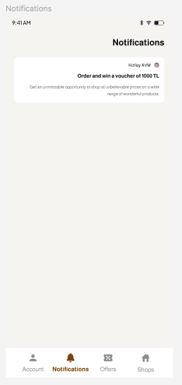
3. MATERIAL and METHOD Cont.
Notifications Page

Slide 15
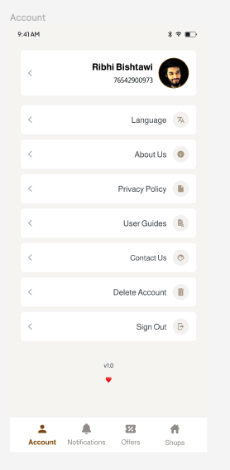
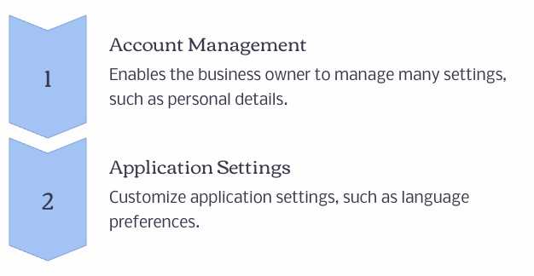
3. MATERIAL and METHOD Cont.
Account Page

Slide 16
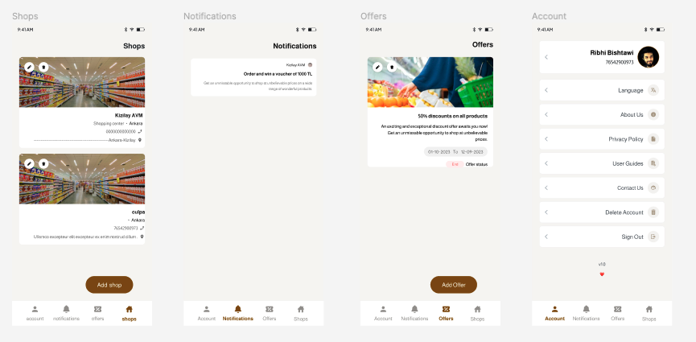
4. APPLICATION
Manager Application: https://github.com/ribhy-bishtawi/Graduation-Project

Slide 17
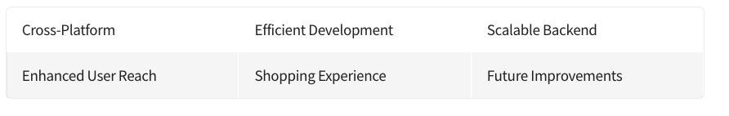
5. CONCLUSION

Slide 18
RESOURCES
[Coding With T]. (2022, February 11). Flutter Firebase Phone Number OTP Authentication - Flutter Firebase 2023 [Video]. YouTube. https://www.youtube.com/watch?v=dGwr66EkJKk&ab_channel=CodingWithT
Firebase. (n.d.). Flutter. https://docs.flutter.dev/development/data-and- backend/firebase
Flutter - Build apps for any screen. (n.d.). https://docs.flutter.dev/docs
Node.js. (n.d.). Node.js Documentation. https://nodejs.org/en/docs/
Prisma. (n.d.). Prisma Documentation. https://www.prisma.io/docs/
[Rivaan Ranawat]. (2022, October 19). Flutter, Firebase & Riverpod Master Class - Build a COMPLETE Reddit Clone App [Video]. YouTube. https://www.youtube.com/watch?v=B8Sx7wGiY-s&ab_channel=RivaanRanawat
Swagger. (n.d.). Swagger Documentation. https://swagger.io/docs/specification/about/
TypeScript. (n.d.). TypeScript Documentation. https://www.typescriptlang.org/docs/

Slide 19

ANKARA UNIVERSITY
COMPUTER ENGINEERING
THANKS
Student Number: 20290078 - 20290947
Student Name SURNAME: Ribhi BISHTAWI – Ibraheem R N HAMDAN
Advisor Name SURNAME: Prof. Enver BAĞCI

