Slide 1
Nuclear Waste Reprocessing Initiatives
CONSOLIDATED FUEL TREATMENT CENTER AND ADVANCED BURNER REACTOR
OCTAVIA BIRIS, KYLE GRACEY, KATY HUFF, WAI KEONG

Slide 2
Nuclear Waste and Storage/Reprocessing Alternatives

Slide 3
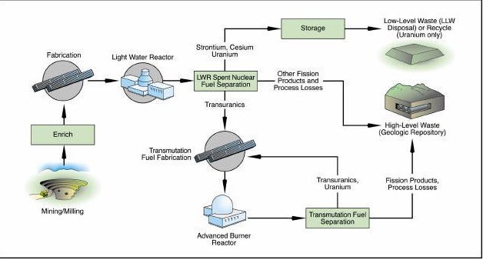
Consolidated Fuel Treatment Center: Nuclear Fuel Cycle

Slide 4
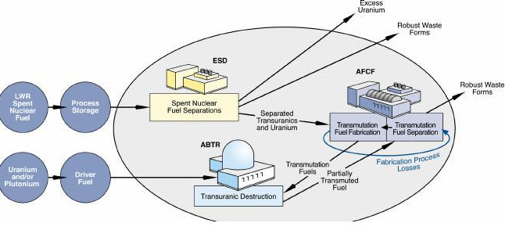
CFTC

Slide 5
Nuclear Waste
Nuclear waste fits loosely in 3 categories, by levels of radioactivity/mass or volume:
Low Level Waste (LLW): contaminated soil, clothing, debris
Intermediate Level Waste (ILW): chemical sludge, reactor shielding, de-commissioning materials
High Level Waste (HLW): fission products and transuranic elements from reactors=Spent Nuclear Fuel (SNF)‏
95% of waste from nuclear power is LLW+ILW

Slide 6
Reactors and Nuclear Waste in the World
442 operating nuclear reactors
400,000 t of waste produced annually
3% of waste (12,000 t ) is high-level waste (HLW):
96% of this is U
1% of this are actinides (TRU transuranics)‏
3% other fission products

Slide 7
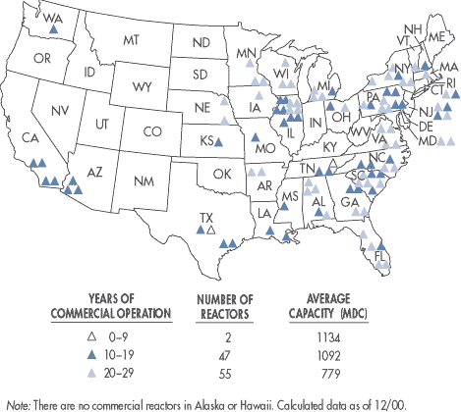
Reactors in the US
Nuclear reactors generate 20% of US electric power
As energy needs are projected to double in 25 years, number of nuclear reactors to increase
103 reactors
2100 t of SNF produced/year
53,000 t SNF in storage today
119,000 t SNF by 2035
Notes:
Nuclear reactors generate

Slide 8
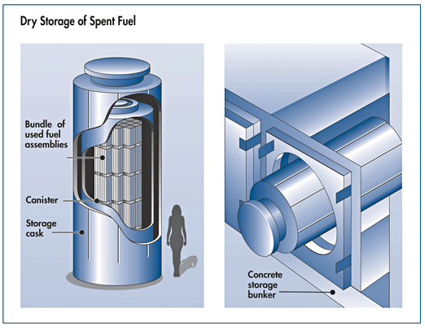
Dry Casks Storage
SNF, cooled for at least 1 year in SNF pools at power plants
SNF surrounded by inert gas inside large steel containers
Theoretically, containers are leak-tight
Disadvantage: de-centralized , temporary storage system

Slide 9
Questions to Consider when comparing CFTC to Yucca Mountain
How much can Yucca be expected to keep without CFTC?
Planned to store 70,000 t of waste--- already in temporary storage
How much can the CFTC be predicted to recycle?
Separation of Uranium, transuranics, fission products with 99% efficiency. ~2000 t/yr.
How much can Yucca be expected to keep with CFTC?
Assuming 99% recycling of current yearly quantity of SNF, the projected capacity will fill up in 3000 years! Since LLW and ILW may also be deposited there, it will reach capacity faster.
What will the results be of the CFTC recycling?
How much high level waste? 0.1% of SNF
How much low level? 0.9 % of SNF
How much recovered energy?

Slide 10
CTFC Research Effort
How much R&D will this take?
20 years until deployment of recycling system
How much has already been done?
Siting studies, 11 sites
Near-term goals:
2011- Engineering Scale Demonstration plant for removal of transuranics (TRU)‏
2014-2019: Advanced Burner Test Reactor to turn TRU into shorter-lived isotopes, while making power
2016-2019: Complete Advanced Fuel Cycle Facility

Slide 11
Transportation
Rail and truck transport
Exemplary safety record of 3,000 SNF shipments in the last 40 years
DOE plans to build a special railroad through Nevada, to Yucca Mountain
Same transportation arrangements can be used to carry fission products from the 11 proposed CFTC sites

Slide 12
Economics of CTFC

Slide 13
Economic Considerations
CFTC has be opened up to Expressions of Interest (EOI) from the private sector
  Cost dependent on the final design chosen by the DOE
  Thus, cost cannot be easily estimated for the final form of the CFTC
Specific goals have been set for industry
  Benefits of meeting these goals can be estimated for use in comparison with costs when released

Slide 14
Inputs and Outputs
Spent nuclear fuel (SNF) from light water reactors (LWRs)‏
High purity uranium (reusable by LWRs)‏
Transuranic fuel feed (for use by fast reactors)‏
Fission products (with lower heat and radioactivity)‏

Slide 15
Other Goals
Research and Development
  Making fuel recycling cost effective compared to the once-through fuel cycle
  Improvements in fuel processing to reduce proliferation risks

Slide 16
Potential Benefits
CFTC as a source of fuel
  Produces both uranium for reuse in LWRs and transmutation fuel for fast reactors from SNF
CFTC as a way of handling waste
  Augments the current waste repository plans (Yucca Mountain)‏
CFTC as a way of enabling increased nuclear energy use
  As a means of increasing waste handling capacity

Slide 17
Estimating Benefits
CFTC as a source of fuel
  Assumptions used:
    Fuel for LWRs valued at least as much as cost of mining and processing today
    Transmutation fuel is valued at a premium above LWR fuel
    Benefits from using the CFTC as a fuel source will be realized over the lifetime of its operation as long as inputs are available

Slide 18
Estimating Benefits
CFTC as a way of handling waste
  Assumptions used:
    Benefit of handling waste at least equivalent to cost of doing so under Yucca Mountain plan
    Yucca Mountain will be able to handle fission products from the CFTC (after minor modifications)‏
    The CFTC will decrease the volume of SNF that requires storage from LWR, thus increasing capacity of the Yucca Mountain site
    Benefits from increasing waste handling capacity will be realized over time as waste is produced

Slide 19
Estimating Benefits
CFTC as a way of enabling increased nuclear energy use
  Assumptions used:
    Yucca Mountain capacity unable to support expansion of nuclear industry without the CFTC
    Nuclear energy represents an overall cost saving when carbon emissions costs are taken into account
    Benefit will be realized over time based on additional energy produced by reactions supported by the CFTC

Slide 20
Total Benefits
Benefits from all three sources can be summed:
  CFTC with a given capacity will give a stream of benefits from the three sources
  Benefits to be discounted over time and summed for a few hypothetical capacities
  Sum of benefits at a given capacity can be compare to cost of construction and operation to be proposed by industry

Slide 21
The Politics of Nuclear Waste

Slide 22
Congressional (in)action on waste
819 Congressional bills proposed addressing nuclear waste in the last 15 years
532 that actually were voted on
62 passed and sent to President
  Incorporating provisions of many of above bills
54 in 110th Congress alone

Slide 23
Jurisdiction
Mostly Federal
  Waste crosses state boundaries
  (either to be store or reprocessed)‏
Some State
  Internal storage and transport

Slide 24
Yucca Mountain
Nevada delegation opposed
Democrats more vocal
Less to say about reprocessing
  Jon Porter ♥ reprocessing

Slide 25
Reprocessing
Mostly internationally-focused

Slide 26
CFTC
Barely mentioned in Congress
Not included in any current bills
Just a few hearings in Senate Environment and Public Works Committee
Mild support from Reps on shortlist for facility locations – but mainly as source of construction jobs

Slide 27
Presidential Candidates

Slide 28
Clinton
While supporting nuclear waste in theory, prefers efficiency and renewables for sources of new energy, due in part to proliferation and disposal concerns
Opposes Yucca Mountain
  Instead would convene scientific panel to develop alternative disposal solution
Campaign brief on energy and climate change doesn’t even mention nuclear
  Only mentioned in longer fact sheet

Slide 29
Obama
Nuclear is likely contributor to global warming solution, but only if cost, proliferation, public information, and disposal concerns are improved
Opposes Yucca Mountain
Nuclear not even mentioned on campaign energy and environment site
Fact sheet: Supports dry cask storage using most modern technologies possible until a more permanent solution is found

Slide 30
McCain
Strongly supports nuclear power on climate change and energy independence grounds
Wants to see 20 new plants under construction by end of first term
Nuclear features prominently on energy and environment portions of website
Supports Yucca as storage site for waste
Also “not opposed” to reprocessing
Doesn’t address what to do if new plants overflow Yucca

