Slide 1
CucONNECT
Project by: Team 41
Jayakrishnan HJ
Richard Noronha

Slide 2
Video

Slide 3
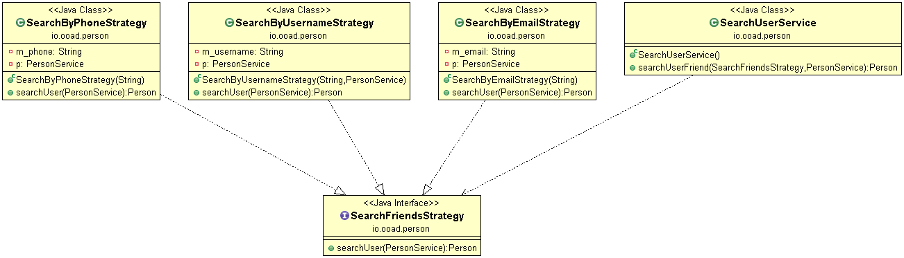
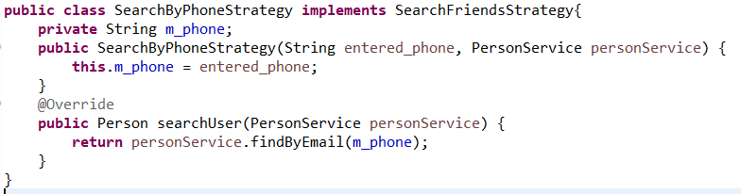

Strategy Design

Slide 4
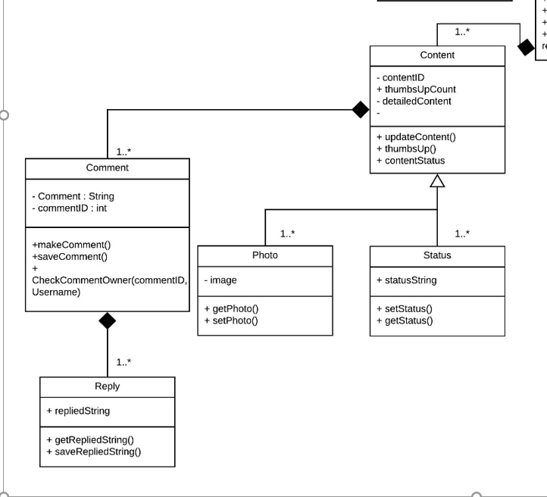
Composite Design Pattern

Slide 5
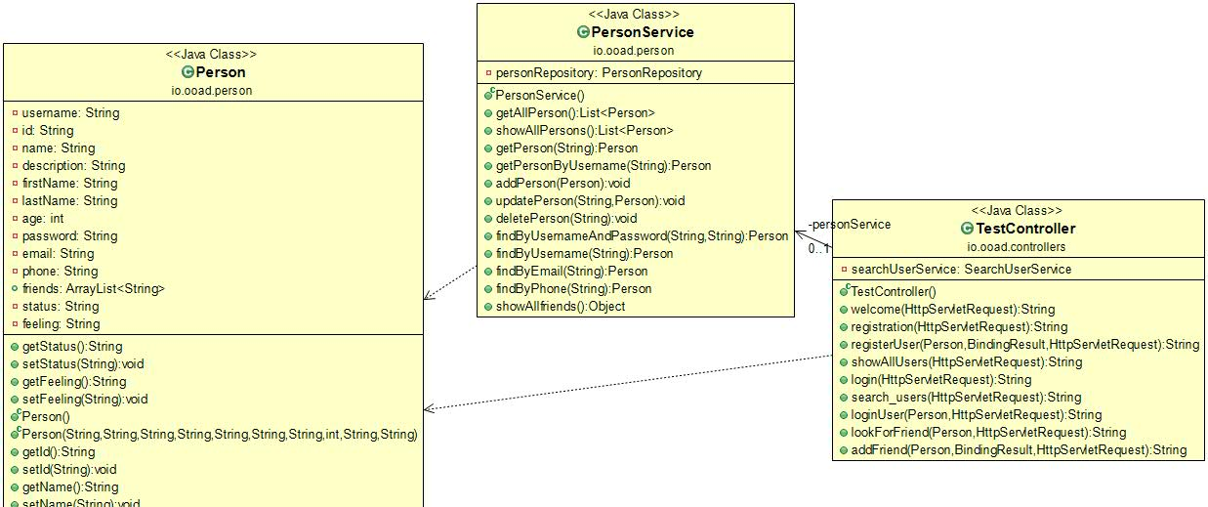
MVC

