Slide 1
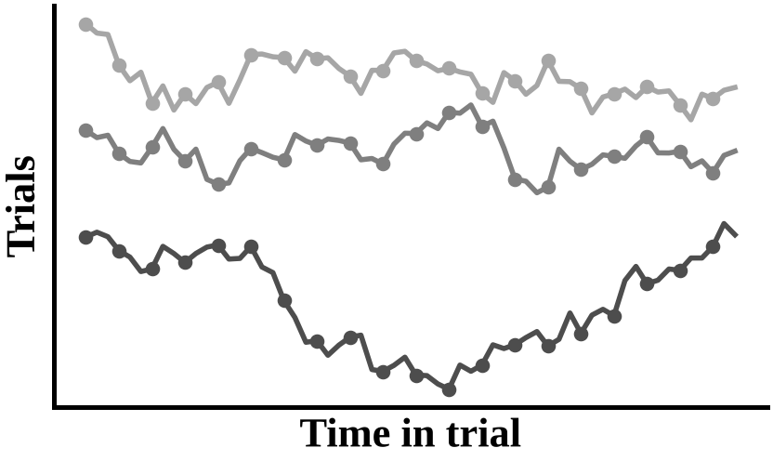
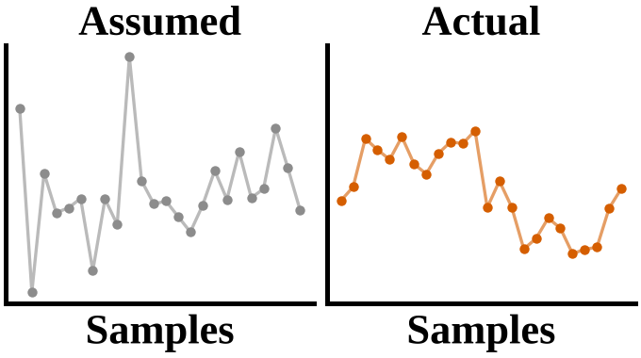
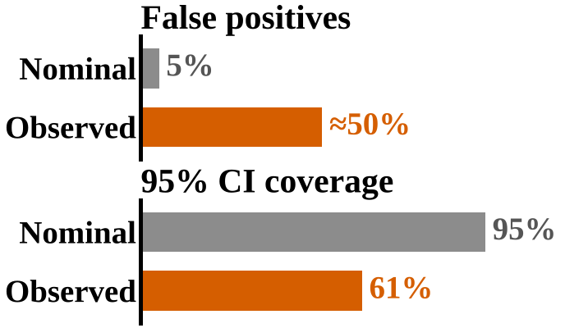
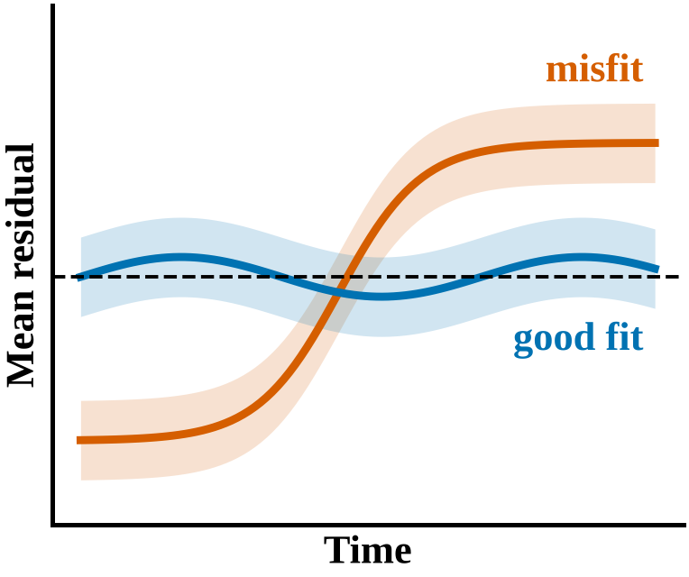
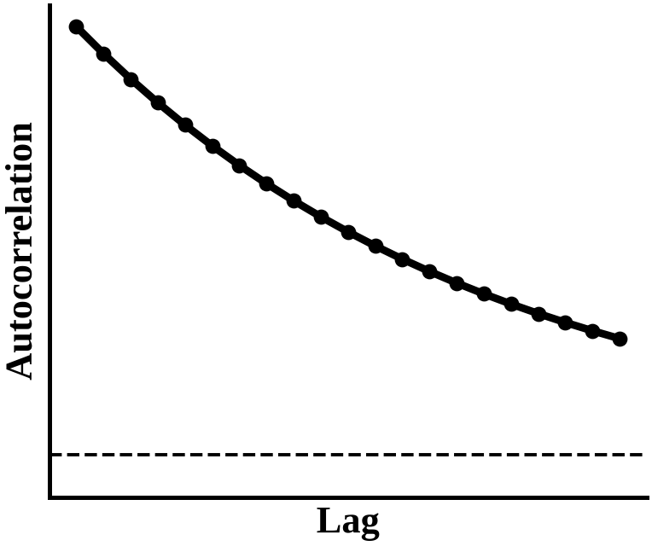
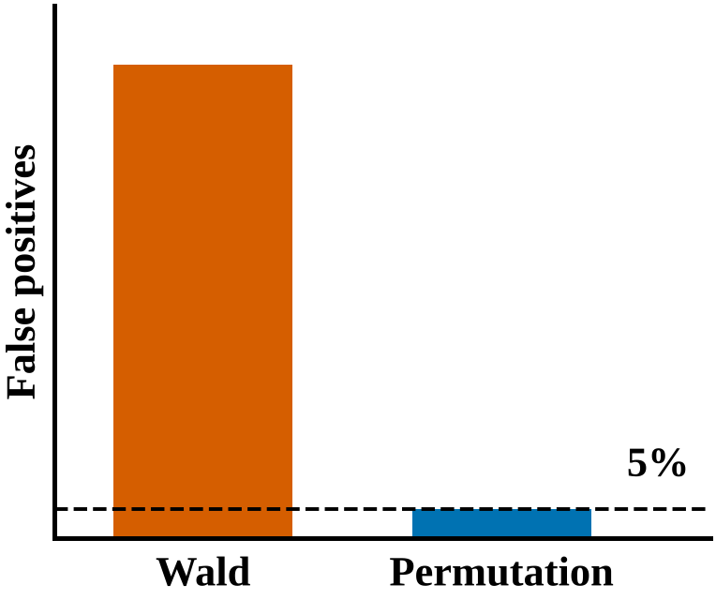
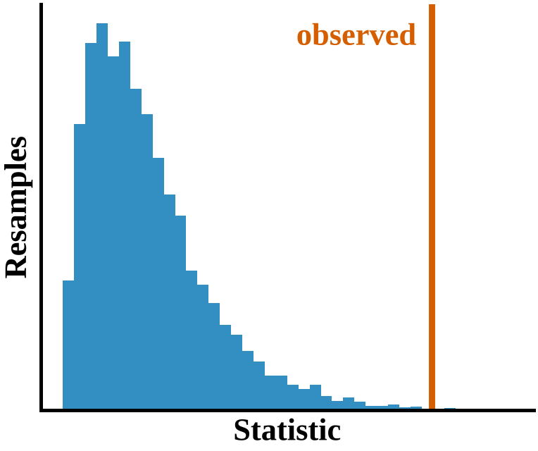
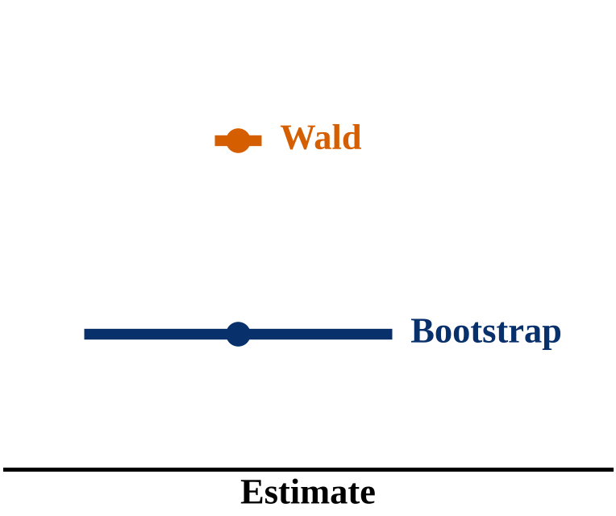
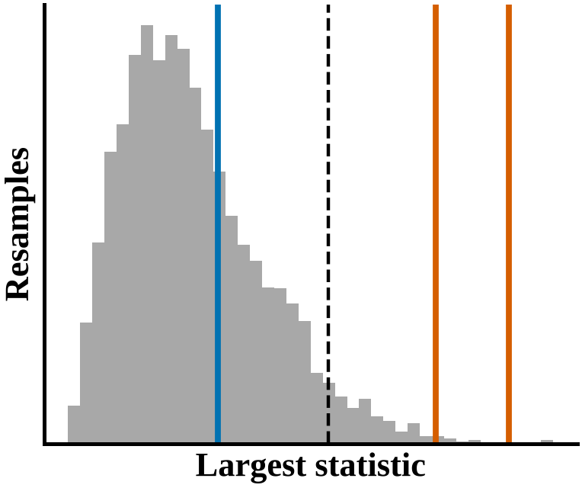
A The problem
Usual mixed-model tests
Condition × time effect
Densely sampled trials
e.g. 67 samples per trial at 33 Hz
Wald and Satterthwaite tests treat correlated samples as nearly independent
Simulated data with no true effect (false positives) and with a known effect (coverage)
B The lmmresample workflow: keep the model, replace the inference
1 Model fit
2 Dependence
3 Validity
Is the time course captured?
How correlated are the samples?
Is the test valid in my data?
diag_timecourse()
diag_acf()
perm_calibrate()
4 Test
5 Size
6 Several tests
Is there an effect?
How large is it?
Which features or pairs differ?
perm_test()
boot_ci()
perm_maxt(), perm_pairwise()
Schematic illustrations; results for the real data are shown in Figures 9–11.

