Slide 1
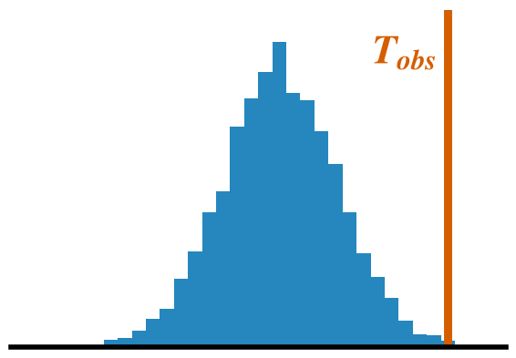
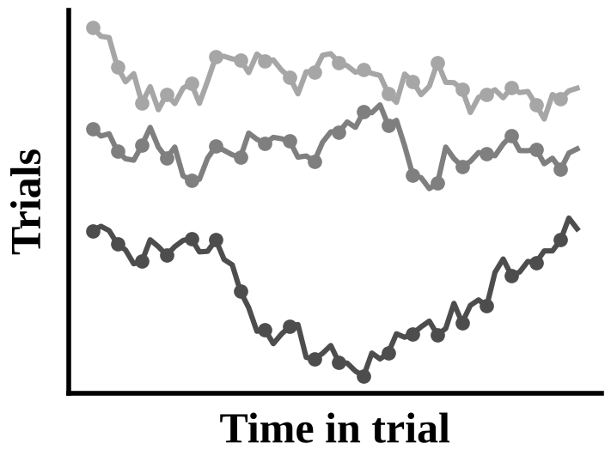
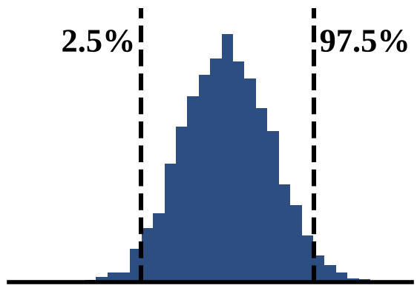
A Data
B Fit the model once
C Resample whole blocks
D Refit and compare
Permutation (tests)
P1
P1
P2
P2
P3
P3
P4
lmer(y ~
condition *
ns(time, 4) +
(1 | participant))
P4
Condition A / B
Outlined participants: labels of all their trials flipped
p-value: share of resamples with T ≥ T_{obs}
Observed statistic T_{obs} (e.g. joint Wald χ² of condition × time)
Bootstrap (intervals)
P3
×2
The same model is refitted to every resample
P1
Participants (rows) complete trials (squares); each trial is a series of correlated samples
P3
×2
P4
Participants drawn with replacement with all their trials (P3 twice, P2 not drawn)
95% CI: percentiles of the refitted estimates
Trials are never split, so the dependence between samples within a trial is carried into every resample without being modelled.

