Slide 1
iOS Development
iOS application + runtime execution

Slide 2
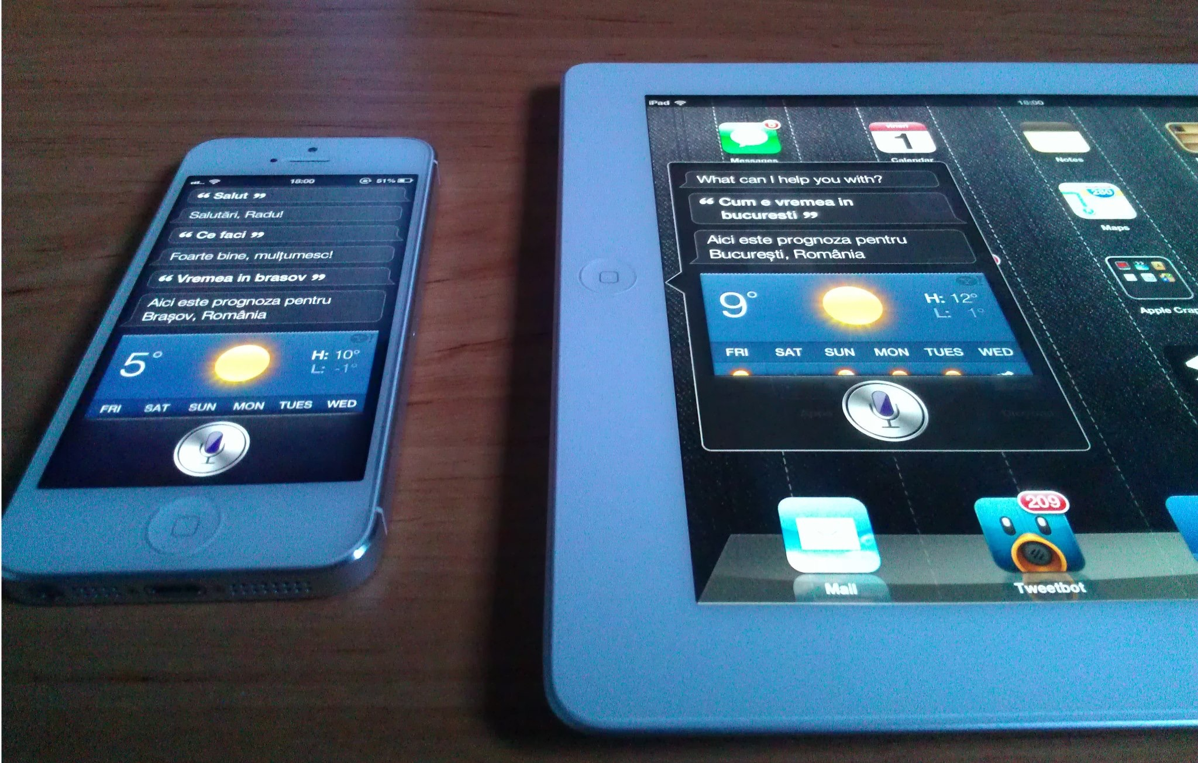
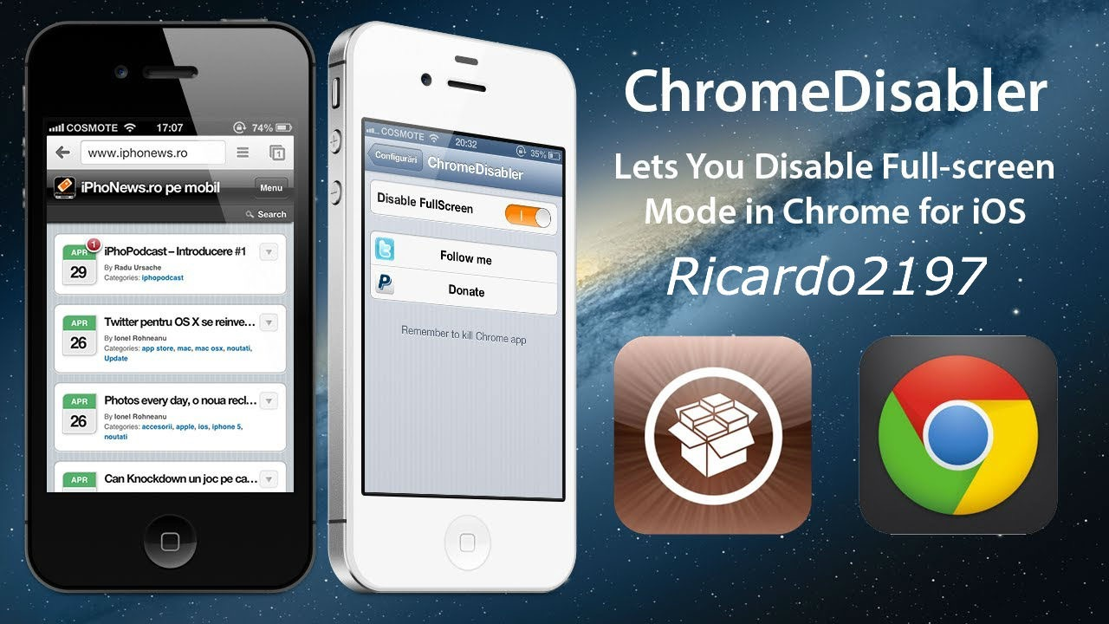
Introducere
Ricardo Ungureanu - 17 ani (aka ricardo2197)
Computer addicted
iOS developer de 2 ani
SiriRO, FBMUnrestrictor, ChromeDisabler
Blogger in timpul liber
http://ricardo2197.com

Slide 3
Cuprins
Dezvoltarea unei aplicatii pe iOS
Securitatea
Sandbox si runtime execution
Executarea si distribuirea ei

Slide 4
Cerinte
OS X 10.9 + (VM sau Mac)
Nivel mediu de cunoastere Obj-C, PHP
Cateva notiune de securitate
Nopti nedormite

Slide 5

Controlori
Raporteaza un controlor pe un anumit traseu de autobuz
Toti cei care au instalata aplicatia vor primi o notificara atunci cand pe traseul lor de autobuz se afla un controlor
Client - Server

Slide 6

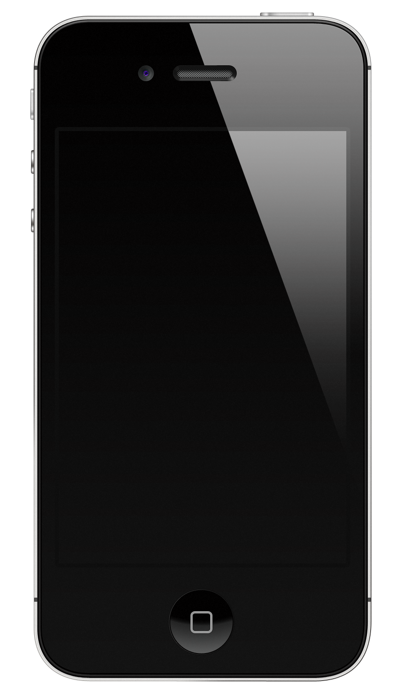

Server
Notificare Push

Slide 7
Client side
O simpla aplicatie cu suport iPhone/iPad
3 view-uri
Conexiune catre baza de date

Slide 8
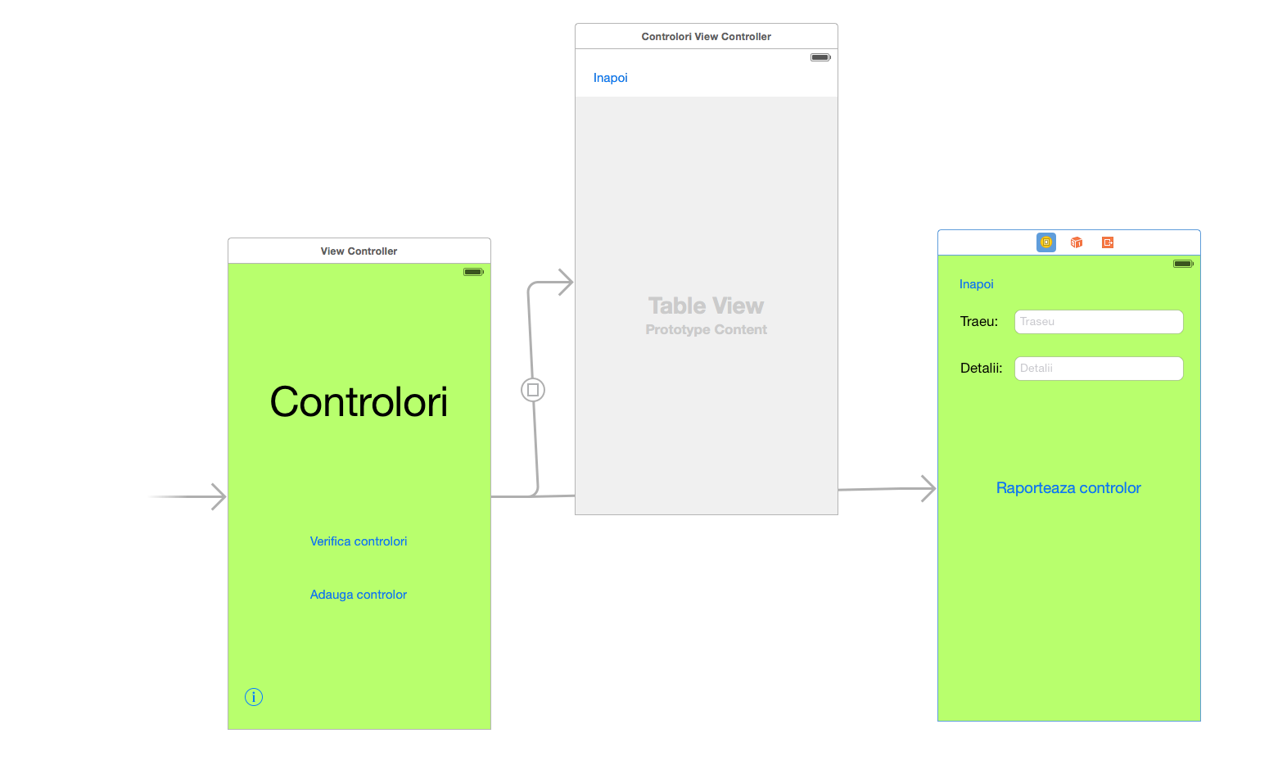

Slide 9
- (IBAction)raporteaza:(id)sender {
[self.text_traseu resignFirstResponder];
[self.text_detali resignFirstResponder];
NSMutableURLRequest *request = [NSMutableURLRequest
requestWithURL:[NSURL URLWithString:@"http://www.ricardo2197.com/"]];
NSString *params = [[NSString alloc] initWithFormat:@"traseu=%@&detali=%@", self.text_traseu.text, self.text_detali.text];
[request setHTTPMethod:@"POST"];
[request setHTTPBody:[params dataUsingEncoding:NSUTF8StringEncoding]];
NSURLConnection *conn = [[NSURLConnection alloc] initWithRequest:request delegate:self];
UIAlertView *alerta = [[UIAlertView alloc] initWithTitle:@"Alerta" message:@"Successful" delegate:self cancelButtonTitle:@"ok" otherButtonTitles:nil, nil];
[alerta show];
}
Adaugam controlorul

Slide 10
Request la baza de date
-(void)getData
{
NSURL *url = [NSURL URLWithString:@“http://ricardo2197.com/.”];
NSURLRequest * request = [NSURLRequest requestWithURL:url];
NSURLConnection *conn = [[NSURLConnection alloc] initWithRequest:request delegate:self];
[conn start];
/* ........ */
/* ........ */
/* ........ */
}
-(void)connection:(NSURLConnection *)connection didReceiveData:(NSData *)data
{
ruta = [NSMutableArray array];
detali = [NSMutableArray array];
raspuns = [NSJSONSerialization JSONObjectWithData:data options:NSJSONReadingMutableLeaves error:nil];
for(NSDictionary *lista in raspuns)
{
[ruta addObject:[lista objectForKey:@"ruta"]];
[detali addObject: [lista objectForKey:@"detali"]];
}
NSLog(@"%@%@", ruta, detali);
[self tableView:self.tabel numberOfRowsInSection:0];
[self.tabel reloadData];
}

Slide 11
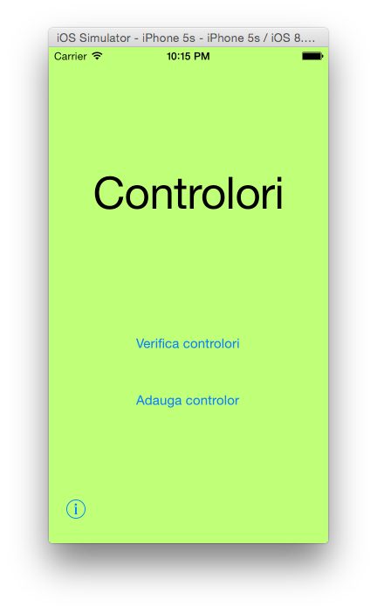
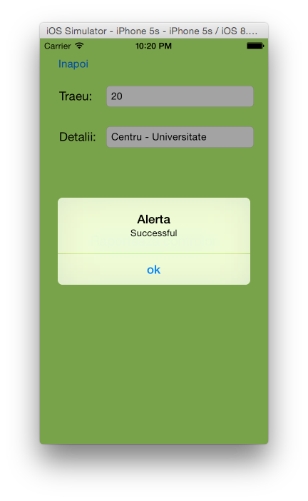
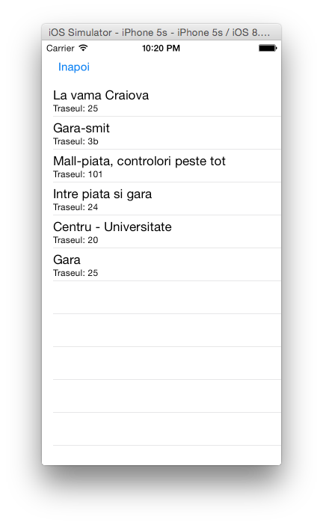

Slide 12
Server side
Baza de date
Request POST
Raspuns in format JSON
Protectii impotriva sql injection si alte atacuri

Slide 13
<?php
$username = “xyz_user";
$database = “xyz__cont";
mysql_connect("mysql.hostinger.ro", $username,”…”);
@mysql_select_db($database) or die("NO DATABASE");
$query = "SELECT * FROM Controlori";
$result = mysql_query($query) or die(mysql_error());
$num = mysql_numrows($result);
mysql_close();
$rows = array();
while ($r = mysql_fetch_assoc($result))
{
$rows[]=$r;
}
echo json_encode($rows);
?>

Slide 14
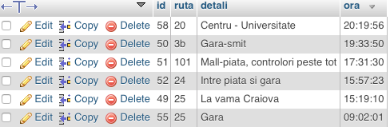
<?php
$username = "xyz_user";
$database = "xyz_cont";
mysql_connect("mysql.hostinger.ro", $username,”…”);
@mysql_select_db($database) or die("NO DATABASE");
$traseu = $_GET["traseu"];
$detali = $_GET["detali"];
$date = date("Y-m-d H:i:s");
$traseu= trim($traseu, "<> &?!+%=");
$detali = trim($detali, "<> &?!+%=");
if ($traseu != "" AND $detali != ""){
$query = "INSERT INTO Controlori VALUES ('','$traseu','$detali','$date')";
mysql_query($query) or die (mysql_error());
echo "Successful";}
mysql_close();
?>

Slide 15
Sandbox - runtime execution
Securitate
Interactiunile intre aplicatii sunt limitate
Plus pentru dezvoltatori

Slide 16
Imbunatatiri
Implementarea notificarilor remote cu ajutorul unui server dedicat si conexiune SSL (Apple push notification server)
Versiune de Android
Webapp pentru alte device-uri
Lansarea publica?

Slide 17
Q/A?

