Slide 1
DevOps - Lab
MI1547

Slide 2
The Challenge
Creating teams - Skills Matrix
Environment setup
Web App Java CI/CD
Web App Node - Githib integration - Multiple Stages - Pull requests
Serverless web App - CI/CD Docker

Slide 3
The Challenge

Slide 4
Customer situation
Based in Portland, OR, MyShuttle.biz. makes and sells one of the world’s leading integrated analitycs systems for apps use. Their products are sold worldwide and can be explored on their public website.
They have already moved their IT infrastructure, with no significant re-architecture, into Microsoft Azure. They have also started a series of process improvements to become a more agile company with a specific focus on delivering frequent feature updates and fixes to their public website.

Slide 5
Customer situation
“Even though our products are better, our competitors are generating more online sales. For every feature we deliver, they have delivered 2 or 3. Our development processes are too cumbersome and slow for us to build quality code at that pace.”
—Alex Montgomery, VP of Sales, MyShuttle.biz

Slide 6
Customer needs
Todd Culp, the enterprise architect at MyShuttle.biz, has been tasked with changing the development processes for his team, so they can be more agile and adaptive in the marketplace.
He has also been tasked with automating the entire process of testing, building, and deploying to the cloud for both the developers, so they cannot deploy any builds that fail the test suite, and the QA team, so they can fully test new builds in a realistic cloud environment.
The builds for the different environments should not affect each other, and there must be an easy way to promote a tested build to production.

Slide 7
Customer needs
Todd requires the development team to run unit tests and integration tests for every build, but there is no formal procedure or accountability over this process.
He always makes the team sign off on the build before it goes live, but there have been some bugs that appeared in production that should have been caught by a software-based test before deployment.
He thinks the developers are not consistently running all required tests and needs an automated way to enforce this before builds are deployed into the cloud.

Slide 8
Customer needs
When customers encounter problems on the website, the help desk team records the issues and submits them as tickets to the development team.
The developers often complain about the quality of the application logs and must resort to a live “reproduction session” to witness application behavior and exceptions. This sometimes causes the help desk tickets to remain unresolved for lengthy periods of time.

Slide 9
Customer needs
Todd wants to improve the turnaround time for fixing these bugs, and he needs better logs for the developers. He needs a solution to gather new types of logs including browser errors and application dependency errors such as timeouts.
Ideally, he wants to make the application logs searchable as well as implement an automated warning system that emails alerts when application behavior is unusually slow or problematic.

Slide 10
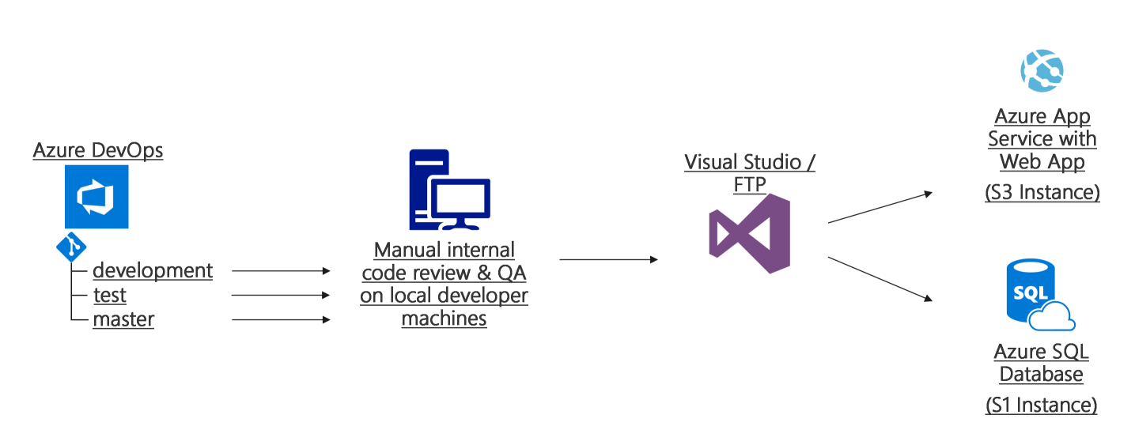
Current Process

Slide 11
Customer objections
We do not want to be locked into a specific source control repository. We are evaluating GitHub and Azure DevOps and need to be able to change between them without frustrating rework.
We do not want the developers to be able to make changes to the Azure resources even though they will have access to make source code changes.
If developers can deploy directly to the cloud, will that expose us to the same quality problems we had before when untested code was promoted to production?

Slide 12
Customer objections
How much of an impact will these process changes have on our development cadence? Will learning this place a new burden on the developers?
Our developers are already having challenges learning how to use Git; will adding a continuous deployment system on top of that slow them down and confuse them even more?

Slide 13



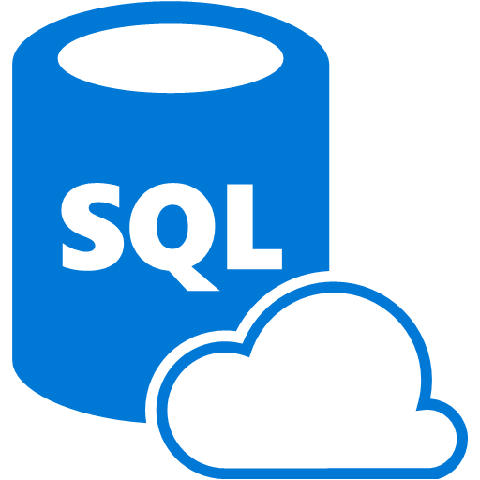
Common scenarios
Azure DevOps
Application Insights
Azure Repos
Azure Web Apps
Azure DevOps with GitHub
Azure SQL Database
SOURCE CONTROL
CI
PACKAGE
PIPELINE
DEPLOYMENT

Slide 14
Creating teams - Skills Matrix

Slide 15
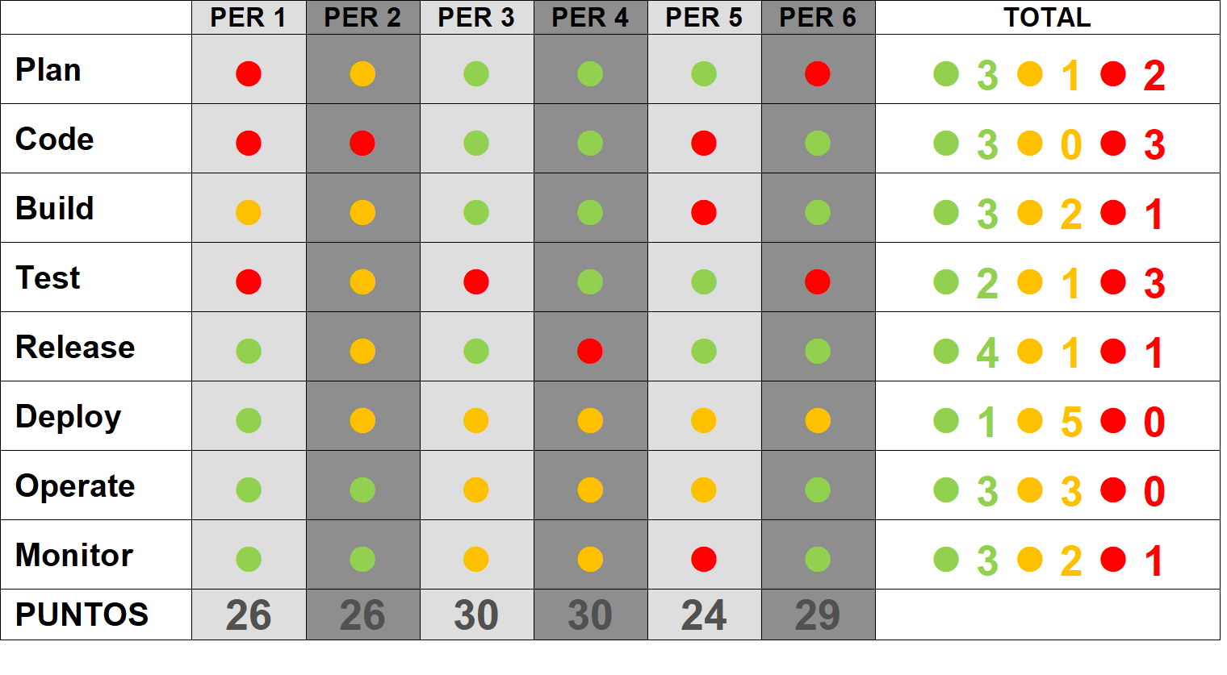
Skills Matrix
http://bit.ly/2vKq9Js

Slide 16

Design the solution
Outcome
Design a solution and prepare to present the solution to the target customer audience in a 15-minute chalk-talk format.
Timeframe
30 minutes
Business needs | Respond to questions outlined in your guide and list the answers on a flipchart.
Design | Design a solution for as many of the stated requirements as time allows. Show the solution on a flipchart.
Prepare | Identify any customer needs that are not addressed with the proposed solution. Identify the benefits of your solution. Determine how you will respond to the customer’s objections. Prepare for a 15-minute presentation to the customer.

Slide 17
Present the solution
Outcome
Present a solution to the target customer in a 15-minute chalk-talk format.
Timeframe
10 minutes for each team to present and receive feedback
Directions
Pair with another table.
One table is the DevOps team and the other table is the customer.
The DevOps team presents their proposed solution to the customer.
The customer asks one of the objections from the list of objections in the case study.
The DevOps team responds to the objection.
The customer team gives feedback to the DevOps team.

Slide 18
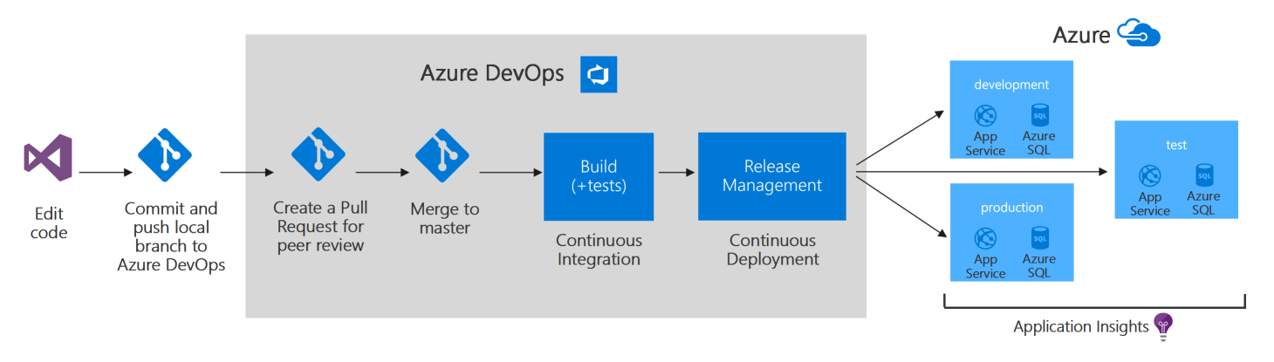
The Challenge
Preferred solution

Slide 19
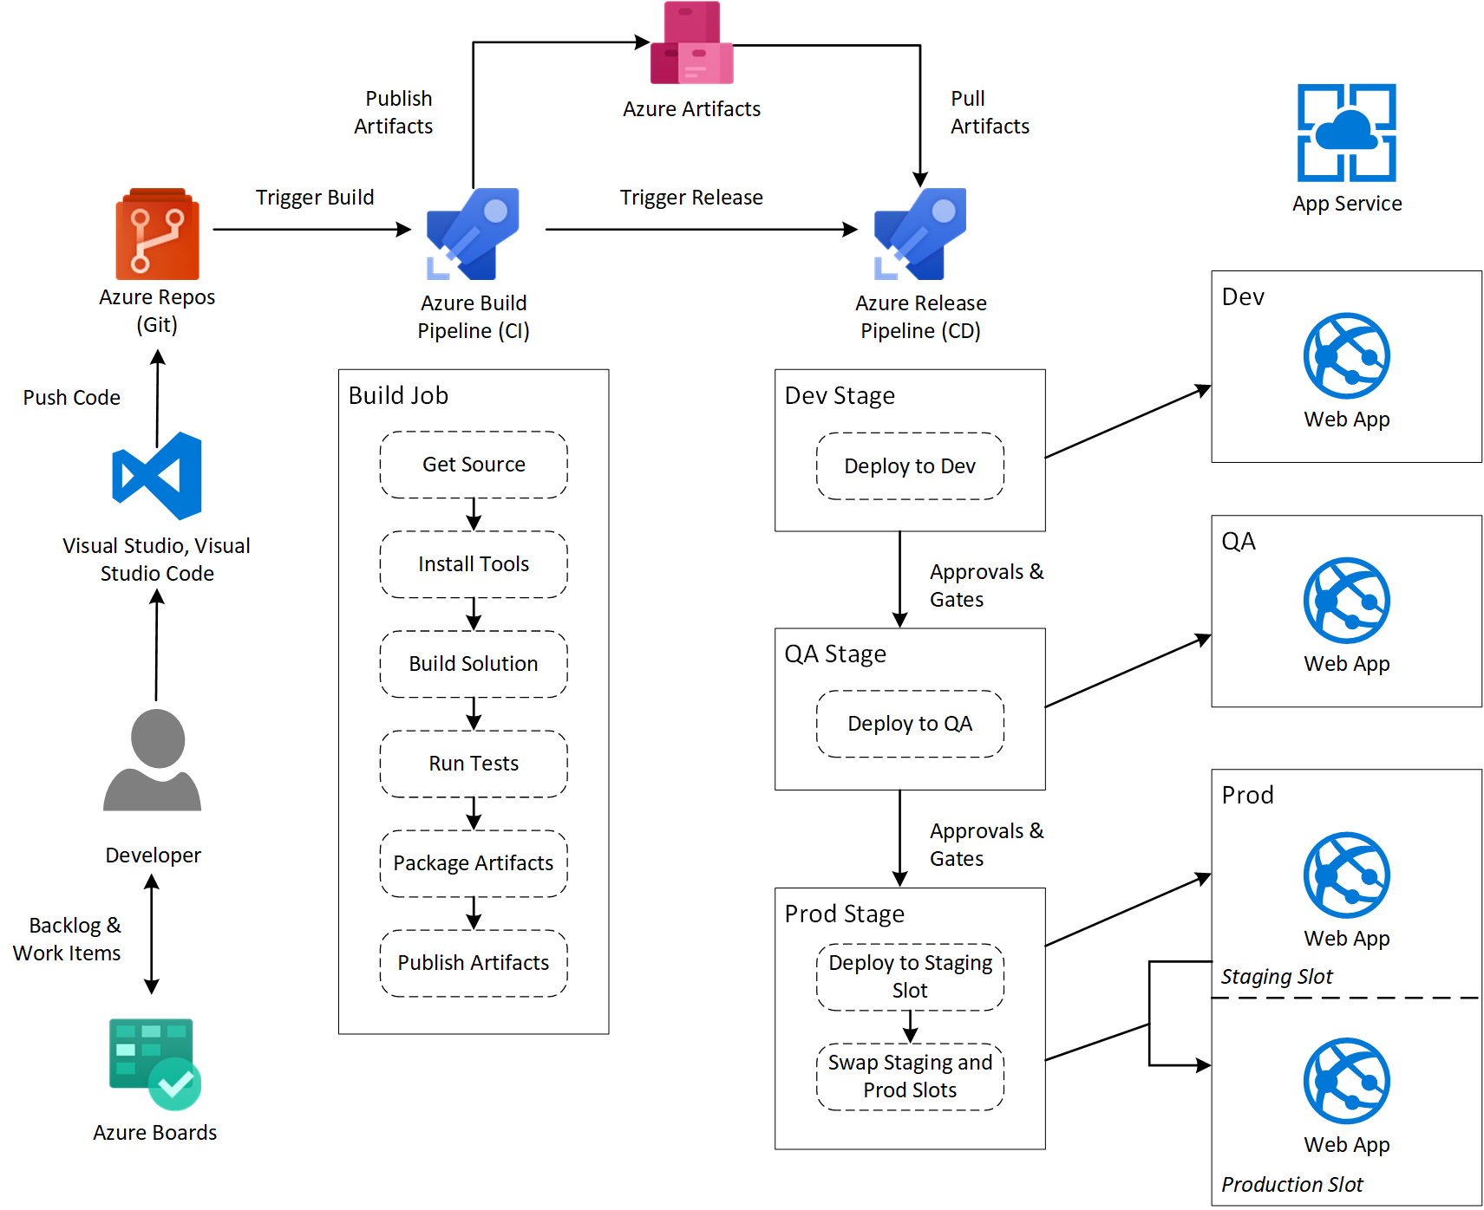
The Challenge

Slide 20
Environment setup

Slide 21
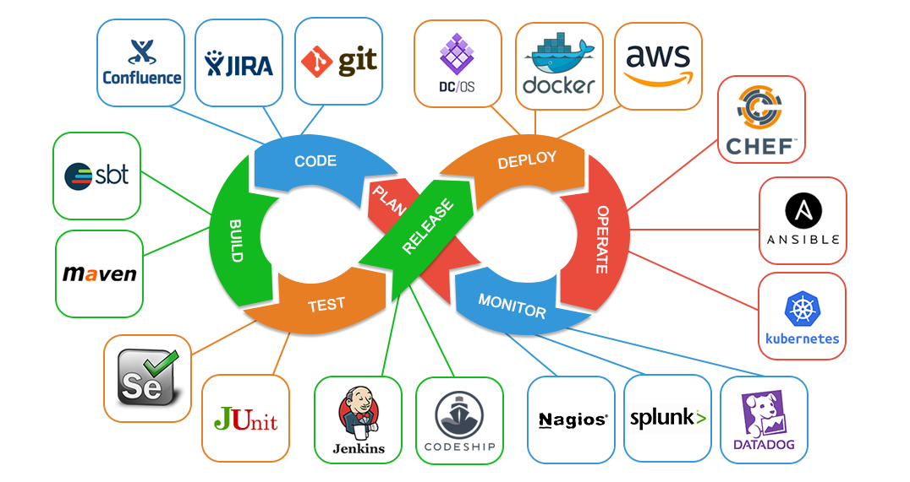
Pipeling tools

Slide 22
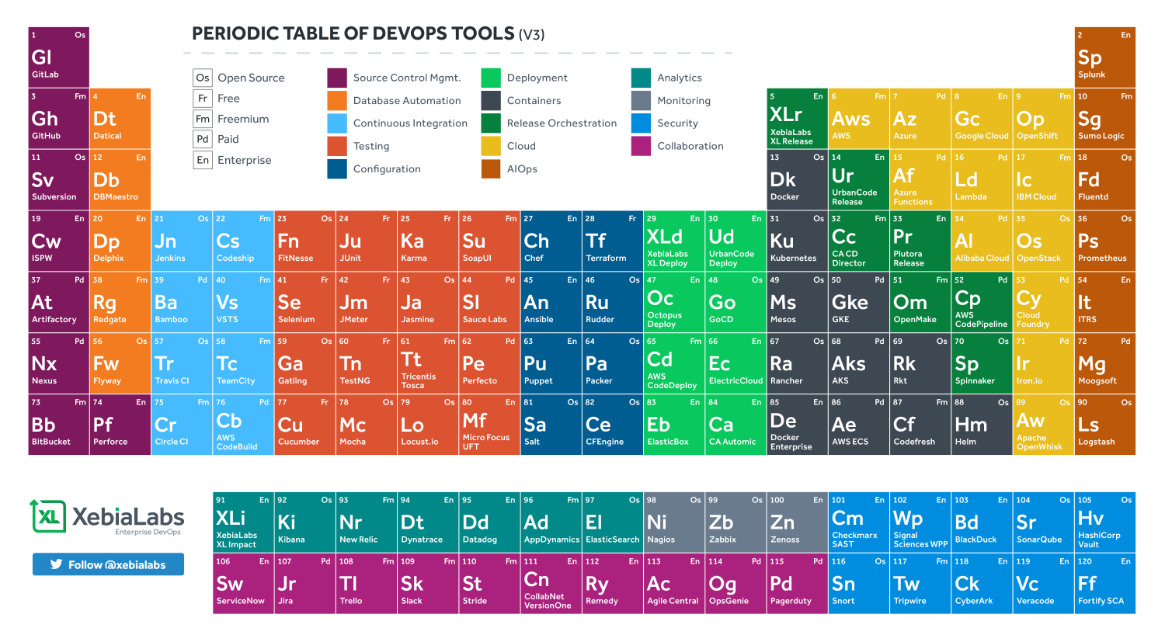
Pipeling tools

Slide 23
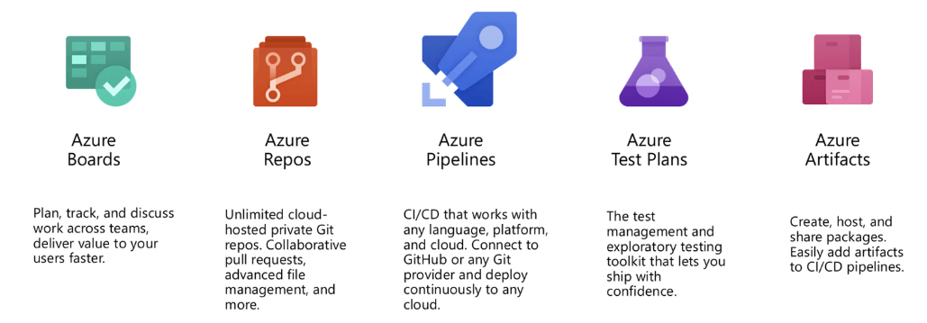
Azure DevOps

Slide 24
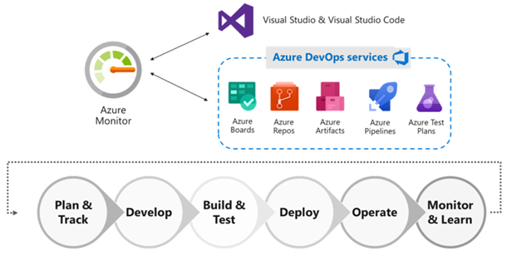
Azure DevOps

Slide 25
Azure DevOps
Create an Azure account: https://azure.microsoft.com
Access Azure Devops: https://dev.azure.com
Create a Github account: https://github.com/join

Slide 26
Web App Java CI/CD

Slide 27
WebApp Java CI/CD
Follow the instructions in WebAppJavaCICD.pdf document
Source: https://www.azuredevopslabs.com/labs/vstsextend/tomcat/
Modify the trigger parameters to enable the CI
Configure the CD in order that the commits generate new deplyments

Slide 28
Web App Node - Github integration - Multiple stages - Pull requests

Slide 29
WebApp Node - Github - Pull request
Follow the instructions in WebAppNode.pdf document
Source: https://mikepfeiffer.io/azure-devops-pipeline.html
Generate a new feature branch for adding changes
Generate a pull request in your team
Approve and merge changes

Slide 30
Serverless web App - CI/CD Docker

Slide 31
Serverless web App - CI/CD Docker
Follow the instructions in WebAppServerlessDocker.pdf document
Source: https://medium.com/microsoftazure/the-power-of-azure-devops-projects-for-java-apps-cda6c69bef0e
Validate the CI/CD pipeline

