Slide 1

Kafka Raft
(KRaft)
Ricardo Cordeiro, Rui Grafino

Slide 2

Table of Contents
1
Motivation
2
What is KRaft?
3
KRaft in Production
4
How to Deploy?
5
Differences
6
Future

Slide 3
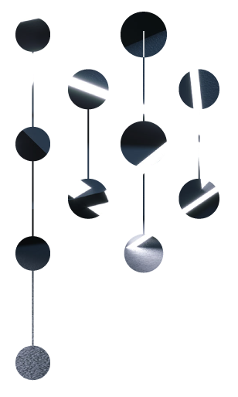
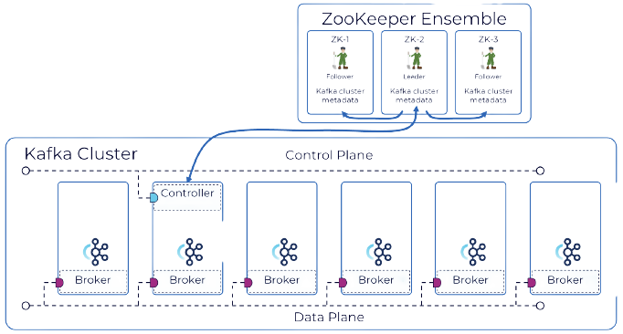
1
Motivation
Metadata Management
Leader Election
Cluster Coordination
Configuration Management
Failure detection
Operational Complexity
Single Point of Failure
Latency
Scalability Concerns
Synchronization Overhead
Notes:
Motivation (ZooKeeper + Kafka-ZooKeeper Architecture & Problems)
One key component in Kafka’s architecture is ZooKeeper, which plays a critical role in managing and coordinating the Kafka cluster.
What is ZooKeeper? It basically is a distributed system that provides a centralised infrastructure for to distributed applications.
In the case of Kafka, ZooKeeper is used to:
Manage metadata about brokers, topics and partitions (Metadata Management)
Help in leader election (Leader Election)
Cluster Coordination, to ensure that all nodes are aware of changes (Cluster Coordination)
Store and manage configurations (Configuration Management)
Failure detection, through heartbeats and session management (Failure detection)
While ZooKeeper has been reliable, there still are some challenges:
Running and maintaining two separate distributed systems. Monitoring, configuring and managing the systems independently. (Operational Complexity)
If ZooKeeper experiences issues it can impact the Kafka cluster stability and availability, introducing a single point of failure. (Single Point of Failure)
Communication between Kafka brokers and ZooKeeper introduces additional network latency. (Latency)
ZooKeeper is not as horizontal scalable as Kafka and can become a bottleneck. (Scalability Concerns)
The dependency on ZooKeeper for the Kafka cluster well functioning introduces a synchronization overhead (Synchronization Overhead)
This challenges and consideration have led the Kafka community in exploring alternatives to minimize its dependence on Zookeeper.

Slide 4
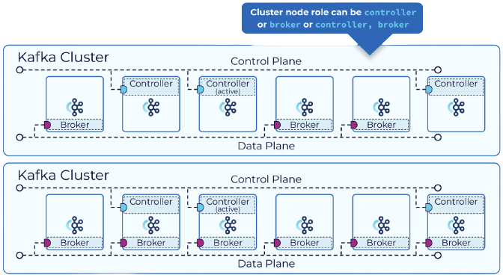
2
What is KRaft?
Simplification of Architecture
Scalability and Performance
Metadata Management
Leader Election
Notes:
What is KRaft? (What is Kraft + KRaft advantages)
KRaft aims to provide an alternative to ZooKeeper for managing the metadata of brokers and partitions.
Kafka nodes take on the roles of brokers, controllers, or both
Raft is a consensus algorithm for distributed systems that helps ensuring consistency and fault tolerance.
The key points of KRaft are:
Metadata is managed through Raft consensus group, eliminating the need for ZooKeeper for metadata coordination. (Metadata Management)
Replaces ZooKeeper in leader election, removing the overhead associated in the communication with ZooKeeper while doing it. (Leader Election)
By not having 2 separate systems we simplify the architecture and reduce operational complexity. (Simplification of Architecture)
It provides better scalability and performance, particularly for large-scale Kafka clusters (Scalability and Performance)
In the Diagram we can see KRaft running in Isolated Mode, where there is a distinction between controller nodes and broker nodes.
There also is a combined mode, where a Kafka node can act both as a broker and a controller.

Slide 5
3
KRaft in Production
KRaft Limitations:
Strimzi Limitations:
Migration
Combined Mode
JBOD
Quorum reconfiguration
Migration
Rolling updates
Version Upgrades and downgrades
Unidirectional Topic Operator
JBOD
Notes:
KRaft in Production (Current limitations of KRaft + KRaft&Strimzi)
While work on KRaft is progressing it’s not yet ready for production.
Some current limitations are:
Migration from ZooKeeper to KRaft is still in early access and only available for clusters with supported features.
Combined mode, where Kafka nodes act as both a broker and controller, is not currently supported for production.
This because there are key security and feature gaps between modes.
JBOD is not supported, meaning only one directory can be configured.
No support for quorum reconfiguration, meaning you cannot add more KRaft controllers or remove existing ones.
What does this mean for KRaft on Strimzi:
Moving between ZooKeeper and KRaft clusters is not supported.
Controller-only nodes cannot undergo rolling updates or be updated individually.
Upgrades and downgrades of Kafka or Strimzi versions are not supported without deleting and re-deploying.
Only Unidirectional Topic Operator is supported in KRaft mode. Meaning operation to topics can only be realized within the brokers because there is no TopicOperator.
The type jbod storage can be used but can only contain one disk.

Slide 6
4
How to deploy?
apiVersion: kafka.strimzi.io/v1beta2
kind: KafkaNodePool
metadata:
name: controller
labels:
strimzi.io/cluster: kraft-cluster
spec:
replicas: 3
roles:
- controller
storage:
type: jbod
volumes:
- id: 0
type: persistent-claim
size: 10Gi
deleteClaim: false
apiVersion: kafka.strimzi.io/v1beta2
kind: Kafka
metadata:
name: kraft-cluster
annotations:
strimzi.io/node-pools: enabled
strimzi.io/kraft: enabled
spec:
kafka:
...
replicas: 3
...
storage:
type: jbod
...
zookeeper:
...
entityOperator:
#topicOperator: {}
userOperator: {}
apiVersion: kafka.strimzi.io/v1beta2
kind: KafkaNodePool
metadata:
name: broker
labels:
strimzi.io/cluster: kraft-cluster
spec:
replicas: 3
roles:
- broker
storage:
type: jbod
volumes:
- id: 0
type: persistent-claim
size: 20Gi
deleteClaim: false
Notes:
How to deploy?
To deploy a KRaft cluster with Strimzi, first we need:
First a Kubernetes cluster running. And a Strimzi Custom Resource Definition.
*show kafka-with-raft.yaml snipets*
*kind: KafkaNodePool -> name: controller*
*kind: KafkaNodePool -> name: broker*
*cluster beginning -> NodePools & KRaft enabled*
*Replicas field is required by Kafka's CRD schema, but will be ignored when NodePools are used*
*The storage field is required by Kafka’s CRD schema, but will be ignored when NodePools are used*
*ZooKeeper section is required by Kafka’s CRD schema, but will be ignored when running in KRaft mode*
*Because only Unidirectional Topic Operator is supported using KRaft, topicOperator must be removed*

Slide 7
4
How to deploy?
STRIMZI_FEATURE_GATES=+UseKRaft,+KafkaNodePools
kraft % kubectl get pods -n kafka
NAME READY STATUS RESTARTS AGE
kraft-cluster-broker-0 1/1 Running 1(6m48s ago) 8m50s
kraft-cluster-broker-1 1/1 Running 0 8m49s
kraft-cluster-broker-2 1/1 Running 0 8m49s
kraft-cluster-controller-3 1/1 Running 0 8m48s
kraft-cluster-controller-4 1/1 Running 0 8m47s
kraft-cluster-controller-5 1/1 Running 0 8m47s
kraft-cluster-entity-operator-7bf88fb885-x4l7d 1/1 Running 0 5m5s
strimzi-cluster-operator-65df6865f8-kn84n 1/1 Running 1(11m ago) 13m
Notes:
How to deploy?
In strimzi KRaft is hidden behind a FeatureGate
To enable we need to specify +UseKRaft,+KafkaNodePools in the STRIMZI_FEATURE_GATES environment variable.
The UseKRaft feature gate provides an API that configures Kafka cluster nodes and their roles.
*kubectl apply -f kafka-with-kraft.yaml -n <namespace>*
*show pods*

Slide 8
5
Differences
Monitoring:
Security:
Log replication
Leader election
Consensus algorithms
Prometheus metrics/dashboards
TLS/SSL
Certificate-base / SASL
Kafka authorization
Key & Truststores
Clients, Producers, and Consumers:
Load balancing
Error handling
Metadata retrieval
Broker discovery/communication
Handling leader changes
Notes:
Differences
When transitioning from ZooKeeper to KRaft we need to review and adapt some strategies when integrating with other components.
Monitoring:
KRaft has its own set of metrics and behaviors, so the monitoring will have differences.
Kafka with KRaft still exposes JMX MBeans, but the set of metrics related to coordination and leadership will be different.
Specific metrics related to log replication, leader election, and consensus algorithms may be exposed.
And prometheus specific metrics and dashboards for KRaft cluster may differ.
Clients, Producers, and Consumers:
These components need to be aware that some things may change when using KRaft:
The discovery and communication with brokers may change.
The handling of leader changes, like detecting when a partition leader changes.
Load balancing may be different when distributing connection across brokers.
Error handling should be resilient to temporary failures and delays associated with KRaft protocol.
Metadata retrieval or updating might need to be adapted.
Security:
Authentication and authorization mechanisms and credentials may need to be reconfigured to align with the security features of KRaft.
In a ZooKeeper-based architecture we usually relly in Acess control lists and other mechanisms configured in ZooKeeper, also sometimes Kerberos.
In Kraft we still relly on TLS/SSL for encryption, authentication is often Certificate-based and Simple Authentication is also supported, authorization is managed by Kafka. For this reason Key and Truststore management is important for a secure communication.

Slide 9
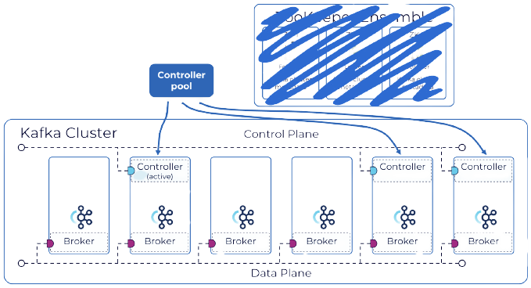
5
Future
Notes:
Future (Strimzi KRaft&NodePools future + Inevitability of KRaft)
The migration from ZooKeeper-based Kafka cluster to KRaft will be the main turning point where everyone will have start to use KafkaNodePool resources.
Strimzi is following Kafka’s work on Kraft currently working on improving KafkaNodePools on next releases:
Test coverage, integration, bug fixes and expanding resources and configurations.
Strimzi plan is to promote KafkaNodePools from feature gate to beta on 0.39, and finally in 0.41 to General Availability. This of course is subject to change.
In conclusion, Kafka has been actively exploring alternatives to its dependency on ZooKeeper, with a particular focus on KRaft.
It is only inevitable that a change will happen, and we believe that a close following and discussion on KRaft is important.

Slide 10
Ricardo Cordeiro, Rui Grafino

