Slide 1

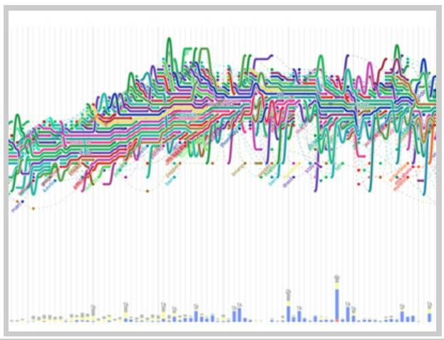
Representation- II Encoding relation
Universidade de Aveiro Departamento de Electrónica, Telecomunicações e Informática
visualcomplexity.com
InfoVis, Universidade de Aveiro, 2022
Beatriz Sousa Santos

Slide 2
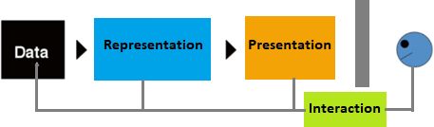
Two types of data:
Value (already addressed)
Relation
What is relation?
A logical or natural association between two or more things; relevance of
one to another; connection (in dictionary)
How to represent relation?
(Spence, 2014)
3

Slide 3
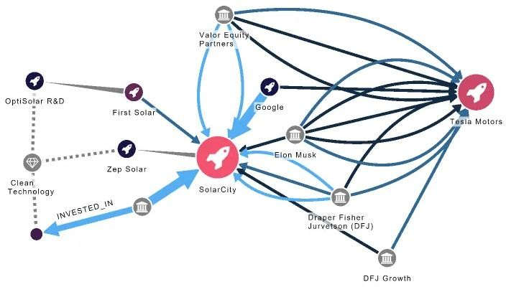
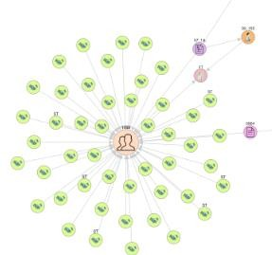
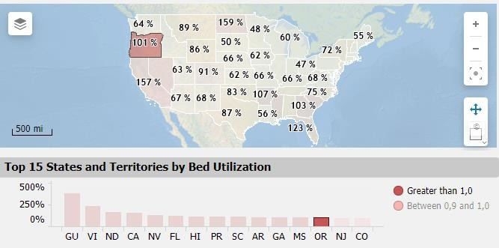
Several ways to represent relation:
Lines indicate relationship
Arrows indicate unique unilateral functional relations
Color indicates a relation between representations
4

Slide 4
The nature of relations is different from values
However, the prime considerations in the choice of a representation are similar:
an understanding of the task
the insight that is sought
what questions might be asked of the relation
Some representations of relation are very simple, yet powerful
5

Slide 5
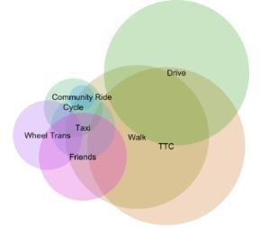
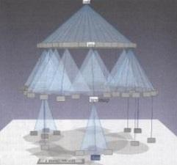
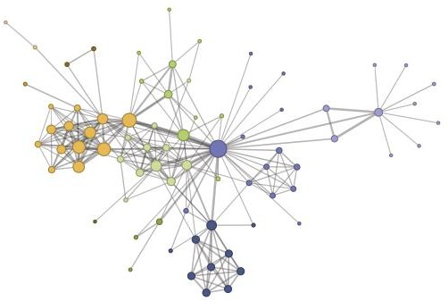
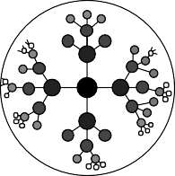
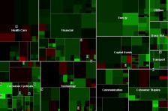
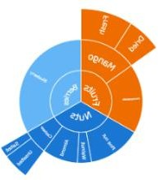
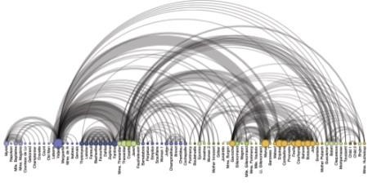
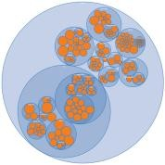
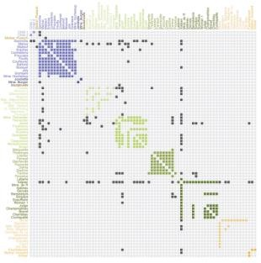
Encoding relation
Lines
Diagrams Venn diagrams
Networks
node-link
Trees
Cone trees
Hyperbolic browser
Treemap
Arc
Sunburst
Nested circles
Matrix
6

Slide 6
Lines are perhaps the simpler way to represent a relation between two entities
Originator
A C I B F G I B K G K C D
Receiver
H L M E H I B M B B E J C
B
A
B
C
K
E
M
D
G
I
L
E
M
K
F
A
H
J
G
F
I
J
C
H
L
D
(a)
(b) (c)
Insight into even a short list of telephone calls (a) is enhanced by their node-
link representation (b), especially if disconnected subsets can be identified (c).
(Spence, 2007)
7

Slide 7
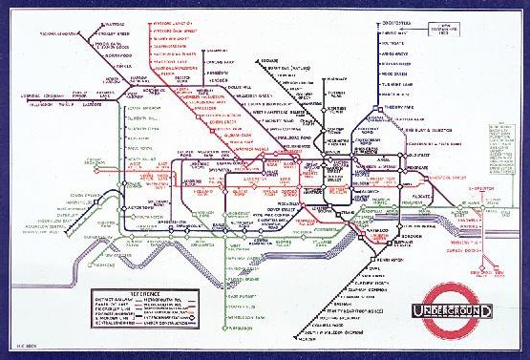
Perhaps the most familiar use of lines to represent relations is in transportation maps
Harry Beck’s original London Underground map (1933) (Spence, 2007)

Slide 8
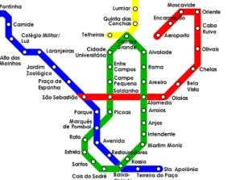
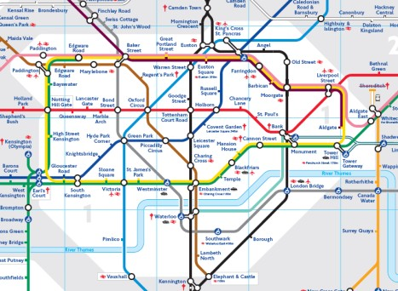
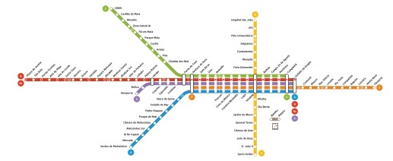
Topological transportation maps:
Exploit the shapes into which lines connecting stations
are arranged
Use color to denote different lines
Use symbols to denote different types of stations
Have general (but not necessarily) accurate veracity
Modern Underground map

Slide 9
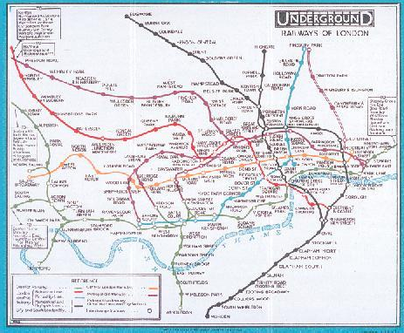
The Underground map in use prior to the introduction of Harry Beck’s map

Slide 10









Swimming Pool
Golf Course
Restaurant
Venn diagrams make easier the search of an object verifying a set of logical relations
A B C D E F G
Hotels
Swimming pool
Golf
Facilities offered by eight hotels
B
Golf
Swimming
pool
D
F
A
C
E
G
Restaurant
A Venn Diagram representation of the attributes of 24 hotels
(Spence, 2007)

Slide 11






The previous representations show relations with no restriction upon what is connected (networks)
designated root node
Trees are a class of networks which have no loops
parent of A
sibling of A
There are several common representations:
A
leaf nodes
- cone trees
child of A
- tree maps
- hyperbolic browser
(Spence, 2007)
leaf nodes

Slide 12
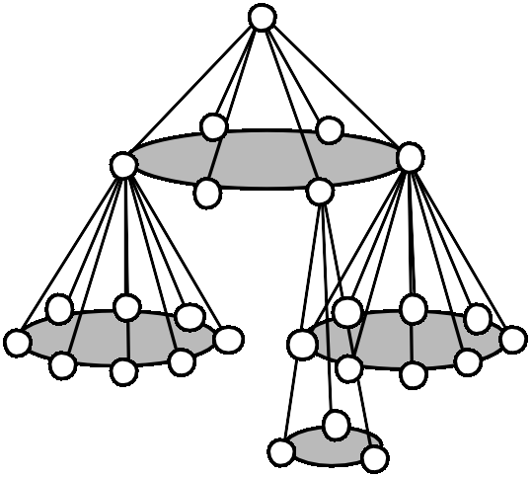
Representing trees with many levels may occupy much space mainly in the horizontal
A Cone tree (Robertson et al., 1991) corresponds to arrange the nodes subordinate
to a given node in a cone
Cone trees are more compact
(Spence, 2007)
(a)
(a) A tree (b) The corresponding Cone Tree
(b)

Slide 13
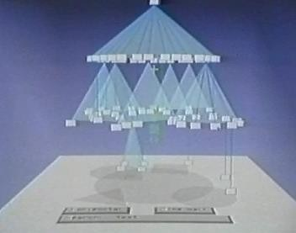
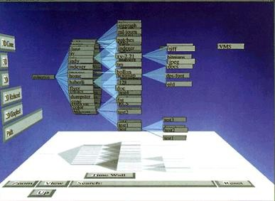
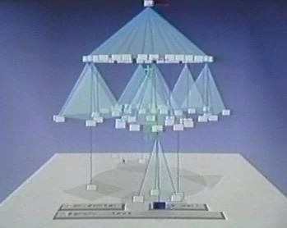
Cone trees
A reorientation of the Cone Tree (Cam Tree), more convenient for the textual labeling of nodes
http://www.youtube.com/watch?v=1eO1pgTVu-g
(Spence, 2007)

Slide 14
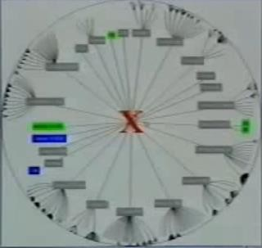
The Hyperbolic Browser (Lamping et al., 1995)
represents a tree within a circle
- It is based on a hyperbolic geometric transformation:
- the designated root node is at the center
http://www.youtube.com/ watch?v=pwpze3RF55o
its children are distributed around it at a particular distance
as the number of levels increase:
the distance between each node and its parent decreases
the size of the node also decreases
- drawing stops at one pixel resolution
The principal advantage is its interactive nature: any node of interest can be moved
to the center
18

Slide 15
The Tree map (Jonhson and Shneiderman, 1991) is another representation of a tree:
the root node is represented by a rectangle (usually as large as possible)
within this rectangle there are smaller rectangles (one for each child node)
this is repeated until all the nodes are represented
Tree
Tree Map
The construction of a Tree Map
(Spence, 2007)

Slide 16




Tree
The ‘slice-and-dice’ construction of a Tree Map to obtain leaf nodes represented
by rectangles more suited to the inclusion of text and images
(Spence, 2007)
http://www.youtube.com/watch?v=4tQeQ_kzYhA

Slide 17
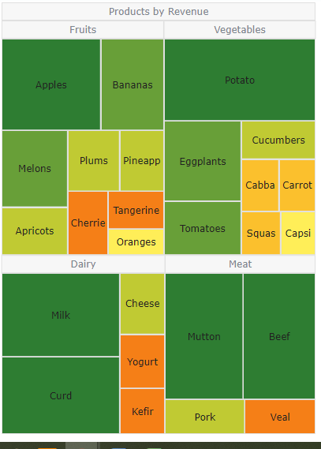


Main advantages of Treemaps:
Allow identifying the relationship between two elements in a hierarchy
optimize the use of space
accurately display multiple elements together
show ratios of each part to the whole

Slide 18
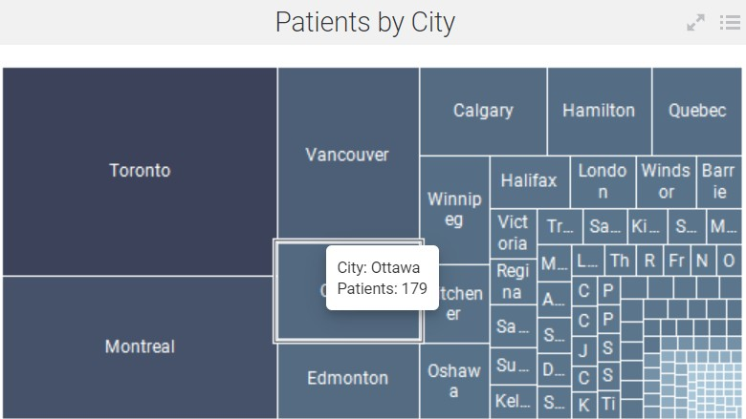
The treemap offers a lot of opportunities for
encoding by color and area
interaction by mouse-over and selection of further detail by mouse click
Heart Disease Prevalence | TIBCO Software

Slide 19
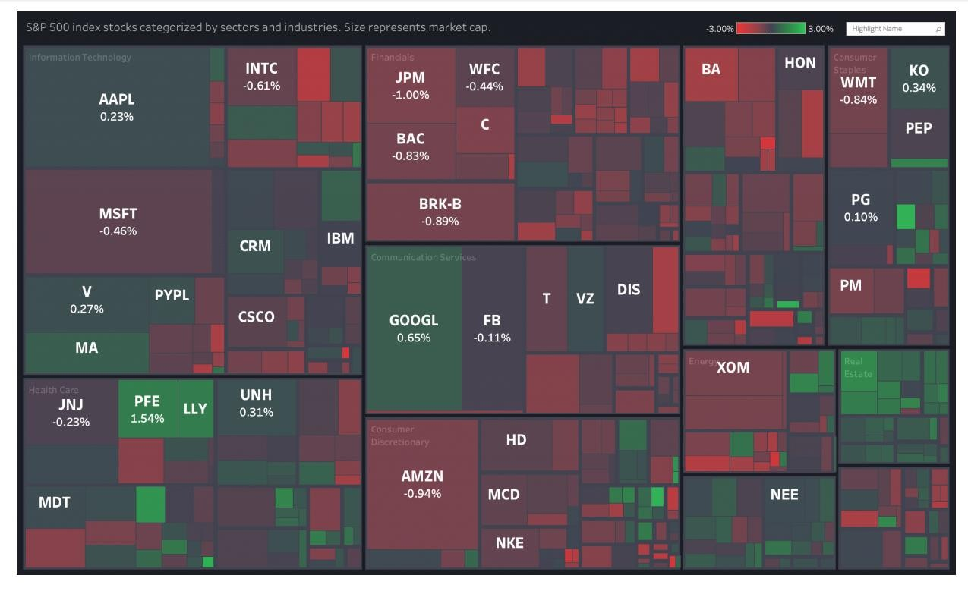
Status of companies within a number of sectors
https://canonicalized.com/tableau-financial-analytics/
23

Slide 20
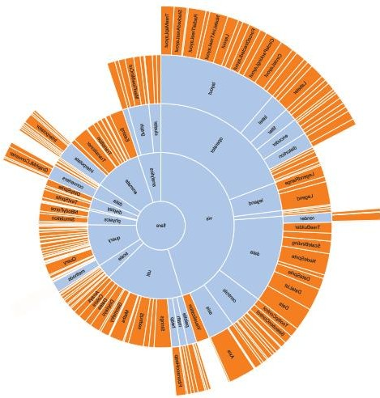
The Sunburst is another enclosure diagram used to represent a tree
Also known as Ring Chart, Multi-level Pie Chart, and Radial Treemap
An inner circle surrounded is by rings
of deeper hierarchy levels
The angle of each segment is:
divided equally under its parent node or
proportional to a value
All segments may be colored according
to category or hierarchy level
(Heer et al., 2010)

Slide 21
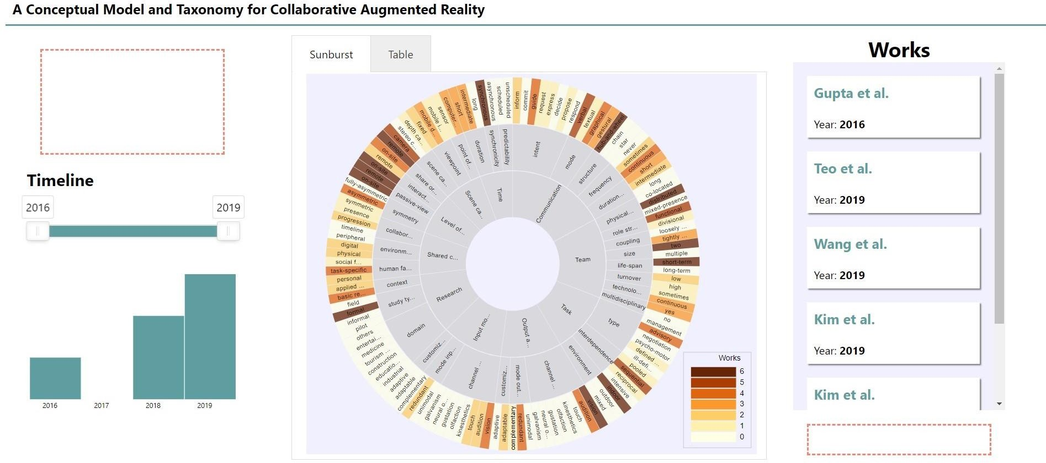
Using a Sunburst to visualize a taxonomy of papers
https://tiagodavi70.github.io/survey_viewer/overview.html

Slide 22
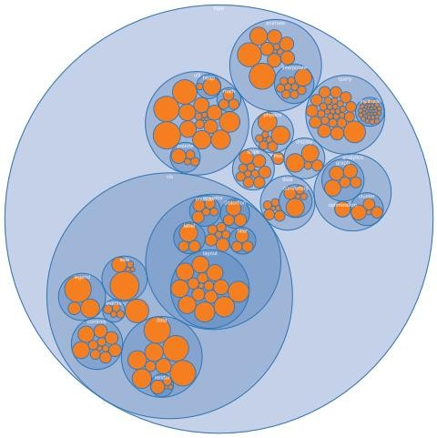
The nested circles layout is a different sort of enclosure
It does not use space as efficiently as a treemap,
but it effectively reveals the hierarchy
Node sizes can be rapidly compared using area judgments.
(Heer et al., 2010)

Slide 23
The node-link (force directed) layout is a common and intuitive approach to network layout; it models the graph as a physical system
Nodes are charged particles that repel each other, and links are dampened springs that pull related nodes together
.
(Heer et al., 2010)

Slide 24
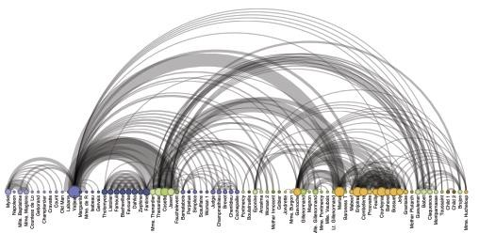
The arc diagrams use a one-dimensional layout of nodes, with circular arcs to represent links
May not convey the overall structure of the graph as effectively as a two- dimensional layout, with a good ordering of nodes it is easy to identify cliques and bridges
, Multivariate data can easily be displayed alongside nodes
Seriation is the problem of sorting the nodes in a manner that reveals underlying cluster structure is formally called seriation
.
(Heer et al., 2010)
30

Slide 25
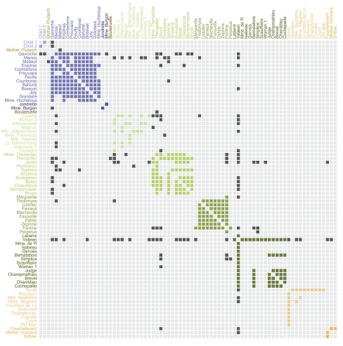
The matrix views represent the adjacency matrix of a graph
Using color or saturation instead of text allows values associated with the links to be perceived more rapidly
, The seriation problem also applies
.
(Heer et al., 2010)
31

Slide 26
“ many more … visualization exist … Emerging domains such as bioinformatics and text visualization are driving researchers and designers to continually formulate new and creative representations
… the DNA underlying all visualizations remains the same: the principled mapping of data variables to visual features such as
position, size, shape and color…”
(Heer et al., 2010)

Slide 27
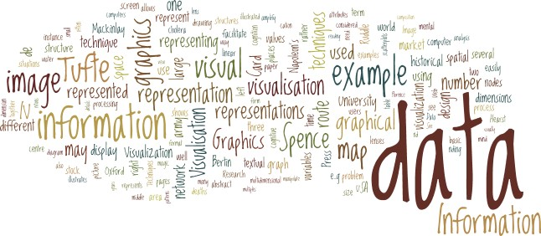
Word Cloud: simple representation of text
Used to visualize free form text or tags
After preprocessing the text the number of occurrences of each
word is shown with font size or color
R. Mazza, Introduction to Information Visualization, 2004 (chap.1):
“Data” was the most often used word

Slide 28
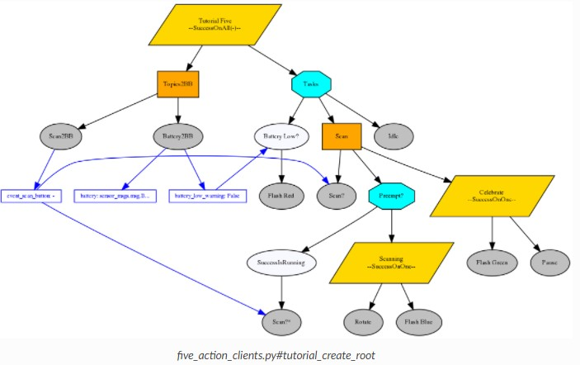
A graph visualization: The ROS Computation Graph
https://py-trees-ros-tutorials.readthedocs.io/en/devel/tutorials.html
34

Slide 29
Main bibliography
Spence, R., Information Visualization, Design for Interaction, 2nd ed., Prentice Hall, 2007
Mazza, R., Introduction to Information Visualization, Springer, 2009
Munzner, T., Visualization Analysis and Design, A K Peters/CRC Press, 2014
Ware, C., Information Visualization, Perception to Design, 2nd ed., Morgan Kaufmann,2004
Heer, J., Bostock, M., Ogievetsky, V., “A Tour through the Visualization Zoo”,
ACM Queue, vol. 8, n.5, 2010 https://queue.acm.org/detail.cfm?id=1805128
http://www.wikiviz.org/wiki/Main_Page
Acknowledgement
The author of these slides is very grateful to Professor Robert Spence as he provided the
electronic version of his book figures
37

