Slide 1

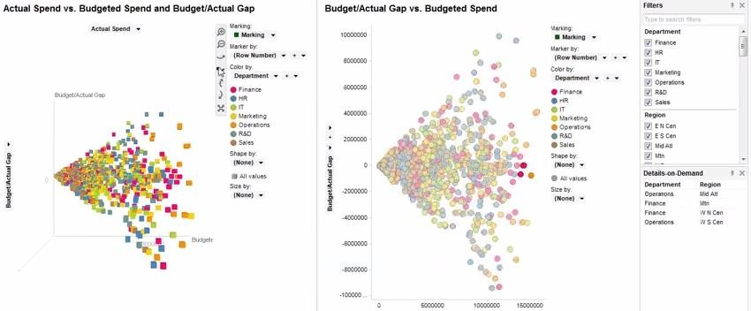
Issues in InfoVis
Universidade de Aveiro Departamento de Electrónica, Telecomunicações e Informática
Beatriz Sousa Santos, University of Aveiro, 2022

Slide 2
Interesting questions:
Why have a human in the decision-making loop?
Why have a computer in the loop? Why use an external representation? Why depend on vision?
Why show the data in detail? Why use interactivity?
What is the design space of visualization idioms?
Why focus on tasks?
Why are most designs ineffective?
What resource limitations matter?
How can better be measured?
(Munzner, 2014, chap. 1)
3

Slide 3

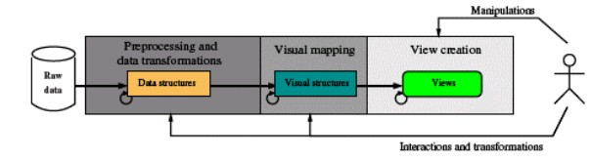
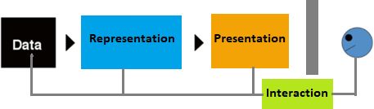
The process of creating a Visualization
Universidade de Aveiro Departamento de Electrónica, Telecomunicações e Informática
(Spence, 2014)
Beatriz Sousa Santos, University of Aveiro, 2021
4

Slide 4



How can we produce a Visualization?
There are many possible Visualization solutions, but how to select the more adequate to a specific case?
Design
Implementation
To obtain efficacy it is fundamental:
a correct definition of goal and user tasks
apply adequate methods and evaluate
Evaluation
in several iterations until the goals are ~satisfied …
I.e. using a human-centered approach
5

Slide 5
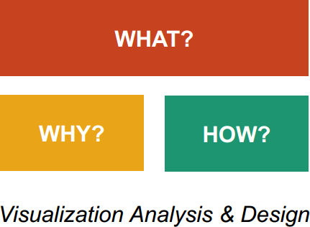
Framework for analyzing Visualization use
It is a “wicked problem”
https://www.interaction-design.org/literature/article/wicked-problems-5-steps-to-help-you- tackle-wicked-problems-by-combining-systems-thinking-with-agile-methodology
Visualization usage can be analyzed in terms of:
Why the user needs it
How the idiom is designed
What data is shown
(Munzner, 2014)
6

Slide 6




Framework for analyzing Visualization use
What ?
What data the user sees
Why?
Why the user intends to use a Vis tool (task)
How?
(Munzner, 2014)
How the visual encoding and interaction idioms are constructed
Simple Vis tools may be analyzed as an instance;
Complex tools may require analysis in terms of a sequence of instances
7

Slide 7
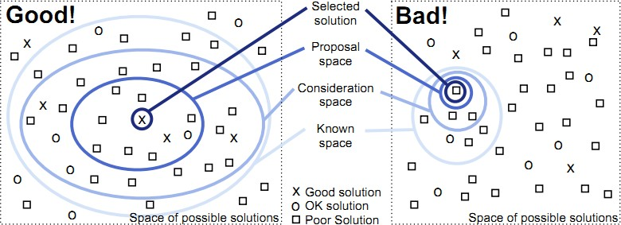
The problem of Visualization design
(Munzner, 2014)
Only a very small number of possibilities are reasonable …
most are ineffective
Consider multiple alternatives and then select the best! (based on evaluation …)
8

Slide 8
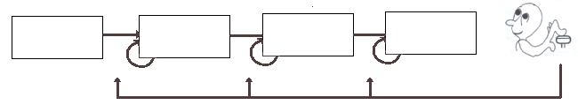


Information Visualization Reference Model
task
Raw data
Data tables
Visual structures
View
Views
Data Transformation
Visual
Mappings Transformation
Human interaction
Visualization can be described as the mapping of data to visual form
supporting human interaction for visual sense making
(Card et al., 1999)
Visualization is a Human in the loop process! -> which calls for specific
methods
9

Slide 9
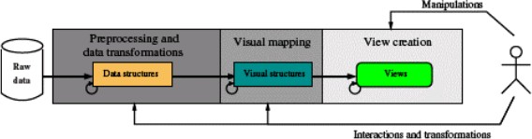
Creating Visualizations
Good design and evaluation is the key to success in producing a Visualization
Visualization S/W can provide many visual templates;
In spite of variation, all S/W packages follow the same generation process
(Mazza, 2009)
10

Slide 10
Creating a visualization can be modeled as a process including several stages:
(Mazza, 2009)
preprocessing and transformation
visual mapping not forgetting evaluation in several iterations!
creation of views
Note: this is similar to the visualization reference model
11

Slide 11
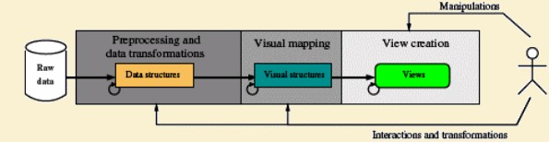
1. Preprocessing (Data transformation):
Abstract data (which don´t have a specific connection with physical space)
are rarely in a suitable format for automatic treatment and visualization
Raw data (data supplied by the world around us, a.k.a. data sets) have to be
given an organized logical structure to be processed by the Visualization S/W
This is a fundamental step; it is assumed to be addressed in another course!
12

Slide 12
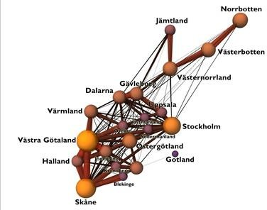
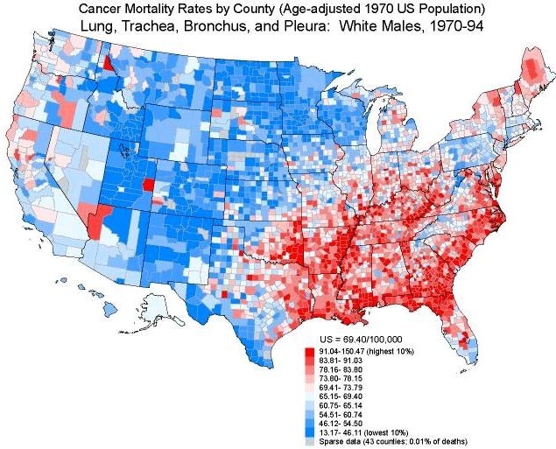
2. Visual mapping:
It is necessary to decide:
which visual structures to use to represent the data
their location in the display
Some types of abstract data can be easily
mapped to a spatial location
http://www.Visualcomplexity.com
Examples:
. data with a topological or geographical structure
Many types of data don’t have an easy correspondence with the dimensions of the physical space around us
13

Slide 13
Three structures must be defined in the visual mapping:
Spatial substrate
graphical elements
graphical properties
Spatial substrate - dimensions in physical space where the visual representation
is created (can be defined in terms of axes and type of data)
Graphical elements - anything visible appearing in the space
points, lines, surfaces, volumes
Graphical properties – properties of the graphical elements to which the human retina
is very sensitive - retinal variables:
size, orientation, color, texture, and shape
14

Slide 14
- Spatial substrate
axes (x, y, …)
type of data (quantitative, ordinal, categorical)
- Graphical elements
points lines surfaces volumes
- Graphical properties
retinal variables: size, orientation
color (depends on physiology and culture)
texture
shape
15
•

Slide 15








































Association
The marks can be perceived as
SIMILAR
Selection
The marks are perceived as
DIFFERENT,
forming families
Order
The marks are perceived as
ORDERED
Quantity
The marks are perceived as PROPORTIONAL
to each other
Size
Value
Bertin’s guidance regarding the suitability of various visual encoding methods to support common tasks
Texture
(Spence, 2007)
Colour
Orientation
Note that only size is adequate to represent quantity accurately
Shape
16

Slide 16


Position
Most accurate
Length
Angle
Slope
Area
Volume
Colour Density
Least accurate
The relative difficulty of assessing quantitative value as a function of encoding method, as established by Cleveland and McGill (Spence, 2007)
17

Slide 17
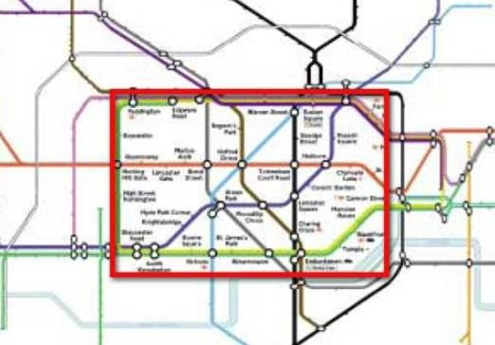
3. Creation of views:
Views are the final result of the generation process
Producing them corresponds to the computer graphics phase:
Often the quantity of data to represent is too large for the available space
To overcome this problem there are presentation and interaction techniques as:
Zooming
Panning
Scrolling
Focus + context
Magic lenses
...
https://www.interaction-design.org/literature/book/the-encyclopedia-
of-human-computer-interaction-2nd-ed/bifocal-display
18

Slide 18
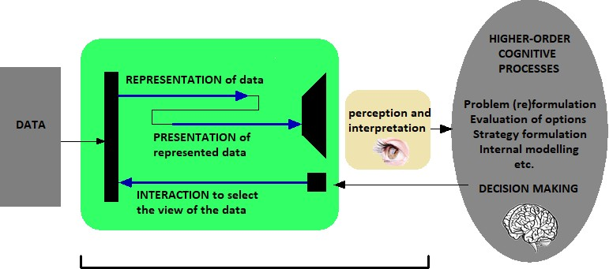
The process of visualization
Let us increase the known solution space organizing the methods!
(Spence, 2007)
Interaction with data governed by high-order cognitive processes involves:
Representation
Presentation
- Interaction
19

Slide 19
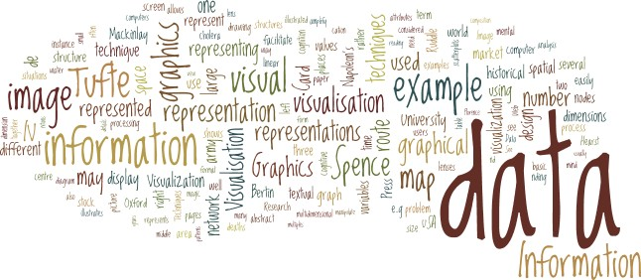
Data Characteristics
Universidade de Aveiro Departamento de Electrónica, Telecomunicações e Informática
Beatriz Sousa Santos, University of Aveiro, 2021

Slide 20
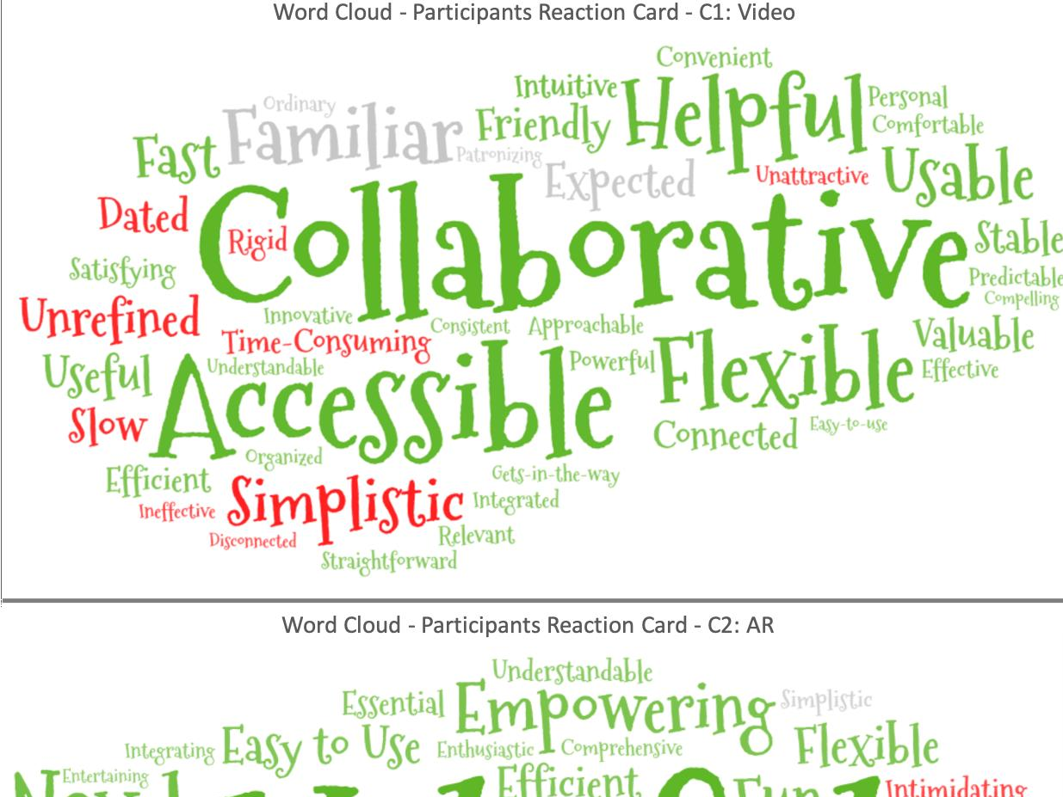

Slide 21
Data may have a lot of different forms and there are many techniques and systems to visualize them
A data classification is important to:
predict what visualization techniques are adequate
make easier the communication about the data
allow a more systematic approach to Visualization
….

Slide 22
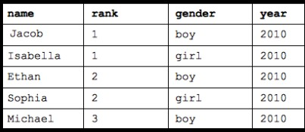
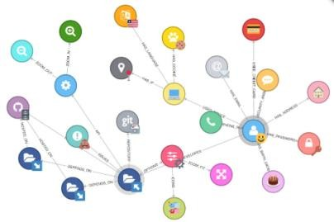

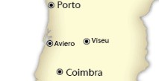

Data Abstraction
Four basic dataset types:
Tables
Networks
Fields
Geometry
Five basic datatypes
Items
Attributes
Links
Positions
Grids
Categorical
Ordinal
Ordered
Quantitative

Slide 23
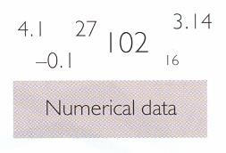
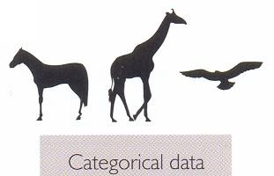
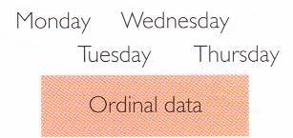
Data representation level:
Qualitative (or categorical)
Quantitative (or numeric)
Data nature:
Continuous
Discrete
Measuring scale:
Nominal
Ordinal
Interval
Ratio
(Spence, 2007)

Slide 24
Examples of measuring scales and types of data:
nominal --> car brands, gender, animal species…
ordinal --> week days, preferences, levels measured in a Likert-type scale
Interval --> date, IQ, temperatures in ºC
Ratio --> temperatures in ºK, weight, height
The ratio scale represents the highest level of representation, has a non-
arbitrary zero (unlike the interval scale)
This is a general classification and might be used to select the statistical methods to use with the data

Slide 25
Model, structure and format of the data to Visualize
Consider a data set with three columns:
latitude longitude d
Which is the most adequate way to visualize these data?
If d is depth, the selected visualization technique may involve interpolation (ex: contours)
If data represent location and the number victims of traffic accidents, interpolation and contours do not make sense
Know the data structure is not enough
It is necessary to know the phenomenon behind the data!

Slide 26
Example: beyond the structure
of the data to Visualize
Consider a data set with three columns:
latitude longitude d
Which is the most adequate way to visualize these data?
If d is depth or altitude?
the selected visualization technique may involve interpolation
(e.g. isocontours, isosurfaces, 3D surface)
27

Slide 27
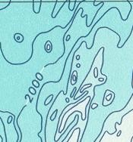
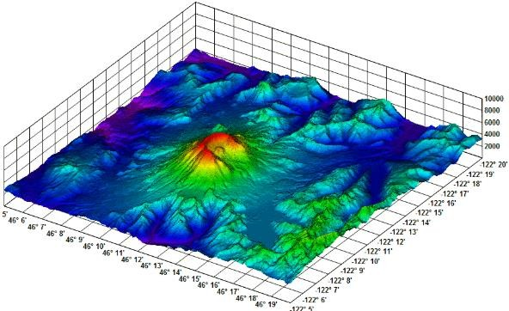
Example: beyond the structure
of the data to Visualize
Consider a data set with three columns:
latitude longitude d
Which is the most adequate way to visualize these data?
If d is depth or altitude?
the selected visualization technique may involve interpolation
(e.g. isocontours, isosurfaces, 3D surface)
28

Slide 28
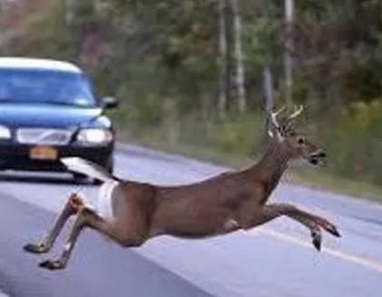
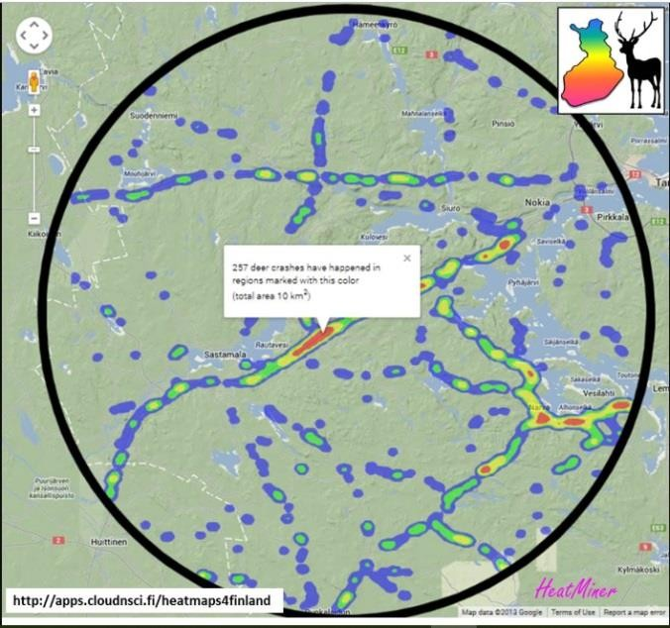
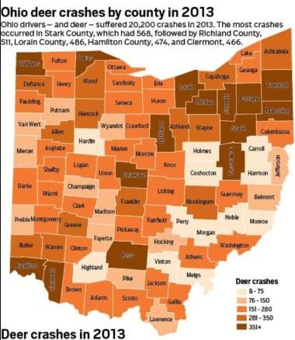
What if the data represent location and the number of “deer crash” accidents?
http://cloudnsci.fi/wiki/index.php?n
=Applications.Heatmaps4Finland
Interpolation and contours don’t make sense! Know the data structure is not enough
It is necessary to know the phenomenon behind the data

Slide 29
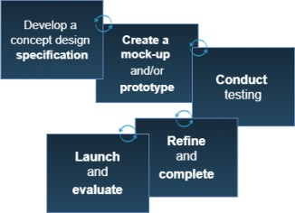
Developing a Visual data exploration application
a very brief introduction

Slide 30
Phases of the development cycle
of a visual data exploration application
(after understanding the users and their questions to elicit requirements, and pre-processing the data)
(Kirk, 2019)

Slide 31
There are several methods that can be used to help requirement
elicitation of an interactive application, e.g.
– User models (such as Personas)
Typical in user-centered design approaches (UCD)
– Scenarios
– Task analysis
– …

Slide 32
Personas
Personas are fictional characters based on user research to help
understand:
users’ needs,
experiences,
behaviors
goals.
Make the design task at hand less complex
Guide the ideation processes, and help to achieve the goal of creating a good user experience for the target user group
https://www.interaction-design.org/literature/article/personas-why-and- how-you-should-use-them

Slide 33
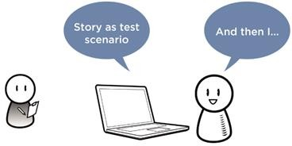
Scenarios
Stories and contexts about how the user groups use a future product/service
Note the goals and questions to be achieved and sometimes define the possibilities of how the user(s) can achieve them on the application
Scenarios are critical for
- designing
- UX testing
(Note: Different from User stories and Use cases)
https://www.usability.gov/how-to-and-tools/methods/scenarios.html https://www.interaction-design.org/literature/topics/user-scenarios
34

Slide 34
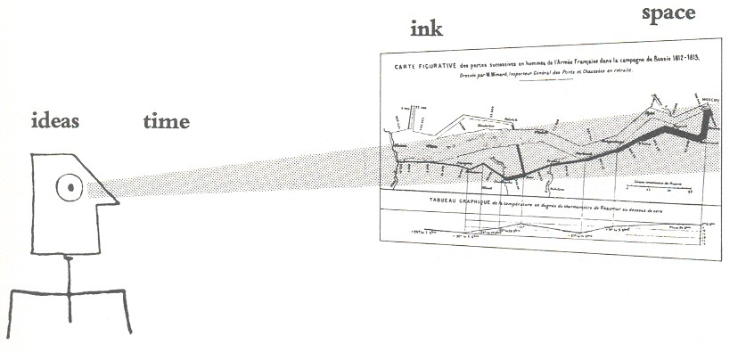
Effective Visualization
Universidade de Aveiro Departamento de Electrónica, Telecomunicações e Informática
Beatriz Sousa Santos, University of Aveiro, 2022

Slide 35
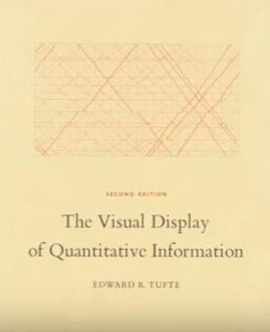
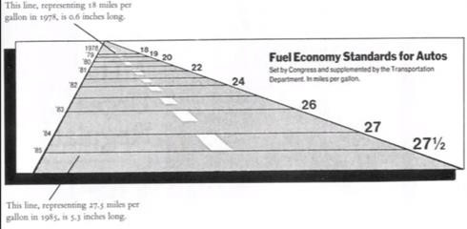
Effective visualization
Implies saying the truth about the data
Tufte presents a lot of commented examples in his book:
Tufte, E., The Visual Display of Quantitative Information, Graphics Press, 1983
There are methods to evaluate visualizations that should be used along the process of creating a visualization
https://infovis-wiki.net/wiki/Lie_Factor
36

Slide 36
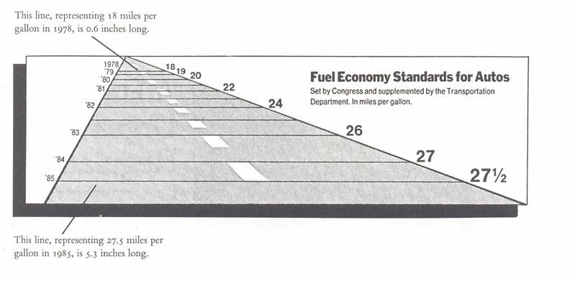
this example has several problems:
Lie Factor = 14.8
Legends have a constant size in one side and variable in the other
In roads, future usually lies in front, not behind

Slide 37
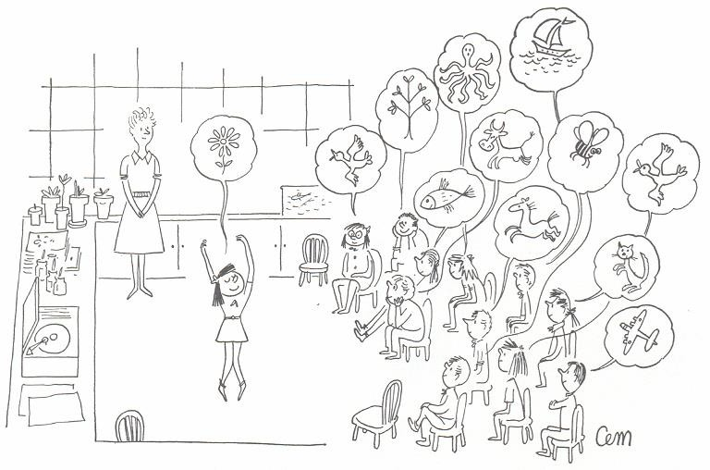
Perception varies with
- context
- experience
(Tufte, 1983)

Slide 38
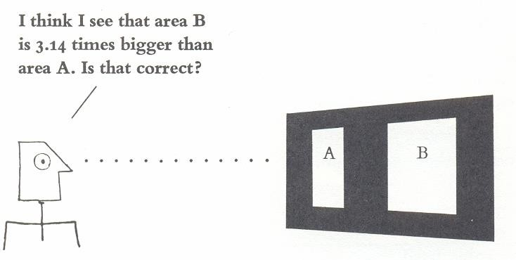
How do we know that the visual image represents the underlying numbers?
One way to try to answer these questions is to conduct experiments on the visual perception of graphics
(Tufte, 1983)

Slide 39
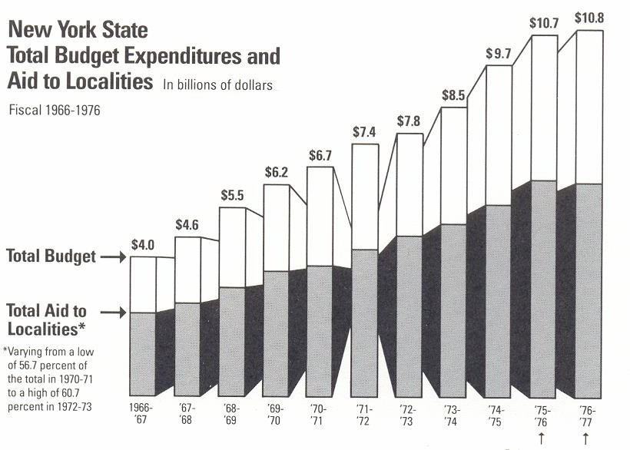
Another example:
42

Slide 40
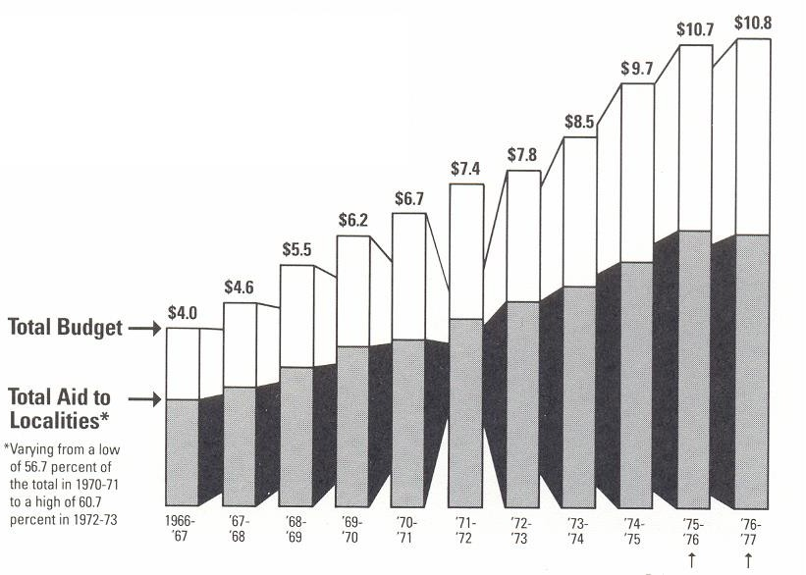
These three parallelipeds have been placed in na optical plane in front of the other eight, creating the image that the newer budgets tower over the older ones
Horizontal arrows provide emphasis,
Encorage the impression that recent
years have shot up from a small stable base
Arrows pointing straight up emphasize
recent growth
43

Slide 41
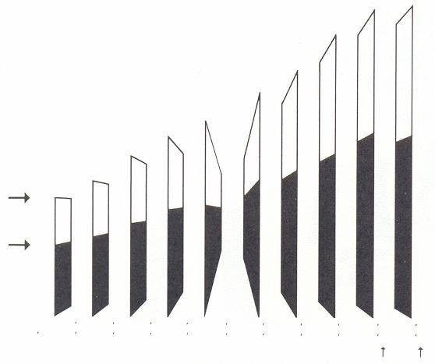
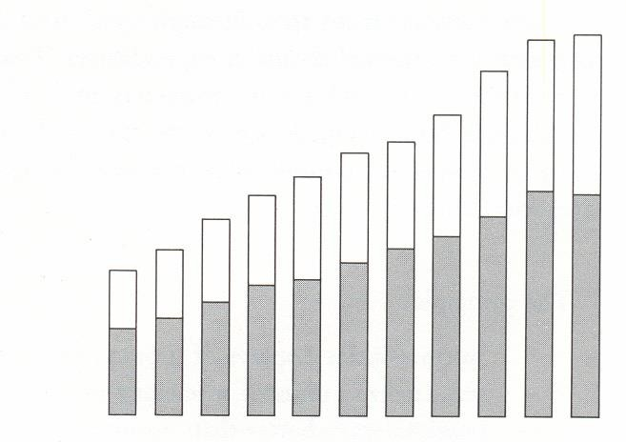
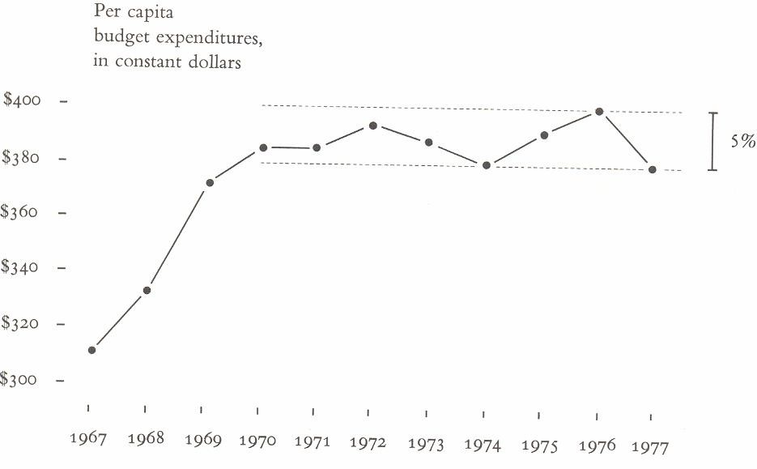
we have a calmer view:
Leaving behind the distortion
Two statistical lapses also bias the chart :
Population increased10%
there was substantial inflation
Final result

Slide 42
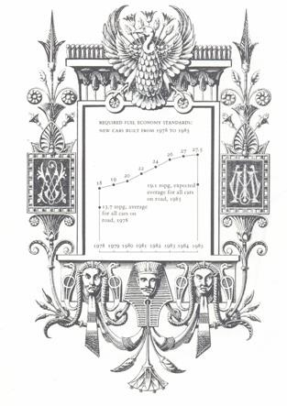
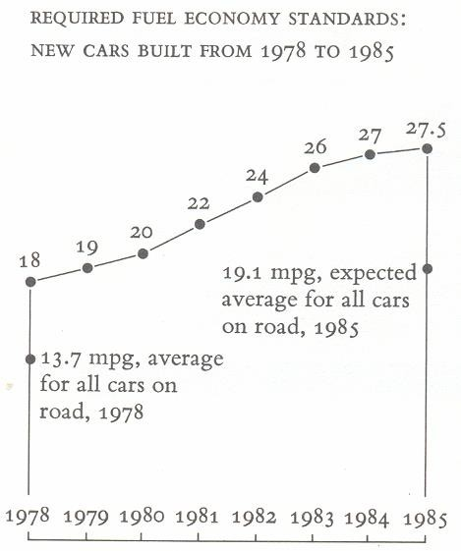
Decorations without lies:

Slide 43
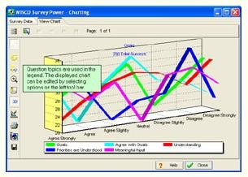
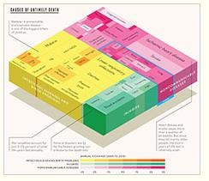
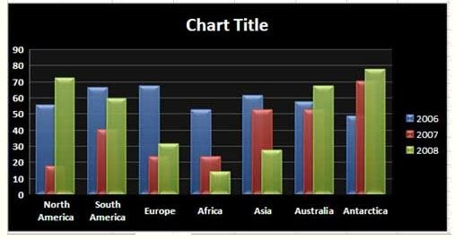
Effective visualization: more poor examples analyzed
There are methods to evaluate visualizations that should be used along the process of creating a visualization
http://www.perceptualedge.com/examples.php
46

Slide 44
Main bibliography
Spence, R., Information Visualization, An Introduction, Springer, 2014
Munzner, T., Visualization Analysis and Design, A K Peters, 2014
Kirk, A., Data Visualization : a successful design process. Packt Publishing, 2012
Mazza, R., Introduction to Information Visualization, Springer, 2009
Alberto Cairo, How Charts Lie: Getting Smarter about Visual Information, W.
W. Norton & Company; 1st edition, 2020
Tufte, E., The Visual Display of Quantitative Information, Graphics Press,
1983
47

