Slide 1


Introduction to Computer Graphics
main concepts and methods - II
Universidade de Aveiro Departamento de Electrónica, Telecomunicações e Informática
(Wikipedia)
Beatriz Sousa Santos
University of Aveiro, 2022

Slide 2
Topics
Computer Graphics main tasks
Geometric Primitives
Geometric transformations
2D and 3D visualization
Projections

Slide 3
CG Main Tasks
Modeling
Construct individual models / objects
Assemble them into a 2D or 3D scene (using transformations)
Rendering
Generate final images:
How is the scene illuminated?
What are the materials of the objects?
Where is the observer? How is he/she looking at the scene?
Animation
Static vs. dynamic scenes
Movement and / or deformation
33

Slide 4
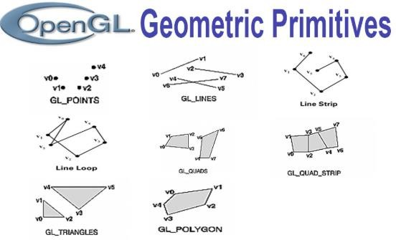
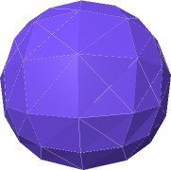
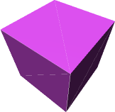

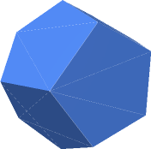

Geometric Primitives
Simple primitives
Points
Line segments
Polygons
Examples:
Geometric primitives
Parametric curves / surfaces
Cubes, spheres, cylinders, etc.
https://threejs.org/manual/#en/primitives
4

Slide 5







Computer Graphics APIs
Create 2D / 3D scenes from simple primitives
OpenGL and variants …
Rendering
No modeling or interaction facilities
Direct 3D – Microsoft
VTK
3D CG + Image processing + Visualization
Three.js
Vulkan …
5

Slide 6

Three.js
Cross-browser JavaScript library/API used to create and display animated 3D computer graphics in a web browser.
Uses WebGL
https://threejs.org/

Slide 7
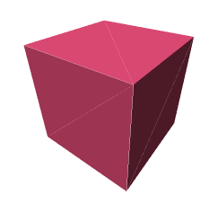
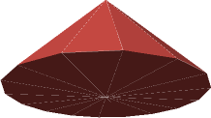
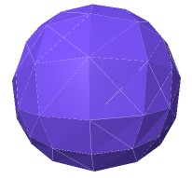
Geometric Primitives – three.js examples
const width = 8; // ui: width const height = 8; // ui: height const depth = 8; // ui: depth
const geometry = new THREE.BoxGeometry(width, height, depth);
const | radius = | 6; | // ui: radius
const | height = | 8; | // ui: height
const radialSegments = 16; // ui: radialSegments
const geometry = new THREE.ConeGeometry(radius, height, radialSegments);
const | radius = 7; | // ui: | radius
const | widthSegments = 12; |  | // ui: widthSegments
const | heightSegments = 8; |  | // ui: heightSegments
const geometry = new THREE.SphereGeometry(radius, widthSegments, heightSegments);
https://threejs.org/manual/#en/primitives
7

Slide 8
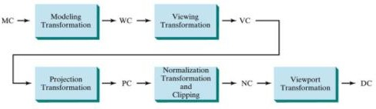
3D visualization pipeline (coordinate transformations)
MC - Modelling coordinates WC – World coordinates
VC – Viewing coordinates
PC – Projection coordinates
NC – Normalized coordinates DC – Display coordinates
(Hearn & Baker, 2004)
8

Slide 9
2D and 3D visualization pipeline
We will start by 2D transformations and viewing a 2D scene and then generalize to 3D
Main operations represented as point transformations
Basic transformation matrices
Homogeneous coordinates
Matrix multiplication and composed transformations
9

Slide 10
Basic 2D Transformations
p = (x, y) →
original point
p’ = (x’, y’) → transformed point
x
P
=
Basic transformations:
y
- Translation
x’
P’
=
- Scaling
y’
- Rotation
Vector notation
Complex transformations may be expressed as a composition of these
10

Slide 11
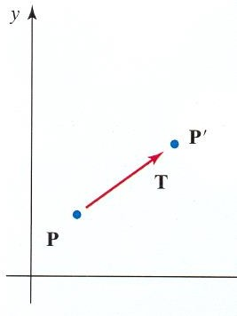
Translation
It is necessary to specify translations in x and y
x’ = x + tx y’ = y + ty
x
x’
tx
P
=
P’
=
T
=
y
y’
ty
P´ = P + T
transformation matrix
11

Slide 12
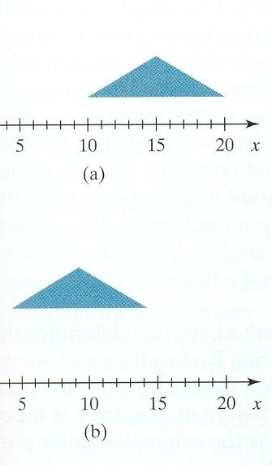
Translation
It is a rigid body transformation (it does not deform the object)
To apply a translation to a line segment we need only to transform the end points
To apply a translation to a polygon we need only to transform the vertices
(Hearn & Baker, 2004)
12

Slide 13
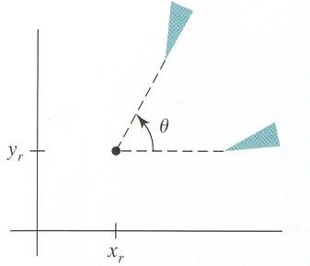
Rotation
To apply a 2D rotation we need to specify:
a point (center of rotation)
(x_{r} , y_{r} )
a rotation angle θ (the convention is: positive -> counter-
clockwise)
Positive rotation
13

Slide 14
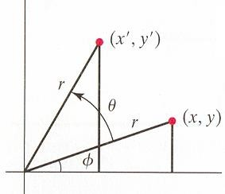
Rotation around the origin
The simplest case:
x’= r cos (Φ + Θ) = r cos Φ cos Θ – r sin Φ sin Θ
y’= r sin (Φ + Θ) = r cos Φ sin Θ + r sin Φ cos Θ
Polar coordenates of the original point:
x = r cos Φ
y = r sin Φ
r sin (Φ + θ)
Replacing:
x’ = x cos Θ – y sin Θ
y´ = x sin Θ + y cos Θ
r cos (Φ + θ)
14

Slide 15


2D Rotation in matrix notation
x’= r cos (Φ + Θ) = r cos Φ cos Θ – r sin Φ sin Θ
y’= r sin (Φ + Θ) = r cos Φ sin Θ + r sin Φ cos Θ
r sin (Φ + θ)
Reminder:
cos(α+β) = cos α cos β − sin α sin β
cos (α−β) = cos α cos β + sin α sin β
r cos (Φ + θ)
15

Slide 16


Scaling
Modifies the size of an object; we need to specify scaling
factors: s_{x}
and s_{y}
x’ = x . s_{x} y’ = y . s_{y}
Trasformation matrix
Transforming a square into a larger square applying a scaling s_{x}=2, s_{y}=2
(Hearn & Baker, 2004)
P’ = S . P

Slide 17
2D Transformations (composed)
Matrix representation
Homogeneous coordinates !!
Concatenation = Matrix products
Complex transformations ?
Decompose into a sequence of basic transformations
17

Slide 18
Homogeneous coordinates
Most applications involve sequences of transformations
For instance:
visualization transformations involve a sequence of translations and rotations to render an image of a scene
animations may imply that an object is rotated and translated between two consecutive frames
Homogeneous coordinates provide an efficient way to represent and apply sequences of transformations
18

Slide 19
It is possible to combine in a matrix the multiplying and additive terms if we use 3x3 matrices
All transformations may be represented by multiplying matrices in homogenous coordinates
Each point is now represented by 3 coordinates
( x, y ) → (x_{h}, y_{h}, h),
h = 0
x = x_{h} / h y = y_{h} / h
( x.h, y.h, h)
19

Slide 20
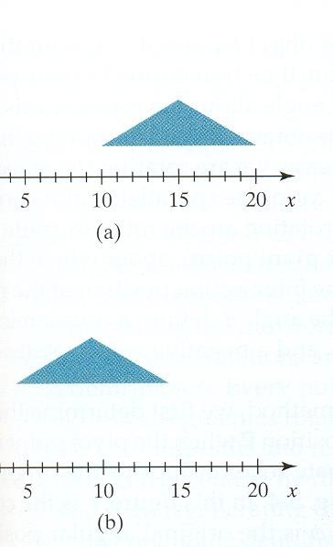
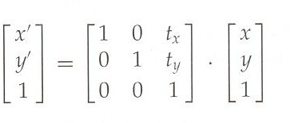

2D Translation
(in homogeneous coordinates)
(Hearn & Baker, 2004)

Slide 21
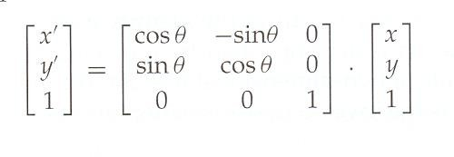
2D Rotation
(in homogeneous coordinates)
x’= r cos (Φ + Θ) = r cos Φ cos Θ – r sin Φ sin Θ
y’= r sin (Φ + Θ) = r cos Φ sin Θ + r sin Φ cos Θ
r sin (Φ + θ)
r cos (Φ + θ)

Slide 22
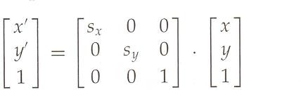

2D Scaling
(in homogeneous coordinates)
(sx = sy)
(sx ≠ sy)
(Hearn & Baker, 2004)
22

Slide 23
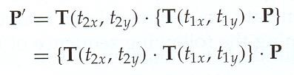
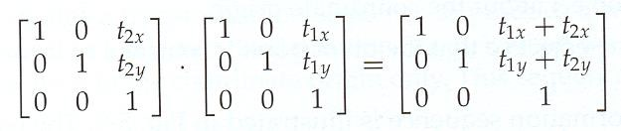
Concatenation of two translations

Slide 24
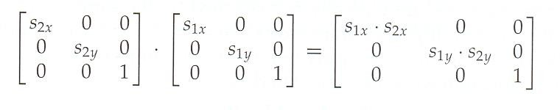

Concatenation of two scaling transformations

Slide 25
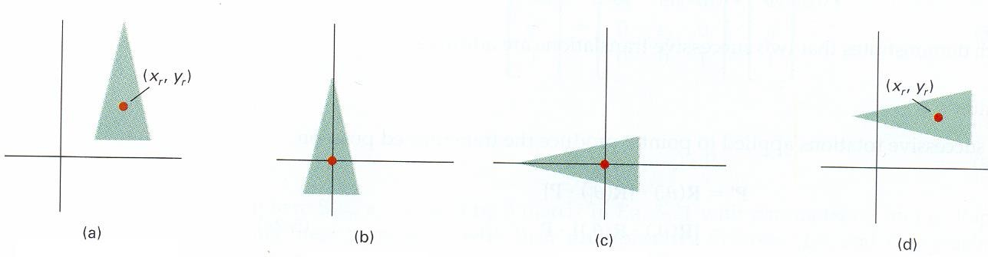
Arbitrary Rotation (around any point)
(Hearn & Baker, 2004)
Translation +
(to the origin)
Rotation +
(around the origin)
Inverse Translation (to the initial position)

Slide 26
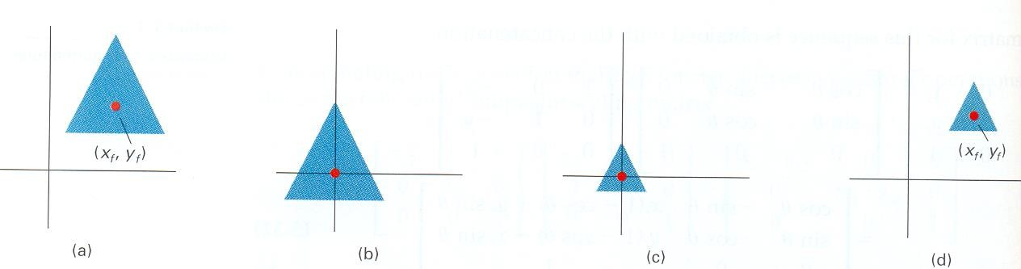
Arbitrary Scaling
(Hearn & Baker, 2004)
Translation + Scaling + Inverse Translation

Slide 27
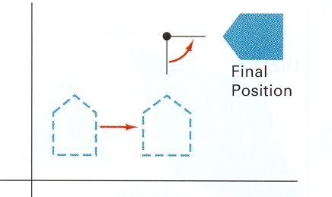
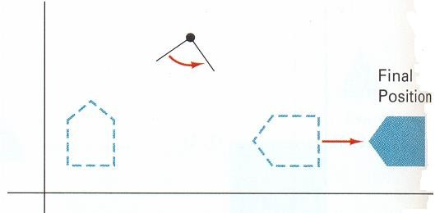
Order is important !
a) Translation + rotation
b) Rotation + translation
(Hearn & Baker, 2004)
Results may be different if transformations are applied in a different order!

Slide 28
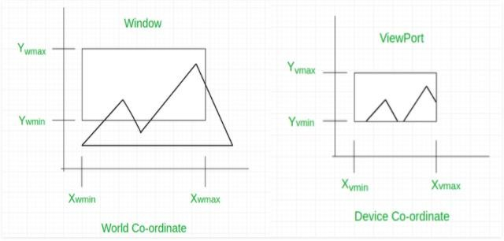
The case of viewing 2D scenes
Define a 2D scene in the world coordinate system
Select a clipping window in the XOY plane
– The window contents will be displayed
Select a viewport in the display
The viewport displays the contents of the clipping window
Note: Clipping window and viewport are the traditional terms in CG
https://www.geeksforgeeks.org/window-to-viewport-
transformation-in-computer-graphics-with-implementation/

Slide 29
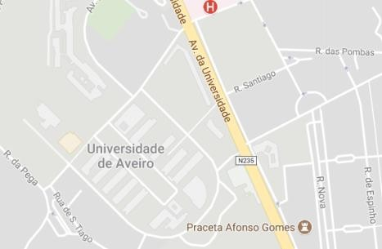



Viewport
World -> display
y
Clipping Window
yw
Display Coordinates
x
World Coordinates
xw

Slide 30
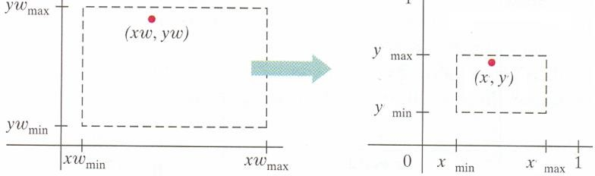
Coordinate mapping
Clipping Window
Viewport
World Coordinates
Screen coordinates
(Hearn & Baker, 2004)
Objects inside the clipping window are mapped to the viewport (the area on
the screen where they will be displayed).
Home work:
Compute (x,y) given (xw, yw)

Slide 31
Coordinate mapping
Clipping Window
Viewport
World Coordinates
Screen coordinates
(x,y) given (xw, yw) :
xw – xwmin = xwmax – xwmin
x – xmin xmax - xmin
yw – ywmin ywmax – ywmin
= y – ymin ymax - ymin

Slide 32
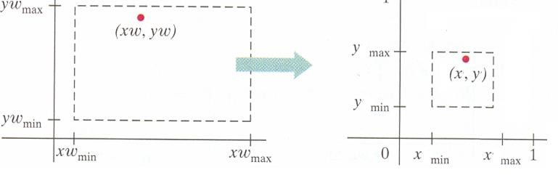
Coordinate mapping
If the aspect ratio is not the same in both situations the result is distortion
(Hearn & Baker, 2004)

Slide 33

World -> screen
y
y
Screen Coordinates
x
The aspect ratio is not the same in both situations: distortion!
World Coordinates
x

Slide 34
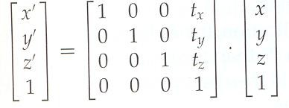
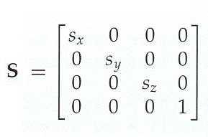
3D Transformations
(in homogeneous coordinates)
Translation
x
P y
z
=
Scaling
x’
P’ y’
z’
A 3D point in vector notation
=
34

Slide 35
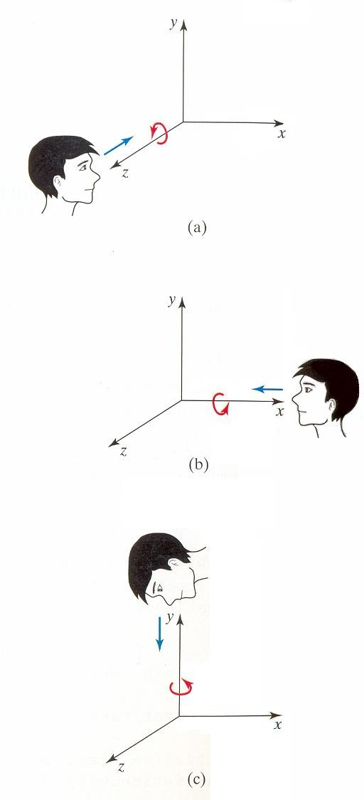
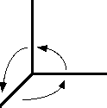
3D Rotation
(in homogeneous coordinates)
Rotation around each one of the coordinate axis
Positive rotations are CCW (counter
clock wise)!!
y
x
3D coordinate system in CG
z
(Hearn & Baker, 2004)
35

Slide 36
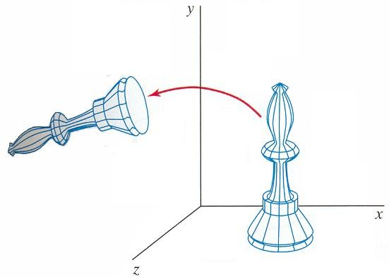
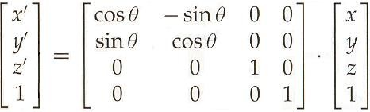
Rotation around ZZ’

Slide 37
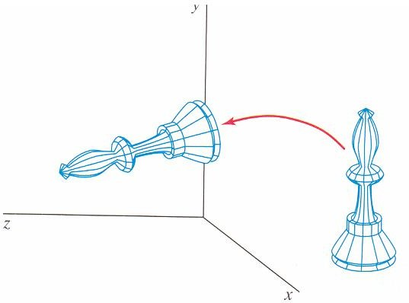
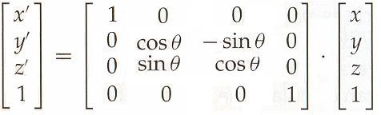
Rotation around XX’
(Hearn & Baker, 2004)

Slide 38
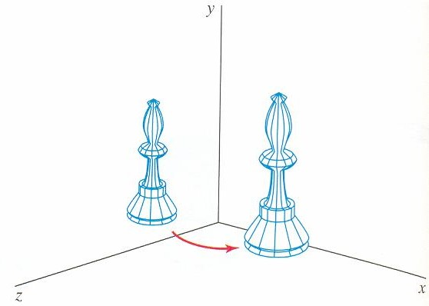
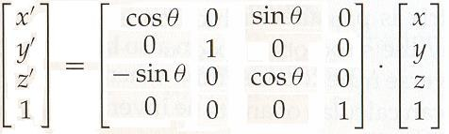
Rotation around YY’
(Hearn & Baker, 2004)

Slide 39
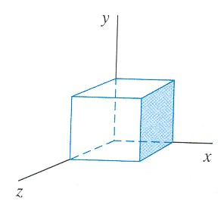
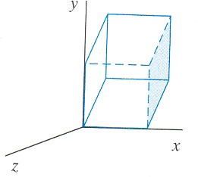
Other useful 3D Transformations
Shears
Reflections
Shear in ZZ’

Slide 40
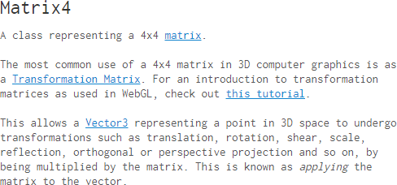
Transformations in three.js
https://threejs.org/docs/#api/math/Matrix4

Slide 41
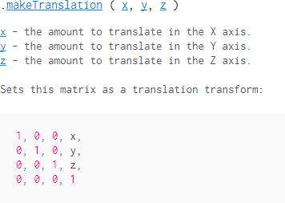
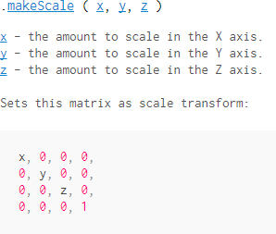

Slide 42
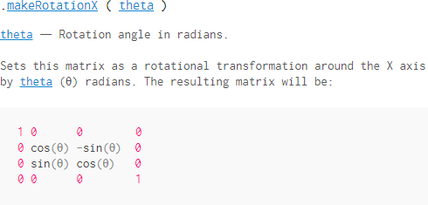
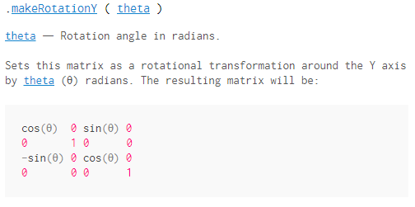
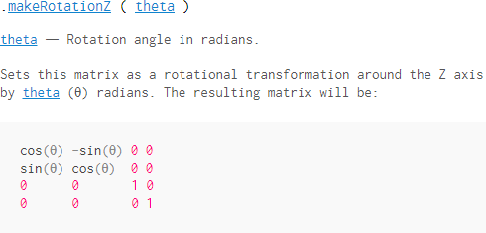

Slide 43



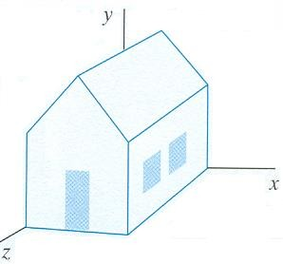

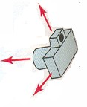
3D Viewing
(Hearn & Baker, 2004)

Slide 44
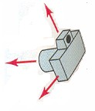
3D Viewing
Where is the observer / the camera ?
Position ?
Close to the 3D scene ?
Far away ?
How is the camera/observer looking at the scene ?
Orientation ?
How to represent as a 2D image ?
Projection ?

Slide 45
3D visualization pipeline
Instantiate models of the scene
Position, orientation, size
Establish viewing parameters
Camera position and orientation
Compute illumination and shade polygons
Perform clipping
Project into 2D
Rasterize
49

Slide 46
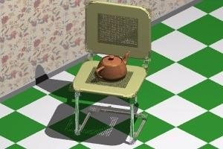
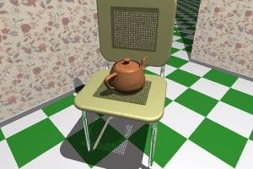
Projection (from 3D to 2D)
Obtaining a 2D representation of a 3D scene may be done in different ways …
Parallel Projection
(allows measures)
Perspective Projection
(more realistic images)
https://www.britannica.com/science/projection-geometry
51

Slide 47

Projections
https://www.javatpoint.com/computer- graphics-projection

Slide 48




Projections
Examples of resulting representation on the viewing plane
Parallel Projection
(Hearn & Baker, 2004)
Perspective Projection
53

Slide 49


Parallel Projections
Orthographic / Axonometric projection
Oblique projection
Orthographic/ Multiview projection
(Hearn & Baker, 2004)
54

Slide 50


Perspective Projections
One vanishing point perspective projection
Two vanishing points perspective projection
(Hearn & Baker, 2004)

Slide 51



Perspective Projections
Foreshortening indicates a
perspective projection
Approximate representation as a scene is seen by the eye
Object's dimensions along the line of sight appear shorter than its dimensions across the line of sight https://en.wikipedia.org/wiki/Perspective_(graphical)

Slide 52


Orthographic vs
perspective camera

Slide 53
How to represent ?
Projection matrices
Homogeneous coordinates
Concatenation through matrix multiplication
Don’t worry !
Graphics APIs implement usual projections !
58

Slide 54




How to apply Projections?
Also by matrix multiplication
Example: Matrix of the orthographic projection on the xy plane in homogeneous coordinates:
zz coordinates are discarded
y
_{x} 9
z
5

Slide 55


How to limit what is observed and represented ?
Clipping window on the projection plane
View volume (frustum) in 3D
Far Clipping plane
Clipping window
Near Clipping plane
(Hearn & Baker, 2004)
Parallel projection
Perspective projection
61

Slide 56
Examples using Three.js
https://threejs.org/

Slide 57

Projections
https://threejs.org/examples/#webgl_camera

Slide 58

Clipping (and shadows)
https://threejs.org/examples/#webgl_clipping

Slide 59



Thee.js first example
1. Defining the scene, the camera and where the scene is rendered
var scene = new THREE.Scene();
var camera = new THREE.PerspectiveCamera( 75, window.innerWidth / window.innerHeight, 0.1, 1000 );
var renderer = new THREE.WebGLRenderer(); renderer.setSize( window.innerWidth, window.innerHeight ); document.body.appendChild( renderer.domElement );
65

Slide 60



2.Creating an object and camera position
var geometry = new THREE.BoxGeometry(1,1,1); var material = new THREE.MeshBasicMaterial( { color: 0x00ff00 } );
var cube = new THREE.Mesh( geometry, material ); scene.add( cube );
camera.position.z = 5;
66

Slide 61


3. Scene rendering
function render() { requestAnimationFrame(render); renderer.render(scene, camera);
}
4. Scene animation
render();
cube.rotation.x += 0.1;
cube.rotation.y += 0.1;

Slide 62



Adding lights and shading
var material = new THREE.MeshPhongMaterial({
ambient: '#006063', color: '#00abb1', specular: '#a9fcff', shininess: 100
});

Slide 63
Some reference books
D. Hearn and M. P. Baker, Computer Graphics with OpenGL, 3rd
Ed., Addison-Wesley, 2004
E. Angel and D. Shreiner, Introduction to Computer Graphics,
6th Ed., Pearson Education, 2012
J. Foley et al., Introduction to Computer Graphics, Addison-
Wesley, 1993
Hughes, J., A. Van Dam, et al., Computer Graphics, Principles and Practice, 3rd Ed., Addison Wesley, 2013
72

