Slide 1
A brief introduction to gRPC
High performance, open-source, universal RPC framework

Slide 2
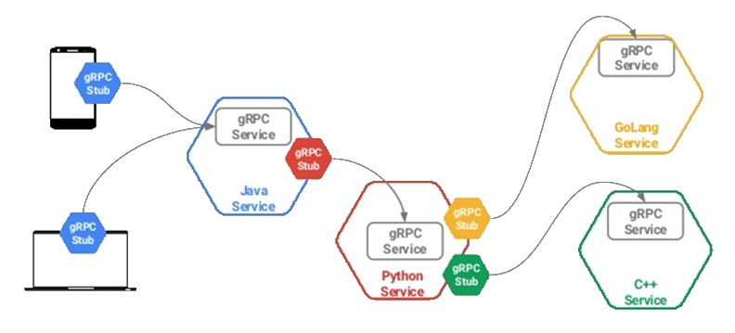
Overview
Client-Server architecture
Over HTTP/2

Slide 3
Why not REST?
For simple services REST is ok
HTTP verbs (GET, POST, PUT, DELETE, etc)
For complex services where efficiency is importante
Domain specific
Strongly typed
Efficiency with HTTP/2 and Protocol Buffer

Slide 4
Introduction to gRPC
Free (open source and license free)
Runs over HTTP/2 + TLS
Native bidirectional streaming
Payload agnostic (default is protocol buffer)
More than 20 languages
Native implementation in C, Java and Go
C stack wrapped by C++, C#, Node, Objective C, Python, Ruby, PHP
High performance interfaces (async, streaming)
High throughput and scalability, low latency
Minimal external dependencies

Slide 5
Supported Languages
Java
GO
Python
Ruby
C#
C/C++

Slide 6
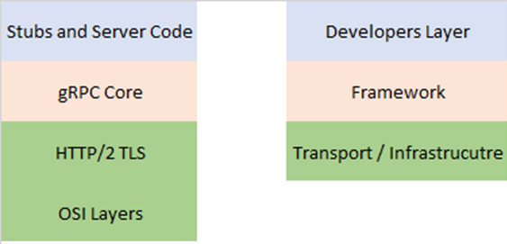
Developer’s perspective
You only work on Developers Layer

Slide 7
Where to find more information?
http://grpc.io
https://github.com/grpc

Slide 8
Demo
Server to Server communication
Greeting application
https://github.com/ricardodemauro/grpc_poc

Slide 9
References
https://www.stevejgordon.co.uk/early-look-at-grpc-using-aspnet-core-3
https://pt.slideshare.net/Codemotion/introduction-to-grpc-a-general-rpc-framework-that-puts-mobile-and-http2-first-mete-atamel-codemotion-amsterdam-2017
https://cloud.google.com/blog/products/gcp/announcing-grpc-alpha-for-google-cloud-pubsub
https://platformlab.stanford.edu/Seminar%20Talks/gRPC.pdf
https://grpc.io/
https://developers.google.com/protocol-buffers/docs/overview
https://www.stevejgordon.co.uk/early-look-at-grpc-using-aspnet-core-3
https://devblogs.microsoft.com/aspnet/asp-net-core-updates-in-net-core-3-0-preview-3/

