Slide 1
Customization of Bioinformatics Workflows for (Meta)genomics.
Ricardo Oliveira; Msc Student. Pedro Santos; Supervisor.
Notes:
Slide 1: Title Slide
•⁠ ⁠Customization of Bioinformatics Workflows for (Meta)genomics
•⁠ ⁠Ricardo Oliveira1 and Pedro Santos2
•⁠ ⁠1 School of Engineering, Minho University, Campus de Azurém, Guimarães, Portugal
•⁠ ⁠2 Biology Department, Minho University, Campus de Gualtar, Braga, Portugal

Slide 2
01
Background
Notes:
Slide 4: Background Part 1
•⁠ ⁠Importance of identifying and characterizing microorganisms in microbiology.
•⁠ ⁠Shift from traditional physical and biochemical methods to DNA-based approaches.
•⁠ ⁠Advances in high-throughput sequencing technologies and their impact on metagenomics.

Slide 3
Background
Importance of identifying and characterizing microorganisms in microbiology.
Shift from traditional physical and biochemical methods to DNA-based approaches.
Advances in high-throughput sequencing technologies and their impact on metagenomics.
Key software: QIIME, USEARCH, DADA2, DECIPHER, RDP classifier, PHYLOSEQ.
Explosion in bioinformatics tools for metabarcoding analysis.
Notes:
Slide 3: Background Part 1
•⁠ ⁠Importance of identifying and characterizing microorganisms in microbiology.
•⁠ ⁠Shift from traditional physical and biochemical methods to DNA-based approaches.
•⁠ ⁠Advances in high-throughput sequencing technologies and their impact on metagenomics.
Background Part 2
•⁠ ⁠Explosion in bioinformatics tools for metabarcoding analysis.
•⁠ ⁠Key software: QIIME, USEARCH, DADA2.
•⁠ ⁠Challenges: Choosing the right tools and dealing with different datasets.

Slide 4
02
AIMS
Notes:
Slide 3: Keywords and Objective
•⁠ ⁠Keywords: Metabarcoding
•⁠ ⁠Objective: Evaluate performance of metabarcoding analysis tools using different sequencing platforms (Illumina, PacBio, Oxford Nanopore).
•⁠ ⁠Assess each workflow step using tools like DADA2, USEARCH/VSEARCH.
•⁠ ⁠Develop customizable scripts for each analysis phase.
⁠ ⁠Evaluate each workflow phase and develop adaptable scripts.
•⁠ ⁠Apply scripts to a real-world case study.
•⁠ ⁠Address complexity in selecting suitable algorithms and ensure robustness through benchmark studies.

Slide 5
Aims
Asses each step
Evaluate the performance of metabarcoding
02
01
Using the following tools: DADA2, USEARCH/VSEARCH.
Analyzing tools using different sequencing platforms. (Illumina, PacBio, Oxford Nanopore).
Develop customizable scripts for each analysis phase.
Apply scripts to a real-world case study.
03
04
Address complexity
05
In selecting suitable algorithms and ensure robustness through benchmark studies.
Keywords: Metabarcoding
Notes:
Slide 3: Keywords and Objective
•⁠ ⁠Keywords: Metabarcoding
•⁠ ⁠Objective: Evaluate performance of metabarcoding analysis tools using different sequencing platforms (Illumina, PacBio, Oxford Nanopore).
•⁠ ⁠Assess each workflow step using tools like DADA2, USEARCH/VSEARCH.
•⁠ ⁠Develop customizable scripts for each analysis phase.
•⁠ ⁠Apply scripts to a real-world case study.
•⁠ ⁠Address complexity in selecting suitable algorithms and ensure robustness through benchmark studies.

Slide 6
03
Project Workflow

Slide 7
Project Workflow
Mock communities:
Zymo Research (D6300, D6305), ATCC.
Development of customizable scripts.
Classification algorithms:
RDP classifier SINTAX.
1
2
3
4
5
Performance analysis tools:
DADA2, USEARCH/VSEARCH.
Metrics:
Taxa identification & quantify proportions.
Notes:
Slide 11: Project Workflow Part 1
•⁠ ⁠Mock communities used: Zymo Research (D6300, D6305), ATCC, customized mock communities.
•⁠ ⁠Performance analysis tools: DADA2, USEARCH/VSEARCH.
Slide 12: Project Workflow Part 2
•⁠ ⁠Classification algorithms: RDP classifier, SINTAX.
•⁠ ⁠Metrics: Ability to identify organisms, quantify proportions.
•⁠ ⁠Development of customizable scripts based on performance studies.

Slide 8
04
Results

Slide 9
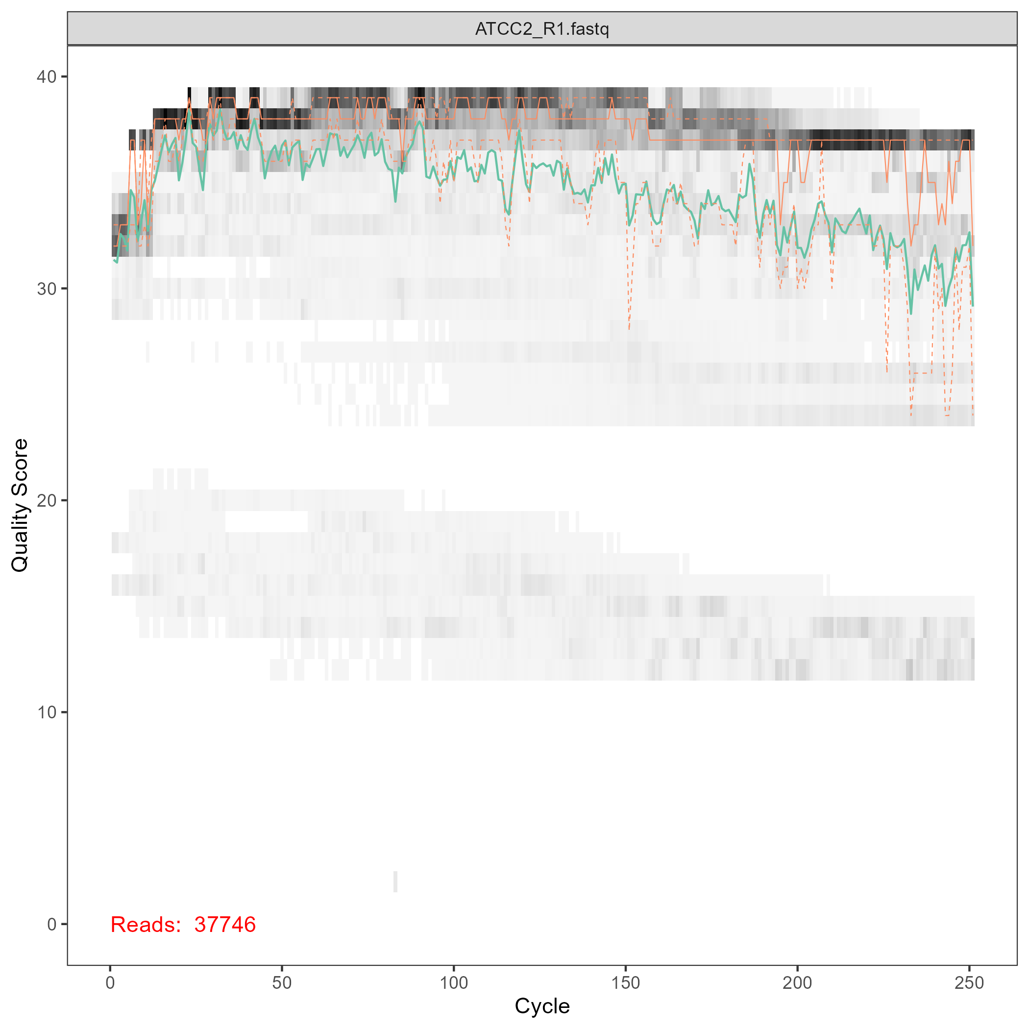
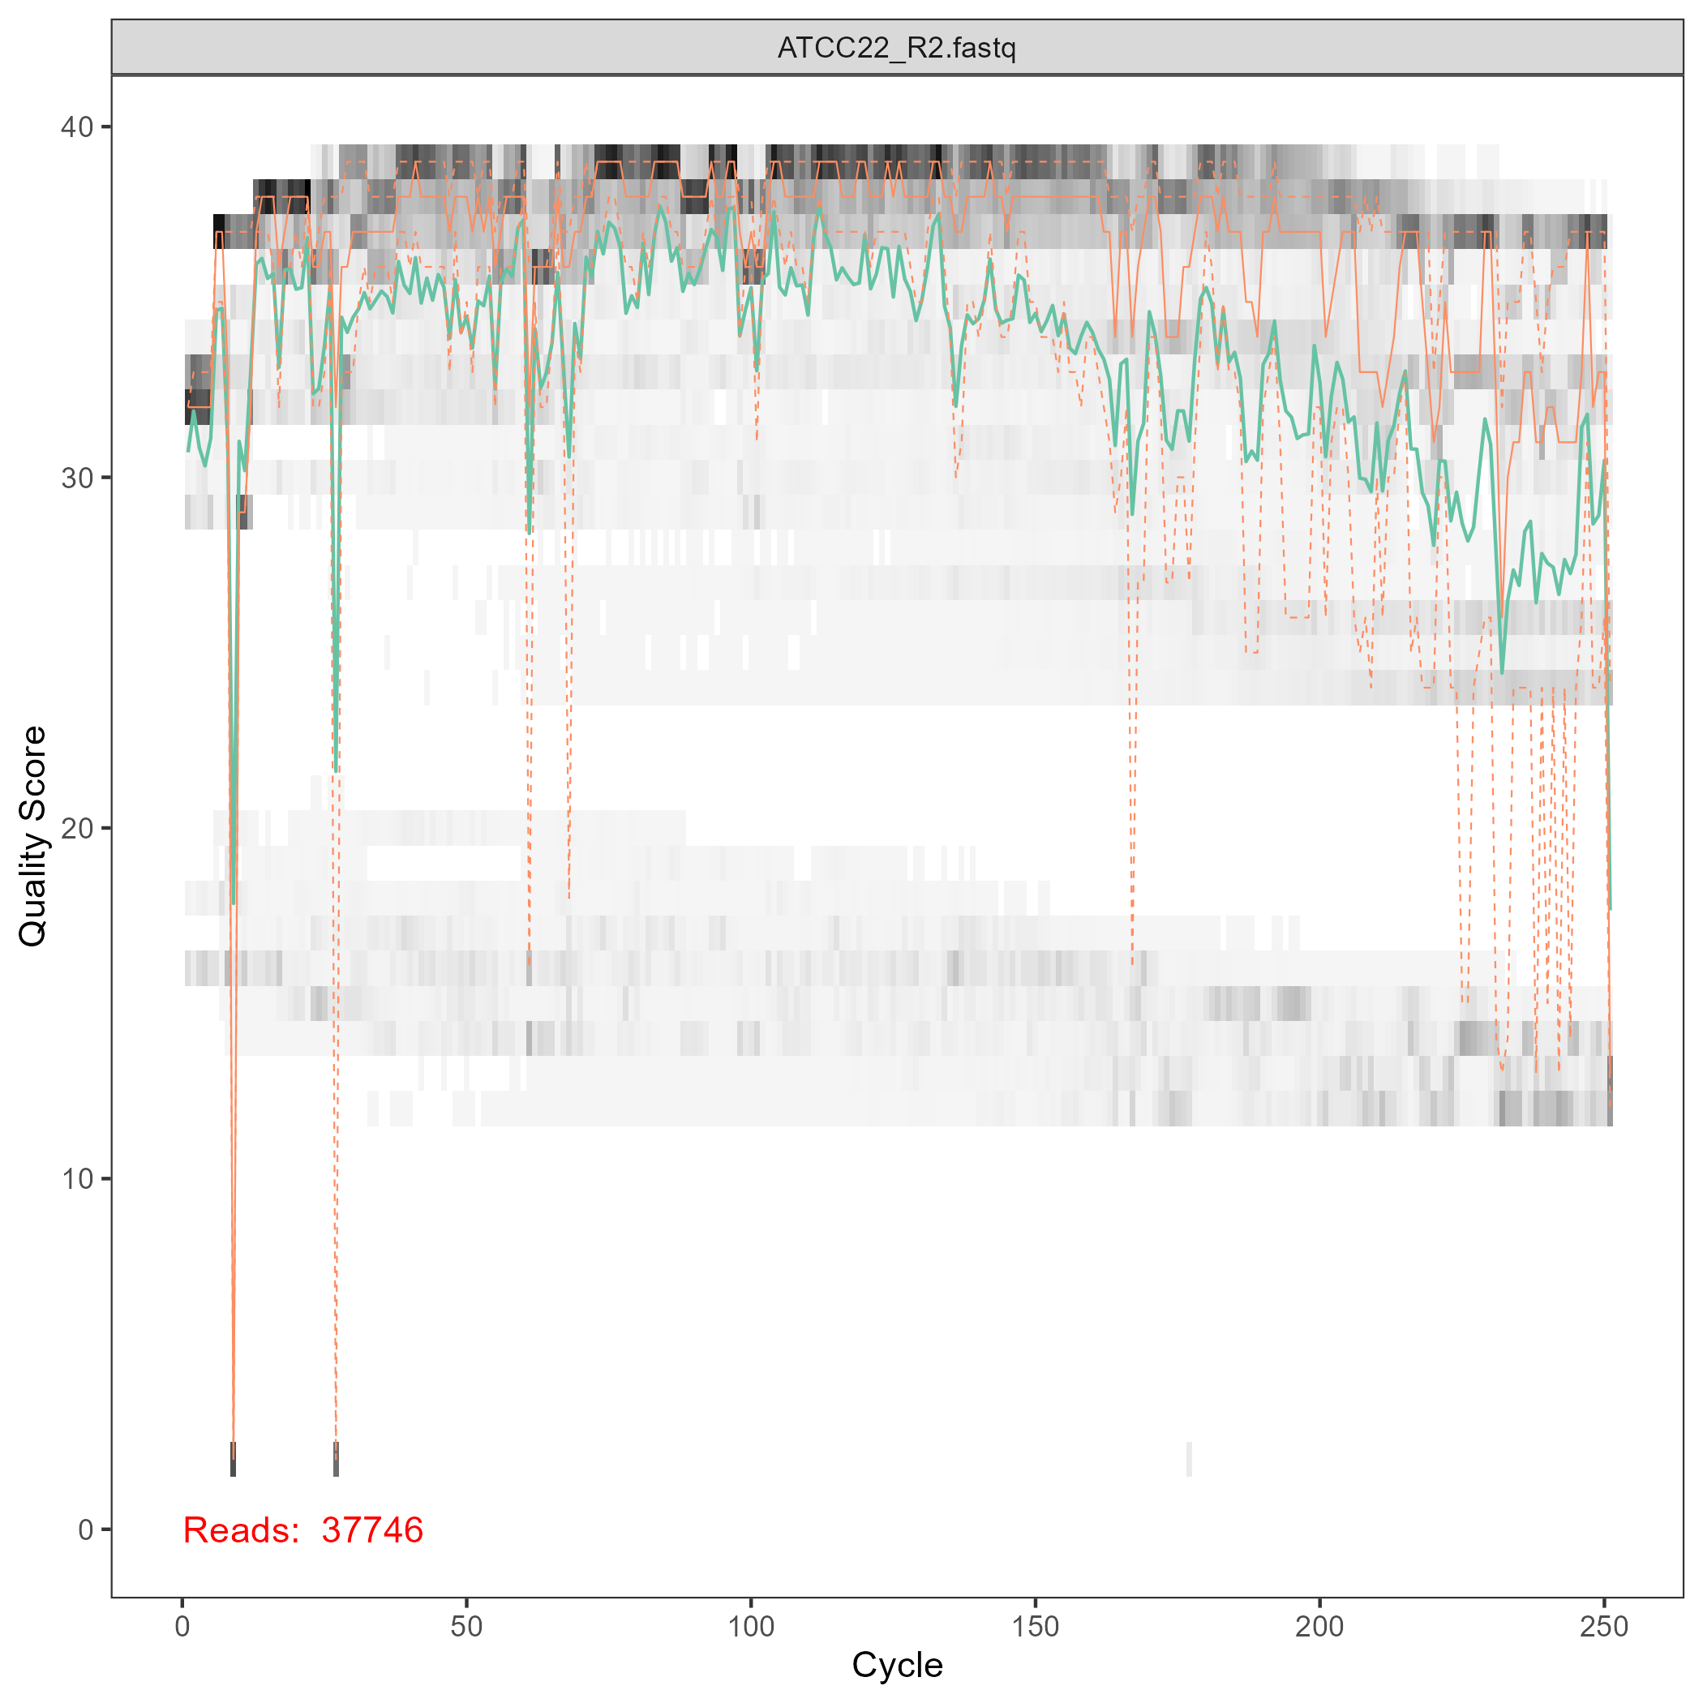
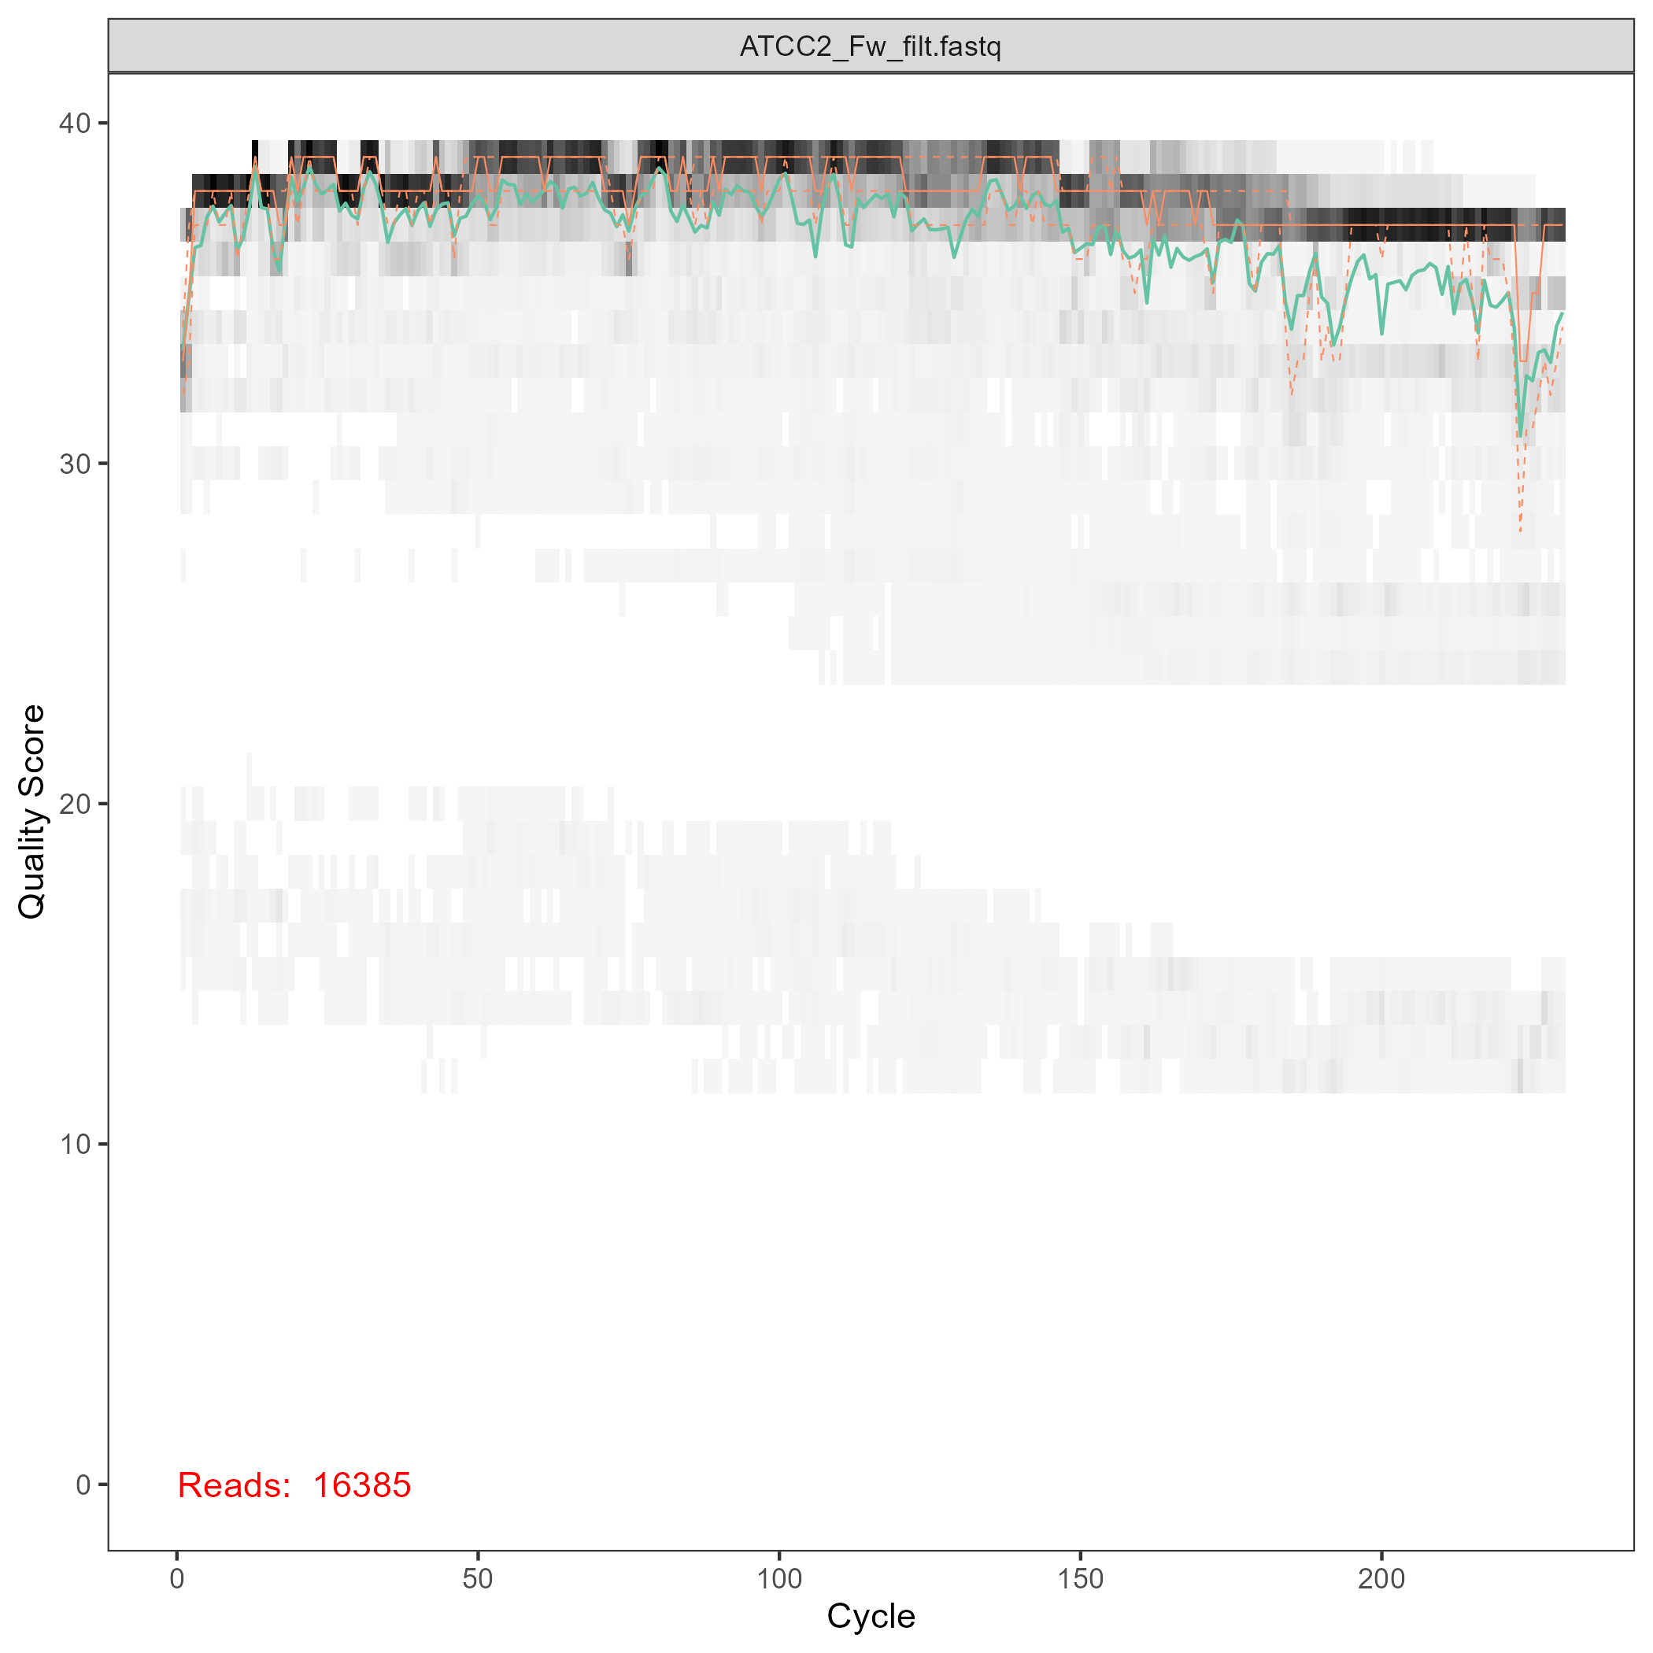
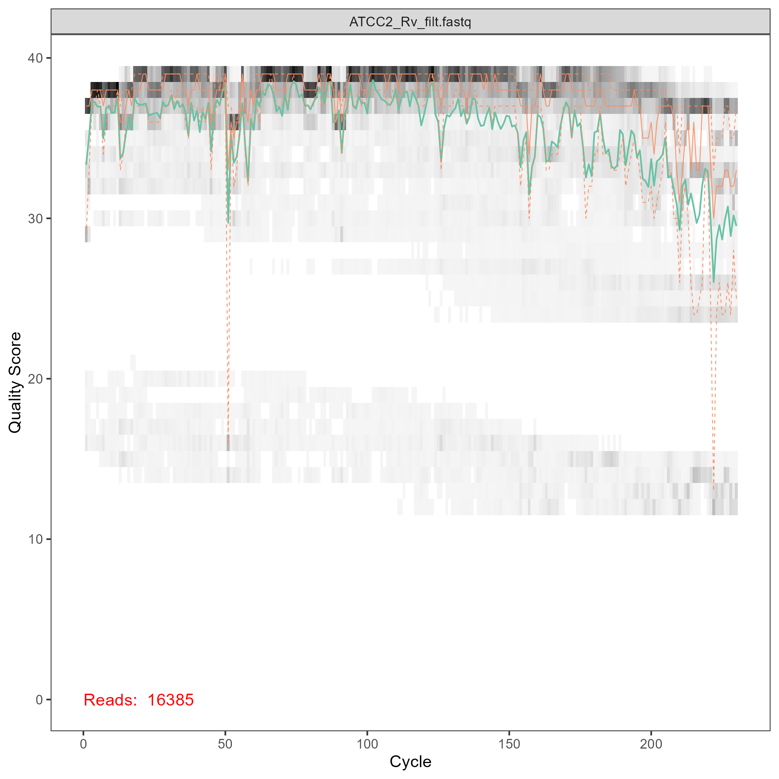
Quality control
Fig 1: Reads filtration for the sample ATCC2 (Top: unfiltered; Bottom: filtered)
Notes:
truncLen=c(240,240), minLen=200, trimLeft=10, truncQ=2, maxEE=c(1,2), maxN=0

Slide 10
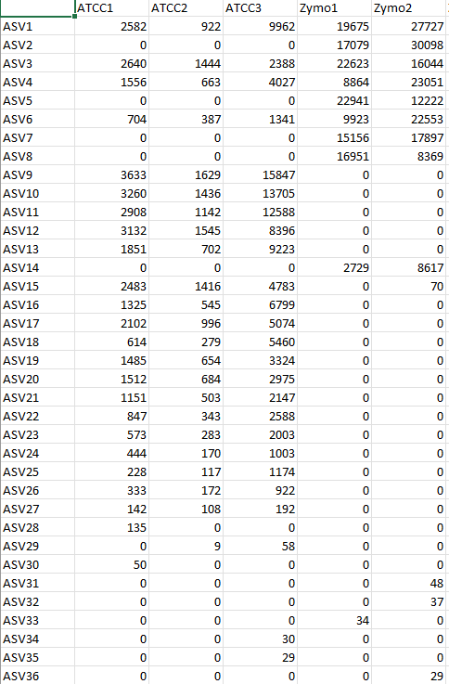
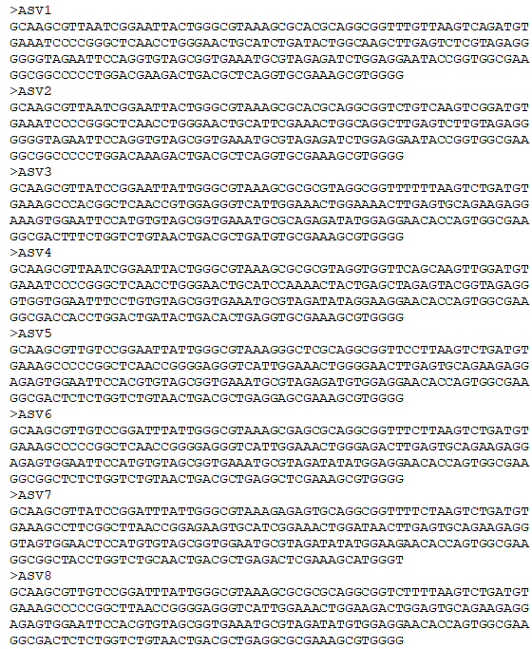
ASV formation
Fig 2: Results of the ASV formation using DADA2

Slide 11
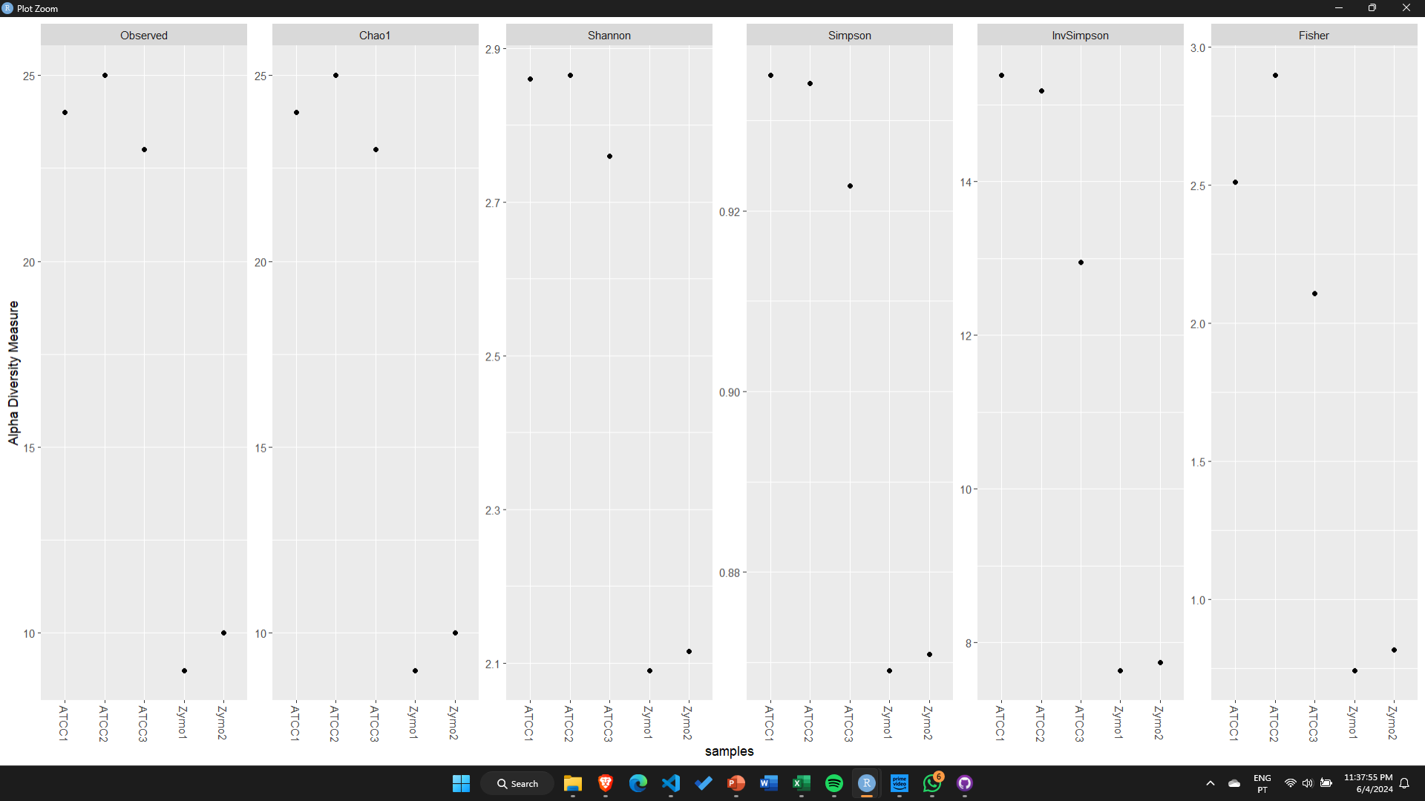
Phyloseq analysis
Fig 3: Biodiversity analysis
Notes:
1. Observed: It simply counts the number of observed OTUs in your sample. It's a good starting point but can underestimate the true richness, especially in low-sampled datasets.
2. Chao1: This is a non-parametric richness estimator that attempts to account for the number of unobserved ASVs in your sample.
3. Shannon: This is a widely used diversity index that considers both the richness and the evenness (abundance distribution) of your microbial community. Higher Shannon values indicate greater diversity, with more evenly distributed abundances.
4. InvSimpson (1/Simpson): Simpson index is a diversity measure that incorporates richness and evenness. However, it emphasizes dominance by giving more weight to abundant OTUs. Higher values indicate higher diversity.
5. Fisher: The Fisher alpha diversity index is another estimator that takes into account the number of singletons and doubletons to estimate richness. It can be a good alternative to Chao1 in some cases.

Slide 12
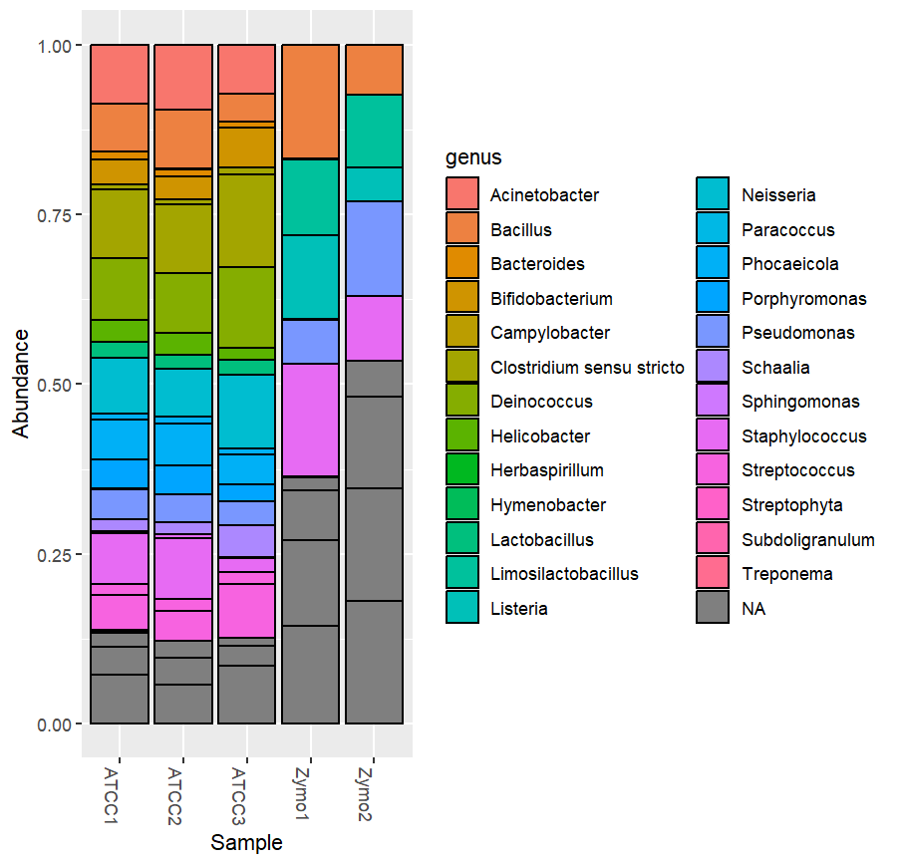
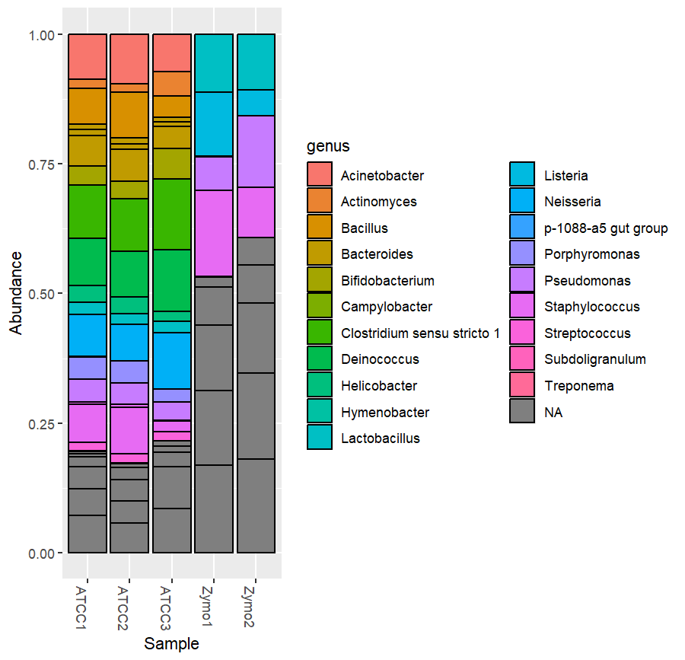
Phyloseq analysis
Fig 4: Genus classification (left: RDP; right: SILVA; blue: ATCC; red: Zymo)
Notes:
ATCC – from the 20 organisms only 4 were not detected
Zymo – from 8 organisms only 3 were not detected

Slide 13
05
Upcoming Goals

Slide 14

Upcoming Goals
Application of the develop scripts to real case study.
Expansion of the software used, and the sequencing technologies supported.
Allow a personalized analysis
Microbobes composition of marine sediments.
Testing & validation of the develop workflow.
Notes:
Slide 13: Project Workflow Part 3
•⁠ ⁠Application of developed scripts to real case study.
•⁠ ⁠Example case study: Microbes composition of marine sediments.
•⁠ ⁠Testing and validation of the developed workflow.

Slide 15
Thanks!

