Slide 1


Offer analysis
December 2015
Private and Confidential

Slide 2

Agenda
Objective
Data description
Data manipulation
Methods
Descriptive Statistics
Association Rules
Decision Tree
Conclusion

Slide 3
Objective
Find out if there is any relation between the features of the Offer and chances of booking.

Slide 4
Data Description
The data was divided into three groups:
Success: trips who had at least one booking who wasn’t canceled and the trip wasn’t canceled by the driver.
Not success: trips who had no bookings or all the bookings were canceled, but the trip wasn’t canceled by the driver.
Canceled: trips who had or not bookings but the trips were canceled by the driver.
Database selected:
Routes from Campinas to São Paulo on Fridays between 02/05/2015 and 09/25/2015.
Why this route and this day of week?
To minimize the effect of external factors, like different number of users from different Countries and different chances of booking by day of week.
Number of instances after all treatments:
Total: 2955 instances
Success: 2255 instances
Not Success: 140 instances
Canceled: 560 instances

Slide 5
Data Manipulation
Data extraction:
Users and Trips tables from Data Warehouse.
Cars table (and other tables connected to the Cars table) from the Production database.
Process flow of the database creation before the analysis:
Join of the tables by user_id and id of leg
Problems and errors identification
Creation of new variables
Variables categorization
Solution of the problems and errors identified (data cleansing)

Slide 6
Data Manipulation
Errors identification:
Instances with more final bookings than seats offered.
On our database, some trips who were canceled by the driver added on the variable seats_canceled (seats canceled by the pax).
The age of the user is according to the date of the data extraction, not the date of the trip.
Problems identification:
The leg Campinas -> São Paulo can be just a leg between a trip, we have the following cases:
More than one leg between Campinas e São Paulo involving another city.
Example A: Americana -> Campinas - > São Paulo.
This leg probably would be on the NOT SUCCESS group. But we don’t know if the leg didn’t had bookings because in fact no one wanted to take the leg or because the car were already full by another leg and it was not possible anymore to book the leg.
Example B: Campinas -> São Carlos -> São Paulo
Like the example A, would not solve to bring just the main leg.
Departure City | Arrival City | Seats Offered | Seats Booked | Seats Canceled | Seats Rejected | Main leg
Americana | São Paulo | 4 | 3 | 1 | 0 | 1
Campinas | São Paulo | 4 | 0 | 0 | 0 | 0
Americana | Campinas | 4 | 4 | 1 | 1 | 0
Departure City | Arrival City | Seats Offered | Seats Booked | Seats Canceled | Seats Rejected | Main leg
Campinas | São Carlos | 5 | 2 | 0 | 0 | 0
Campinas | São Paulo | 5 | 1 | 1 | 0 | 1
São Carlos | São Paulo | 5 | 8 | 4 | 1 | 0

Slide 7
Data Manipulation
2) More than one leg between Campinas and São Paulo without involve another city.
Example : Campinas - > São Paulo (Center) -> São Paulo(USP).
Same problem as the other cases. But in this case, two legs would be selected from the table to the same trip, one would be on the SUCCESS and the other on the NOT SUCCESS group.
In the three cases the cars were full on the trip but not necessarily on the legs.
An unsolved problem:
It’s not possible to considerer the pages on the website that the offer apeared to the pax, because this can be different by pax and filters.
Departure City | Arrival City | Seats Offered | Seats Booked | Seats Canceled | Seats Rejected | Main leg
Campinas | São Paulo (Center) | 6 | 4 | 0 | 0 | 0
Campinas | São Paulo (USP) | 6 | 0 | 0 | 0 | 1
São Paulo (Center) | São Paulo (USP) | 6 | 3 | 0 | 1 | 0

Slide 8
Data Manipulation
Solution of the problems and errors identified:
Exclusion of 17 instances who had more final bookings than seats offered.
Replacement of the variable “seats_canceled” by “seats_canceled_pax”. We did a research on the database to find out what seats were in fact canceled by the pax.
Replacement of the variable age by the age on the date of the trip.
Exclusion of 27 instances who the bookings, cancellations or rejections were on another leg from the trip that was not Campinas -> São Paulo.
Exclusion of 25 instances who show that the leg Campinas -> São Paulo didn’t had bookings, but were full because of another leg.

Slide 9
Data Manipulation
Creation of new variables:
User_created_time: HH:MM
User_created_hour: HH
Trip_created_time: HH:MM
Trip_created_hour: HH
Trip_departure_time: HH:MM
Trip_departure_hour: HH
User_age_calculated_grouped: age groups from "18-21", "22-25", "26-29", "30-33", "34-37", "38-41", "42-45", "46-49", "50-70", "DESCONSIDERAR“ and "NoAge"
User_avg_rating: user_total_rating / user_ratings
Count_trip_id_geral: quantity of legs on a trip
Trip_realized: if in the end the trip happened or not (more than one booking or zero bookings)
Seats_booked_final: seats_booked – (seats_rejected + seats_canceled)
Trip_car_conditions: seats_offered(trip) - seats_booked_final(trip) = EMPTY, FULL, NOT FULL
Leg_car_conditions: seats_offered(leg) - seats_booked_final(leg) = EMPTY_CAR, EMPTY_PAX, FULL, NOT FULL
Days_created_to_trip: trip_departure_datetime – trip_created_datetime
Leg_group: SUCCESS, NOT SUCCESS, CANCELED

Slide 10
Methods
Descriptive Statistics: are used to describe the basic features of the data in a study. They provide simple summaries about the sample and the measures. Together with simple graphics analysis, they form the basis of virtually every quantitative analysis of data. In our analysis, we worked with frequency distribution bar chart and boxplot.
Association rules: are used to find patterns in a large data set. The association rule find if an item or set of items has an association with another item or set of items.
Decision tree: builds classification or regression models in the form of a tree structure. It breaks down a dataset into smaller and smaller subsets while at the same time an associated decision tree is incrementally developed.

Slide 11
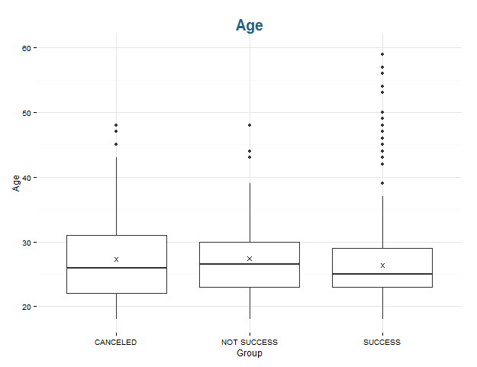
Methods
Descriptive Statistics: boxplot
OUTLIERS
MAXIMUM
Q3 OR 3rd QUARTILE (75% OF THE BASE)
MEAN
MEDIAN (50% OF THE BASE)
Q1 OR 1st QUARTILE (25% OF THE BASE)
MINIMUM
GROUPS
MIN = Q1 – 1,5(Q3-Q1)
MAX = Q3 + 1,5(Q3-Q1)

Slide 12
Methods
Association Rules
{LHS}
{RHS}
LHS | RHS | SUPPORT | CONFIDENCE | LIFT
User_age_calculated_grouped = 22-25 User_email_verified = 1 User_badges = UNICAMP User_android = 1 Recurrent = 0 Comfort = 3 | Leg_group = SUCCESS | 0.05279188 | 0.9936306 | 1.302075
This is a rule that express the incidence across transactions of one set of items as a condition of another set of items.
In our analysis we will not represents the rule. As the RHS will be ALWAYS the condition of being SUCCESS, we will show just a table with the LHS and the results.
The set of items that co-occur in a observation
The proportion of all transactions that contain the set. In this case, this set appears in 5.2% of all transactions.
The support for the co-occurrence of all items in a rule, conditional on the support for the LHS. In other words, the SUCCESS appear alongside this LHS 99.3% of the time that this LHS appears.
The support of a set conditional on the joint support of each element. In other words, the combination of this LHS with the SUCCESS occurs 1.30 times more often than we would expect if the LHS and RHS were independent. Lift above 1 shows evidence of dependence between the LHS and RHS.

Slide 13
Methods
Decision Tree
1
SUCCESS
6% 94%
100% (2395)
SUCCESS
1% 99%
68% (1626)
SUCCESS
15% 85%
32% (769)
NOT SUCCESS
8% 92%
24% (566)
SUCCESS
36% 64%
8% (203)
SUCCESS
4% 96%
23% (541)
NOT SUCCESS
84% 16%
1% (25)
The majority of the node
Left: percentage of the NOT SUCCESS in the node; Right: percentage of the SUCCESS in the node
Right is always NO for the rule
Percentage and absolute value of cases from the total database
Left is always YES for the rule
YES
NO
2
Driver_message < 0.5
3
The color orange is for the the internal node who is SUCCESS
The rule: attribute with the largest information gain
Pax_message < 0.5
5
4
The color brown is for the the leaf node who is SUCCESS
The color light blue is for the the internal node who is NOT SUCCESS
Trip_created_hour >= 12
7
6
The color dark blue is for the the leaf node who is NOT SUCCESS

Slide 14
Descriptive Statistics

Slide 15
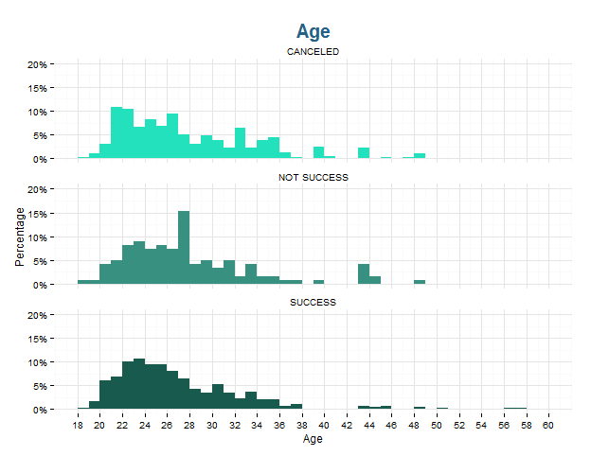
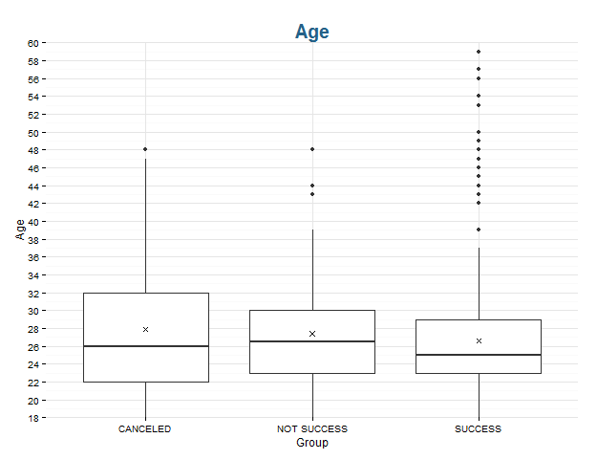
* Data limited between 18 and 60 years old. Excluded 255 Nas and 10 outliers.
Notes:
Tanto no sucesso quanto no não sucesso, vemos uma predominância entre 22 e 26 anos, provavelmente por causa do público universitário. Há uma porcentagem de destaque de não sucesso em 27 anos.

Slide 16
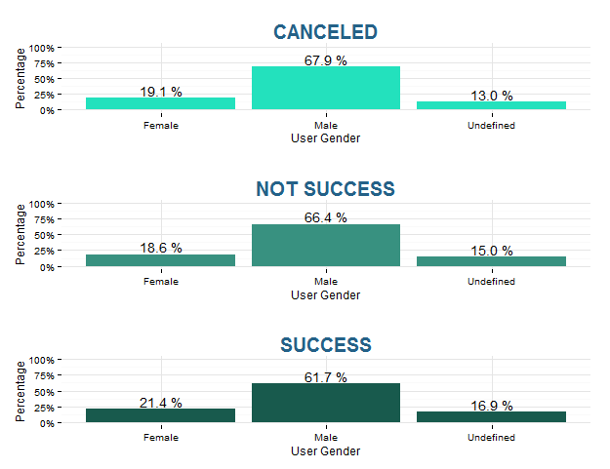
Notes:
Não há muita diferença entre os sexos no sucesso e não sucesso. Predominância muito maior de homens do que mulheres oferecendo carona.

Slide 17
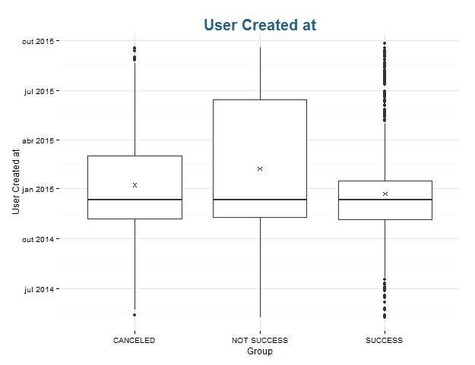
We can see a difference between Success and Not Success in relation to Q3. While in the Success at least 75% of users have created their accounts until shortly after January, in the Not Success there’s a bigger distribution between December and June of 50% to 75%. This boxplot shows the weight of Unicaronas.

Slide 18
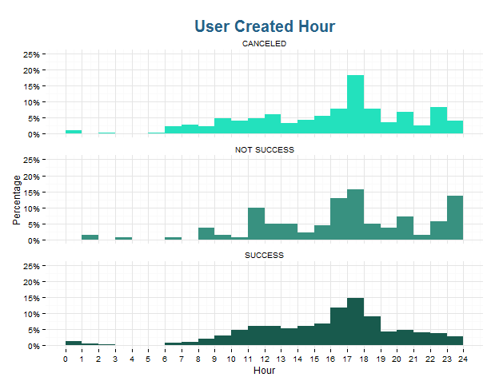
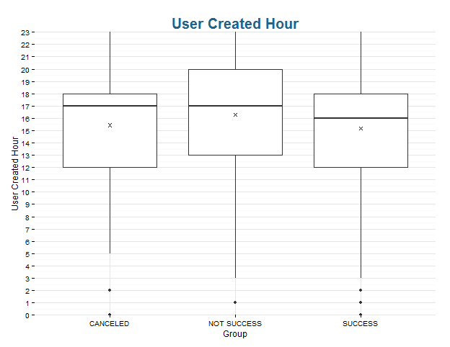
Notes:
Metade dos usuários que criaram viagens que foram sucesso, criaram ela até 16h. Há um destaque no período entre 16h e 18h.

Slide 19
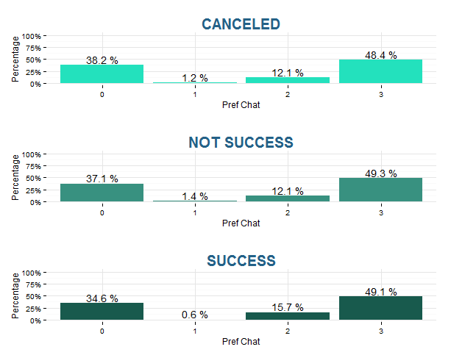
Notes:
Não há uma diferença grande entre os grupos.

Slide 20
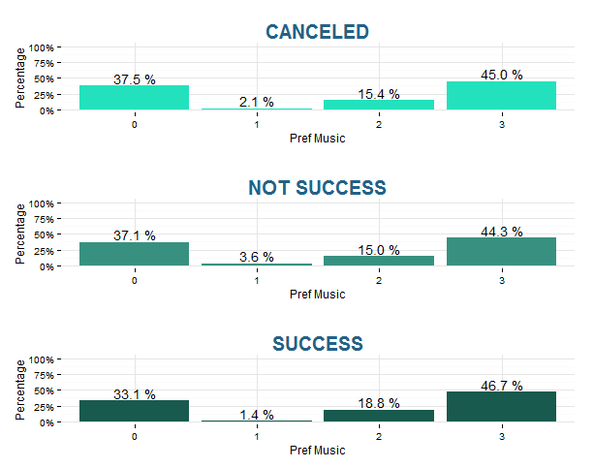
Notes:
Não há uma diferença grande entre os grupos.

Slide 21
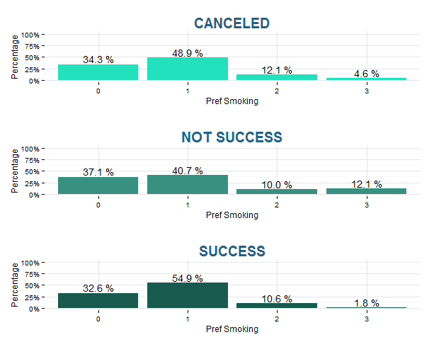
Although in both groups the preference of not smoking is the highest, we can see that in the Not Success there’s much more users on the “smoking allowed” group than the Success. Probably the user who book a seat don’t like cars where the driver is probably smoking.

Slide 22
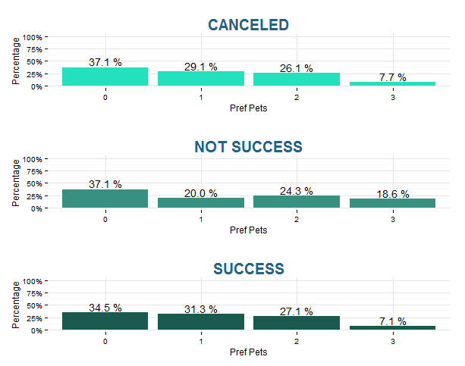
Most users who book prefers drivers that not allow pets. That is curious because as the case of the smoking, just because the driver allows pets, doesn’t mean the driver or any passenger will lead one.

Slide 23
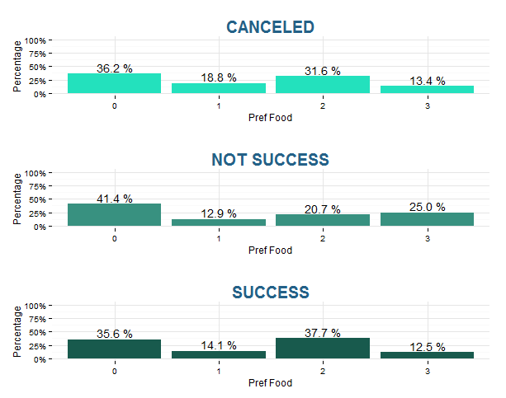
Same case than the previous slide. Allow food doesn’t mean that will have food on the trip, but just because of this possibility, many users prefer not book this car. The only difference here is the driver is more flexible on the Success group, the passenger can ask before.

Slide 24
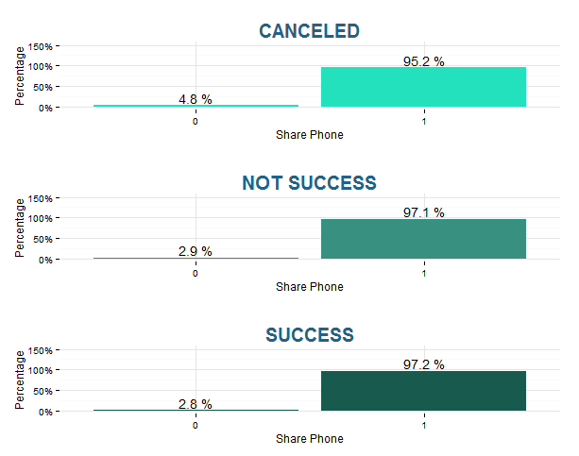

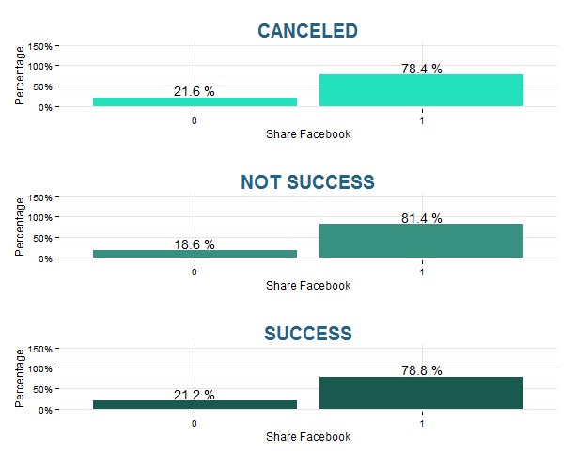
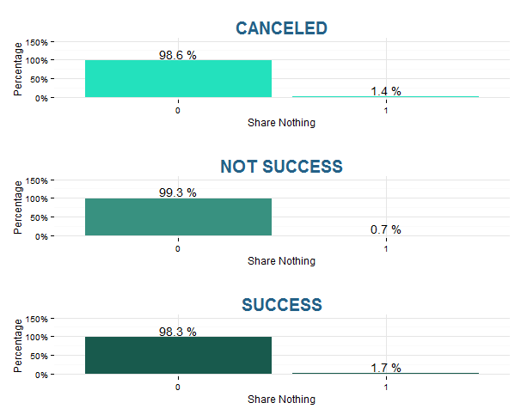
Notes:
Não há uma diferença grande entre os grupos.

Slide 25
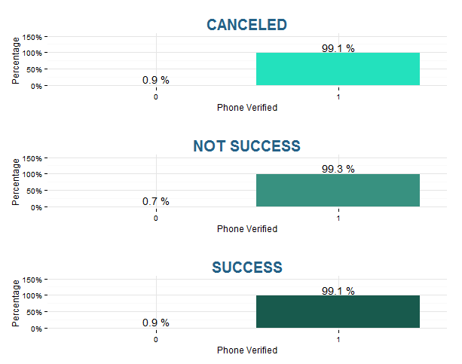
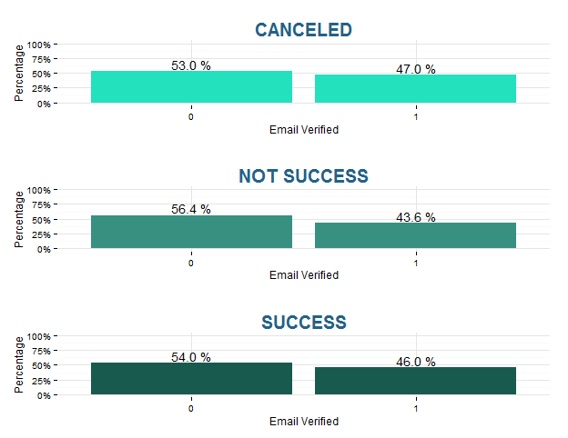
Notes:
Não há uma diferença grande entre os grupos.

Slide 26
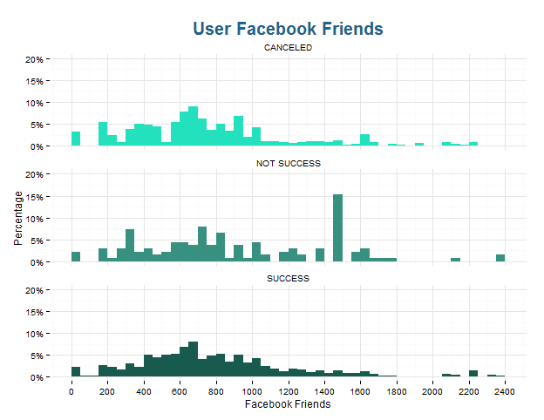
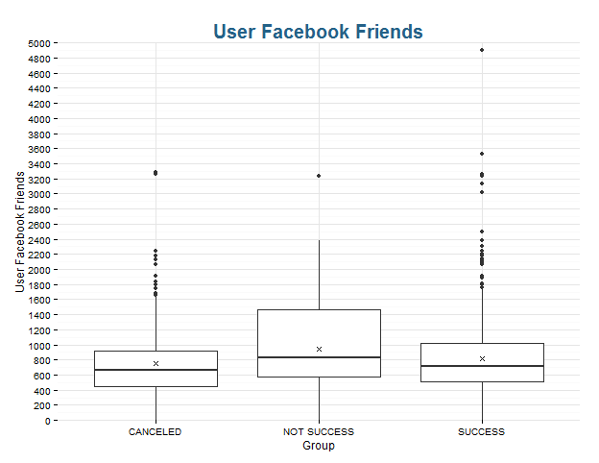
Notes:
Muitos amigos no facebook não necessariamente significa que a carona terá mais booking. No sucesso há uma lineariedade no número de amigos, já no não sucesso há uma porcentagem de mais de 15% por volta de 1400 amigos.

Slide 27
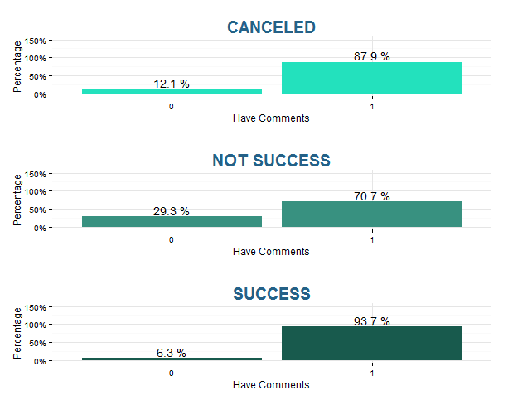
This is one of the most important slides of the analysis. It shows that if the driver has some comments evaluating him, the chance of the trip be a Success is much higher.

Slide 28
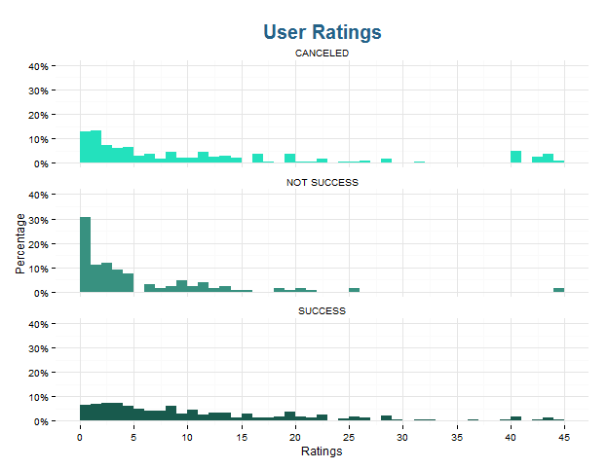
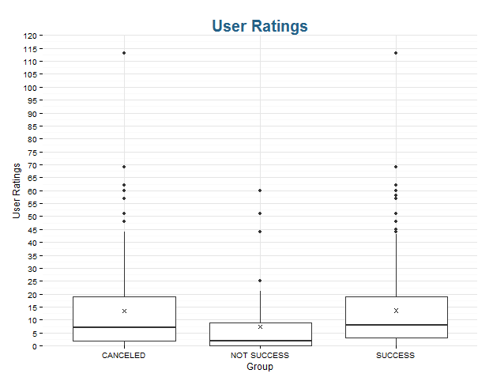
This is an important slide too. Shows the amount of ratings that the driver had. Related to the previous slide, we can see that more reviews, more chances of success. We can see on the Not Success group there’s a large percentage that does not have ratings.

Slide 29
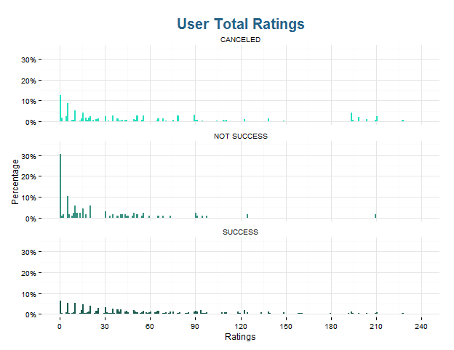
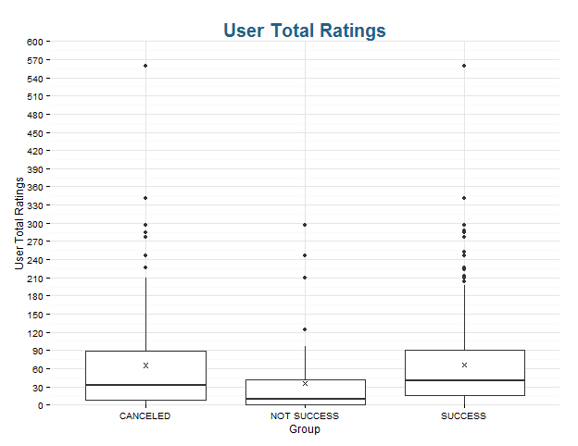
This slide is related with the previous one. It shows the sum total of star ratings. We can see that with more stars, higher the chances of booking.

Slide 30
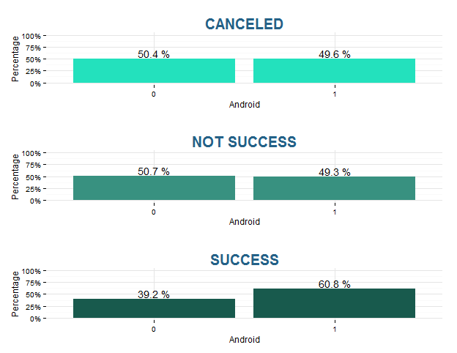
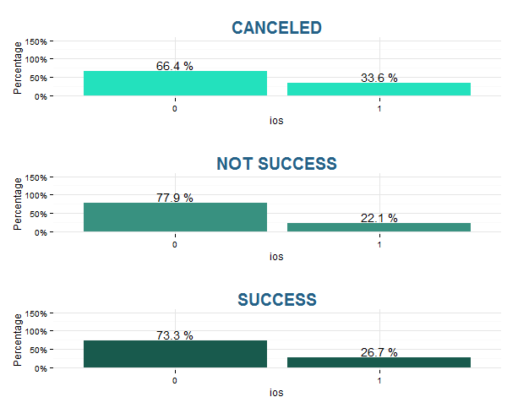
Notes:
Não há uma diferença grande entre os grupos.

Slide 31
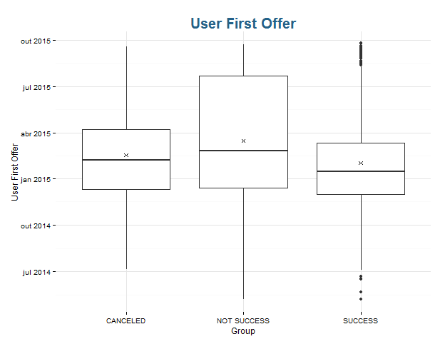
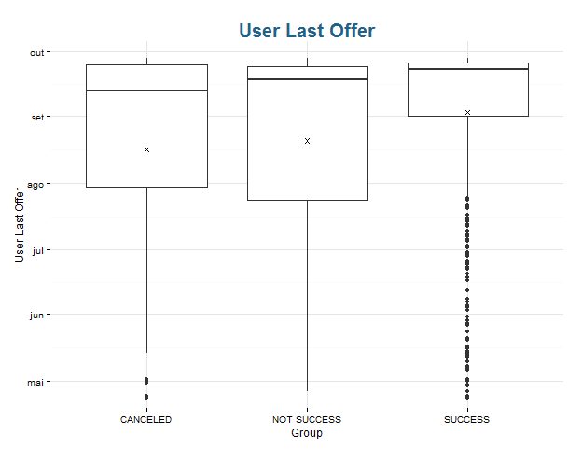
Notes:
Assim como a data de criação do usuário, podemos ver que usuários que ofereceram a primeira carona há mais tempo tem mais chances de sucesso.

Slide 32
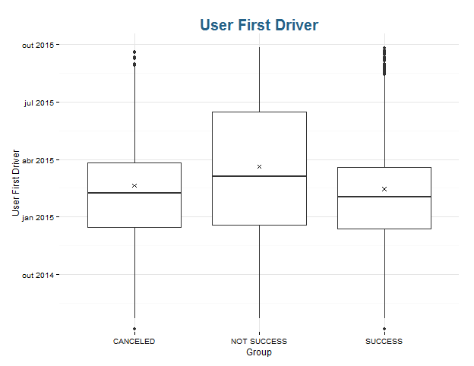
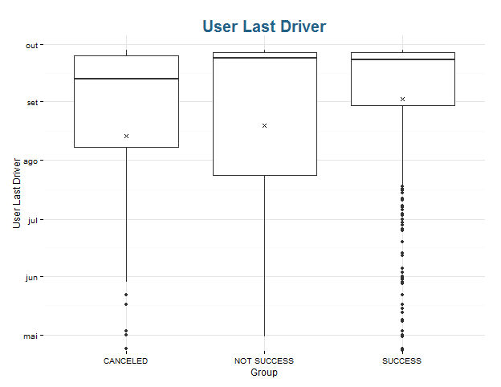
Notes:
Esse gráfico está associado ao gráfico de primeira offer. Podemos ver que a diferença entre esse e o de primeira offer é que o eixo desse é mais acima. Ou seja, no caso do grupo de sucesso, enquanto metade das primeiras offers foram até pouco depois de janeiro, metade das primeiras caronas foram por volta de fevereiro.

Slide 33
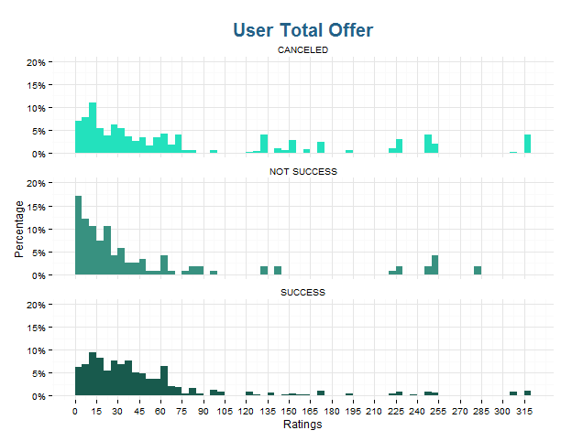
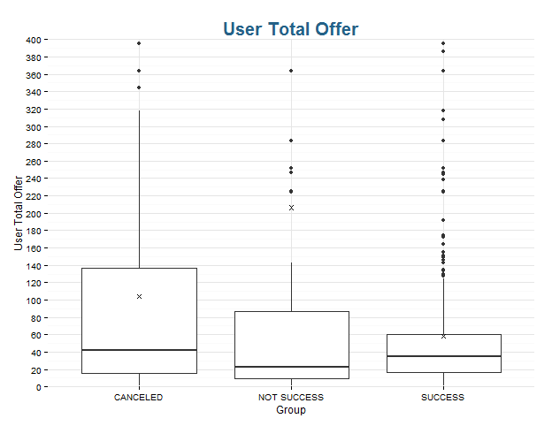
These graphs are of user Total Offer without the highest outiliers. Looking at the bar chart, we can see that most users of the Not Success group did just a few offers, with some ponctual cases of a lot of offers. On the Success group the distribution is more uniform, with a smooth decay curve.
Offers

Slide 34
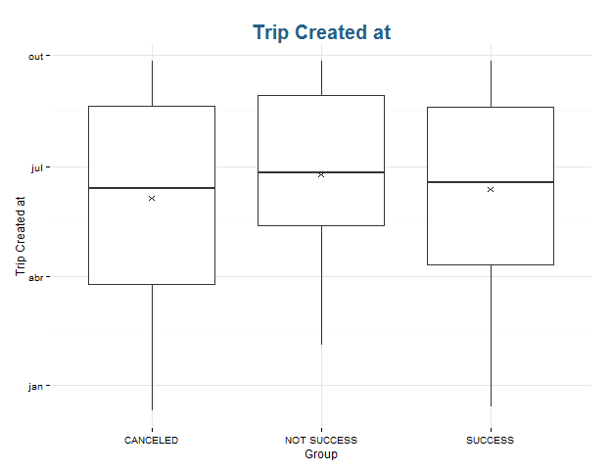
Notes:
Não há muita diferença entre os boxplots, a não ser o fato de entre os 25% dos usuários de sucesso serem mais recentes do que não sucesso.

Slide 35
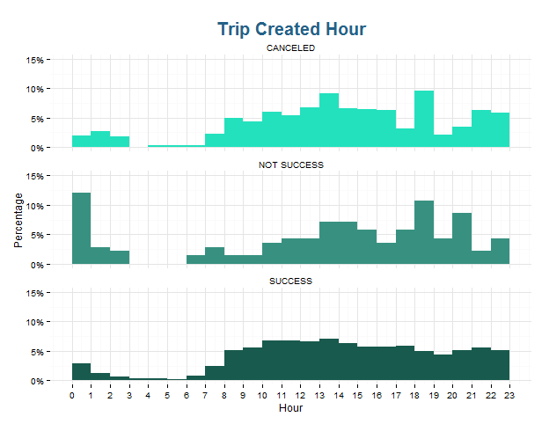
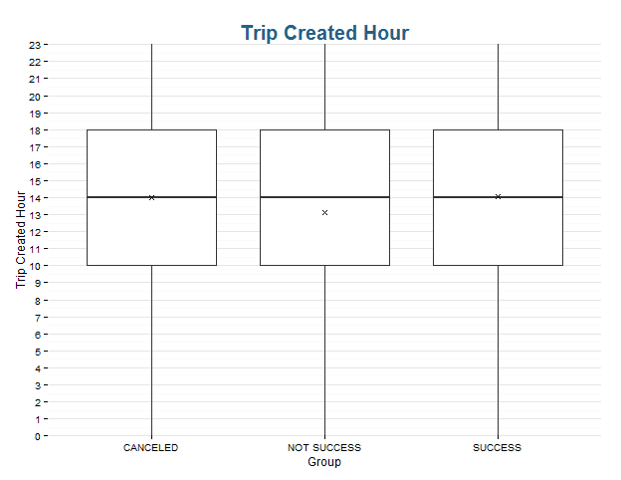
Notes:
Apesar de terem comportamentos muito parecidos, há um volume alto de usuários que criaram a viagem à meia-noite no grupo de não sucesso.

Slide 36
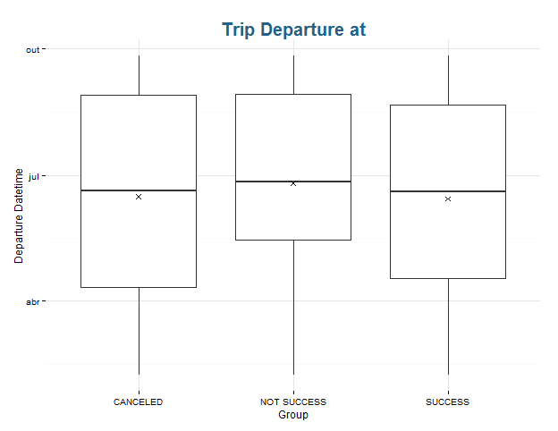
Notes:
Como no caso da data de criação, não há muita diferença entre os grupos.

Slide 37
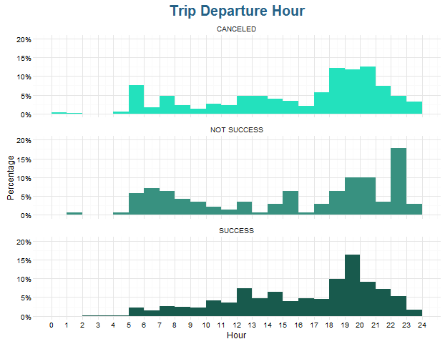
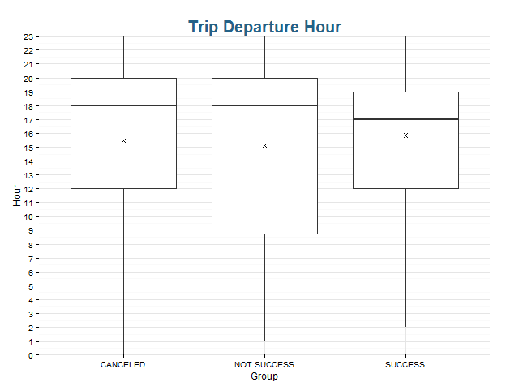
The Success group has trips who travel more at the end of the day. On the Not Success group there is cases at 23h but the majority is on the morning.

Slide 38
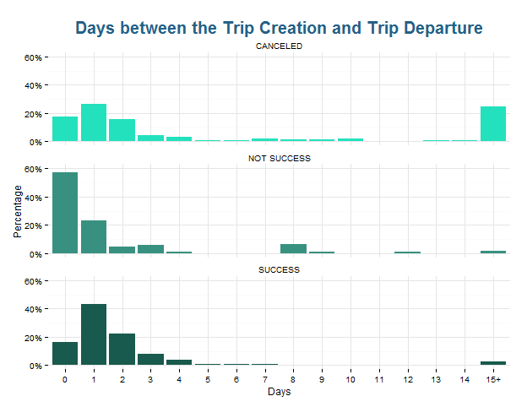
Users who created the trip on the day of the departure has fewer chances of success.

Slide 39
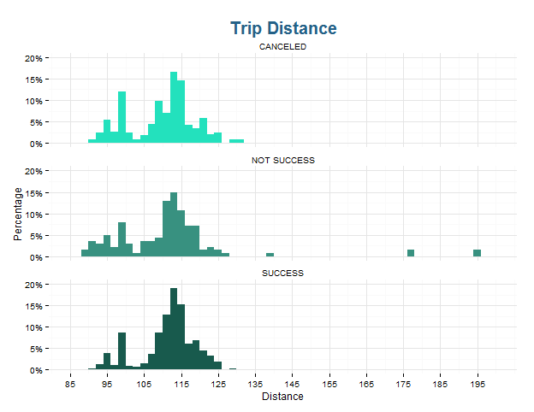
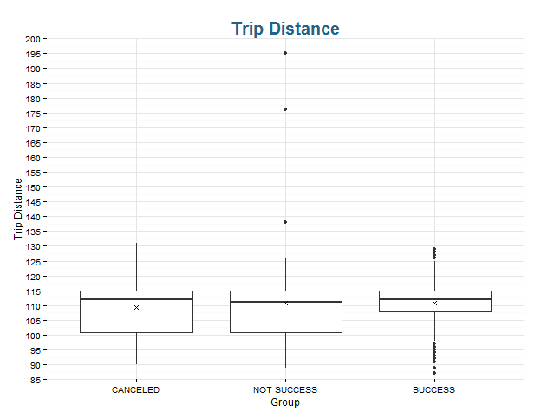
Notes:
Podemos ver que não há muita variação de distância no grupo de sucesso em relação ao não sucesso. Provavelmente porque a maioria dos usuários que pegam carona nessa rota saem especificamente de um ponto de Barão Geraldo. Os motoristas que oferecem rotas que fogem desse padrão (como por exemplo do aeroporto de Campinas), tem menos chances de booking porque não é o foco da rota Campinas São Paulo.

Slide 40
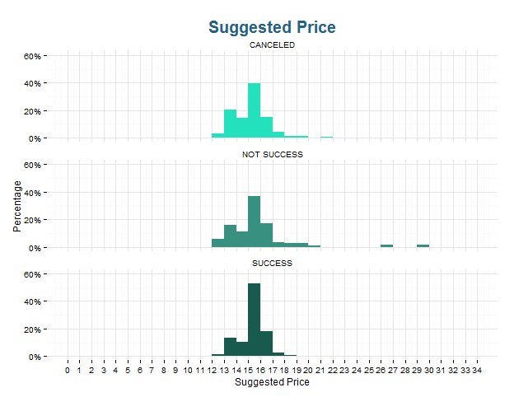
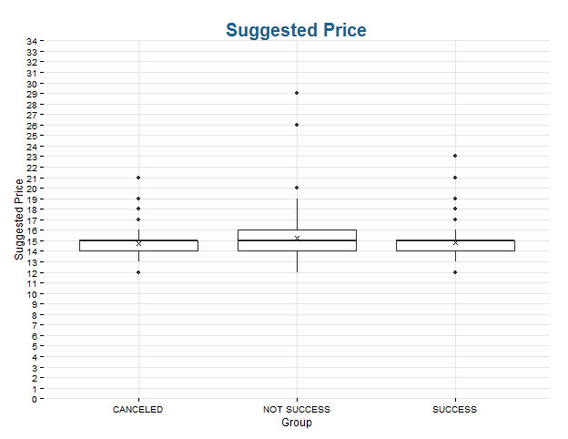
Notes:
Não há muita diferença entre os grupos em relação ao preço sugerido

Slide 41
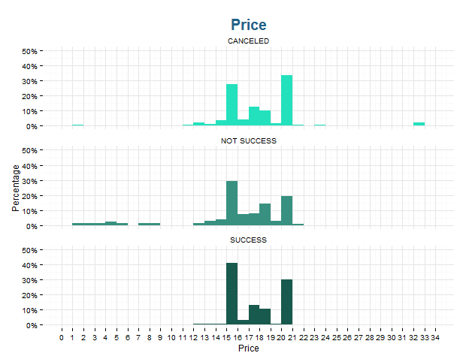
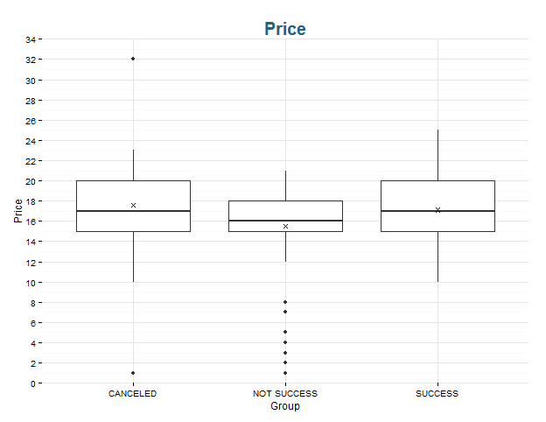
Notes:
Comparando esse slide com o anterior, podemos ver que muitos usuários aumentam o valor da viagem.

Slide 42
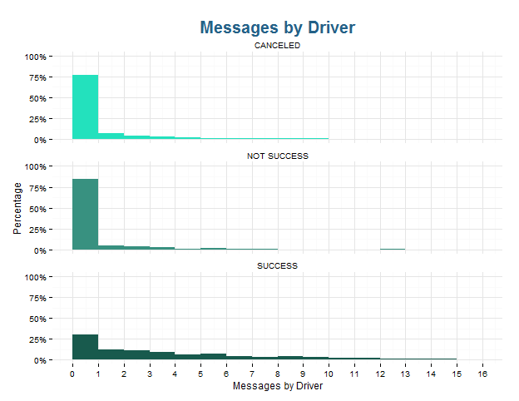
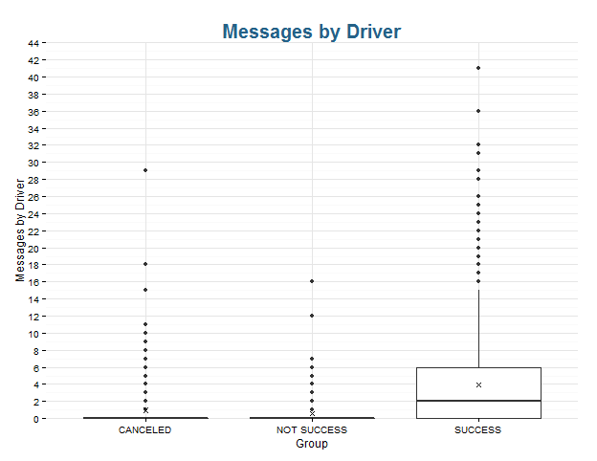
These charts are important to show the importance of the exchange of messages between driver and pax to the success of the trip. Tripda had the fear that this chat harm the booking for having telephone exchange, but these graphs show the opposite, it actually helps.

Slide 43
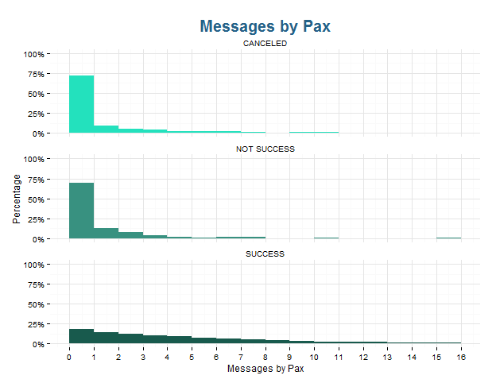
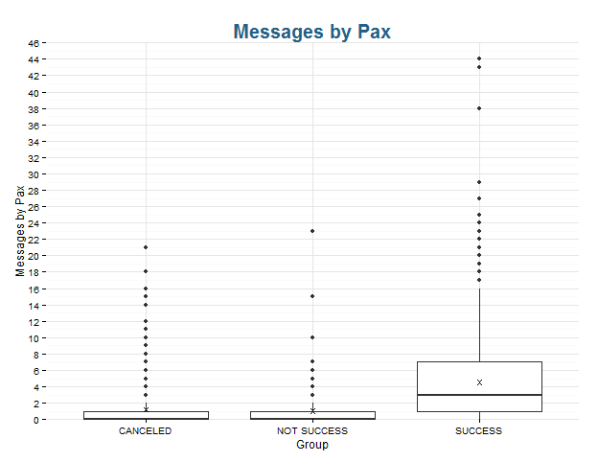
Same as the previous slide.

Slide 44

Notes:
Trip Comment é se há alguma observação na viagem feita pelo motorista. Podemos ver que não existe relação entre sucesso e esse comentário.

Slide 45
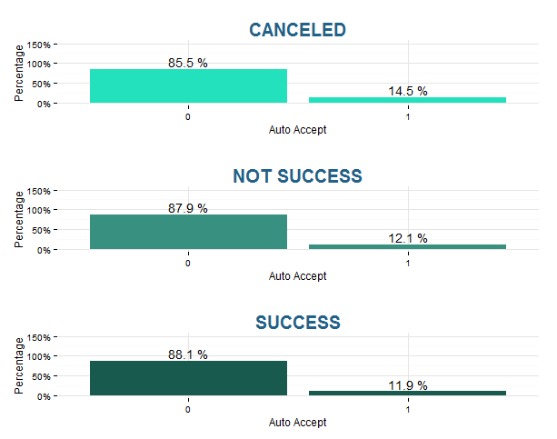
Notes:
Não há diferença entre os grupos

Slide 46

Notes:
Analisamos se existe alguma relação com a recorrência e cancelamento de assentos pelo passageiro, pelo motorista e número de bookings e não encontramos relação que explique porque há um índice tão alto de recorrência no não sucesso.

Slide 47


Notes:
Não há diferença nenhuma entre os grupos em relação ao número de assentos oferecidos. Mas podemos ver que a maioria dos usuários da rota oferecem mais de 3 assentos.

Slide 48

The better the car's comfort, the greater the chances of booking.

Slide 49
Association Rules

Slide 50
{LHS}
{leg_group = SUCCESS}
LHS | SUPPORT | CONFIDENCE | LIFT
User_age_calculated_grouped = 22-25 | User_email_verified = 1 | User_badges = UNICAMP User_android = 1 | Recurrent = 0 | Comfort = 3 | 0.05279188 | 0.9936306 | 1.302075
User_age_calculated_grouped = 22-25 | User_email_verified = 1 | User_badges = UNICAMP | User_android = 1 Trip_comment = 1 | Recurrent = 0 | Comfort = 3 | 0.05245347 | 0.9935897 | 1.302021
User_age_calculated_grouped = 22-25 | User_email_verified = 1 | User_badges = UNICAMP User_have_comments = 1 | User_android = 1 | Recurrent = 0 | Comfort = 3 | 0.05245347 | 0.9935897 | 1.302021
User_age_calculated_grouped = 22-25 | User_email_verified = 1 | User_badges=UNICAMP | User_have_comments=1 User_android = 1 | Trip_comment = 1 | Recurrent = 0 | Comfort = 3 | 0.05245347 | 0.9935897 | 1.302021
User_age_calculated_grouped = 22-25 | User_email_verified = 1 | User_badges = UNICAMP | User_avg_rating = 5 User_android = 1 | Recurrent = 0 | Comfort = 3 | 0.05211506 | 0.9935484 | 1.301967
User_age_calculated_grouped = 22-25 | User_email_verified=1 | User_badges = UNICAMP | User_avg_rating = 5 User_android = 1 | Trip_comment = 1 | Recurrent = 0 | Comfort = 3 | 0.05211506 | 0.9935484 | 1.301967
User_age_calculated_grouped = 22-25 | User_email_verified = 1 | User_badges = UNICAMP | User_avg_rating = 5 User_have_comments = 1 | User_android = 1 | Recurrent=0 | Comfort = 3 | 0.05211506 | 0.9935484 | 1.301967
User_age_calculated_grouped = 22-25 | User_email_verified = 1 | User_badges = UNICAMP | User_avg_rating = 5 User_have_comments = 1 | User_android = 1 | Trip_comment = 1 | Recurrent = 0 | Comfort = 3 | 0.05211506 | 0.9935484 | 1.301967
User_age_calculated_grouped = 22-25 | User_email_verified=1 | User_badges = UNICAMP | User_avg_rating = 5 Trip_comment = 1 | Recurrent = 0 | Comfort = 3 | 0.05549915 | 0.9879518 | 1.294633
User_age_calculated_grouped = 22-25 | User_email_verified=1 | User_badges = UNICAMP | User_avg_rating=5 User_have_comments = 1 | Trip_comment = 1 | Recurrent = 0 | Comfort = 3 | 0.05549915 | 0.9879518 | 1.294633
The top 10 rules are very similar and show things close to what we saw in the descriptive charts. Here we see that these set of variables combined have at least 98.8% of chances of Success (Confidence). Also, these variables appears together in only 5% of the offers (Support). The increase of Success with these variables combined versus the variables isolated is at least 29% (Lift).

Slide 51
Decision Tree

Slide 52
1
SUCCESS
6% 94%
100% (2395)
SUCCESS
1% 99%
68% (1626)
SUCCESS
15% 85%
32% (769)
SUCCESS
8% 92%
24% (566)
SUCCESS
36% 64%
8% (203)
SUCCESS
18% 82%
3% (73)
SUCCESS
46% 54%
5% (130)
SUCCESS
4% 96%
23% (541)
NOT SUCCESS
84% 16%
1% (25)
SUCCESS
39% 61%
4% (107)
NOT SUCCESS
78% 22%
1% (23)
SUCCESS
2% 98%
20% (489)
SUCCESS
25% 75%
2% (52)
SUCCESS
35% 65%
4% (99)
NOT SUCCESS
88% 12%
0% (8)
SUCCESS
20% 80%
2% (49)
NOT SUCCESS
50% 50%
2% (50)
SUCCESS
0% 100%
1% (17)
SUCCESS
37% 63%
1% (35)
SUCCESS
15% 85%
1% (20)
NOT SUCCESS
67% 33%
1% (15)
SUCCESS
41% 59%
2% (39)
NOT SUCCESS
82% 18%
0% (11)
SUCCESS
24% 76%
1% (25)
NOT SUCCESS
71% 29%
1% (14)
CP | 0.010000
Nsplit | 12
Rel error | 0.61429
Xerror | 0.96429
xstd | 0.080620
2
YES
Driver_message < 0.5
NO
3
4
Days_created_to_departure < 0.5
6
5
Pax_message < 0.5
9
10
Price < 14
11
16
User_facebook_friends >= 1198
17
22
Trip_departure_hour < 9.5
23
34
Trip_departure_hour < 9
36
44
Trip_created_hour >= 12
45
70
User_ratings < 2.5
71
55
User_total_offer >= 135
59
140
Trip_distance < 106
141
252
Trip_created_hour >= 16
253

Slide 53
Conclusion

Slide 54
Conclusion
Descriptive Statistics
More time created drivers are more likely to have an offer booked.
Legs where drivers allow to smoke or to eat are less booked. Not necessarily someone will smoke or eat, but the possibility decreases the chances of booking.
The same applies to pets preference: legs where drivers allow to bring pets are less booked. These possibilities should be advantages because they are less restrictive, but many passengers aren’t understanding like this. They see the permission like a way to the travel be less comfortable. We need to think a way to show to the pax how the trip will be. Like show if someone will travel with a pet, for example, or show the other pax that already booked (I don’t know, it’s just an example).
If the driver had any comments rating him, the chance of success increases considerably. Maybe we should think in campaigns that encourage ratings and the advantage of it.
The amount of ratings and stars are directly related to the success too.
Users who the first offer were a long time ago and the last one were recently are more susceptible to have bookings in their trips.
The date of the first trip and the last one have the same behavior as the conclusion above.

Slide 55
Conclusion
Descriptive Statistics
Curiously, although drivers who have been longer and who are more active have a better chance of booking, not necessarily drivers who offered many rides have more bookings.
Legs who were created at the same day as the departure day have less chances of booking. Legs who were created 1 or more days before has more chances of success.
In the case of Campinas -> São Paulo, there’s cases of legs with more than 175km of distance on the NOT SUCCESS group. On the success group the majority is between 105 and 115 km, because they are from Barão Geraldo. The cases of not success are trips from the airport. This reinforces the Tripda is very strong in the university route, not in all city of Campinas.
The price suggested in Success is between 13 and 16, the median is 15. But que final price chose by the driver is between 10 and 25, the median is 17.
If the driver and the pax talked with each other, the chance of cancelation of the seats by the pax or the driver is very low.
For some reason, recurrent trips have less chance of booking.

Slide 56
Conclusion
Association Rules
This method shows how the combination of some of the features described early increases the chances of success. And most of the best rules found are combination of trip comments, user comment (rating), e-mail verification and average rating score.
The main takeaway here is that although we can have at least 98% confidence of success for trips with these features only 5% of the trips contains these features.
Decision Tree
- The tree shows that driver who talked with their pax have more chances of success. If the driver didn’t send a message but the leg happened at least one day after the creation of the trip, the chance of success is also high.

Slide 57

Private and Confidential

