Slide 1
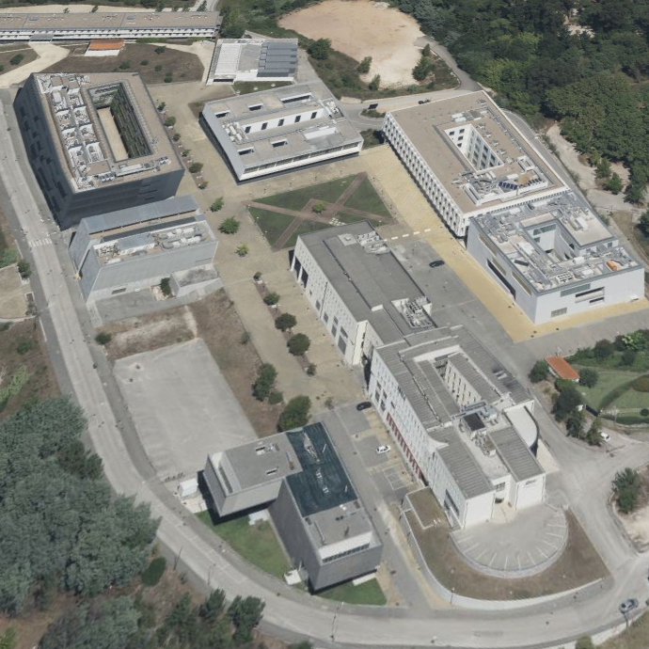
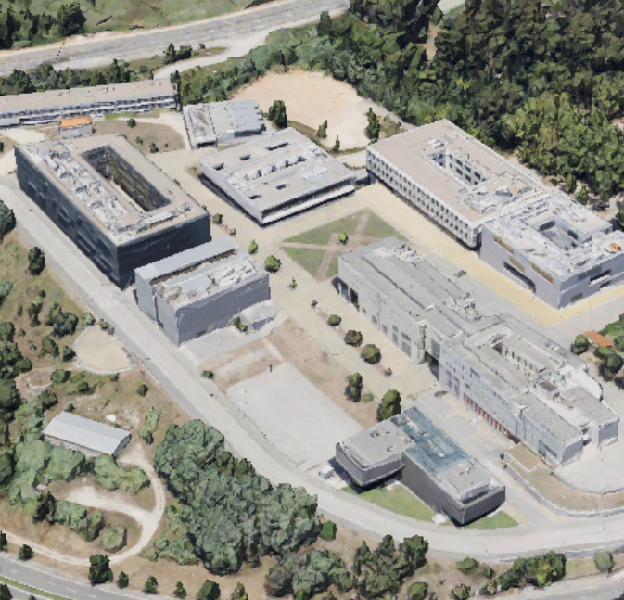
CANTINA
.
CANTINA
FMUC-1
FMUC-3
.
FMUC-3
FMUC-1
.
iCBR
.
iCBR
ICNAS
ICNAS
.

