Slide 1
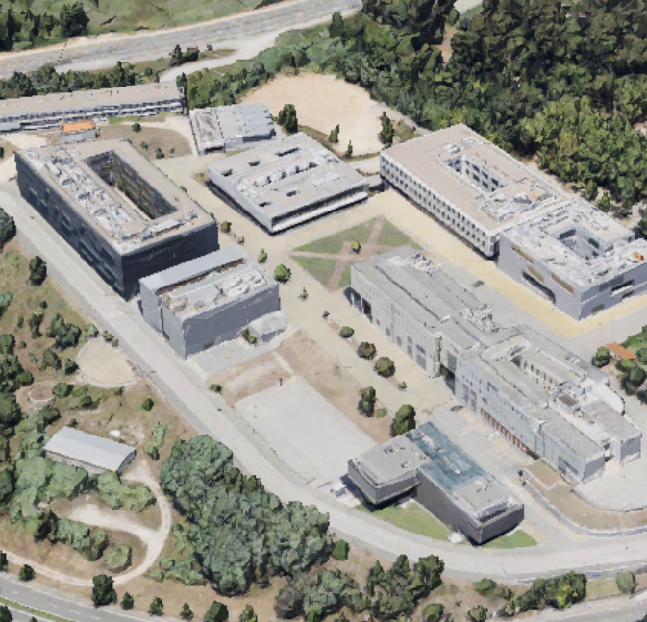
CANTINA
FMUC-3
FMUC-1
iCBR
ICNAS

