Slide 1

ˬ
Projeto ACCT HC 2021-28
{..} Backend.jsonc
{..} Frontend.jsonc
{..} Testes.jsonc

Slide 2


{
"Frontend"{
"block":[
"Header",
"Footer",
"Home"
]
},
"Header":{
"childen": ["Ricardo Carvalho"],
"porps":{
"Menu":true,
"Logo":true
}
},

Slide 3


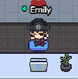
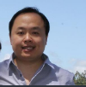


"Home" :{ "children": [ "Ricardo Kubo", "Christiane Natacha Gozza", "Emily Talini P. de Sousa" ], "props":{ "About-us":true, "Serviços":true, "Contato":true, "Leads":true } },

Slide 4


"Footer":{ "children": [ "Wanderson Lontra" ], "props":{ "Logo": true, "Social Network":true, "Endereços":true } } }

Slide 5
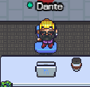

{ "Backend"{ "block": [ "VTEX.IO", "AWS", "Leads" ] }, "VTEX.IO":{ "childen": [ "Dante Souza e Souza" ] },

Slide 6


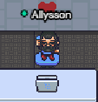

"Leads":{ "childen": [ "Nathan Liyodi Nariai" ] }, "AWS":{ "children": [ "Allysson Fernando Guedes de Almeida" ], "props":{ "API AWS":true, "DynamoDB":true } } }

Slide 7

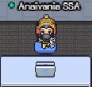


{ "Teste":{ "children": [ "Erica Akira", "Anaivânia Cardoso" ], "Testes de Composição":true, "Testes de Integração":true, "Teste de Compras":true } }

