Slide 1
Report layout UX guidelines
Business Central, UX team
May 2022

Slide 2
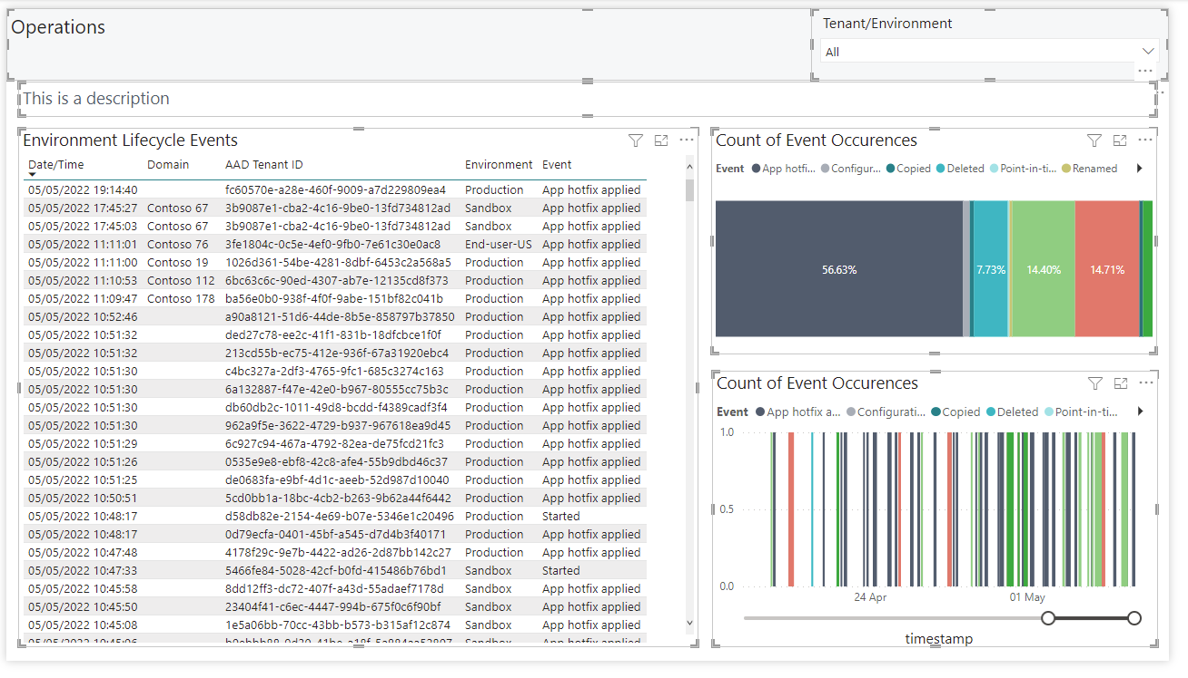
Layout guidelines for Power BI
Background color: MedFlat_Background #F6F7F8
Alignment: Align top and bottom of all elements, like here
Colors for dataviz: please see next slide
Outline color: No outlines
Margins: Keep a constant margin size both between elements and and around all objects.

Slide 3
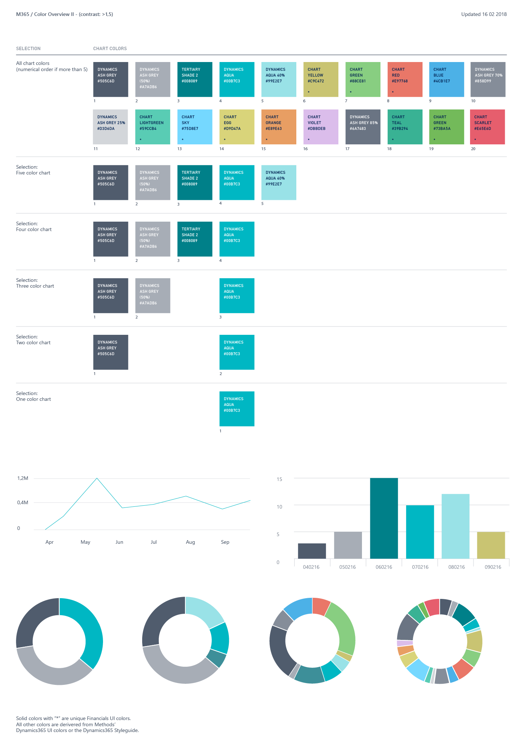
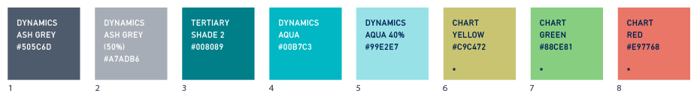
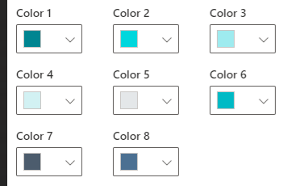
Color guidelines for data visualization
BC colors - dataviz: M365 - Dev I (main) (invisionapp.com)
Notice that that the colors are prioritized. Please use these 8 colors for the data viz pallette
Note that these are not the same as favorable/unfavorable
Before
StyleFavorable #35AB22
StyleAmbiguous #9F9700
StyleUnfavorable #EB6965

Slide 4
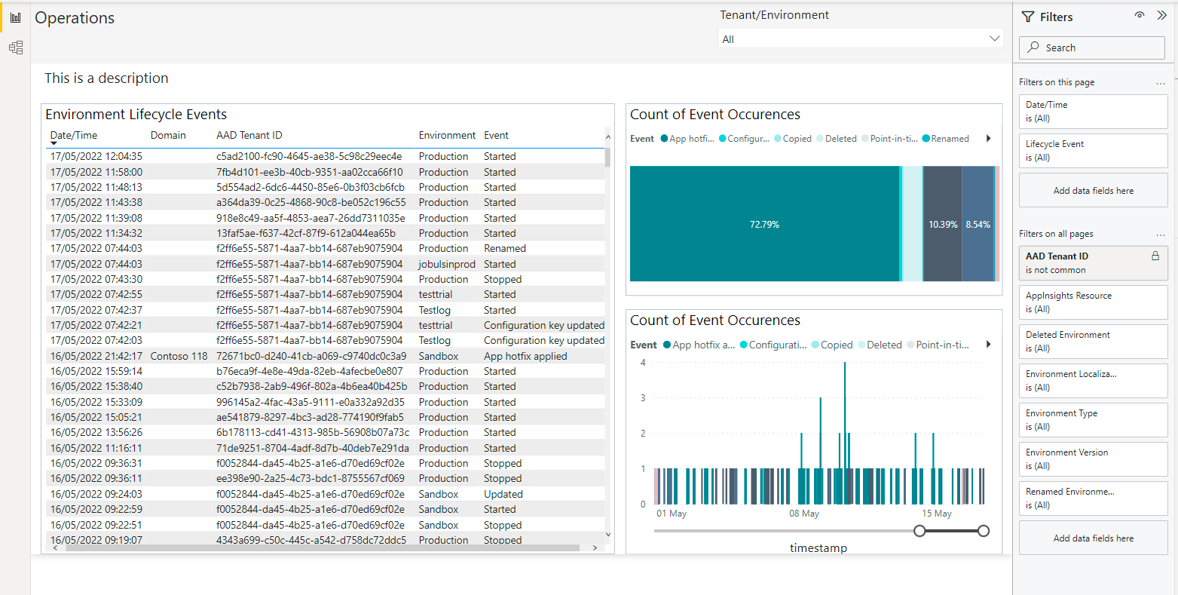
Font and text guidelines
Segoe UI, size: 16
Title:
Color: StyleStrong #212121
Description:
Color: BrandSecondary #505C6D
Graph title:
Color: StyleStandard #212121

Slide 5
Appendix
Modena color guidelines

Slide 6
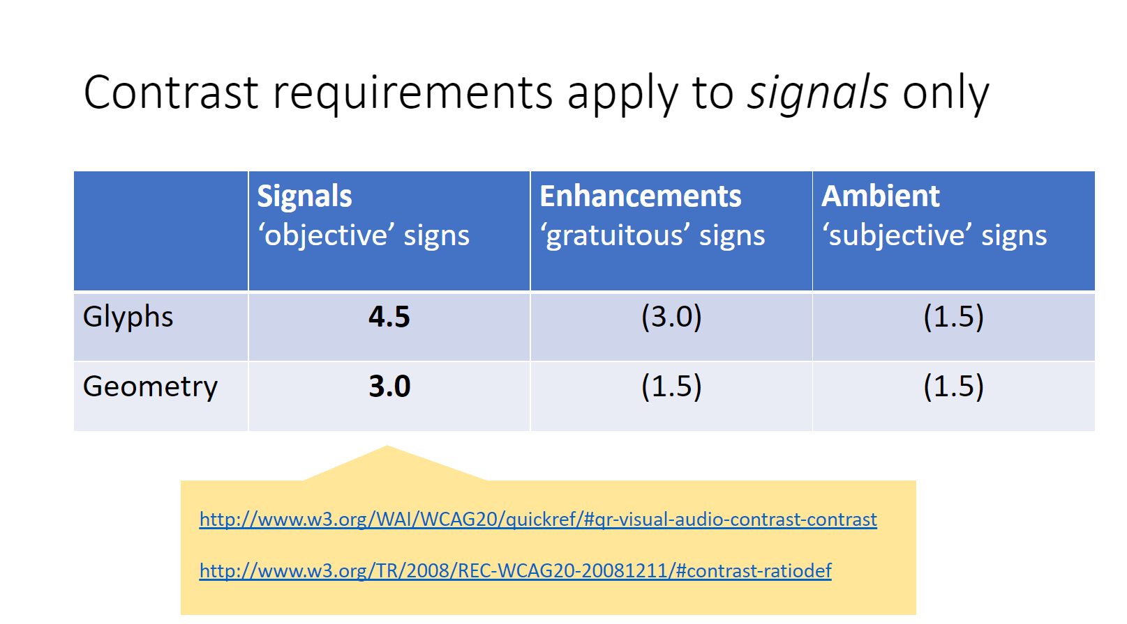
Modena color guidelines
DesignCPH/BC - Encyclopedia Modena 365 (sharepoint.com)
Business colors: contrast 4.5​, 3.0, 1.5
Designer colors: contrast 4.5​, 3.0, 1.5
Personalization colors: contrast 4.5​, 3.0, 1.5
http://www.w3.org/WAI/WCAG20/quickref/#qr-visual-audio-contrast-contrast
http://www.w3.org/TR/2008/REC-WCAG20-20081211/#contrast-ratiodef​
Signals, Enhancements, and Ambience (SEA)

