Slide 1
Unblocking (larger) Business Intelligence (BI) projects with best practice APIs
How to auto-generate API queries at scale

Slide 2
Partner input
In our BI project, every time we need a new table/field, we need to ask ERP developers for an API

Slide 3
Common BI project DevOps (metadata-driven)
Metadata store
Auto-generate
ETL pipelines (SSIS/ADF)
Schema definitions (sql/model)
Deploy
Data warehouse/data lake
BI tools (Power BI/…)

Slide 4
New: API query auto generator (BCTech)
Metadata store (cvs files)
Metadata store
Auto-generate
Auto-generate
ETL pipelines (SSIS/ADF)
API Query code (al)
Schema definitions (sql/model)
Deploy
Data warehouse/data lake
BI tools (Power BI/…)

Slide 5
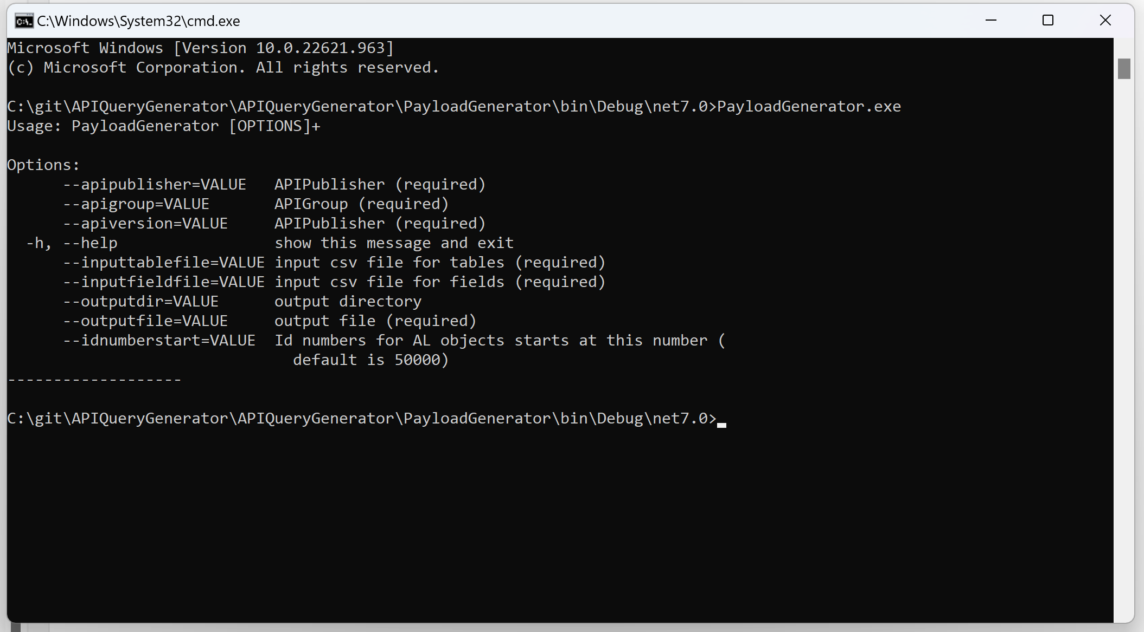
Demo – generating the payload from csv files

Slide 6
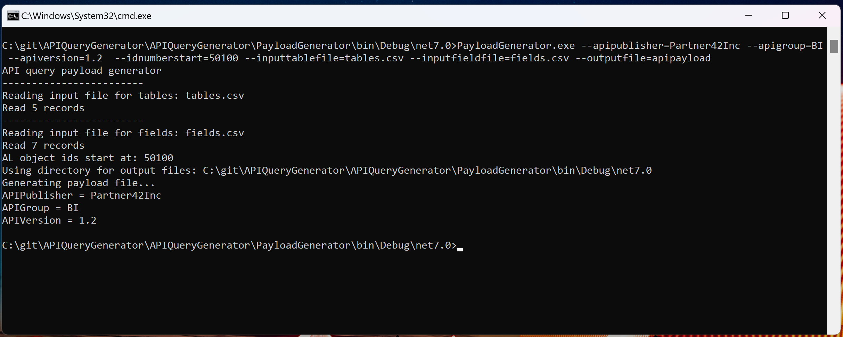
Demo – generating the payload from csv files

Slide 7
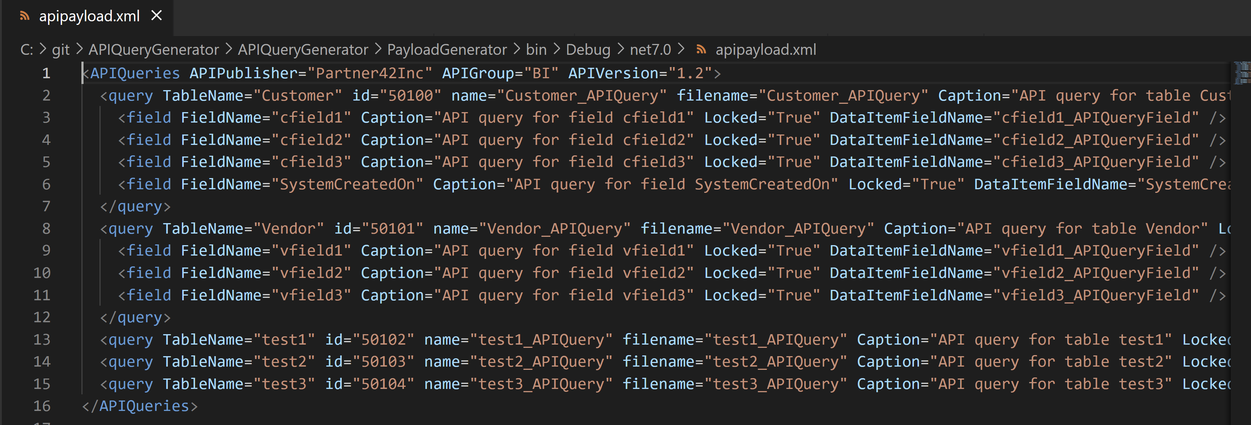
Demo – generating the payload from csv files

Slide 8
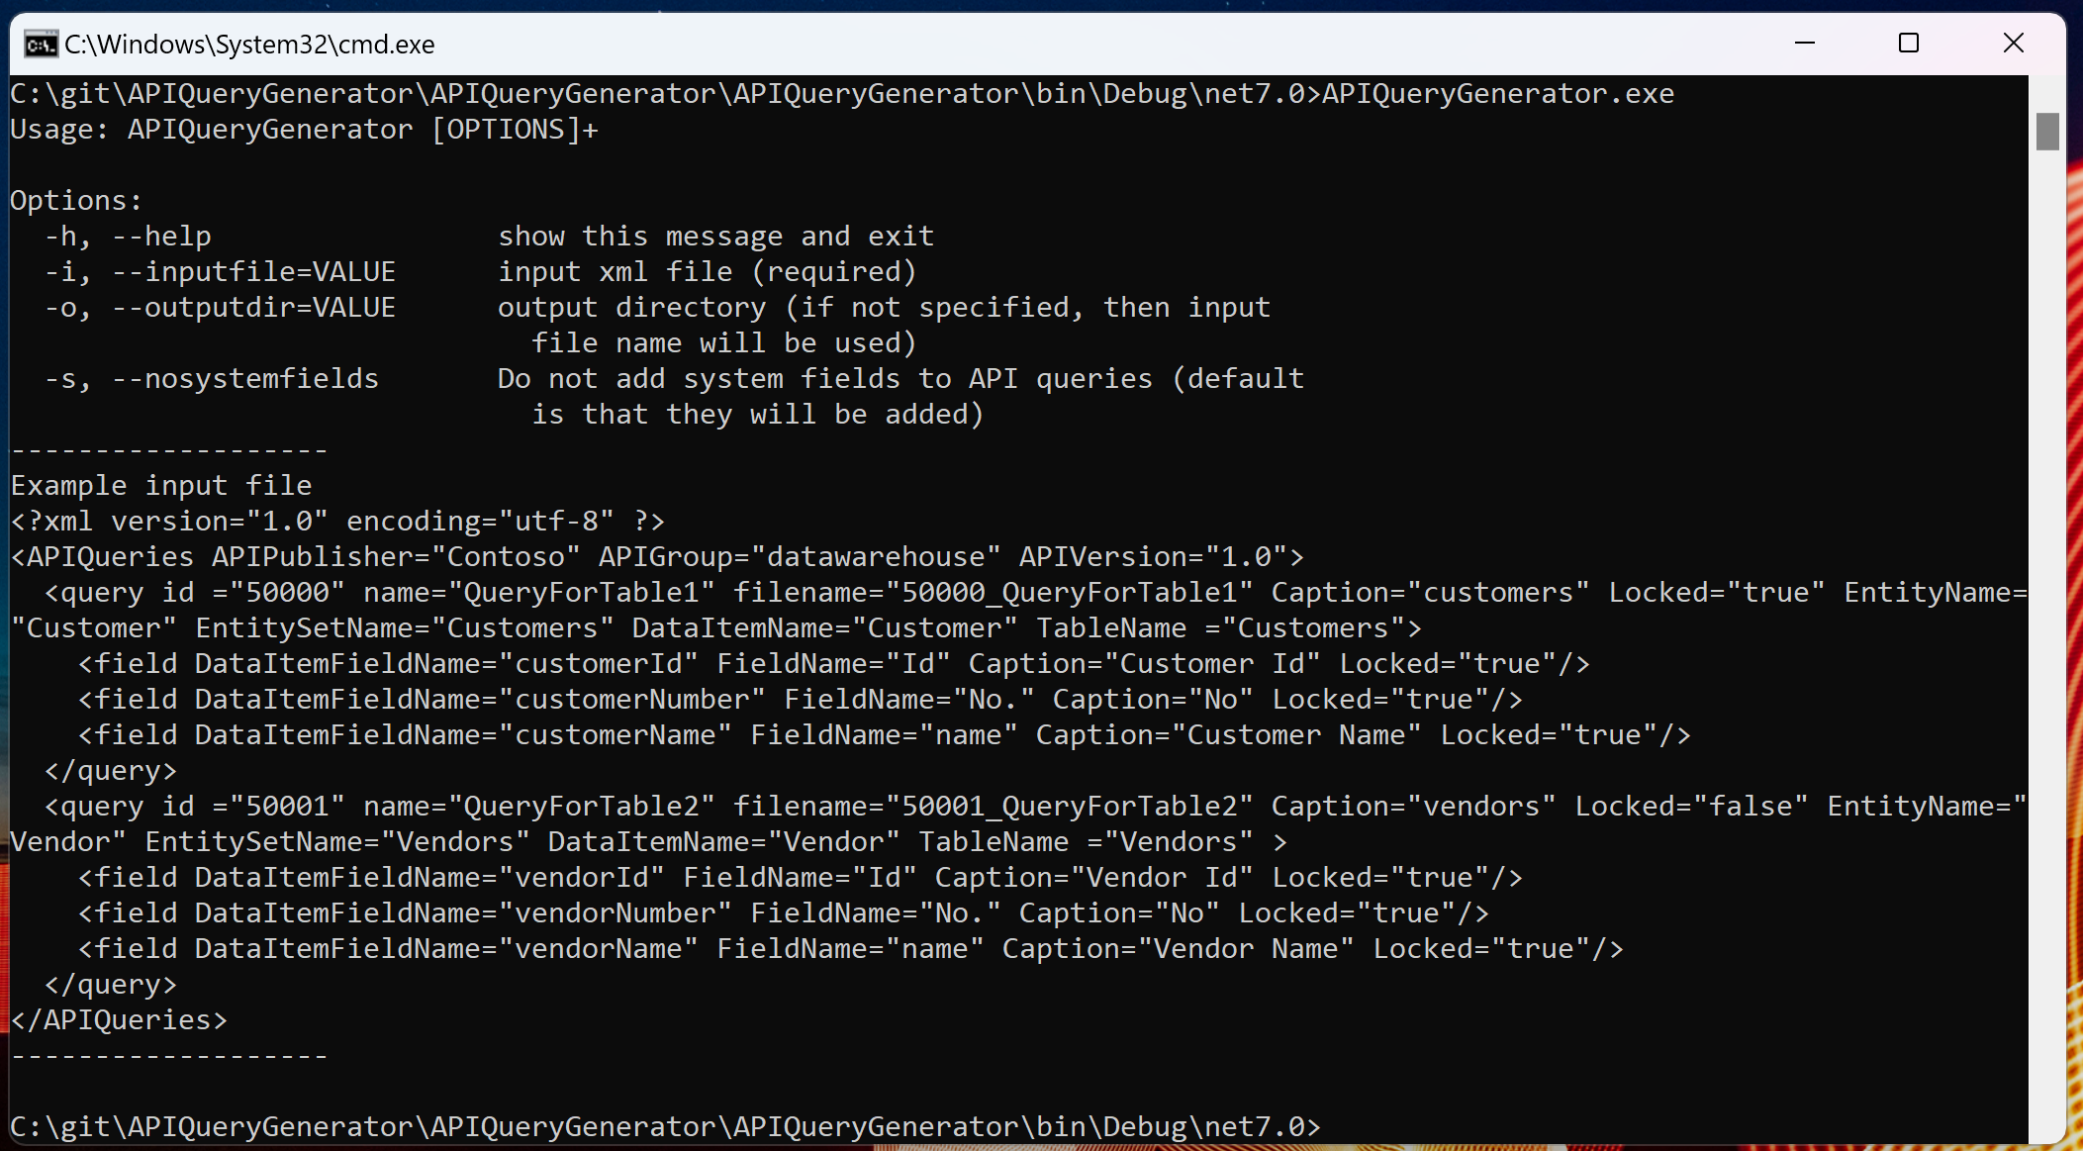
Demo – generating API files from the payload

Slide 9
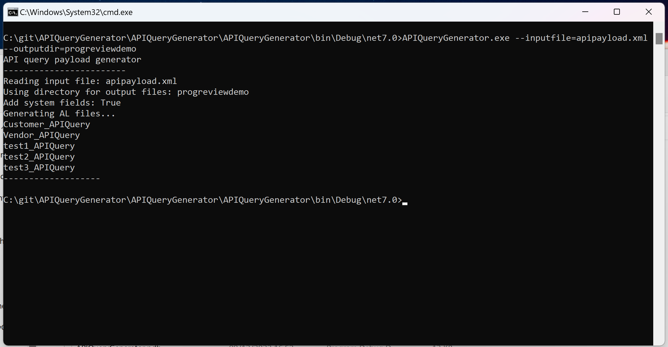
Demo – generating API files from the payload

Slide 10
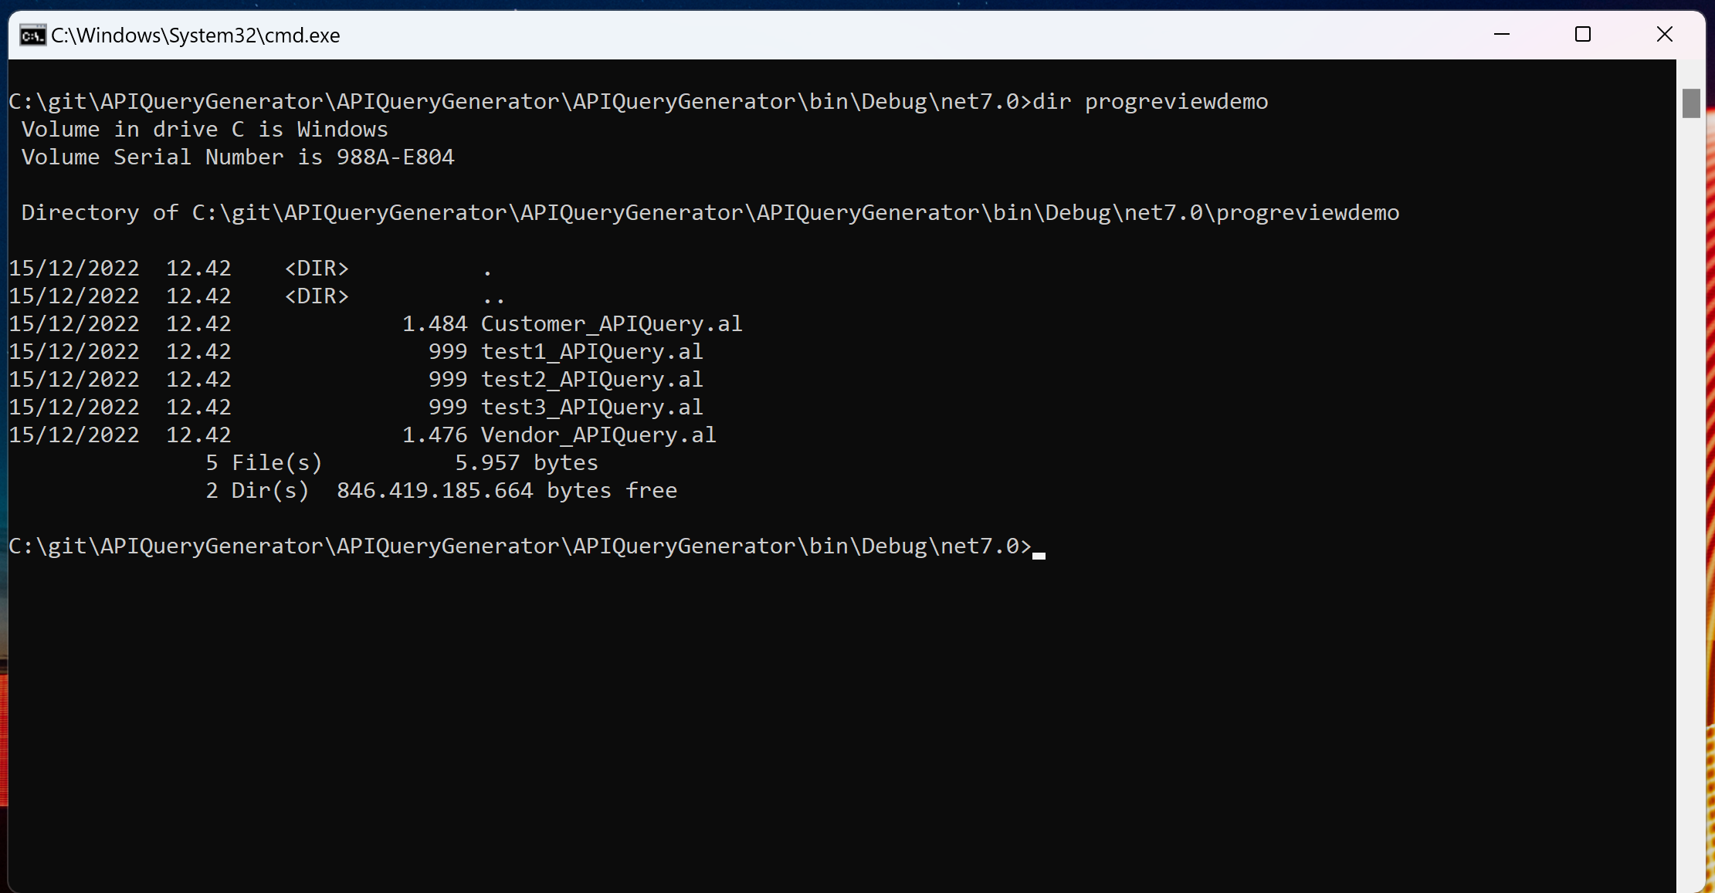
Demo – generating API files from the payload

Slide 11
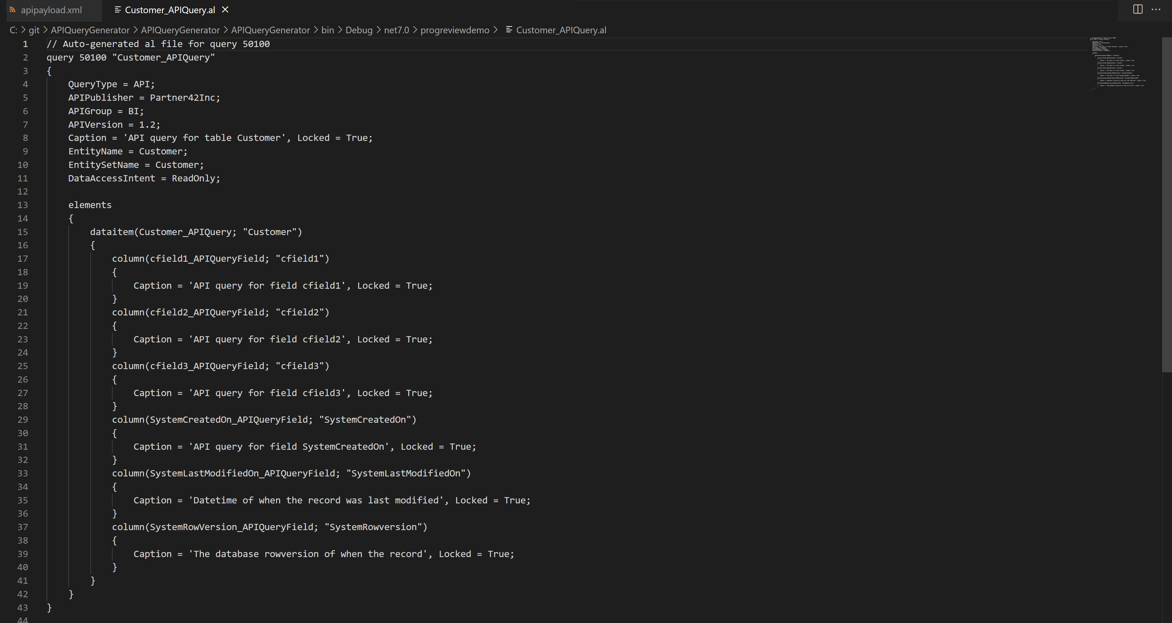
Demo – generating API files from the payload

Slide 12
Benefits
With a bit of help, the BI team can work separate from the ERP team
Can be incorporated to DevOps pipelines
APIs are generated using best practices (enable incremental refresh, read-only intent, …)

