Slide 1
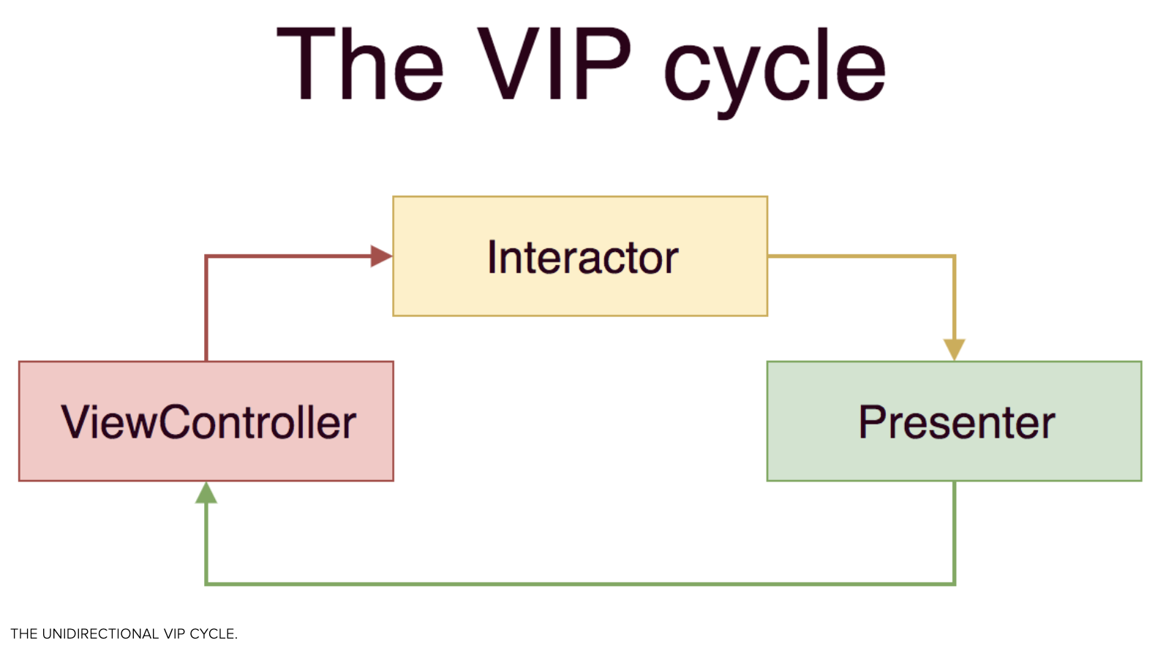
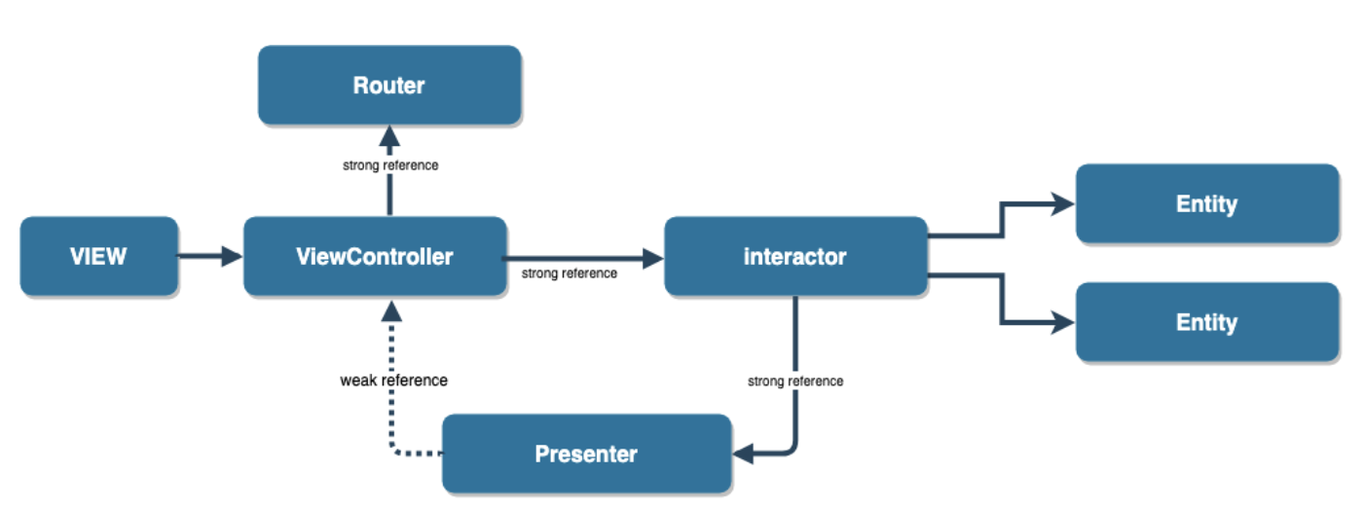
VIP (Clean Swift Architecture) In IOS - https://medium.com/crazy-minds/vip-clean-swift-architecture-in-ios-bb1d71680542
Introducing Clean Swift Architecture](https://hackernoon.com/introducing-clean-swift-architecture-vip-770a639ad7bf
Clean iOS Architecture https://www.essentialdeveloper.com/articles/clean-ios-architecture-part-7-vip-clean-swift-design-pattern-or-architecture
VIP-Demo : https://github.com/sarojraut/VIP-Demo
https://medium.com/@saad.eloulladi/clean-architecture-for-ios-viper-vip-c19de40b71e2

Slide 2
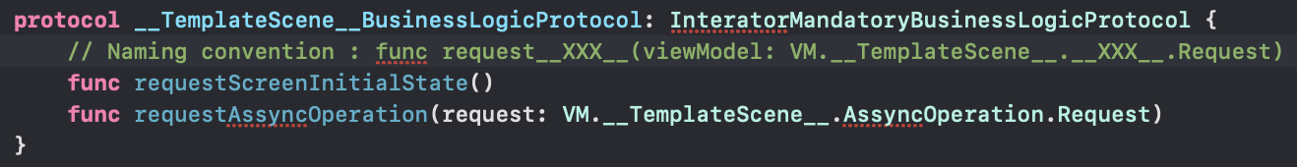
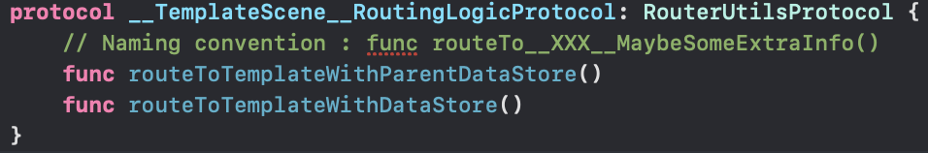
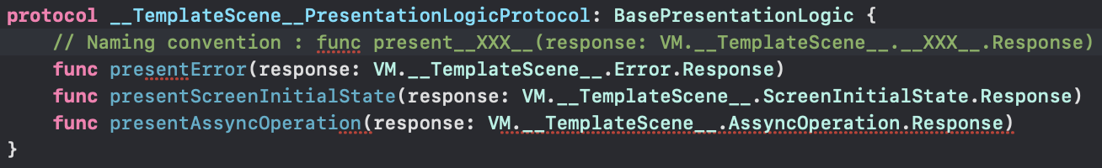
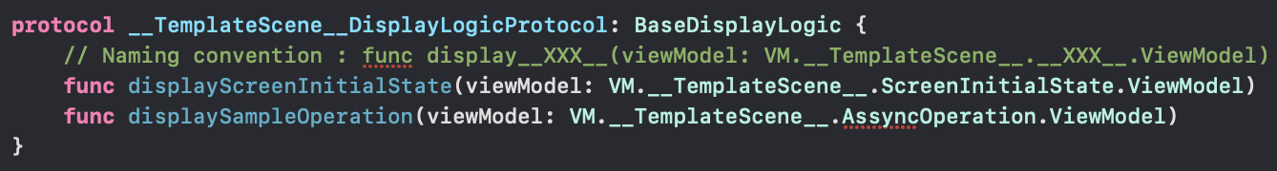
VIP naming convention
VC
I
R
P

Slide 3
Regular Flow
Sheme_Y
R
VC
V
I
Sheme_Z
P
Sheme_X
Managers
UseCases
All the connections are protocols/interfaces
ViewController aka VC, knows the Interactor. Interator will be responsable for the business of a VC.
Interactor knwow the Use Cases as UC, and they are the real brain or the app. Interactor forward the UC responses to the Presenter
Presenter aka P, will parse the response from the Interactor in way the VC can read it and forward it to the VC.
VC know the View (UIView), and the View have all the UI elements (they are not in the ViewController)
VC also knows the Router as aka R
Router is responsable for the navigation between diferent VCs
Repositorys, are a “source” of data. They can be a Cache, a DataBase, the API, etc.
UseCases are the brain of the app, and each one will know the related Network Repository
UseCases will typically comunitace with 1 NetworkRepository only; but in some cases a UseCase migth comunicate with more than 1 NR
API UseCase
Business UseCase
….
Cache Repository
API Repository
…

