Slide 1
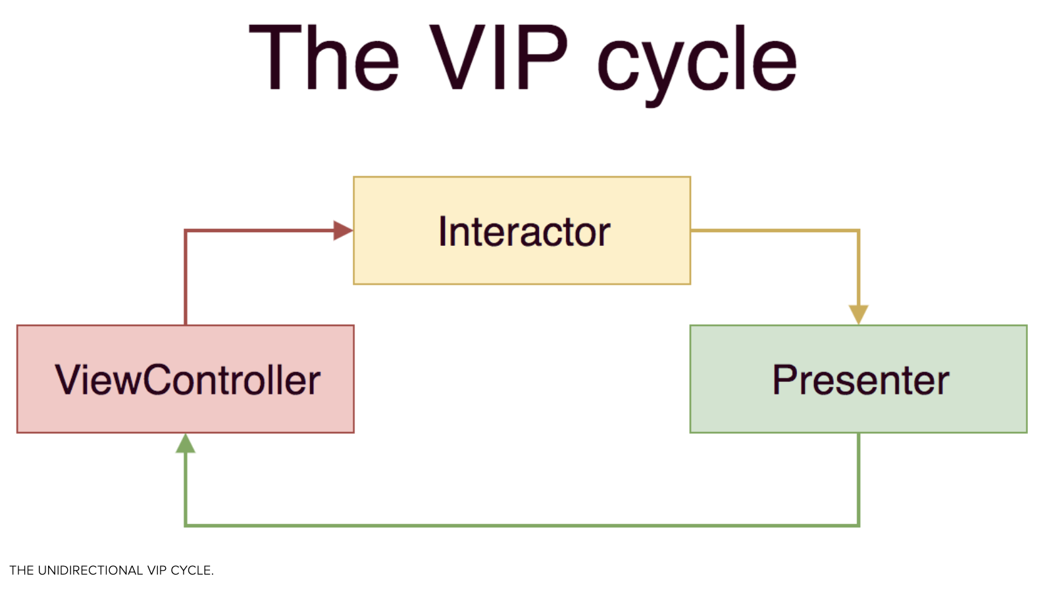
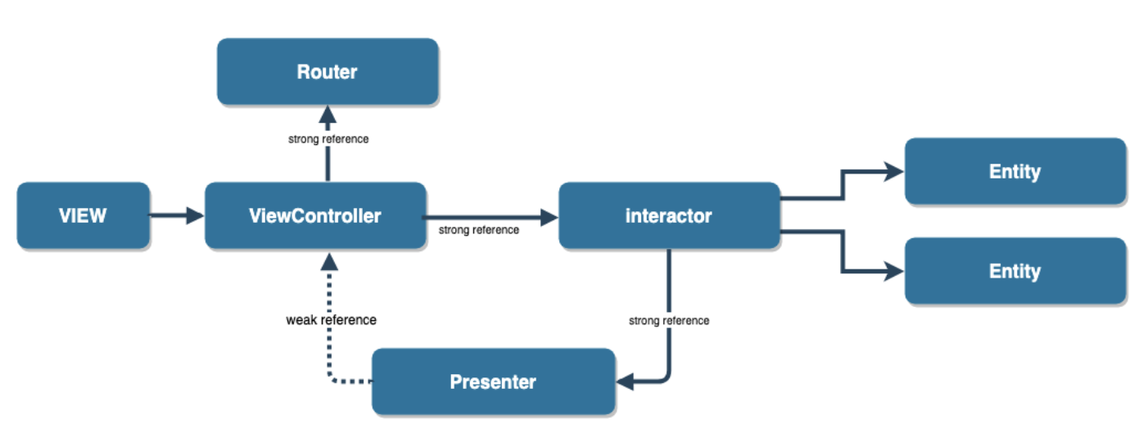
VIP (Clean Swift Architecture) In IOS - https://medium.com/crazy-minds/vip-clean-swift-architecture-in-ios-bb1d71680542
Introducing Clean Swift Architecture](https://hackernoon.com/introducing-clean-swift-architecture-vip-770a639ad7bf
Clean iOS Architecture https://www.essentialdeveloper.com/articles/clean-ios-architecture-part-7-vip-clean-swift-design-pattern-or-architecture
VIP-Demo : https://github.com/sarojraut/VIP-Demo
https://medium.com/@saad.eloulladi/clean-architecture-for-ios-viper-vip-c19de40b71e2

Slide 2
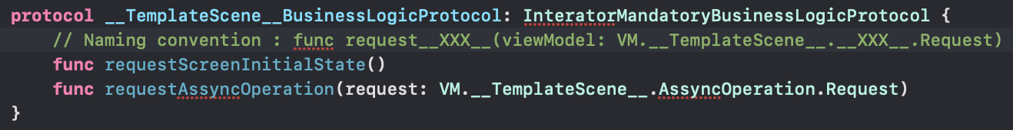
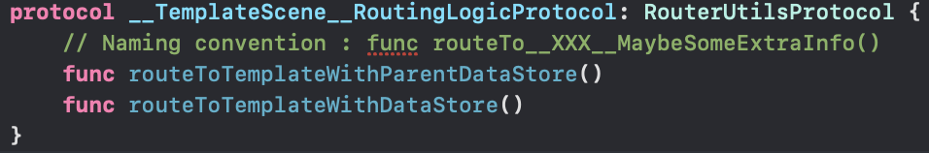
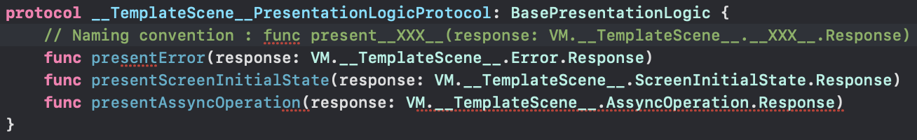
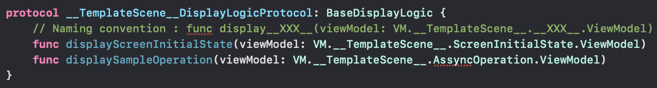
VIP naming convention
VC
I
R
P

Slide 3
Regular Flow
Sheme_Y
R
VC
V
I
Sheme_Z
P
All the connections are protocols/interfaces
View knows the Presenter Protocol. View is passive and should only tell the Presenter about user interations and show data sended by the Presenter. View has no state.
Presenter know the View Protocol and Router Protocol. Have the business that controls the View, and handles all the data.
Router know the View Protocol and know the navigation. The only way of getting from um View to other is by the Router (exception: Logout)
Router, View and Router are glued by Assembly Container File
Presenter can more than UseCase (P1)
Same UseCase can be know by more than 1 Presenter (UC_B)
UseCases will be the brain of the app, and each one will know the related Network Repository
UseCases will typically comunitace with 1 NetworkRepository only; but in some cases a UseCase migth comunicate with more than 1 NR. Example : “Read QRCode” will comunicate with InstitutionEvent NR and if there is sucess will comunicate with User NR to refresh user points.
Exists 1 Network Repository for each WebAPI domain (Account, Quis, Vouchers...) and same NR can have more than 1 API request
Its possible that we can have Use Cases that are not related with any Network Repository (cant give na exemple rigth now)
Sheme_X
Managers
UseCases
API_UseCase
BussineseUseCase
….
Cache Repository
API Repository
…

