Slide 1

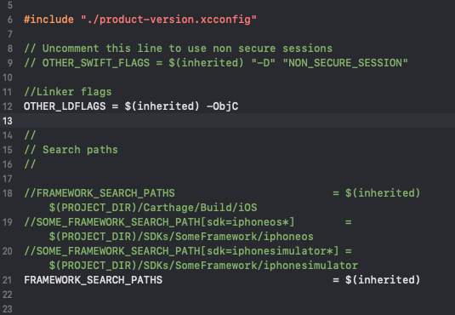
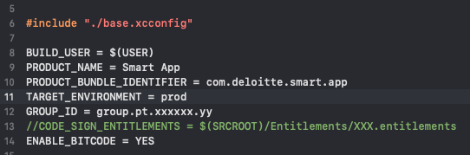
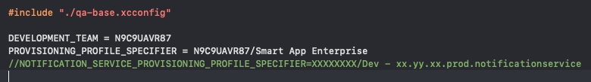
product-version.xcconfig
base.xcconfig
env-base.xcconfig
env-debug-signing.xcconfig
env-release-signing.xcconfig.xcconfig
Env: production, qa, dev, mock

