Slide 1
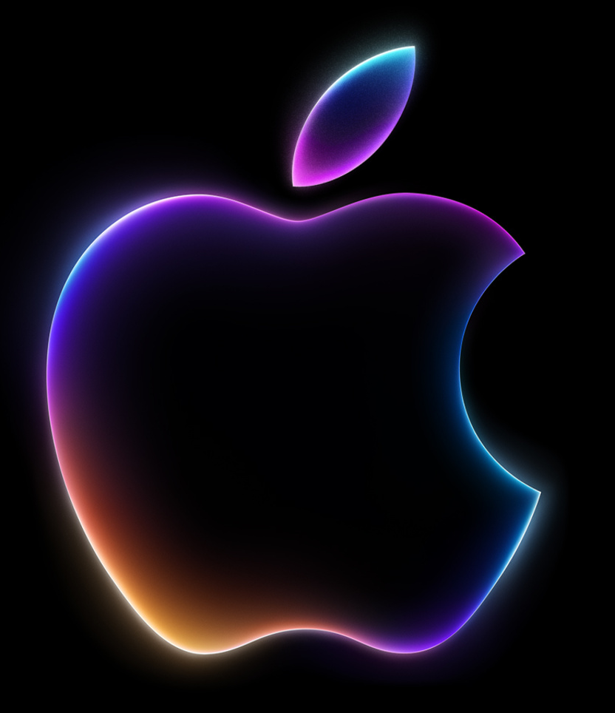
Talking Before Trading: Are StockTwits Comments Linked to Apple's Trading Volume?
Team B08: Alicia Mora, Almira Lazim, Ricardo Huang Wei Di, Pakaporn (Zoe) Leetrairong

Slide 2
Our Question: Do More Comments Today Mean More Trading Tomorrow?
What is StockTwits?
It's a platform like X, but only for investors.
People write short comments using tickers like $AAPL
They can tag their sentiment Bullish or Bearish.
Bullish = optimistic
Bearish = pessimistic
Why Apple?
One of the most traded stocks and people talk about it every day (about 1,700 comments per trading day in our data).
A $5 trillion dollar company today
If people comment more about Apple today, is more Apple stock traded tomorrow?
Why volume and not price?
If comments predicted price, traders would use them and the pattern would disappear
Why tomorrow and not today?
Same-day comments could just be a reaction to trading. The next day makes sure comments come first

Slide 3
Why It Matters
The Problem
Trading volume is the number of shares bought and sold in a day
Busy days bring more orders, more customer calls and more traffic on apps
If a busy day is only noticed when it starts, there is little time to prepare
Since 2020, many new small investors trade and talk about it online
Who could use it?
Brokers and IT teams → plan staff, customer support and servers
Market makers, portfolio managers → have shares and cash ready for more orders
Apple’s investor relations → see when small investors pay more attention
Our Hypotheses
When comments are above their 30-day average, Apple's trading volume is higher than normal the next day
The number of comments matters more for next-day volume than whether comments are bullish or bearish

Slide 4
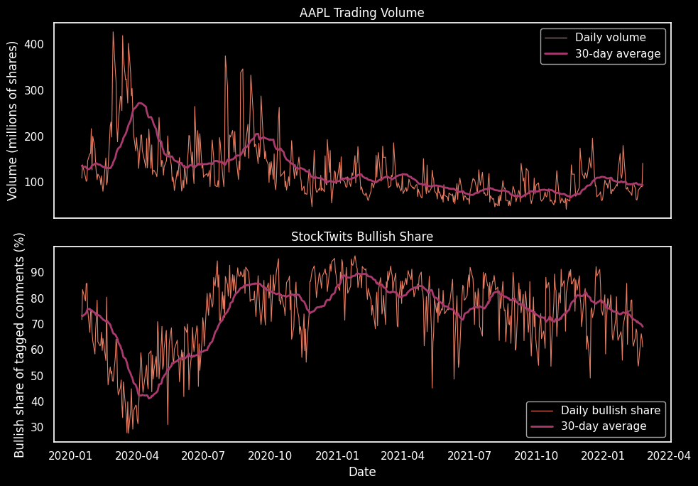
Our Data: Apple, 2020 to 2022
StockTwits (Kaggle)
914,962 comments from 63,822 users
Columns used: comment text, date and time, sentiment tag, likes, replies, followers
About half of the comments have no tag
Yahoo Finance - AAPL
Price and volume for 543 trading days
What we built
Comments per trading day and bullish share
Each day compared with its 30-day moving average
Earnings days

Slide 5
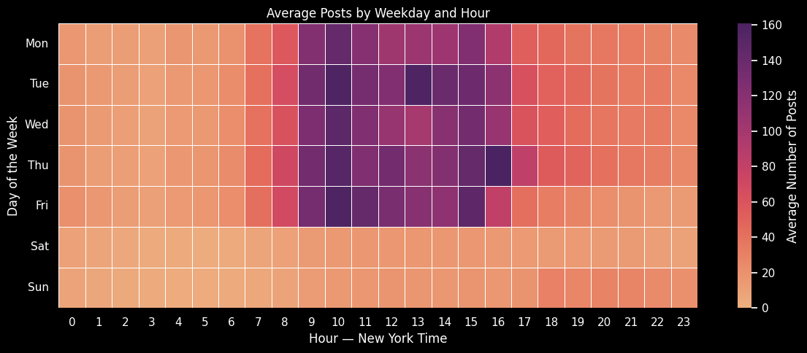
Data Challenge: Assigning Session Dates
47% of comments were posted while the market was closed
We labeled every comment with its session date → the first trading day it could affect.
Comments after 4pm, on weekends and on holidays go to the next trading day

Slide 6
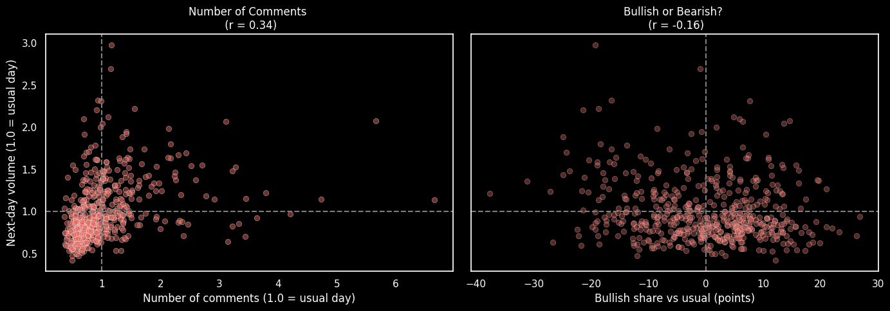
More Comments, More Trading the Next Day
15–23% more trading
the day after more comments than usual
How much people comment (r = 0.34) matters more than investor sentiment (r = -0.16)
Dot = one trading day
Dashed lines = a usual day

Slide 7
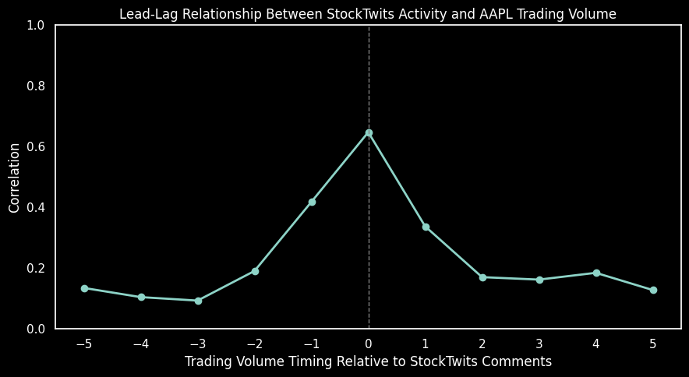
Comments and Volume Move Together
Correlations:
Day before = 0.42
Same day = 0.65
Next day = 0.34
What this means
Comments mostly react to current trading
But some signal is left for tomorrow

Slide 8
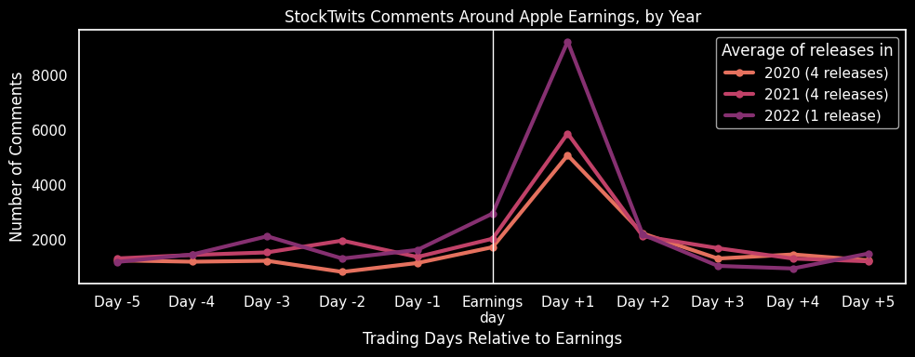
What Happens After Earnings?
On the day after earnings, comments increase to 4 to 6 times their average for the previous five days.
71% of those comments occur before the market opens

Slide 9
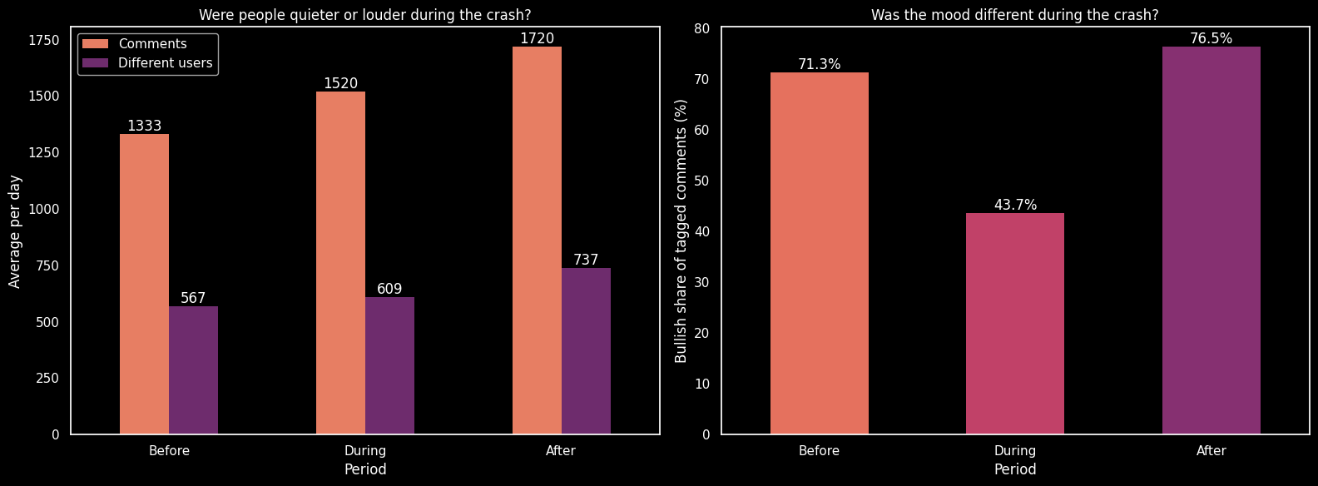
Did the COVID crash change how people commented on StockTwits?
Bullish share COVID → 71% before, 44% during and 77% after of tagged comments
The number of comments barely changed (1,333, 1,520 and 1,720 per day)

Slide 10
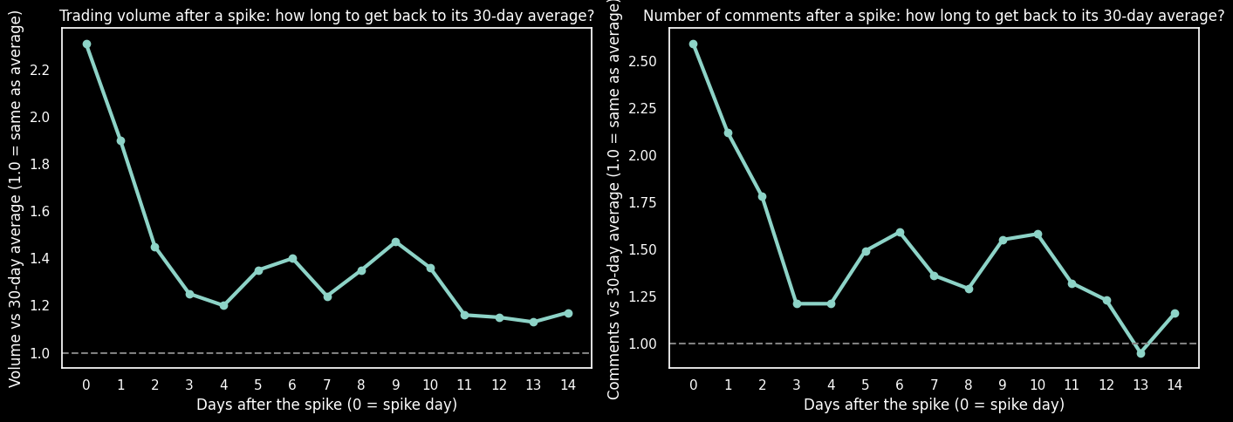
Does tradings stay high after a volume spike?
Spike day → trading volume was 2.31 times and comments were 2.59 times their normal level
3 days after the spike → both were only about 16% to 17% above normal

Slide 11
Conclusions and Recommendations
Our Hypothesis → Partly supported
Comments work as an early warning, not as an exact forecast
Did we prove it?
Significant link → Yes → 15 to 23% more trading after high-comment days (r = 0.34)
3 Findings
The amount of commenting matters more than investor sentiment
The mood follows the market effect (COVID crash, people became less bullish)
Earning days caused the biggest spikes, and spikes fade in about 3 days
Recommendations
Brokers
  Be prepared for more trading when comments are above their 30-day average
  Plan extra capacity for the day after earnings, and for 2 to 3 days after a big spike
Investors → don’t buy and sell just because comments are bullish or bearish
Limits
Only Apple 2020 to 2022
Association, not causation. So, we can’t say that comments caused more trading for sure.

