Slide 1

IBM Data Science Professional Certificate
Opening a Portuguese Restaurant in Toronto
Ricardo Torres
Notes:
Falta o teu nome aqui neste slide

Slide 2
Business Problem
Toronto
3 Million inhabitants
16th place worldwide with 272 restaurants per 100.000 inhabitants
Portuguese community
More than 170.000 people just in Toronto
Portuguese cuisine as one of the richest in the world
If na investor is looking to open a new Portuguese restaurant where would you recommend it?

Slide 3
Data
List of neighbourhoods in Toronto
Boroughs and postal codes (Wikipedia)
Geo coordinates
Portuguese venues data
Using Foursquare API
Category Id for Portuguese Restaurant

Slide 4
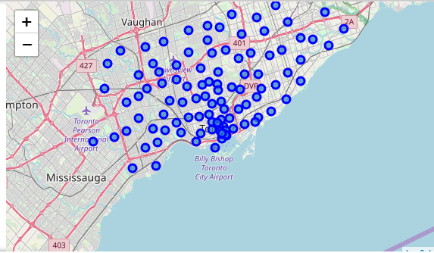
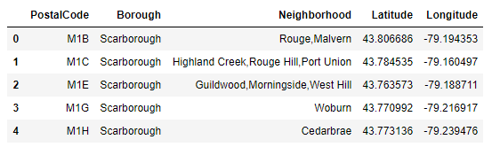
Methodology
Toronto Neighbourhoods Data Exploratory Analysis
Using Wikipedia data and Coursera CSV

Slide 5
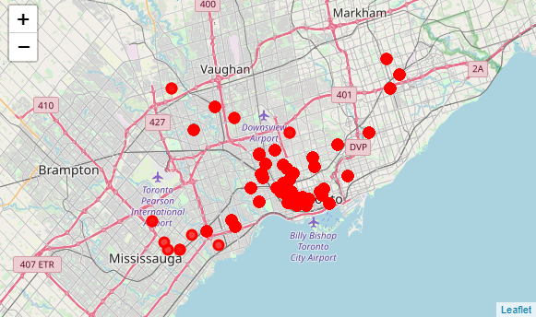
Methodology
Portuguese Restaurants Data Exploratory Analysis
Using Foursquare we retrieved all venues per neighbourhood

Slide 6
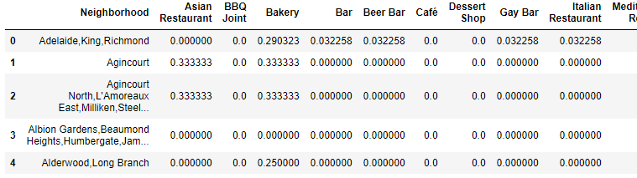
Methodology
Data wrangling
Create frequency based data frame per neighbourhood

Slide 7
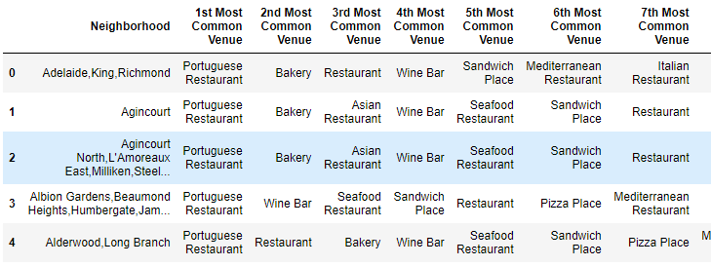
Methodology
Data wrangling
Create top venues data frame

Slide 8
Methodology
K-Means
To perform clustering on the neighbourhoods based on the venue frequency
DBSCAN
To perform venue clustering based on concentration

Slide 9
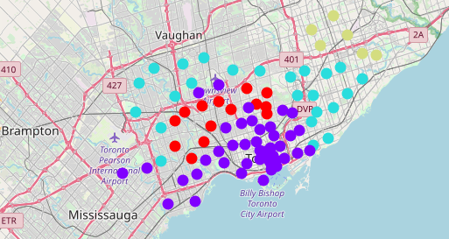
Results
K-Means
With 4 clusters
Purple (high concentration)
Cyan (medium concentration)
Red (low concentration)
Green (low concentration)

Slide 10
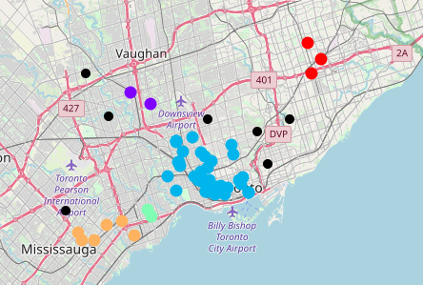
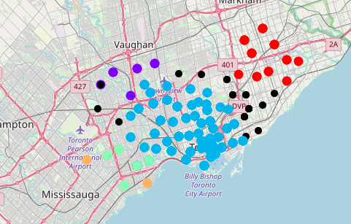
Results
DBSCAN
Per venue location and applied to neighbourhoods shows density areas and outliers where there is little concentration

Slide 11
Discussion and Conclusion
Recommendation
Avoid Central area with high density clusters on both K-means and DBSCAN
Outliers areas in DBSCAN are a good bet
Red and Green clusters in K-Means have less competition
Conclusion
Good insight to avoid high competition areas
More data would be useful (e.g. population density, transports, etc.)

