Slide 1
Smoothed particle hydrodynamics
Computational physics (AP3082 D)
Ludwig Rasmijn
Sebastiaan Lokhorst
Shang-Jen Wang
April 29, 2016

Slide 2
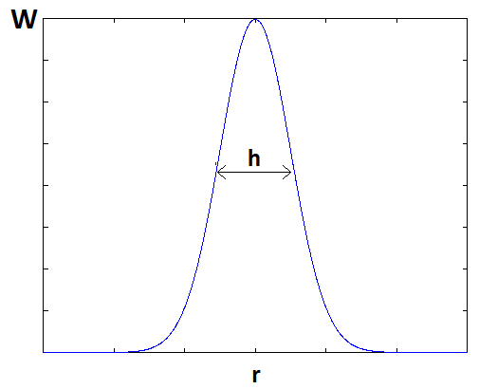
Physics
Every particle is represented with a smoothing kernel

Slide 3



Physics

Slide 4
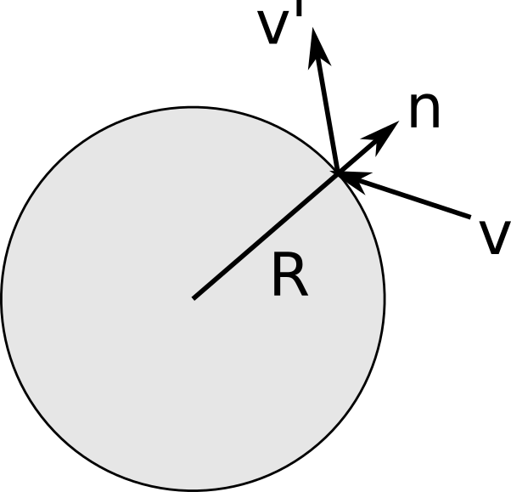
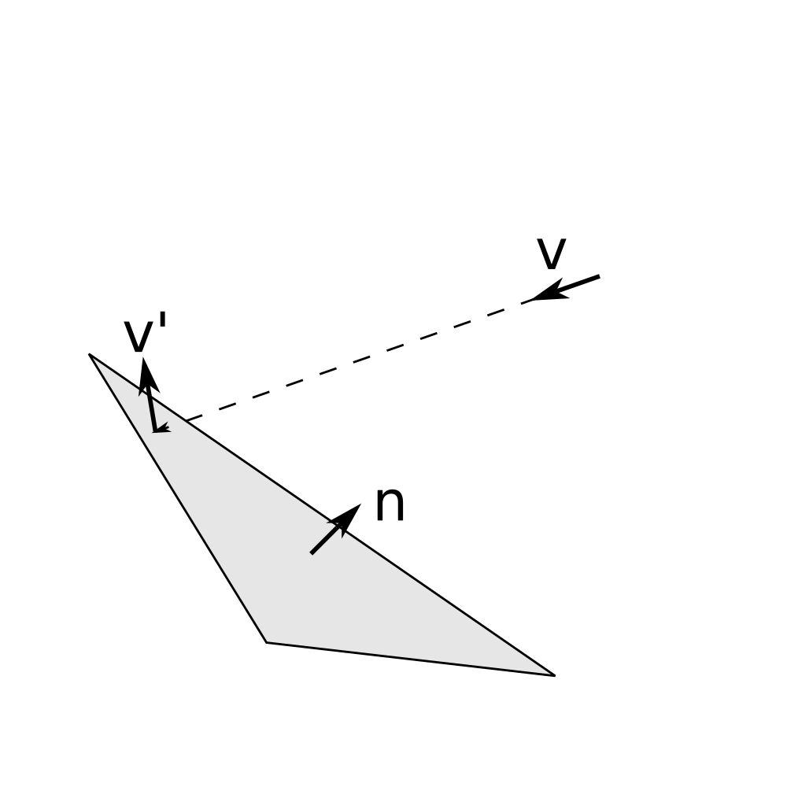
Boundaries
Rigid, motionless bodies
spheres
triangles

Slide 5
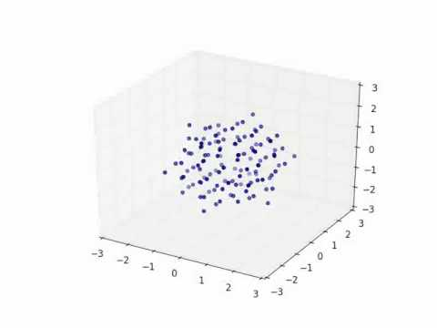
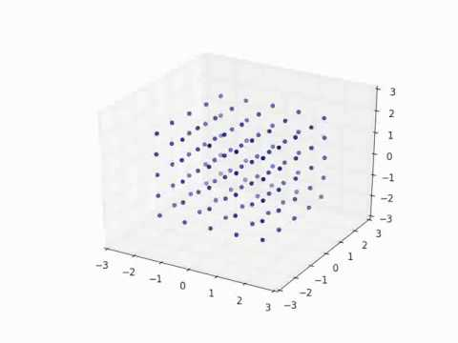
Surface Tension

Slide 6
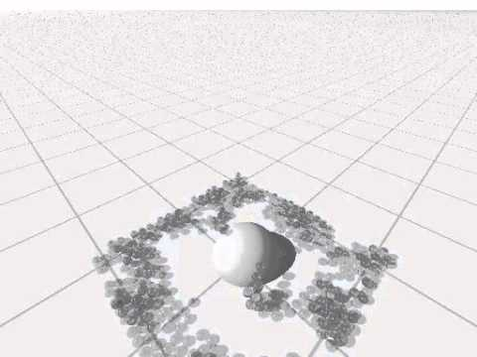
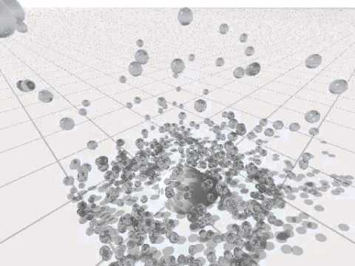
Viscosity

Slide 7
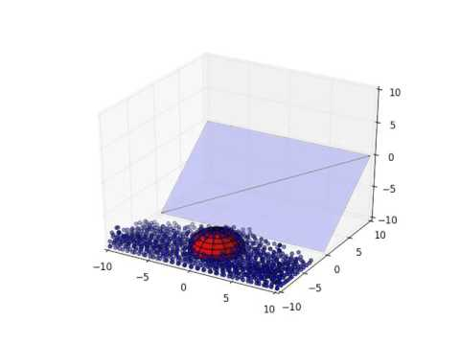
Boundaries
Spheres...

Slide 8
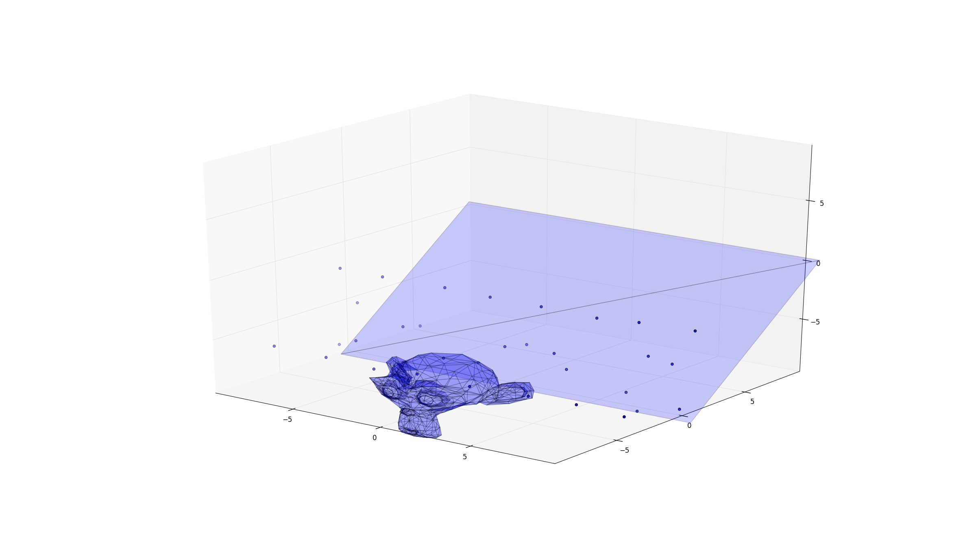
Boundaries
Triangles are nice and versatile...
1000 triangles × many particles = SLOW!
(but can be optimized)

Slide 9
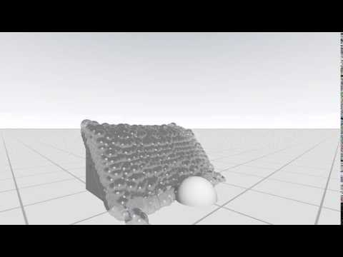
Fancy render

Slide 10
Questions?

