Slide 1
TWIX 2
EXTRACTION WORKBENCH
THESIS RESEARCH SYSTEM
Compile once.
Extract indefinitely.
ID_05 CASE STUDY
95.5%
HELD-OUT ACCURACY
TWIX 2 learns a reusable structured-data extractor from a small sample of a template-based PDF family, then ships ordinary Python code for every later page.
15 test pages
56 matched records
224 physical blocks
0 runtime model calls
1 September 2026
PROJECT OVERVIEW
01
Notes:
[Sources]
- UI/runs/run-20260901-184959-d47392/metadata.json
- UI/runs/run-20260901-184959-d47392/pipeline/eval.json
- UI/styles.css
[/Sources]

Slide 2
TWIX 2
EXTRACTION WORKBENCH
01 / WHY THIS ARCHITECTURE
The problem is not one page - it is the repeated model call
A frontier model can parse a page well. The operational cost still grows every time another page is sent.
CONVENTIONAL MODEL-PER-PAGE
TWIX 2 COMPILE-ONCE
LLM / API COST
LLM / API COST
cost grows with every page
no further model calls
pages processed
pages processed
The hypothesis: structure turns a broad reasoning task into smaller code-generation tasks that cheaper - and potentially local - models can solve.
RESEARCH PREMISE
02
Notes:
[Sources]
- AGENTS.md
- UI/styles.css
[/Sources]

Slide 3
TWIX 2
EXTRACTION WORKBENCH
02 / END-TO-END PIPELINE
Models compile the extractor; ordinary Python runs it
Learning happens once; extraction becomes a repeatable, model-free runtime.
ONE-TIME COMPILATION
1
Detect + split
2
Infer template
3
Write code
4
Train gate
5
Package
Find content start; create train and test OCR.
Define node ids, fields and metadata patterns.
Generate separator and one extractor per node.
Evaluate all train pages; repair if needed.
Copy model-free code into pipeline/.
REPEATED RUNTIME
PDF
OCR
Code
Extracted data
same family
words + geometry
generated scripts
logical records
ARCHITECTURE
03
Notes:
[Sources]
- src/agents/graph.py
- src/pipeline.py
- src/record_grouping.py
[/Sources]

Slide 4
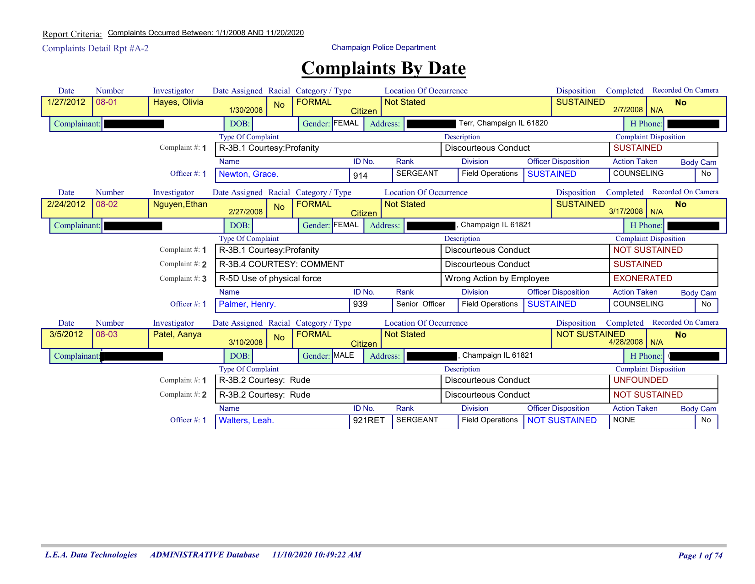
TWIX 2
EXTRACTION WORKBENCH
03 / ID_05
A 20-page sample contains a stable four-block record pattern
The report repeats complaint summaries, complainant details, complaint rows and officer rows.
20
7,270
SOURCE PAGES
OCR WORDS
5 train + 15 test
global ids + geometry
4
56
TEMPLATE NODES
TEST RECORDS
3 tables + 1 KV
after deterministic grouping
Source redactions are preserved in every visual.
CASE STUDY
04
Notes:
[Sources]
- UI/runs/run-20260901-184959-d47392/id_05.pdf
- UI/runs/run-20260901-184959-d47392/metadata.json
- UI/runs/run-20260901-184959-d47392/ocr_extraction_full.csv
- tmp/pdfs/project-overview/source_pages/page_1.png
[/Sources]

Slide 5
TWIX 2
EXTRACTION WORKBENCH
04 / INDEPENDENT EVALUATION SPLIT
Five pages compile the extractor; fifteen pages test it
This run uses all five training pages for code generation, then evaluates the frozen bundle on fifteen independent pages.
5 TRAIN
20
15
FROZEN BUNDLE
5
95.5%
SOURCE PAGES
INDEPENDENT TEST
BUILD PAGES
held-out accuracy
Result
The bundle is generated once from five training pages, then evaluated without changing its code on fifteen independent pages.
CASE STUDY
05
Notes:
[Sources]
- UI/runs/run-20260901-184959-d47392/metadata.json
- UI/runs/run-20260901-184959-d47392/agent_space/train/ocr_extraction.csv
- UI/runs/run-20260901-184959-d47392/agent_space/test/ocr_extraction.csv
- UI/runs/run-20260901-184959-d47392/pipeline/train_eval/eval.json
[/Sources]

Slide 6
TWIX 2
EXTRACTION WORKBENCH
05 / TEMPLATE CONTRACT
Four node ids define every lookup, block and extractor
Field names describe semantics; bid describes visual position; metadata regexes distinguish repeated page furniture from record content.
{
"node_id": 2,
"type": "table",
"fields": [
"Type Of Complaint",
"Description",
"Complaint Disposition"
],
"bid": [2],
"complexity": {
"same_row_structure": true,
"nested": false
}
}
NODE
TYPE
SIZE
ROLE
0
table
10 fields
Complaint summary
1
key-value
5 fields
Complainant details
2
table
3 fields
Complaint rows
3
table
7 fields
Officer rows
9 metadata regexes: 7 document-level + 2 record-level
TEMPLATE
06
Notes:
[Sources]
- UI/runs/run-20260901-184959-d47392/template.json
- AGENTS.md
[/Sources]

Slide 7
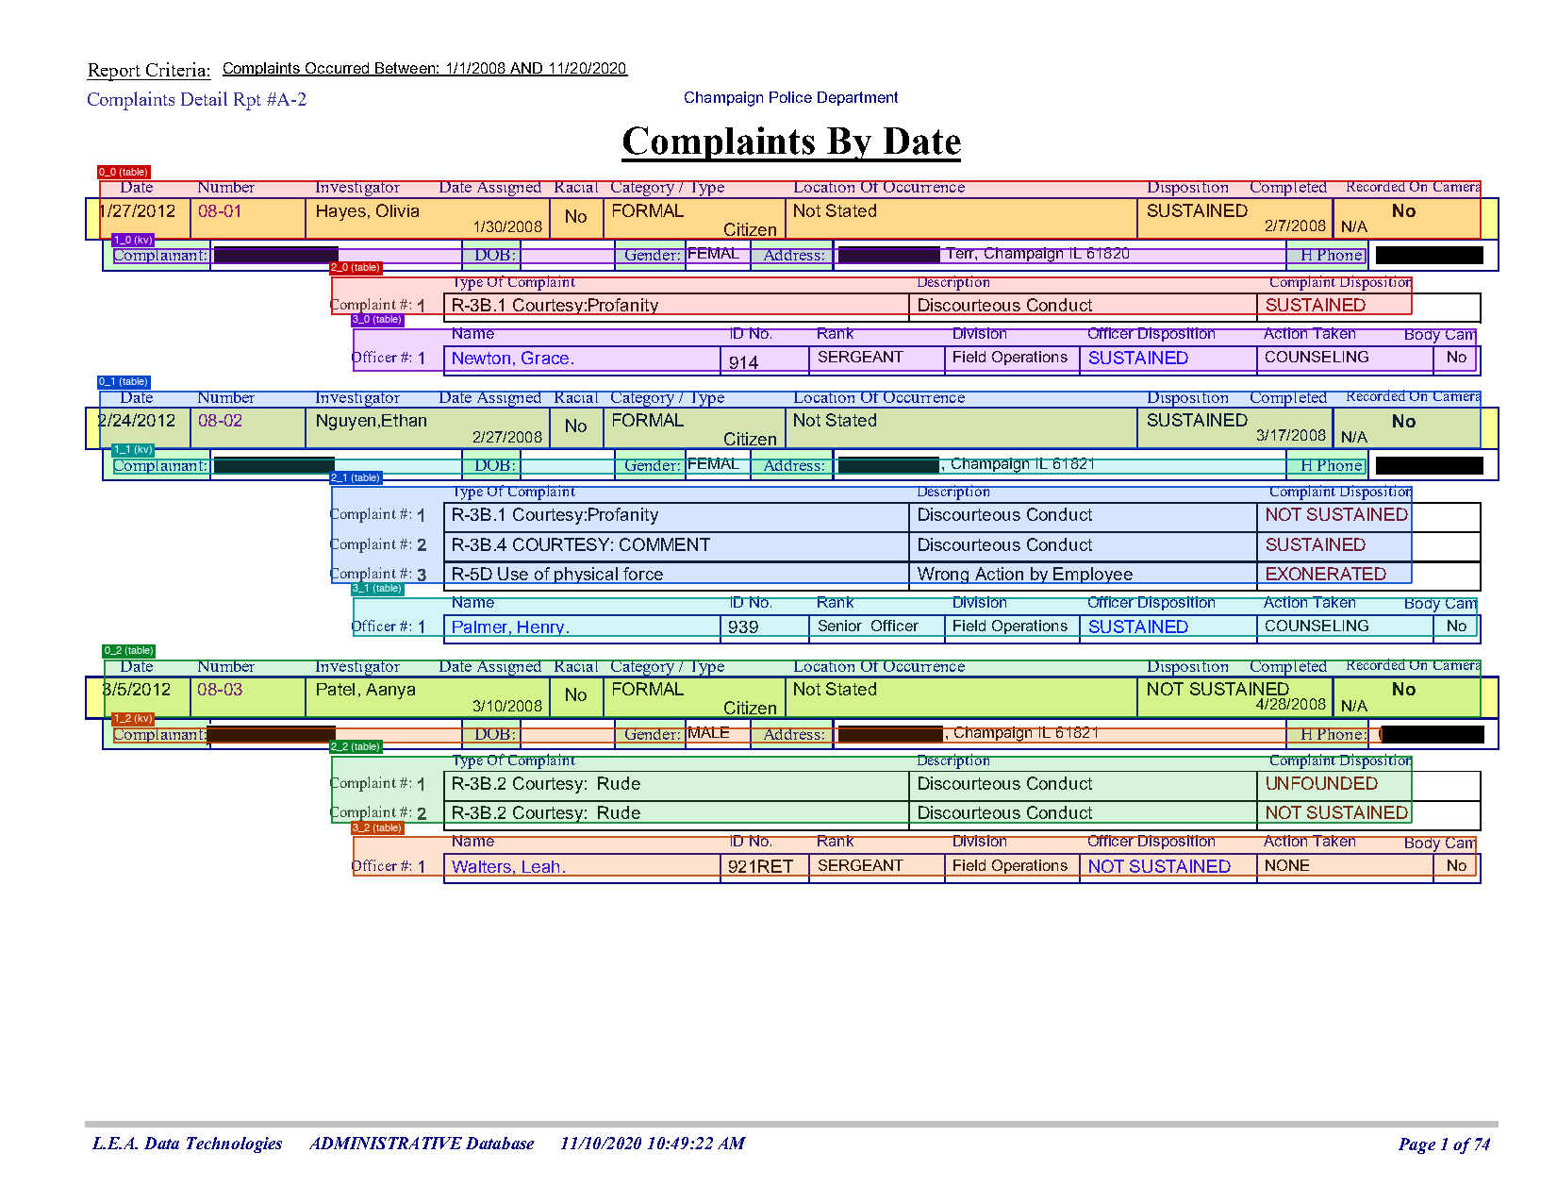
TWIX 2
EXTRACTION WORKBENCH
06 / PHYSICAL BLOCK SEPARATION
Generated geometry code finds page-local blocks
On page 1, twelve visual regions map to four node types; multi-page tables remain separate continuation blocks.
IDENTITY CONTRACT
block_id =
<node_id>_<instance>
0_1 summary
1_1 complainant
2_1 complaints
3_1 officers
uid = physical join key
Page-local only
A block emitted under page P may contain only page-P words.
BLOCK SEPARATION
07
Notes:
[Sources]
- UI/runs/run-20260901-184959-d47392/agent_space/train/block_separation.json
- UI/runs/run-20260901-184959-d47392/artifacts/blocks/page_1_blocks.png
- UI/runs/run-20260901-184959-d47392/metadata.json
[/Sources]

Slide 8
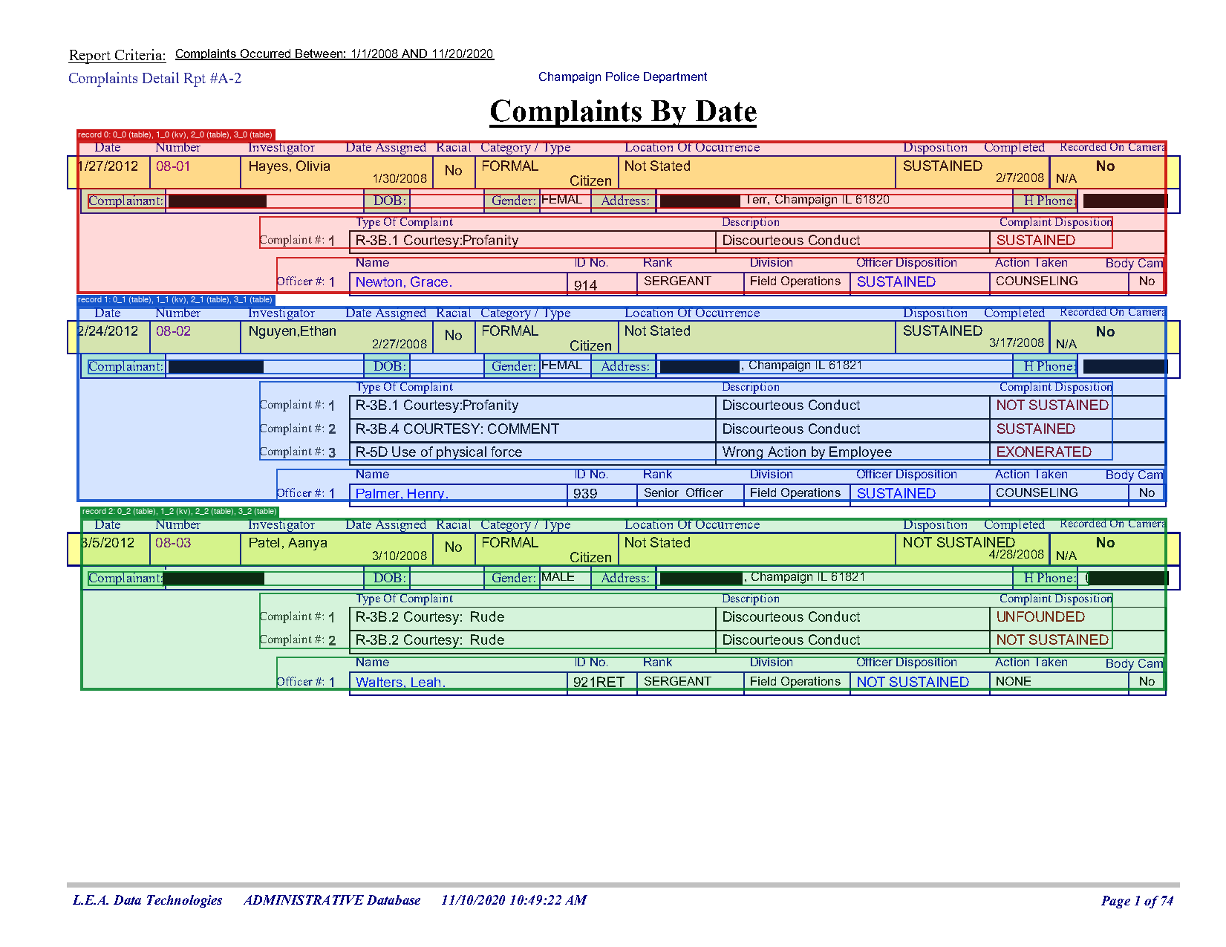
TWIX 2
EXTRACTION WORKBENCH
07 / LOGICAL RECORD GROUPING
Blocks 0 → 1 → 2 → 3 form one complaint record
Deterministic grouping preserves every physical block while producing a record-level JSON structure.
ONE RECORD
0_0
summary
1_0
KV details
2_0
complaint rows
3_0
officer rows
56 / 56
matched test records
RECORD GROUPING
08
Notes:
[Sources]
- UI/runs/run-20260901-184959-d47392/artifacts/record_separation/page_1_records.png
- src/record_grouping.py
- UI/runs/run-20260901-184959-d47392/pipeline/eval.json
[/Sources]

Slide 9
TWIX 2
EXTRACTION WORKBENCH
08 / DIFFICULTY ROUTING
Routing reserves the stronger model for difficult nodes
Nodes 0 and 1 use Qwen3.8 Flash; the harder table extractors use GLM-5.3 Flash.
NODE 0
TABLE
198 lines
Qwen3.8 Flash
# extraction_scripts/<node_id>.py
def extract(block: dict) -> dict:
...
# runtime dispatch
node_id = block["block_id"].rsplit("_", 1)[0]
result = extractor[node_id].extract(relative_block)
result["page"] = page
result["uid"] = uid
NODE 1
KEY-VALUE
139 lines
Qwen3.8 Flash
NODE 2
TABLE
224 lines
GLM-5.3 Flash
NODE 3
TABLE
190 lines
GLM-5.3 Flash
CODE SYNTHESIS
09
Notes:
[Sources]
- UI/runs/run-20260901-184959-d47392/metadata.json
- UI/runs/run-20260901-184959-d47392/pipeline/extraction_scripts/0.py
- UI/runs/run-20260901-184959-d47392/pipeline/extraction_scripts/1.py
- UI/runs/run-20260901-184959-d47392/pipeline/extraction_scripts/2.py
- UI/runs/run-20260901-184959-d47392/pipeline/extraction_scripts/3.py
[/Sources]

Slide 10
TWIX 2
EXTRACTION WORKBENCH
09 / RUNTIME CONTRACT
The deployed path is a six-step local program
LangGraph, OpenCode and model providers disappear from the production extraction path.
1
New PDF
2
OCR
3
Separate
4
Extract
5
Group
6
JSON
same family
words + geometry
blocks + uids
relative blocks
logical records
portable output
NO LANGGRAPH
NO OPENCODE
NO MODEL CALLS
The marginal LLM/API cost of extraction is zero after compilation; local compute remains.
PORTABLE RUNTIME
10
Notes:
[Sources]
- src/pipeline.py
- src/record_grouping.py
- UI/runs/run-20260901-184959-d47392/pipeline/requirements.txt
[/Sources]

Slide 11
TWIX 2
EXTRACTION WORKBENCH
10 / EXTRACTED RECORD
Physical blocks stay visible inside each logical record
Grouping preserves page, uid and block identity while making the output usable downstream.
{
"record_id": "0",
"blocks": [
{"block_id": "0_0", "type": "table", "page": 1},
{"block_id": "1_0", "type": "kv", "page": 1},
{"block_id": "2_0", "type": "table", "page": 1},
{"block_id": "3_0", "type": "table", "page": 1}
]
}
RECORD 0 / SELECTED VALUES
DATE
NUMBER
7/19/2012
08-14
INVESTIGATOR
DISPOSITION
Kim, Joon
UNFOUNDED
GENDER
OFFICER
MALE
Carter, Felix.
COMPLAINT
ACTION
R-3B.3 Courtesy: Conduct
NONE
RUNTIME OUTPUT
11
Notes:
[Sources]
- UI/runs/run-20260901-184959-d47392/pipeline/extracted.json
- UI/runs/run-20260901-184959-d47392/pipeline/grouped.json
[/Sources]

Slide 12
TWIX 2
EXTRACTION WORKBENCH
11 / HELD-OUT RESULT
Held-out extraction reaches 95.5% accuracy
Across 15 independent pages, every record and node type is found; remaining errors are localized value-boundary and column-assignment issues.
95.1%
95.5%
1.000
1.000
TRAIN ACCURACY
TEST ACCURACY
RECORD MATCH F1
NODE MATCH F1
5 pages / 19 records
15 pages / 56 records
perfect precision + recall
typed precision + recall
Content overall
0.910
Key-value content
0.839
Table content
0.939
EVALUATION
12
Notes:
[Sources]
- UI/runs/run-20260901-184959-d47392/pipeline/eval.json
- UI/runs/run-20260901-184959-d47392/pipeline/train_eval/eval.json
- src/eval/score.py
[/Sources]

Slide 13
TWIX 2
EXTRACTION WORKBENCH
12 / ERROR ANALYSIS
The residual gap is narrow and actionable
The scorer reports field-level reasons that can be handed directly to the optional repair loop.
TYPICAL MISMATCH
WHAT IS NOT FAILING
Gold
FORMAL
No missing gold records
No extra candidate records
Candidate
FORMAL Citizen
No missing or extra nodes
Reason
A neighboring column value crosses the Category / Type boundary.
No node type mismatches
EVALUATION
13
Notes:
[Sources]
- UI/runs/run-20260901-184959-d47392/pipeline/eval.txt
- UI/runs/run-20260901-184959-d47392/pipeline/eval.json
- src/agents/train_repair.py
[/Sources]

Slide 14
TWIX 2
EXTRACTION WORKBENCH
13 / AUDIT TRAIL
Every phase leaves a file that can be inspected or deployed
The run directory is simultaneously a provenance record, a visual QA workspace and a portable extractor.
UI/runs/run-20260901-184959-d47392/
pipeline/
├── ocr_extraction_full.csv
full-document OCR
pipeline.py
├── template.json
schema + metadata contract
block_separation.py
├── metadata.json
models, configuration, scores
extraction_scripts/
record_grouping.py
├── artifacts/
block + record overlays
requirements.txt
├── agent_space/
train/test PDFs and OCR
template.json
grouped.json
└── pipeline/
deployable bundle + outputs
pipeline_health.json
eval.json + eval.txt
ARTIFACTS
14
Notes:
[Sources]
- UI/runs/run-20260901-184959-d47392/
- AGENTS.md
[/Sources]

Slide 15
TWIX 2
EXTRACTION WORKBENCH
14 / COST MODEL
One compilation cost is amortized over every later page
The architectural claim is about marginal model cost, not about eliminating local compute.
AFTER COMPILATION
ID_05 COMPILATION SCALE
$0
3.40M
marginal LLM/API cost
input + output tokens
No model context window grows with production pages.
One-time code-generation workload
The same code handles each same-family page.
This expense is paid once for the document family, then amortized across every future extraction.
Local OCR, CPU, storage and hosting still consume resources.
ECONOMICS
15
Notes:
[Sources]
- UI/runs/run-20260901-184959-d47392/metadata.json
- UI/runs/run-20260901-184959-d47392/metadata/cost.json
[/Sources]

Slide 16
TWIX 2
EXTRACTION WORKBENCH
15 / WHAT THE RESULT SUPPORTS
Use models to write the extractor - not every extraction
id_05 preserves record structure and approaches frontier-level content quality on an independent split.
ID_05 RESULT
BOUNDARIES
5
15
56
95.5%
Family-specific, not a generic PDF extractor.
training pages
test pages
matched records
overall accuracy
Layout drift and OCR errors may require recompilation.
0 runtime model calls
Ground truth is only as reliable as its reference process.
A reusable program replaces a repeated model call.
Zero model cost still requires local compute.
CONCLUSION
16
Notes:
[Sources]
- UI/runs/run-20260901-184959-d47392/metadata.json
- UI/runs/run-20260901-184959-d47392/pipeline/eval.json
- AGENTS.md
[/Sources]

