Slide 1

Robotics Project
A.A. 2022-2023
Badole Elena
Bonaccorsi Riccardo
Caporale Federico
Lorengo Sofia

Slide 2
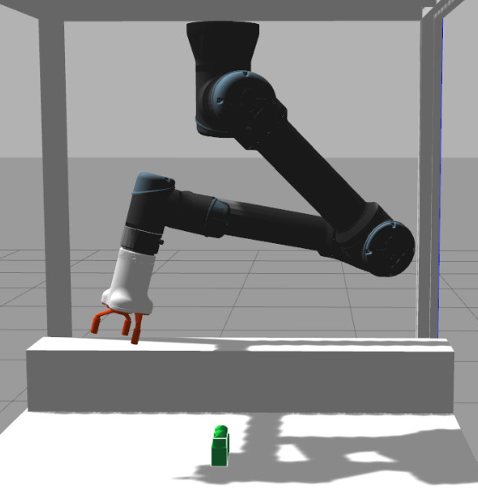
Description - Project n. 1
Manipulator
Anthropomorphic arm
Spherical wrist
Three-fingered gripper
3D sensor
Locate different object
Detect their position
Mega-blocks
Different classes
Known geometry

Slide 3

Assignment 1
Only one object
Base in contact with the ground
Any of the possible classes
Objective:
Recognize the block and its position
Pick the block from the original position
Move the block to the final position

Slide 4
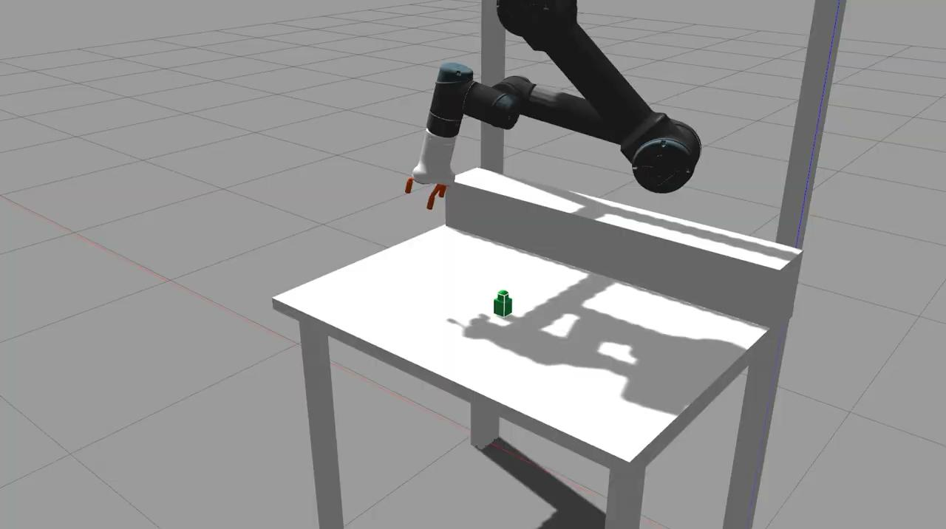

Slide 5
PERCEPTION
Ability of a robot to perceive and understand its surrounding
Sensors like cameras
We need to locate and detect the blocks
They are in the workspace of robot manipulator
We use ZED camera

Slide 6
ROBOFLOW
It is an external service to train the robot’s perception system
It offers tools for image processing and analysis
We train the model with labelled images containing blocks
Our program cameraListener.cpp:
manages images coming from ZED camera
images are sent to Roboflow
it returns location and class of objects
internal processing and publishes information on ROS topic

Slide 7
MOTION
The robotic arm must move correctly
Arm should travel as little road as possible
Follow a linear trajectory
Forward kinematics
Calculate the position and orientation of the end effector
Possible thanks to the knowledge of joint parameters
Inverse kinematics
Determines the position that the robot must assume in order to reach a given position of the robot's end effector

Slide 8
PLANNING
How a block should be moved
Manage the entire movement part of the robot
The robotic arm moves:
up above the block
descends
moves the gripper in order to grab it
moves above the final position
descends again
releases the block
gets up and goes away

