Slide 1
Replication and extension of BERTserini
End-to-end Open-Domain Question Answering
Beatrice Macchia 292178
Riccardo Bosio 291299

Slide 2
Problem statement
Question Answering:
QA aims at building systems that answer questions posed in a natural language by humans. It is commonly used to build conversational client applications, which include social media applications, chat bots, and speech-enabled desktop applications.
Closed-domain:
Answers to a given question are retrieved within a specific area.
Open-domain:
the Task of question answering on open-domain datasets such as Wikipedia: questions can cover any topic, and consequently it makes it even more difficult to the QA system to find the right answer.

Slide 3
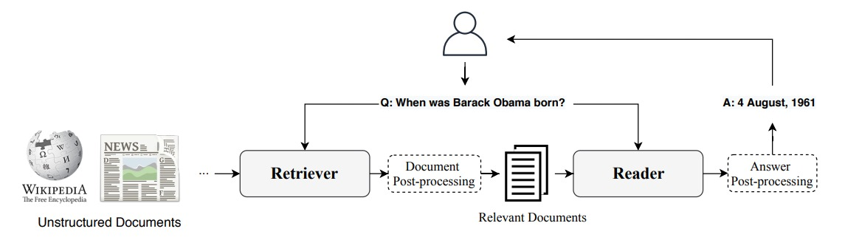
Retriever-Reader
Retriever
Reader
It is responsible for collecting relevant documents from a given corpus w.r.t. the question text.
It aims at identifying the final answer from the received documents.

Slide 4
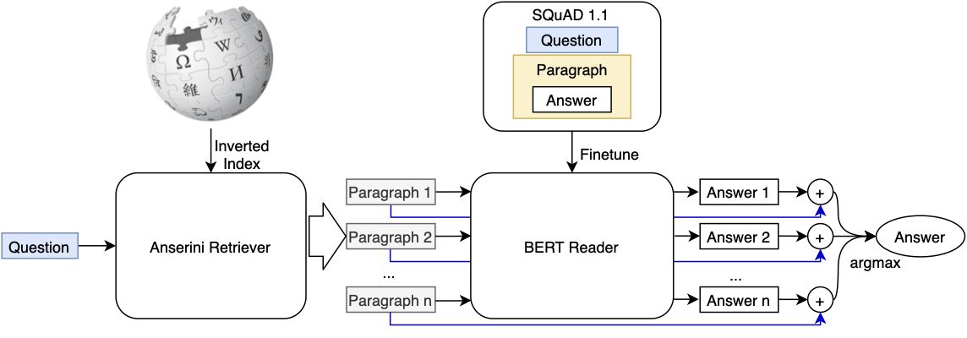
BERTserini: Anserini retriever
The retriever is Anserini, an open source information retrieval toolkit that builds on Lucene. We implemented it using Pyserini, a Python toolkit for reproducible information retrieval research.

Slide 5
BERTserini: BERT reader
BERT is an open source machine learning framework for natural language processing (NLP). The BERT model is pre-trained using text from Wikipedia and then fine-tuned with SQuAD, a questions+answers dataset.

Slide 6
Extensions – Alternative Readers
RoBERTa:
More training data, larger batch and longer sequences;
Dynamic masking pattern;
No Next Sentence Prediction.
ALBERT:
Factorization of the Embedding matrix;
Cross-layer parameter sharing;
Inter Sentence Coherence Prediction.
SpanBERT:
Mask spans of tokens rather than individual ones;
Span Boundary Objective (SBO);
No Next Sentence Prediction.
We tested the end-to-end pipeline replacing BERT with each of these alternative readers

Slide 7
Extensions – RIDER re-ranking
Question
RIDER
Retriever
K re-ranked contexts
K contexts
Reader
Reader
Reader
Answer
N answers

Slide 8
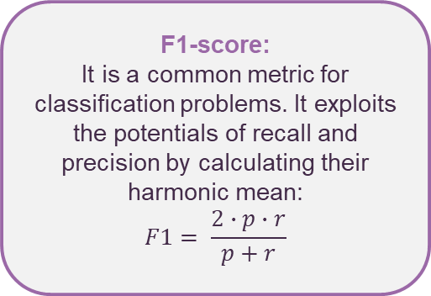
Experiments – Dataset & Metrics
SQuAD:
A reading comprehension dataset, consisting of questions posed on a set of Wikipedia articles, where the answer to every question is a segment of text from the corresponding reading passage. It contains 100.000+ questions&answers pairs from 500+ articles.
Exact-Match (EM):
It is a true/false metric that measures each question&answer pair. If the predictions match the correct answers exactly, then the EM = 1 or else the EM = 0.
F1-score:
It is a common metric for classification problems. It exploits the potentials of recall and precision by calculating their harmonic mean:
$$F1= \frac{2∙p∙r}{p+r}$$

Slide 9
Experiments - Results
2
1
Alternative readers:
Fine-tuning of BERT on SQuAD:
Reader | EM | F1-score
bert-base | 34 | 44.17
roberta-base | 40 | 52.5
spanbert | 35 | 42.5
albert-base | 37 | 46.36
Model | EM | F1-score
bert-base | 80.18 | 87.69
3
RIDER-based contexts re-ranking:
It does not bring any additional value to our pipeline. The majority of contexts present in the top-k retrieved ones are still present after re-ranking and consequently, answers actually change in a very small number of cases

Slide 10
Conclusions/takeaways
Improvements in the training phase of BERT has shown to lead to significant increase in performances, as we observed with RoBERTa’s behaviour as a reader.
Concerning RIDER instead, we can state that the retriever is already performing well and probably the contexts containing the right answer are retrieved at the first step in most cases, so the re-ranking does not lead to improvements.

