Slide 1

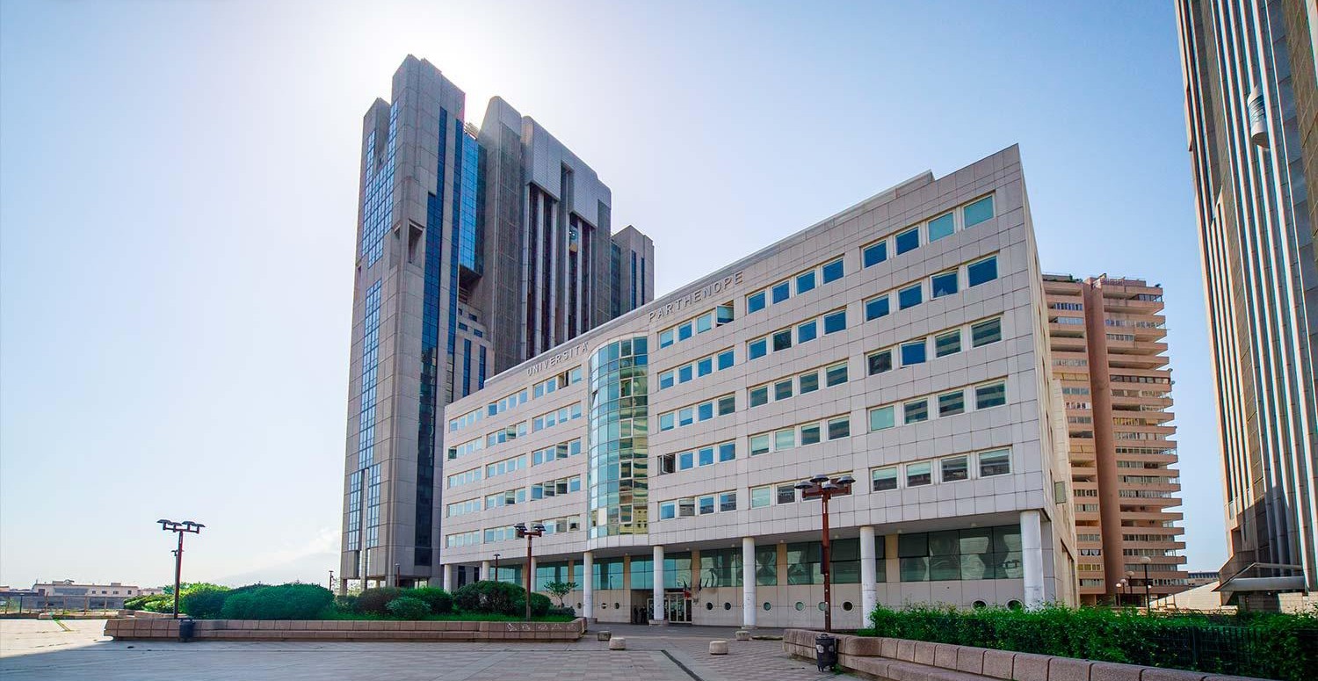
DORMITORIO PARTENOPEO

Slide 2

PROJECT DESCRIPTION
This presentation introduces the "Dormitorio Partenopeo" project, an online software system designed to simplify and improve the management of a university dormitory. The project focuses on providing an efficient, secure, and user-friendly platform for students, guests, and staff, allowing easy room booking, reservation management, and an overall improved user experience.
The software will allow users (students or guests) to:
View room rates
Check the types of rooms available
Make an online reservation.

Slide 3
OBJECTIVES
•Create a user-friendly interface that allows easy navigation
•Implement a booking system for the available room types
•Introduce a secure and flexible payment system
•Use a secure authentication system
•Implement a review system to improve the customer experience

Slide 4
APPLICATION STRUCTURE
The application is structured according to a three-tier architecture: frontend, backend, and database.
Frontend (HTML, CSS, JavaScript)
The frontend is built with HTML, CSS, and JavaScript, without external frameworks.
• HTML:
- page structure (index, login, registration, dashboard, booking, reviews, promotions)
• CSS:
- website styling
- page layouts
- sidebar menu and graphic components
• JavaScript:
- event handling (form submissions, clicks)
- API calls using fetch
- client-side data validation
- user session management using localStorage
- dynamic population of pages with data received from the backend

Slide 5
APPLICATION STRUCTURE
Backend (Python + Flask)
The backend is developed in Python using Flask, a lightweight framework for building REST APIs.
• Flask handles all the APIs used by the frontend:
- student registration and login
- booking creation/cancellation
- review viewing/creation
- viewing and applying promotions
- viewing rates
• The APIs send and receive data in JSON format.
• Authentication is managed via JWT (JSON Web Token):
- a token is generated at login
- the token is then sent by the frontend in protected requests
• The backend also handles:
- validating the received data
- calculating booking prices and applying any discounts

Slide 6
APPLICATION STRUCTURE
Database (MongoDB)
The database used is MongoDB, a document-based NoSQL database.
• The data is organized into collections, for example:
- students
- bookings
- reviews
- rooms
- promotions
• Each document is represented in JSON format, which makes it easy to integrate with Flask.
• MongoDB is used to:
- save registered users
- store bookings
- save student reviews
- manage active promotions
• For the project submission, a database dump is provided, so the project can be immediately tested even on another computer.

Slide 7
APPLICATION STRUCTURE
WORKING FLOW
The user opens the website in a browser.
The frontend sends HTTP requests to the Flask APIs.
The backend:
- validates the request
- interacts with MongoDB
- returns a JSON response.
The frontend dynamically updates the page based on the response.
This approach clearly separates:
- presentation logic (frontend)
- application logic (backend)
- data persistence (database)

Slide 8
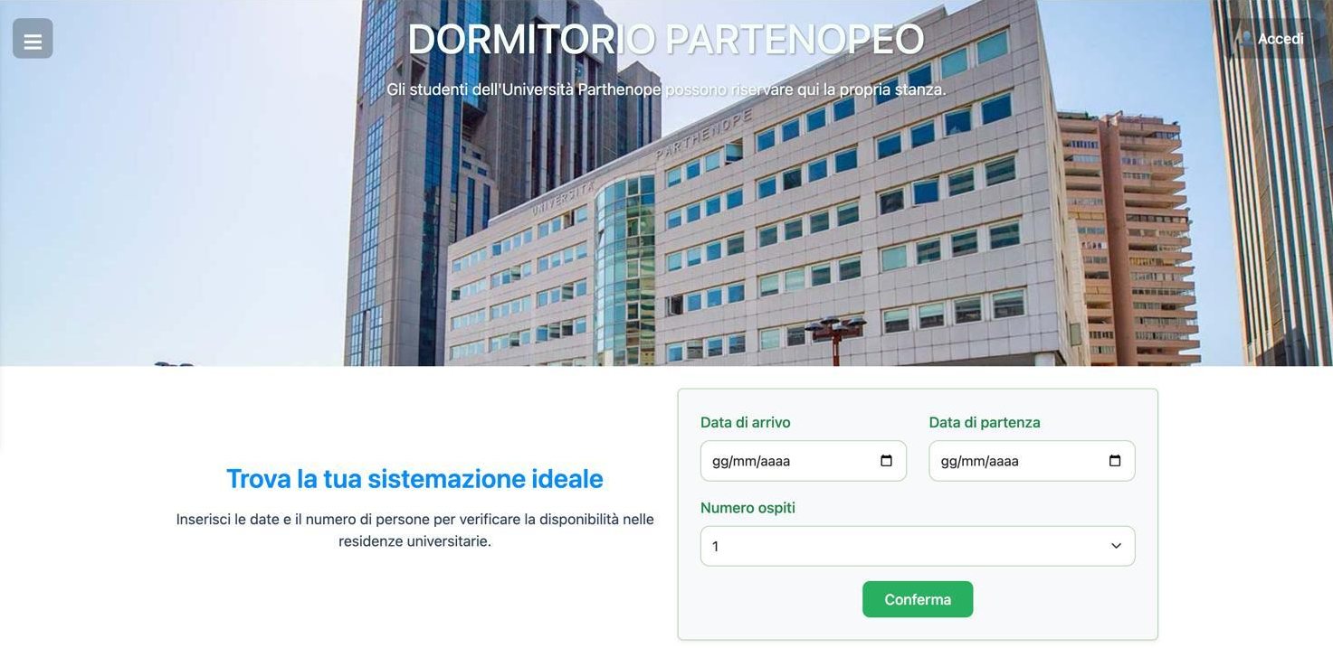
HOME
The "HOME " page allows users to enter dates and number of guests to quickly check room availability.

Slide 9
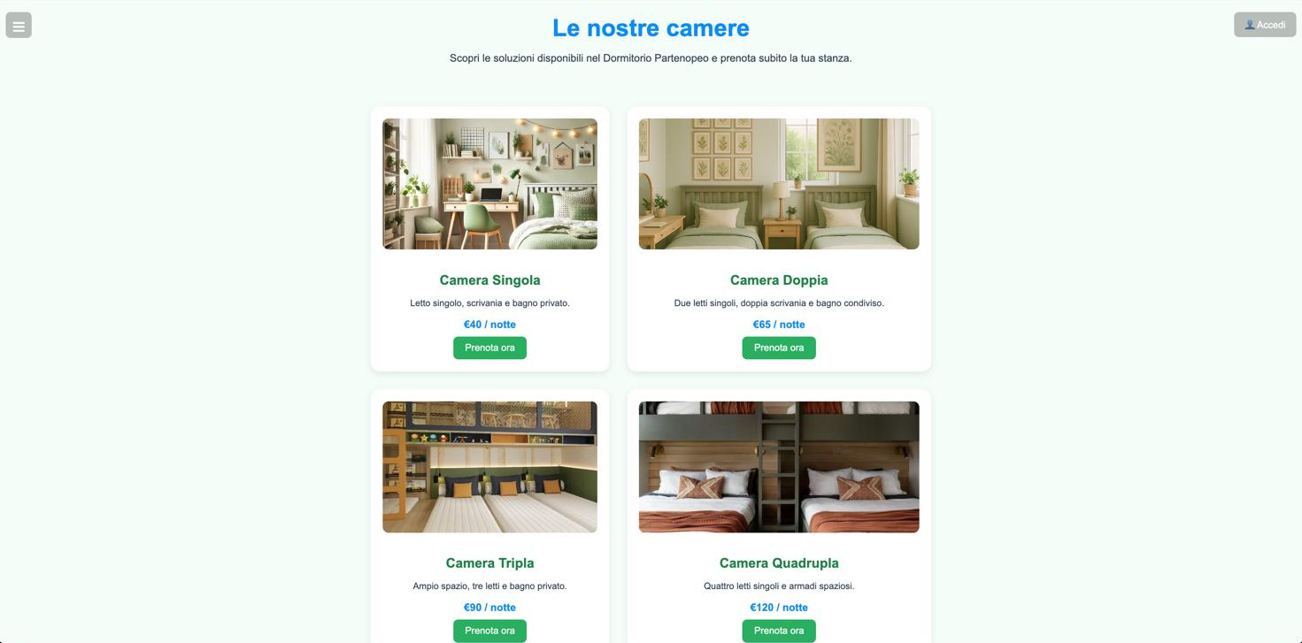
ROOMS
This page displays the available room types in the dormitory.
Each card includes a representative image, a short description of the room features, the price per night, and a “Prenota ora (Book now)” button, allowing users to easily compare options and quickly start the booking process.

Slide 10


SINGLE ROOM
DOUBLE ROOM

Slide 11
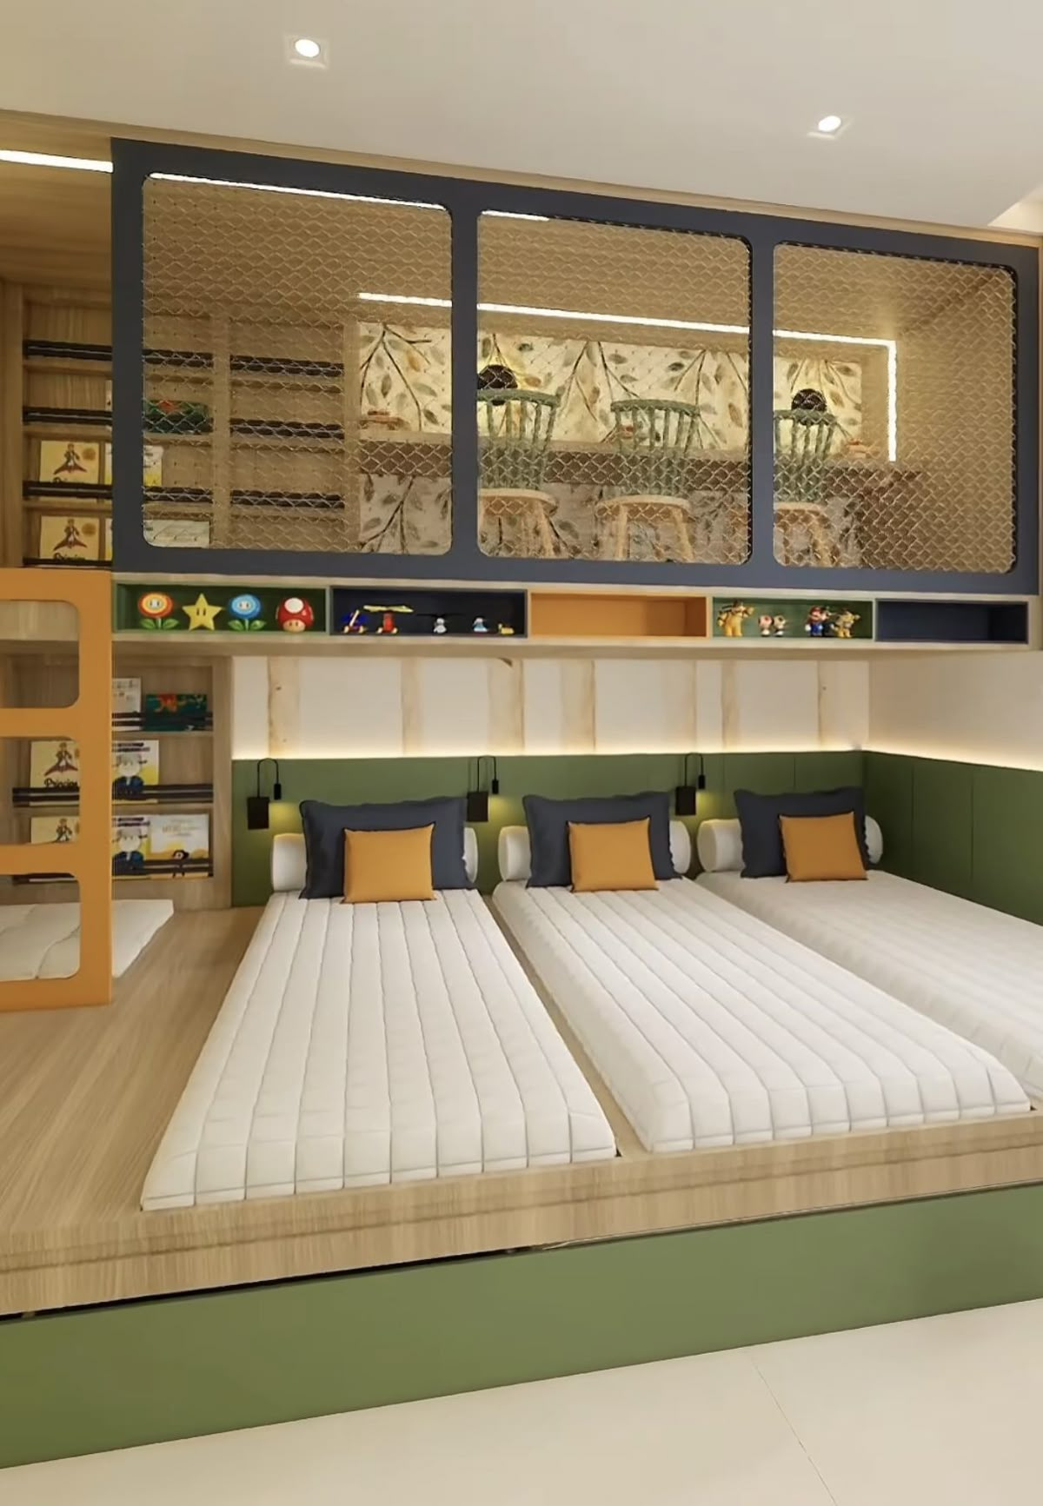
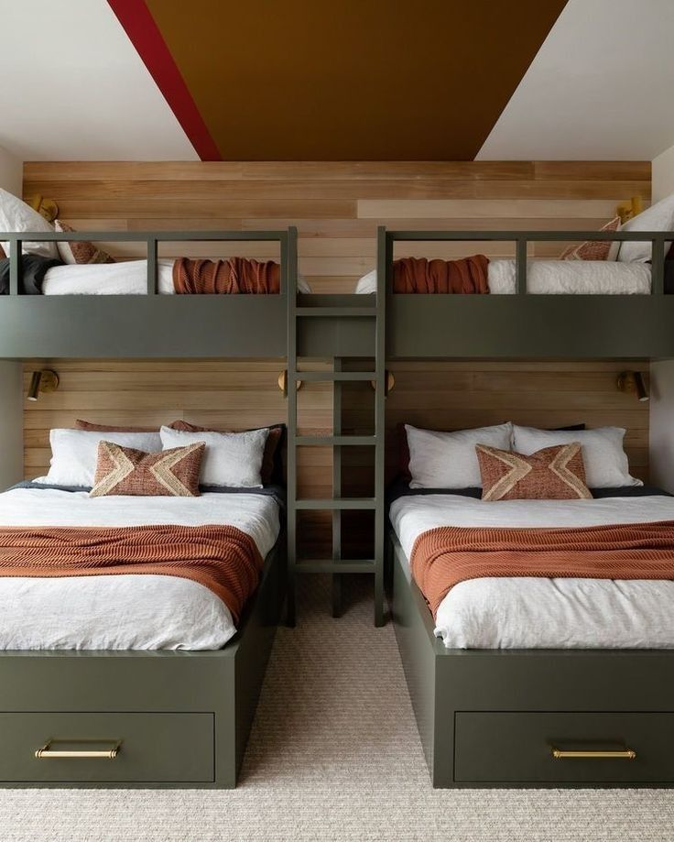
TRIPLE ROOM
QUADRUPLE ROOM

Slide 12
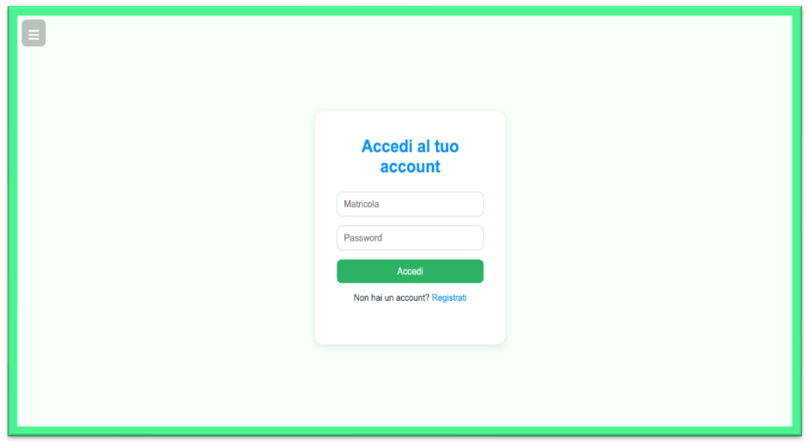
LOGIN
This page allows users to log into their account using their student ID and password.
It also provides links for new user registration.

Slide 13
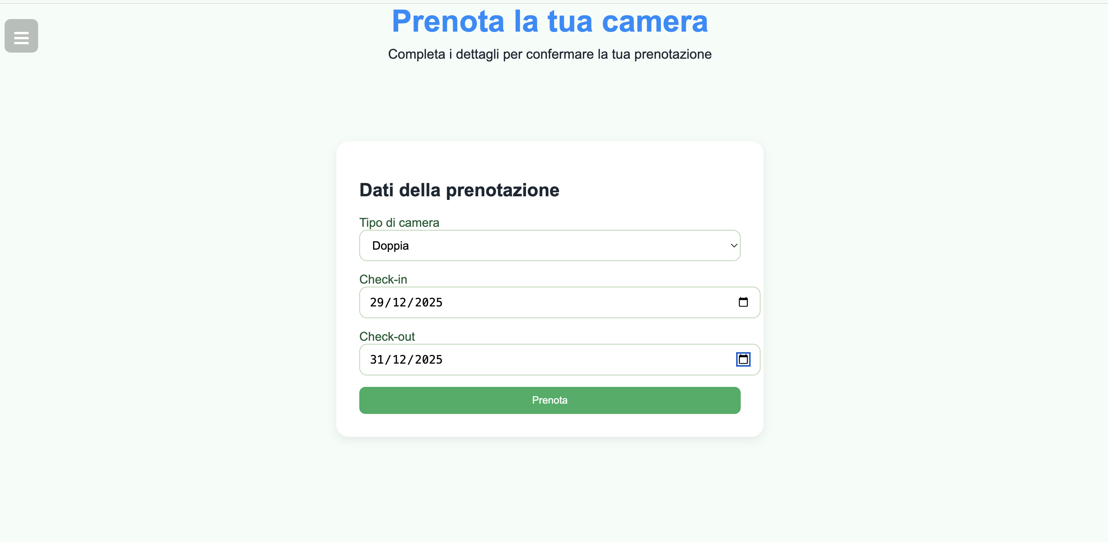
ROOM RESERVATION
This page allows authenticated users to select the room type and dates and confirm their reservation.

Slide 14
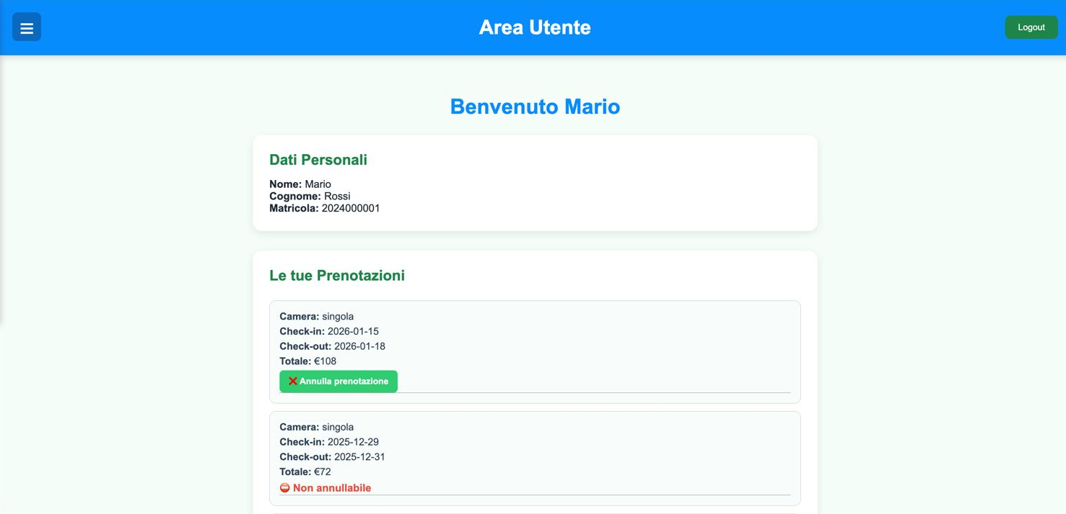
USER AREA
This section represents the user’s personal dashboard.
It displays personal information, the history of bookings, and allows users, when permitted, to cancel a reservation, giving full control over their activities.

Slide 15
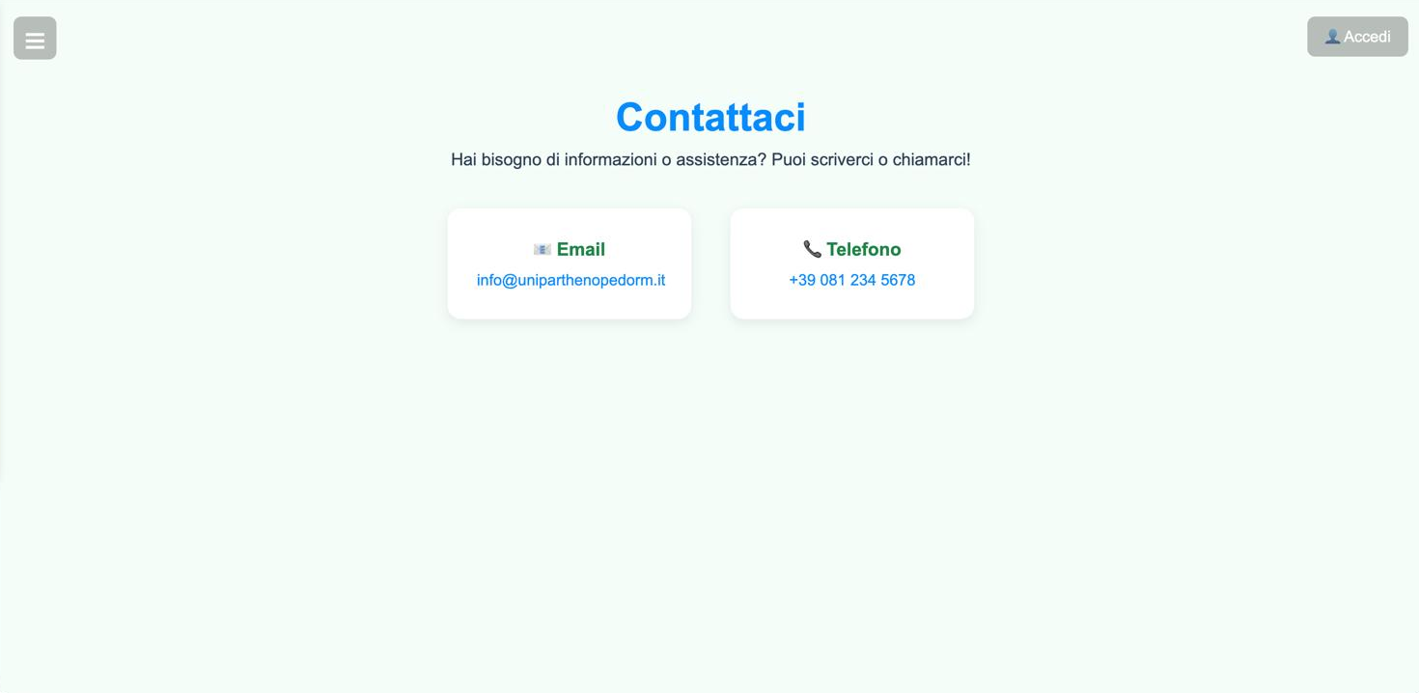
CONTACT
This “Contact Us” page allows users to easily request information or support by clearly displaying the main contact details: email address and phone number.

Slide 16
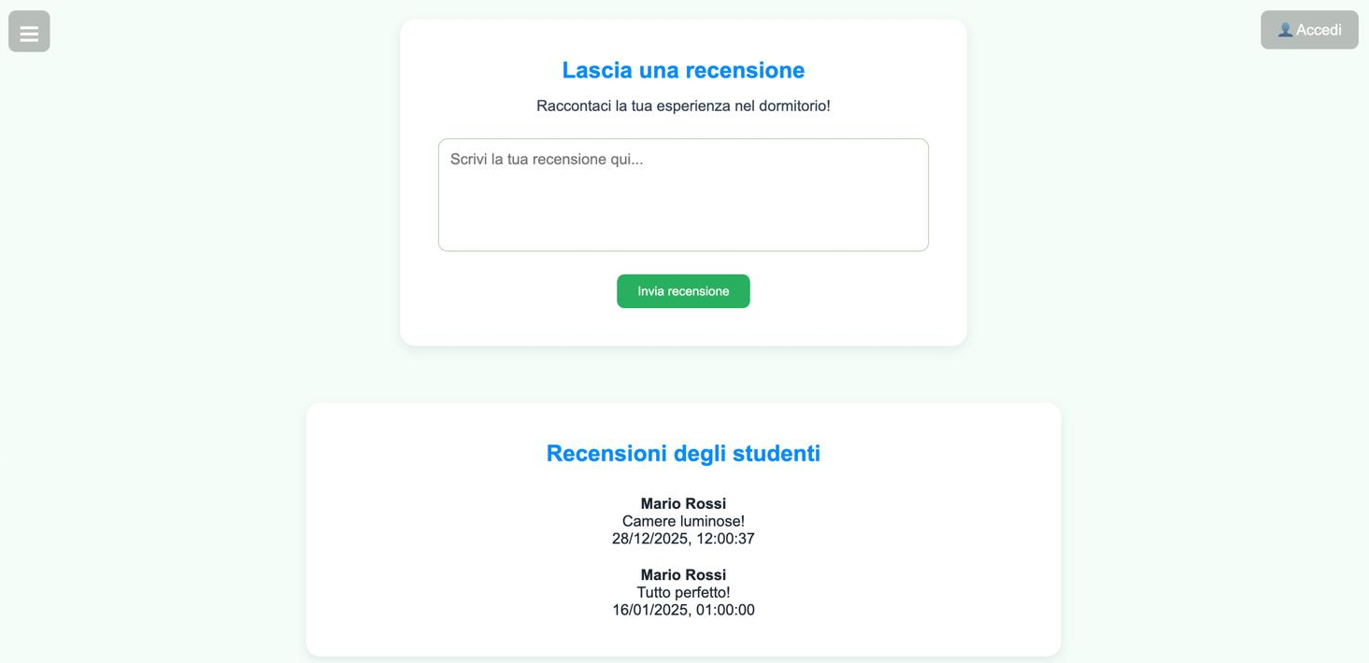
REVIEWS
This page allows users to submit a review about their experience in the dormitory.
It features a form for writing feedback and a section displaying previous student reviews, including name and date, helping to build transparency and trust.

Slide 17
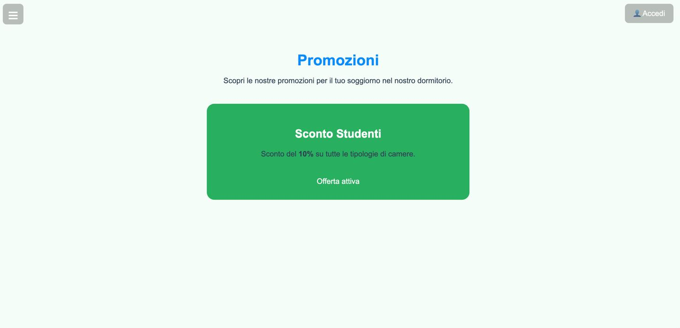
PROMOTIONS
This page presents the current promotions offered by the dormitory.
It clearly highlights available deals, such as student discounts, including offer details and status, allowing users to quickly identify available savings.

Slide 18
TEAM
Università degli Studi di Napoli “Parthenope"
Dipartimento di Scienze e Tecnologie
A.A. 2025-2026
RICCARDO INTRONO
0124003124
ROBERTA DE LUCA
0124003165

