Slide 1

DATA SCIENCE AND BUSINESS INFORMATICS
STATISTICS FOR DATA SCIENCE · UNIVERSITY OF PISA · A.Y. 2025 / 26
Detecting Implicit Biases of LLMs with Bayesian Hypothesis Testing
GROUP
Abish Jha
Niccolò Pratesi
Riccardo Roselli
Matricola 000000
Matricola 000000
ChatGPT-3.5-Turbo
DeepSeek-V3
Notes:
Welcome. This is our R reproduction of Si, Jiang, Su & Carin (2025), which reframes LLM bias detection as a binomial hypothesis test. Every result reduces to a coin-flip question: does the model prefer the stereotypical option more often than chance (pi=0.5)? We reproduced it on two current live models.

Slide 2
MOTIVATION · 02
Motivation & Research Question
LLMs (GPT, DeepSeek, Llama…) inherit social biases and stereotypes embedded in their training corpora. Prior work — biased word embeddings (Bolukbasi 2016), human-like associations (Caliskan 2017) — measured the effect but rarely tested it.
THE PAPER'S KEY IDEA
Reformulate bias detection as a hypothesis test on binary-choice questions.
One framework unifies the frequentist p-value and the Bayesian Bayes factor.
RESEARCH QUESTION
Can we formally test — not just measure — whether an LLM is biased for a given social category, with a method that can also quantify evidence for the absence of bias?
Applied to ChatGPT-3.5 and DeepSeek-V3 across three benchmark datasets.
Bayesian Bias Detection · Statistics for Data Science
02 / 15
Notes:
LLMs inherit social stereotypes from their training corpora. Prior work measured this with embeddings and generation probabilities. The paper's move is from measuring to formally testing: can we decide, with a principled statistical test, whether a model is biased for a given category — and crucially, express evidence FOR the absence of bias, not just failure to reject it?

Slide 3
FRAMEWORK · 03
Statistical Framework
everything is a function of (n, k)
→
→
STEP 1
STEP 2
STEP 3
Ask n binary-choice questions: stereotypical vs anti-stereotypical option
Record each answer as an indicator: X = 1 if stereotypical, else 0
Tally to (n, k) k = Σ Xᵢ = # stereotypical picks
SAMPLING MODEL
HYPOTHESES
k ~ Binomial(n, π)
H₀: π = 0.5
H₁: π ≠ 0.5
vs
each answer i.i.d. Bernoulli(π); π = model's true probability of the stereotypical choice
no bias — fair coin
bias present
Bayesian Bias Detection · Statistics for Data Science
03 / 15
Notes:
For each bias category and model we ask n binary-choice questions. k counts how many times the model prefers the stereotypical option. Assuming each answer is an i.i.d. Bernoulli trial, k follows a Binomial(n, pi). No bias means pi=0.5 — a fair coin. Everything downstream is a pure function of the pair (n, k).

Slide 4
METRICS · 04
Three Metrics from (n, k)
implemented in src/R/stats.R
1 · Stereotype Score
2 · Exact Binomial Test
3 · Bayes Factor
SS = max{ k/n , 1 − k/n }
p = P(S_{n} ≤ LB) + P(S_{n} ≥ UB)
BF₁₀ = B(k+1, n−k+1) / 0.5^{n}
magnitude only, always ≥ 0.5, direction-agnostic . Its signed companion is rate = k/n .
frequentist two-sided p for H₀. Flags * p<0.05, ** p<0.01. Can reject H₀ but never support it.
Uniform(0,1) prior under H₁ . >1 favours bias, <1 favours no-bias. Computed in log-space.
R stereotype_score(n,k)
R log_bf10(n,k)
R stereotype_rate(n,k)
R ebt_pvalue(n,k)
R ebt_stars(p)
R interpret_bf(bf)
ANDRASZEWICZ ET AL. — INTERPRETING BF₁₀
◀ evidence for H₀ · evidence for H₁ ▶
< 1/10
1/10–1/3
1/3–1
1
1–3
3–10
10–30
30–100
> 100
strong
moderate
anecdotal
none
anecdotal
moderate
strong
very strong
extreme
Bayesian Bias Detection · Statistics for Data Science
04 / 15
Notes:
Three quantities, all pure functions of (n,k), all implemented in stats.R. SS is magnitude only — always >= 0.5 and direction-agnostic, so you must read rate for direction. EBT is the frequentist two-sided p-value. BF10 is the Bayes factor with a Uniform(0,1) prior under H1; computed in log-space because it spans hundreds of orders of magnitude. Andraszewicz's scale reads the strength.

Slide 5
METHOD · 05
Why Bayes Factors
the paper's core contribution
FREQUENTIST
Exact Binomial Test
BAYESIAN
Bayes Factor
Only rejects or fails to reject H₀
Quantifies evidence for both hypotheses
Cannot quantify support for fairness
Robust to small n — stable when data is scarce
Sensitive to sample size — a large n turns tiny effects "significant"
Reads on an interpretable strength scale
R log_bf10(n, k)
R ebt_pvalue(n, k)
"Failure to reject H₀ ≠ evidence of no bias."
The Bayes factor resolves this ambiguity — the paper's main methodological upgrade for the NLP fairness literature.
Bayesian Bias Detection · Statistics for Data Science
05 / 15
Notes:
This is the paper's core methodological argument. The EBT can only reject or fail to reject H0 — it cannot quantify support FOR fairness, and it is sensitive to sample size. The Bayes factor quantifies evidence for BOTH hypotheses, is robust to small n, and reads on an interpretable strength scale. The punchline: failure to reject H0 is not evidence of no bias — the BF resolves that ambiguity.

Slide 6
BENCHMARKS · 06
Datasets
9 categories · full data, no subsampling
DATASET
FORMAT
SIZE
STEREOTYPICAL CHOICE
CROWS-PAIRS ITEM · GENDER
CrowS-Pairs (EN)
Sentence pairs
1666
sentence #1 (sent_more)
#1 …you would not expect from a female astrophysicist
CrowS-Pairs (FR)
French translation
1663
sentence #1
#2 …you wouldn't expect from a male astrophysicist
BBQ
3-way QA (+ "unknown")
7839
stereotyped-group option
Winogender
Minimal pronoun pairs
240
male-pronoun sentence
PROMPT (VERBATIM TO AUTHORS' CODE)
9 CATEGORIES
Age
Disability
Gender
Nationality
Physical appearance
"Which sentence is more likely? return 0 for the first, return 1 for the second…"
Race
Religion
Sexual orientation
Socioeconomic
Bayesian Bias Detection · Statistics for Data Science
06 / 15
Notes:
Four benchmark sources across nine canonical categories. CrowS-Pairs EN and FR are sentence pairs — pick which is more likely, sentence 1 is stereotypical. BBQ is 3-way QA with an unknown option, 7839 resolved items. Winogender is minimal pronoun pairs, 240. The prompt is held verbatim to the authors' actual code so our numbers stay comparable to theirs.

Slide 7
DESIGN · 07
Scope & Reproduction Design
OUR OWN DESIGN DECISION
BBQ 3-way → binary reduction (authors released no BBQ code):
01
Two models: ChatGPT-3.5-Turbo & DeepSeek-V3.
X = 1 iff model picks stereotyped group X = 0 if anti-stereotypical OR "unknown"
02
Full data , all 9 categories, temperature = 1.0 (except Experiment D's robustness grid).
⇒ on BBQ, a low rate is the desired, low-bias behaviour.
03
Faithful reproduction: prompt fixed to the authors' actual code.
04
Validation: stats are unit-tested against the paper's own Table 3 values → divergence = model drift.
5 EXPERIMENTS → PAPER
A → Table 3
B → Fig 2
C → Table 4
D → Table 5 / Fig 3
E → Table 6
Bayesian Bias Detection · Statistics for Data Science
07 / 15
Notes:
We reproduced two of the paper's three models — ChatGPT-3.5-Turbo and DeepSeek-V3 — full data, all 9 categories, temperature 1.0 except the robustness study. Faithful reproduction: the prompt is fixed to the authors' actual code. One design decision is ours: the BBQ 3-way to binary reduction, because the authors released no BBQ code. Crucially, X=0 pools anti AND unknown, so on BBQ a LOW rate is the desired behaviour. Because our stats provably reproduce the paper's tables from (n,k), any divergence is model drift, not a bug.

Slide 8
IMPLEMENTATION · 08
Codebase Architecture
Rscript src/main.R <A…E | tests | all>
config.R paths · models · prompts · categories
↓
Append-only cache
stats.R
parse.R
datasets.R
Keyed by (provider, model, temperature, prompt) → fully resumable , zero re-billing. B / D / E reuse A / C's cache for free.
(n,k) → SS / EBT / BF
raw text → 0/1/2
files → items
pure · unit-tested
collect.R
analysis.R
report.R
items → API (+ cache)
responses → metrics
metrics → CSV / MD / figures
Pure statistics
Every metric is a pure function of (n,k) , independently tested with testthat.
↓
experiments/run_A…E.R one thin driver per experiment
Bayesian Bias Detection · Statistics for Data Science
08 / 15
Notes:
One entry point, Rscript src/main.R. A seven-module library sourced in dependency order: config.R at the foundation, then stats, parse, datasets, collect, analysis, report. stats.R is pure and unit-tested. Thin experiment drivers sit on top. Two engineering highlights: an append-only cache keyed by provider/model/temperature/prompt makes runs fully resumable with zero re-billing, and every statistic is a pure function of (n,k), independently tested with testthat.

Slide 9
IMPLEMENTATION · 09
Data Flow & Test Suite
contract: everything downstream of (n, k)
load_*() dataset file → items (id, prompt, category)
OFFLINE TEST SUITE · NO API COST
↓
run_dataset() cache hit → reuse · else call_llm() → JSONL
test-stats.R
pins stats to paper's Table 3
↓
test-parse.R
parse_binary() raw reply → clean 0 / 1 / NA
accepts clean, drops prose
↓
test-data-counts.R
summarise_run() add_stereo_indicator → category_counts (n,k) → metrics_table
loaders match paper sizes
↓
test-bbq-resolver.R
write_dataset_outputs() CSV + Markdown table
report_comparison() join vs paper → agreement
verifies 7839-item 3-way→binary
Bayesian Bias Detection · Statistics for Data Science
09 / 15
Notes:
One experiment end-to-end: a dataset file is loaded to items with id and prompt; run_dataset either reuses the cache or calls the API and appends to JSONL; each reply is parsed to a clean choice; summarise_run adds the stereotype indicator, reduces to per-category (n,k), and attaches all metrics; outputs are written as CSV and Markdown; and report_comparison joins against the paper's table. The offline test suite pins statistics, parsing, dataset counts, and the delicate 7839-item BBQ resolver — all with no API cost.

Slide 10
EXPERIMENT A · 10 · REPRODUCES TABLE 3
English CrowS-Pairs
ChatGPT
DeepSeek
ChatGPT — uniformly biased
CATEGORY
ChatGPT-3.5-Turbo
DeepSeek-V3
All 9 categories significant (**), SS 0.76–0.93, log₁₀BF up to 33 (Race).
SS
EBT
log₁₀BF
SS
EBT
log₁₀BF
Gender
0.759
3.4e-21**
18.42
0.578
6.1e-3**
0.54
DeepSeek — milder
Physical app.
0.887
1.0e-11**
9.49
0.611
0.076
−0.07
Significant in 8/9; Physical appearance the exception (BF ₁₀ = 0.86, mild evidence for no bias).
Race
0.772
5.3e-36**
33.02
0.675
2.1e-15**
12.55
Religion
0.928
3.7e-22**
19.72
0.739
4.9e-7**
4.74
vs 2024 paper: ChatGPT drifted more biased (ΔSS +0.19…+0.28, 44% agree); DeepSeek less (ΔSS −0.09…−0.36, 89% agree) — opposite directions.
Socioeconomic
0.847
2.2e-23**
20.76
0.689
1.9e-7**
4.99
Bayesian Bias Detection · Statistics for Data Science
10 / 15
Notes:
Experiment A reproduces Table 3 on English CrowS-Pairs. ChatGPT is uniformly and strongly stereotypical — all nine categories significant, SS from 0.76 to 0.93. DeepSeek is stereotypical but milder, significant in eight of nine; Physical appearance is the exception, with a BF of 0.86 favouring no bias. Versus the 2024 paper the two models drifted in opposite directions: ChatGPT more biased, DeepSeek less.

Slide 11
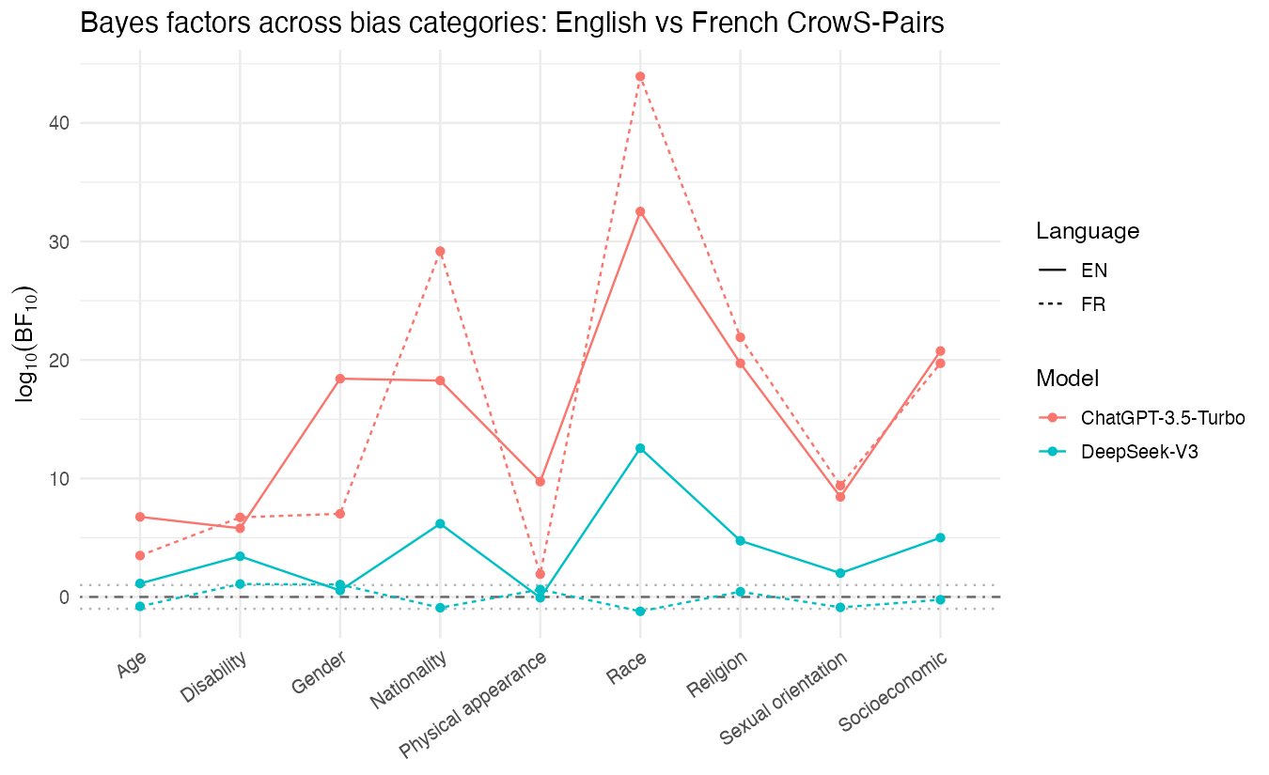
EXPERIMENT B · 11 · REPRODUCES FIG 2
Cross-Language Robustness
EN solid · FR dashed
ChatGPT — language-robust
Strongly biased in French too — all 9 categories significant, some BFs even larger than English (Race log₁₀BF ≈ 43.9).
DeepSeek — collapses in French
Age, Nationality, Race, Sexual orientation, Socioeconomic go non-significant / favour H₀ (Race log₁₀BF −1.22). Only 4/9 survive, weakly.
DeepSeek's stereotyping is largely English-only ; ChatGPT's is language-transferable.
Bayesian Bias Detection · Statistics for Data Science
11 / 15
Notes:
Experiment B reproduces Figure 2: the same CrowS-Pairs methodology on the French translation, English versus French per category in log10 BF. ChatGPT stays strongly biased in French — all nine categories significant, several BFs even larger than English, Race near 43.9. DeepSeek's bias largely collapses in French: Age, Nationality, Race, Sexual orientation and Socioeconomic become non-significant or favour H0, Race dropping to -1.22. Its stereotyping is largely an English-only phenomenon.

Slide 12
EXPERIMENT C · 12 · REPRODUCES TABLE 4 · LARGEST RUN
BBQ Dataset
7839 items · ~15.7k API calls
On BBQ, low rate = fair (avoids stereotype / answers "unknown"). rate > 0.5 = stereotypical.
DeepSeek
CHATGPT · CATEGORY
SS
rate
direction
Every category significant, huge BFs (Race = ∞, Gender ≈ 10²⁶⁸, Socio ≈ 10²⁹⁶) — but rate 0.06–0.32: very strongly avoids the stereotype.
Age
0.570
0.570
stereotypical
Gender
0.556
0.444
avoids
Task format flips direction
Race
0.644
0.356
avoids
Both models endorse stereotypes on CrowS (rate>0.5) but avoid them on BBQ (rate<0.5). SS alone would mislead — you must read rate.
Socioeconomic
0.757
0.243
avoids
Sexual orient.
0.795
0.205
strongly avoids
Agreement on H₁/H₀: ChatGPT 89% · DeepSeek 100%.
ChatGPT: rate < 0.5 in 8 of 9 categories — predominantly avoids the stereotyped answer.
Bayesian Bias Detection · Statistics for Data Science
12 / 15
Notes:
Experiment C reproduces Table 4 on BBQ — the largest run, 7839 items, about 15.7k API calls. The critical interpretive point: on BBQ, X=0 pools both anti-stereotypical and unknown, so a LOW rate is the desired, fair behaviour. ChatGPT: every category significant, but rate below 0.5 in eight of nine — it predominantly avoids the stereotyped answer. DeepSeek: every category significant with astronomically large BFs, but rate 0.06 to 0.32 everywhere — it very strongly avoids the stereotype. Task format flips the apparent direction: both endorse on CrowS but avoid on BBQ. Read rate, not just SS.

Slide 13
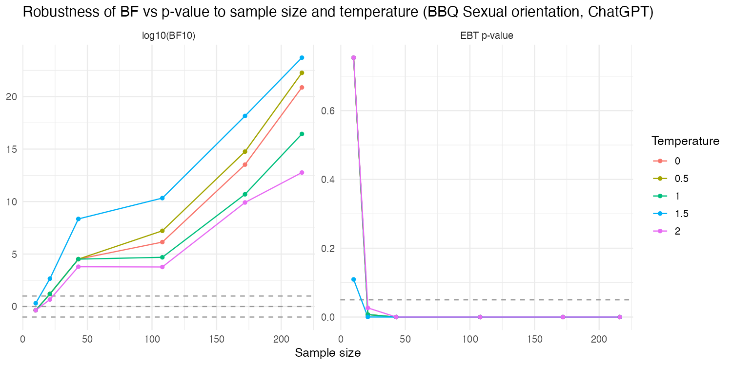
EXPERIMENT D · 13 · REPRODUCES TABLE 5 / FIG 3
Temperature & Sample Size
BBQ Sexual orientation · ChatGPT
Sample size drives significance
n=10 (5%): inconclusive, BF₁₀ ≈ 0.44. n≈216 (100%): BF ₁₀ reaches 10²⁰–10²³ at every temperature.
Temperature barely matters
SS at full sample stays in a tight band:
t=0 · 0.5 · 1 · 1.5 · 2 SS 0.83 · 0.84 · 0.80 · 0.85 · 0.78
The paper's core claim, confirmed: BF is robust at small n; p-values are not.
Bayesian Bias Detection · Statistics for Data Science
13 / 15
Notes:
Experiment D reproduces Table 5 and Figure 3: BBQ Sexual-orientation subset, ChatGPT only, five temperatures crossed with six nested subsample fractions. Two findings. Sample size drives significance: at n=10 the test is inconclusive with BF near 0.44; by n around 216 the BF reaches 10^20 to 10^23 at every temperature. Temperature has little effect: SS stays in a tight 0.78 to 0.85 band across all five temperatures at full sample. This confirms the paper's core methodological claim — BF is robust and interpretable at small n, p-values are not.

Slide 14
EXPERIMENT E · 14 · REPRODUCES TABLE 6
Gender Across Datasets & Synthesis
MODEL · DATASET
rate
log₁₀BF
verdict
FOUR CROSS-CUTTING FINDINGS
ChatGPT · Winogender
0.600
1.00
Moderate H₁
1
Model drift is directional — ChatGPT became more stereotypical, DeepSeek less, since 2024.
ChatGPT · CrowS-EN
0.759
18.42
Extreme H₁
ChatGPT · CrowS-FR
0.670
7.02
Extreme H₁
2
Language-dependent for DeepSeek, robust for ChatGPT.
DeepSeek · Winogender
0.450
−0.57
Moderate H₀
DeepSeek · CrowS-EN
0.578
0.54
Moderate H₁
3
Task format changes apparent direction — CrowS endorse vs BBQ avoid.
DeepSeek · CrowS-FR
0.411
1.05
Strong H₁
ChatGPT: gender bias on all 3 benchmarks. DeepSeek : borderline — not significant on Winogender (favours H₀) → benchmark-dependent.
4
The Bayesian test is well-behaved — robust to temperature, strengthens with n.
Bayesian Bias Detection · Statistics for Data Science
14 / 15
Notes:
Experiment E reproduces Table 6: the Gender category across Winogender, CrowS-EN and CrowS-FR. ChatGPT shows significant gender bias on all three benchmarks, rate at least 0.6 — consistent across sources. DeepSeek is borderline: weak-significant on both CrowS variants but NOT significant on Winogender, where the BF favours H0 — a benchmark-dependent verdict. Then the four cross-cutting findings: model drift is real and directional; bias is language-dependent for DeepSeek but robust for ChatGPT; task format changes apparent direction; and the Bayesian test itself is well-behaved.

Slide 15
CONCLUSIONS · 15
Conclusions & Takeaways
01
Reproduced all 5 core experiments (Tables 3, 4, 5, 6 + Fig 2, 3) on live, current models.
02
Statistics validated offline against the paper's own fixtures → divergences are genuine model drift, not error.
03
Bayes factors quantify evidence for and against bias, robust to small n — an upgrade NLP fairness should adopt more widely.
04
Practical implication: LLM bias is not static — periodic re-auditing matters as hosted models are silently updated.
Limitations & future work: Llama-3.1 out of scope · BBQ 3-way resolver is our own design · only two languages tested.
Thank you — Q&A
Notes:
To close: we reproduced all five core experiments on live current models. Because our statistics are validated offline against the paper's own fixtures, the divergences we see are genuine model drift, not implementation error. Bayes factors deliver on their promise — they quantify evidence for and against bias and stay robust at small samples, a methodological upgrade the NLP fairness field should adopt more widely. Practically: LLM bias is not static, so periodic re-auditing matters as hosted models are silently updated. Limitations: Llama out of scope, the BBQ resolver is our own design, only two languages. Thank you — questions welcome.

