Slide 1
Biometric Systems Project
Password manager secured by iris recognition
Riccardo Scuto-2125102

Slide 2
Introduction
The goal of the project is to create a real-time password management system protected by iris recognition, with the addition of an anti-spoofing system that utilizes eye blink detection.
This project is based on Iris-Recognition-Registration-Database-System by aaahmedms.
Additions: Iris Segmentation; Iris Unwrapping; Password Manager; Blink Counter Verification.
Modifications: User Interface; Matching Algorithm.

Slide 3
Dataset
The "shape_predictor_68_face_landmarks.dat" file is a pre-trained model from the Dlib library used to detect 68 facial landmarks on a face. These landmarks identify key facial features such as the eyes, eyebrows, nose, mouth, and jawline.

Slide 4
Dataset
Face Detection: The system first detects the face in the webcam frame using Dlib's face detection capabilities.
Landmark Detection: Once a face is detected, the system uses the "shape_predictor_68_face_landmarks.dat" model to identify the 68 facial landmarks, focusing particularly on those around the eyes.
Eye Region Isolation: Using the landmarks corresponding to the eyes, the system isolates the eye regions, preparing them for iris detection and analysis.

Slide 5
Registration
Registration is conducted by first scanning the user's facial features using DLIB's landmark detector to pinpoint the location of the eyes. After the photo is taken, a prompt will ask the user to enter the following information:
ID
Name
Age
Blink Number
Once the information is entered, a text editor will open where passwords can be written.
All this information, along with the photo, will be stored in the database.

Slide 6
Registration

Slide 7
Verification
During the verification phase, a new photo will be taken. Afterwards, the user will specify the ID of the account they are claiming. If a correct match rate is achieved, the correct correspondence is confirmed.
The process then moves to the blink check system, and if successfully completed, the verification process will be finished, allowing the user access to the protected file.

Slide 8
Iris
The system employs the Hough Transform algorithm to detect circles. It specifies parameters such as the minimum and maximum radius, which must be chosen based on the expected size of the iris in the image, as well as the camera's resolution and the distance between the eye and the capture device.
Once the iris is located, the process of segmentation begins to isolate it from the rest of the eye. This involves creating a binary mask where the iris area is white (indicating the iris region), and the rest is black.

Slide 9
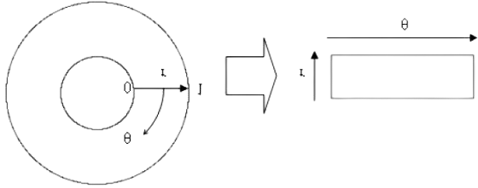
Iris
The isolated iris image is then transformed from Cartesian to polar coordinates. This process serves to represent the iris as a rectangular image, which facilitates the comparison between different iris images.
Normalization adjusts the iris to a standard size, compensating for scale variations due to changes in distance between the eye and the camera.

Slide 10
Matching
The verification process leverages the ORB feature matching algorithm.
The ORB algorithm employs brute force matching to determine if there is a correspondence between the live and registered iris images.
The threshold for determining a match may need adjustment based on the quality of the camera used. For higher-resolution cameras, a match rate of over 50% could be adequate, whereas for lower-quality devices, a lower threshold around 18-25% might be more appropriate.

Slide 11
Matching
Match rate:100%
Match Rate: 35.4%

Slide 12
Blink Check
When "a" is pressed, the system checks if the number of detected blinks meets the authentication requirement and ends the loop, returning True or False. Pressing "w" resets the blink counter to zero.
When "a" is pressed, the system checks if the number of detected blinks meets the authentication requirement and ends the loop, returning True or False. Pressing "w" resets the blink counter to zero.
Once a match between the iris in the database and the one captured during the verification process is found, the system proceeds to verify if the number of blinks performed for confirmation matches the number registered in the database.
For each detected face, the script calculates the Eye Aspect Ratio (EAR) for both eyes. The EAR is a straightforward geometric measure that gauges the openness of the eyes. When the EAR drops below a predefined threshold, it is interpreted as a blink.
The number of detected blinks is displayed on the video frame, along with instructions for user interaction. Users can interact with the system through keyboard inputs. (when "a" is pressed, the system checks if the number of detected blinks meets the authentication requirement and ends the loop. Pressing "w" resets the blink counter to zero).

Slide 13
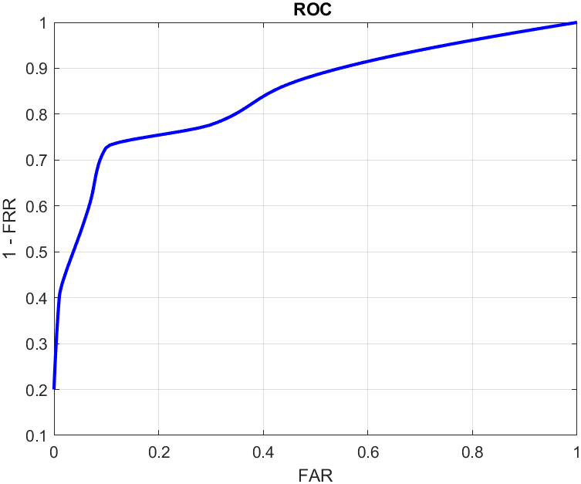
Evaluation

Slide 14
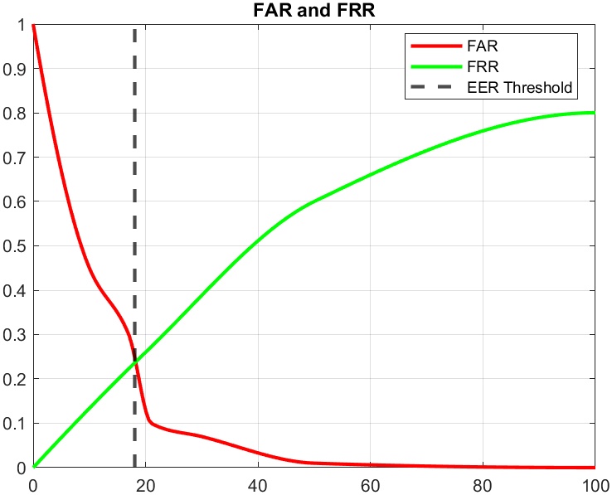
Evaluation

Slide 15
Limitations
When "a" is pressed, the system checks if the number of detected blinks meets the authentication requirement and ends the loop, returning True or False. Pressing "w" resets the blink counter to zero.
When "a" is pressed, the system checks if the number of detected blinks meets the authentication requirement and ends the loop, returning True or False. Pressing "w" resets the blink counter to zero.
Lighting Conditions
Capture devices
Distance and movement
Acceptance

