Slide 1
Amazon Books Reviews
Network Science and Recommender Systems
applied to the retail market
Riccardo Tenuta
Matr n° 26940A

Slide 2
Table of contents
01
02
03
04
Introduction
Community detection
Introduction of the dataset and data pre-processing
Computation of Louvain algorithm and community extraction
Network analysis
Reccomender System
Analysis of the principal characteristics and metrics of the network
Graph embedding with Node2Vec for similarity prediction

Slide 3
01
Introduction
The dataset and data pre-processing

Slide 4
Introduction
The dataset describe and contains data related to books that have been purchased and reviewed on Amazon. The data are split into two different datasets.
books_rating: contains information about the reviews such as the score, the user id and the title of the book
books_data: contains specifics of the book such as the category, the author and the decription
The goal of the project, starting from the two dataset, is to create a network generated with nodes representing the books more liked by the customers, so with a review score greater than 4, and then to study the relationships betweeen the links generated between the nodes. A link between two books exists if the books have been reviewed by at least a common customer, and the weight is the number of customers that have reviewd both.

Slide 5
The datasets
Main atributtes used for the analysis
books_rating.csv
books_data
Id
Title
User_id
Review score
Review summary
Title
Description
Author/s
Link
Categories

Slide 6
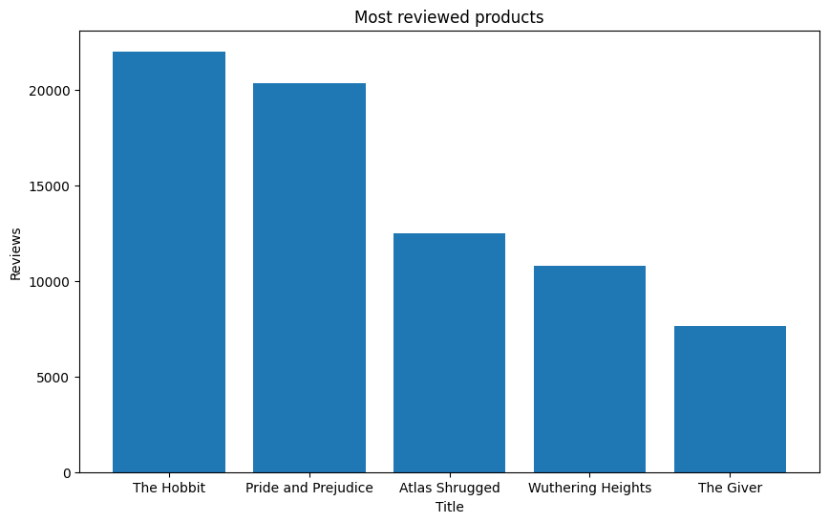
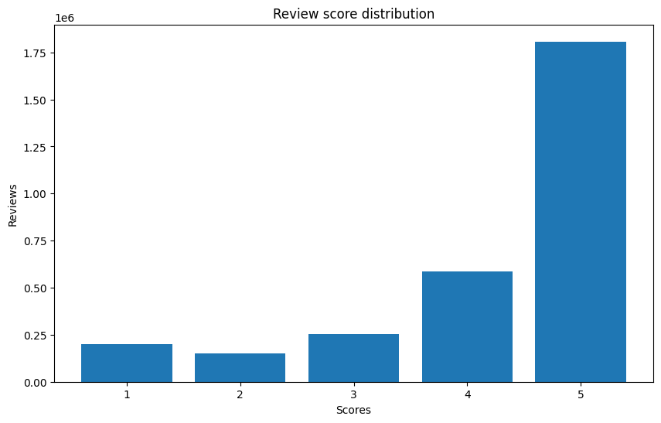
Data exploration
Some plots about the final dataset
Top 5 most reviewd books
Review score distribution

Slide 7
02
Network Analysis
Analysis of the principal characteristics
and metrics of the network

Slide 8

The Graph
The graph has been built considering the books as nodes and the edges as the number of customers that reviewed both the books.
Only the best reviews has been taken into acocunt in order to build a better suggestion network. So only reviews with score greater than 4 have been considered.
The graph sampled the 1% of the total reviews

Slide 9
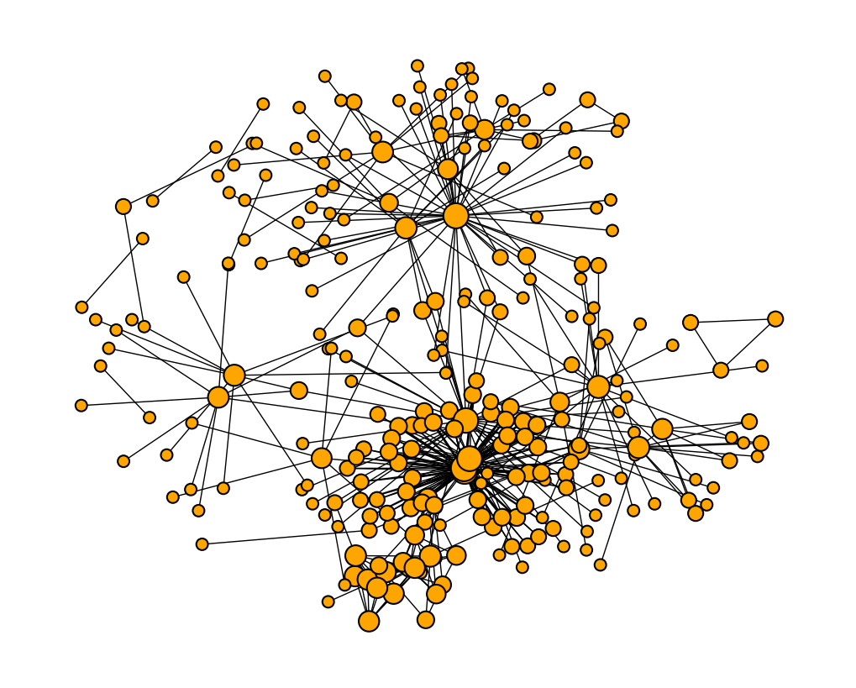
The Graph
N° nodes: 2217
N° edges: 5929
Density: 0.002
Average degree: 5.35
Median degree: 2
Max degree: 79
Min degree: 1
Std. Deviation: 10.02

Slide 10
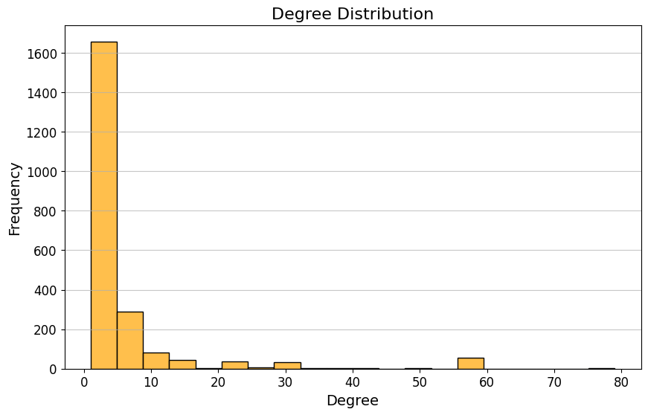
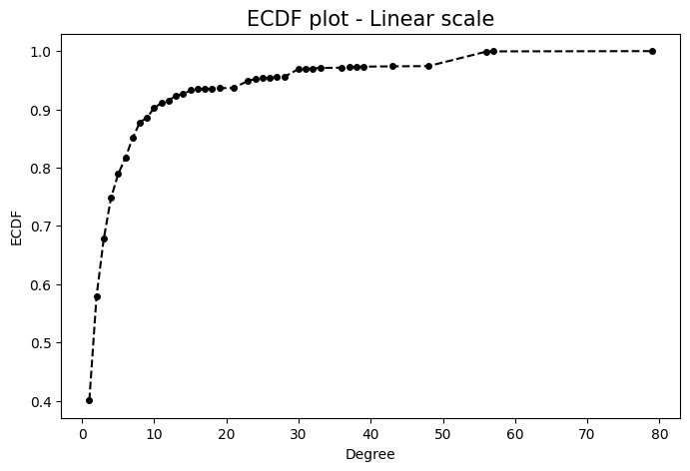
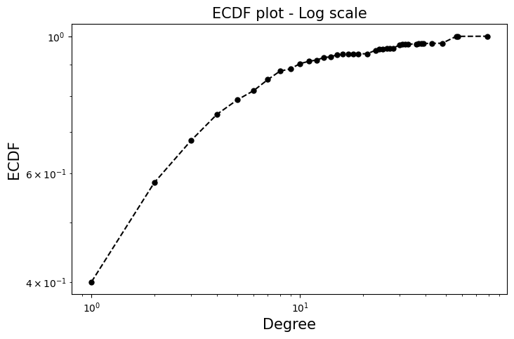
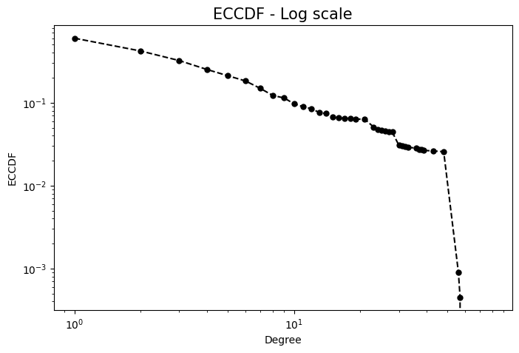
The Degree distribution

Slide 11
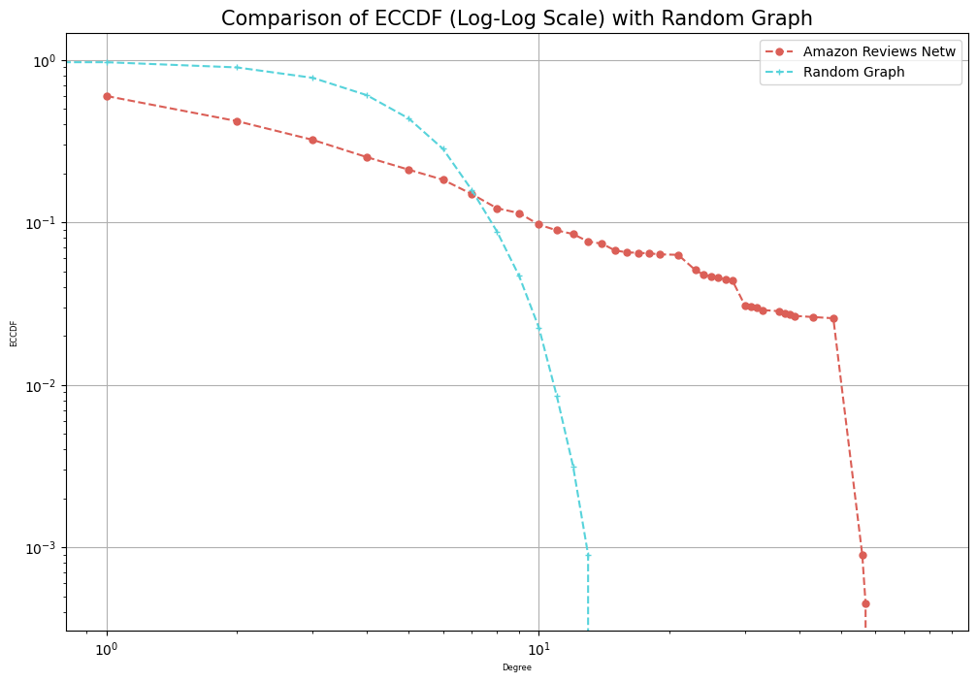
The network vs. a random network

Slide 12
Centrality measures
Degree
Betweenness
Anansi Boys, 0.035
Alice's Adventures in Wonderland, 0.025
Stories of Hope and Spirit, 0.025
The Picture of Dorian Gray, 0.043
Pride and Prejudice, 0.042
Wuthering Heights, 0.027
Closeness
Eigenvector
The Picture of Dorian Gray, 0.117
Pride and Prejudice, 0.115
Wuthering Heights, 0.109
Anansi Boys, 0.134
Alice's Adventures in Wonderland, 0.132
Stories of Hope and Spirit, 0.132

Slide 13
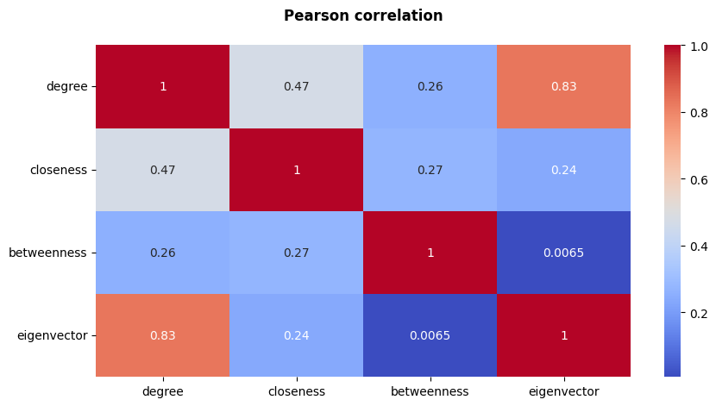
Pearson correlation matrix

Slide 14
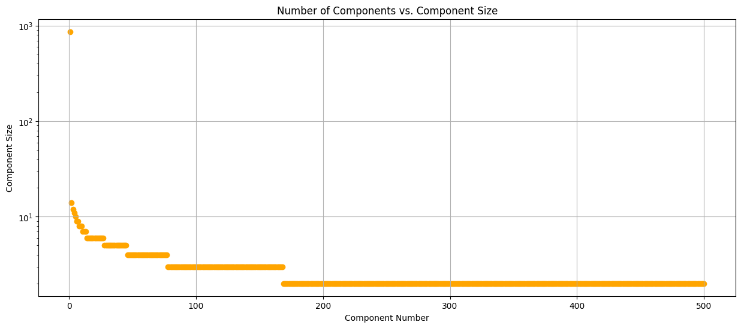
Connected components
N° of components: 500
Larger components: 868
Smaller components: 2

Slide 15
Others network’s metrics!
10%
51%
93%
Bridges
Clustering coeff.
Assortativity
10.2% of bridges, 603 nodes
51.6% of global clustering coefficients
93% of assortativity, how much probable is the connection between two nodes with the same degree

Slide 16
03
Community Detection
Community detection using the Louvain algorithm

Slide 17
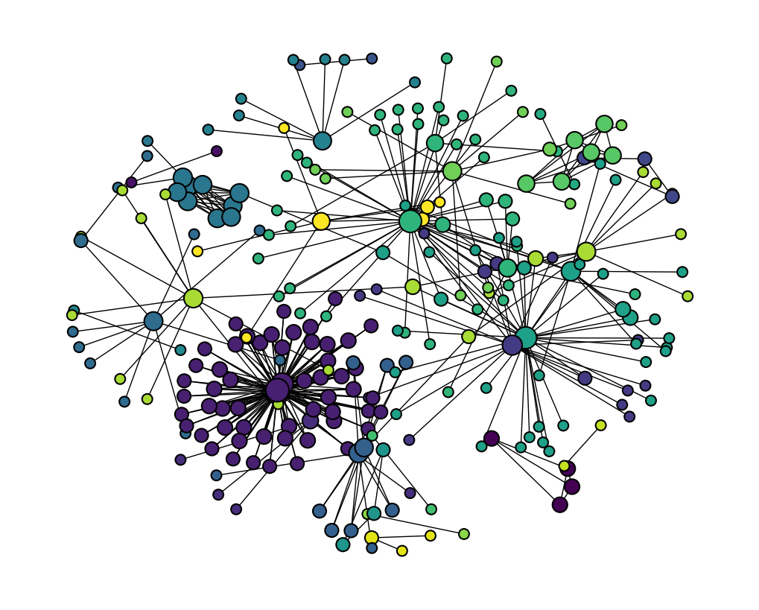
The communities
N° communities: 24
Modularity of the partitions
0.79
Top 3 communities:
57 nodes (14%)
41 nodes (10%)
37 nodes (9%)

Slide 18
04
Recommendation System
Graph embedding with Node2Vec for similarity prediction

Slide 19
RecSys with Node2Vec
Node2Vec is a graph embedding algorithm that, turning nodes of the graph into a vector strcuture, optimize the neighborhood of the nodes through a biased random walk. This allow to find similar nodes and recommend in this case new books to buy.
Choosing the parameters p and q has been optimized the similarity algorithm and the neighborhood exploration.

Slide 20
Some recommendations
recommend_book_from('George Orwell 1984’) - Cat's cradle (A Dell book) - Little men : life at Plumfield with Jo's boys
recommend_book_from('The Picture of Dorian Gray (Classic Collection (Brilliance Audio))’) - Hamlet (The Shakespeare Folios) - The Berlin Stories: The Last of Mr. Norris
recommend_book_from('Pride and Prejudice’) - Dragonwyck - Emma (Penguin Readers, Level 4)
After having fitted the model, the algorithm has been tested with some examples
1
2
3

Slide 21

As we noticed, book similarity is very related to the category

Slide 22
Conclusions
In this case the Node2Vec algorithm is very precise since the fact that a customer bought and positively reviewed different books is a very good recommendation for others to buy them.
Genres and categories helps into identifying the most similar books, specially for those in the same clique with a high clustering coefficient.

Slide 23
Thanks for the attention!
Please keep this slide for attribution

