Slide 1
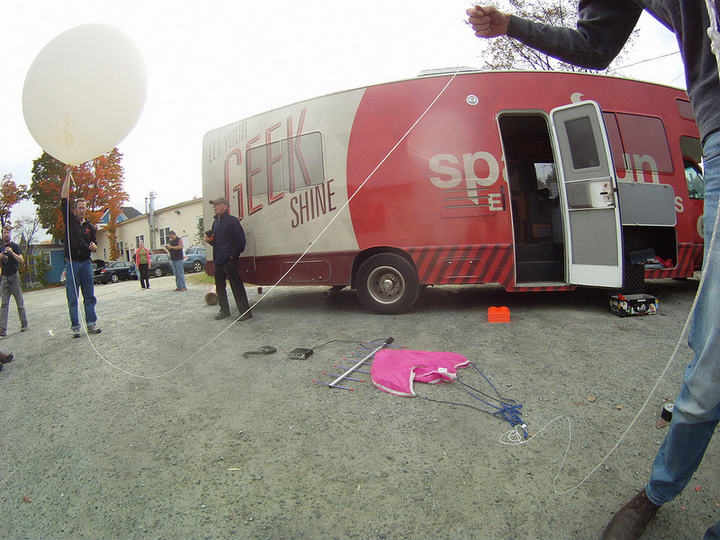

Data Collection with High Altitude Balloons

Slide 2
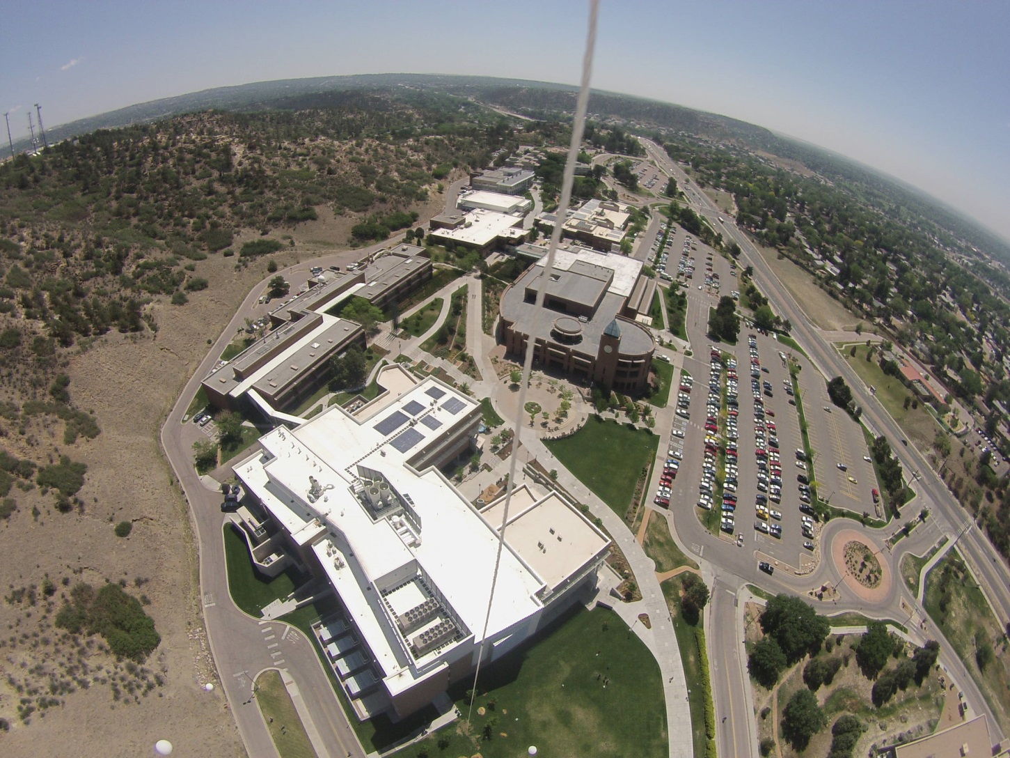

Slide 3
Brian Huang, Jeff Branson, Derek Runberg
NSTA, April 2014

Slide 4

Overview
Introductions
Buoyancy as a platform for learning
Hands on time
An introduction to some tools for better measurement
Code, hardware and getting data
Fly, be free

Slide 5
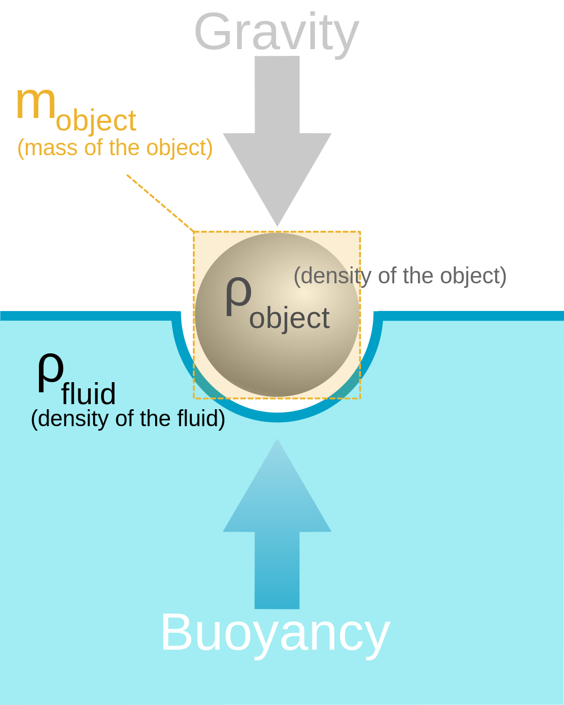
Buoyancy
Any object, wholly or partially immersed in a fluid, is buoyed up by a force equal to the weight of the fluid displaced by the object.
— Archimedes of Syracuse

Slide 6
Let's check Archimedes against our measurements
At 15 degrees Celsius air has a density of 1.225 Kg/m^3 at sea level
If we measure the lifting power of our balloon what do we get?
How do we measure?
Archimedes says the volume displaced should be equivalent the buoyant force, what is the buoyant force and what is the volume?

Slide 7
Where are the differences in our problem set?
What does Helium weigh?
Is the balloon fully filled?
Is it spherical?
What is the weight of the balloon?
What is the weight of the string?

Slide 8
Where are the differences in our problem set?
What does Helium weigh?
Is the balloon fully filled?
Is it spherical?
What is the weight of the balloon?
What is the weight of the string?
How would we get better numbers?

Slide 9
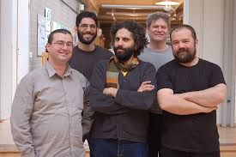
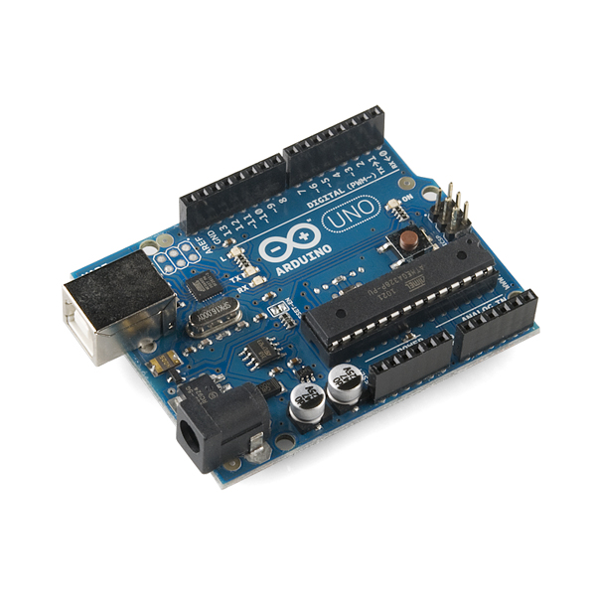
What is Arduino?
Hardware and Software
Supports a range of hardware
Free, open source, community supported
Graphical environments
Named after a bar

Slide 10
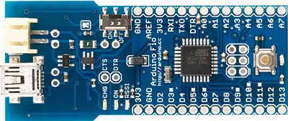
Using some new tools
Arduino Fio
8 bit microcontroller
32K of flash
8K of RAM
This one includes a wireless footprint

Slide 11
Using some new tools
Arduino Fio
8 bit microcontroller
32K of flash
8K of RAM
This one includes a wireless footprint

Slide 12
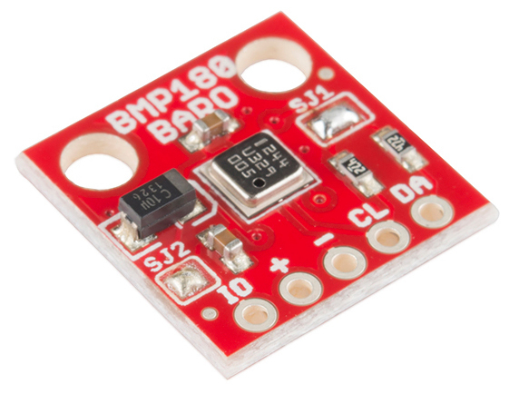
Instrumentation (Sensor): BMP 180
Bosch sensor
I2C
Pressure, Temperature
From this we can derive Altitude and Standard Atmospheres

Slide 13

Let's open Arduino
Click on the desktop icon or open the applications folder, we're looking for this;
Double click and open the .exe file

Slide 14
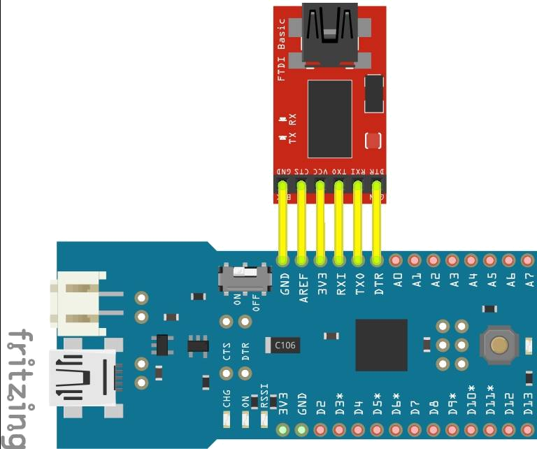
Let's hook up the FTDI

Slide 15
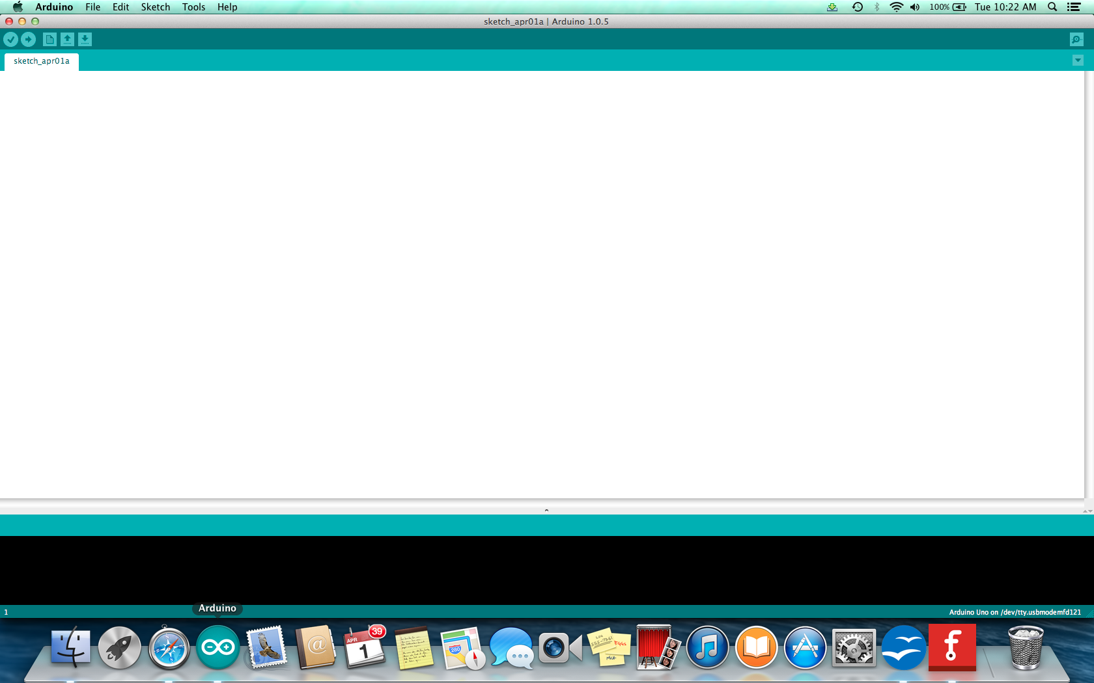
Here's our window

Slide 16
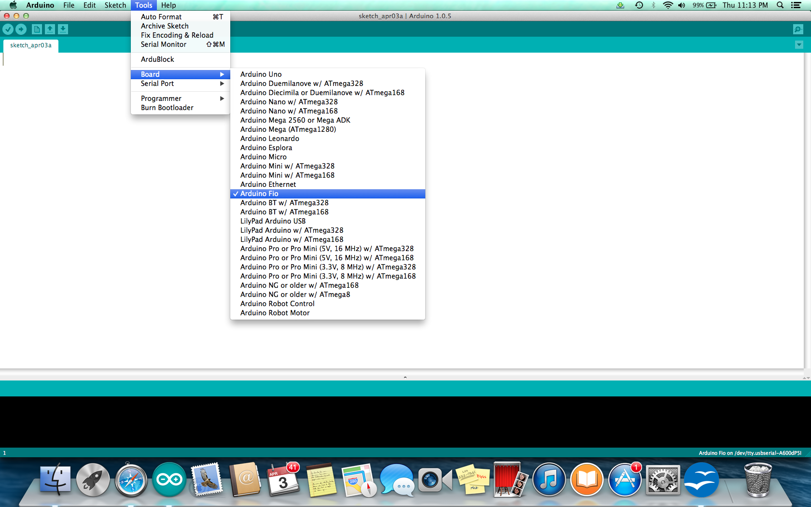
We'll need to make a couple selections
First the Board, the Fio;

Slide 17
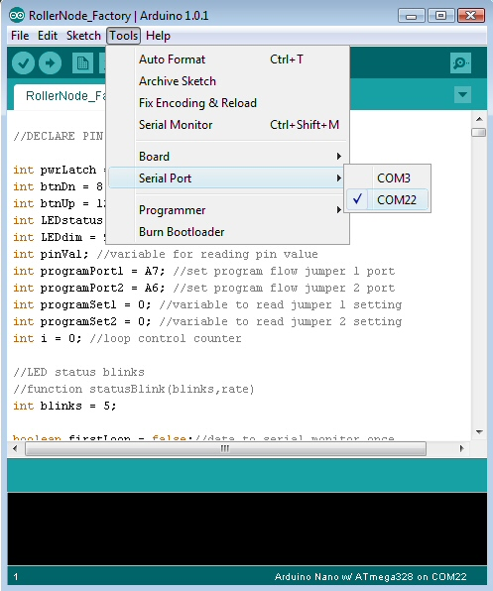
Now for the COM port
We need to select where the programming data goes to;

Slide 18
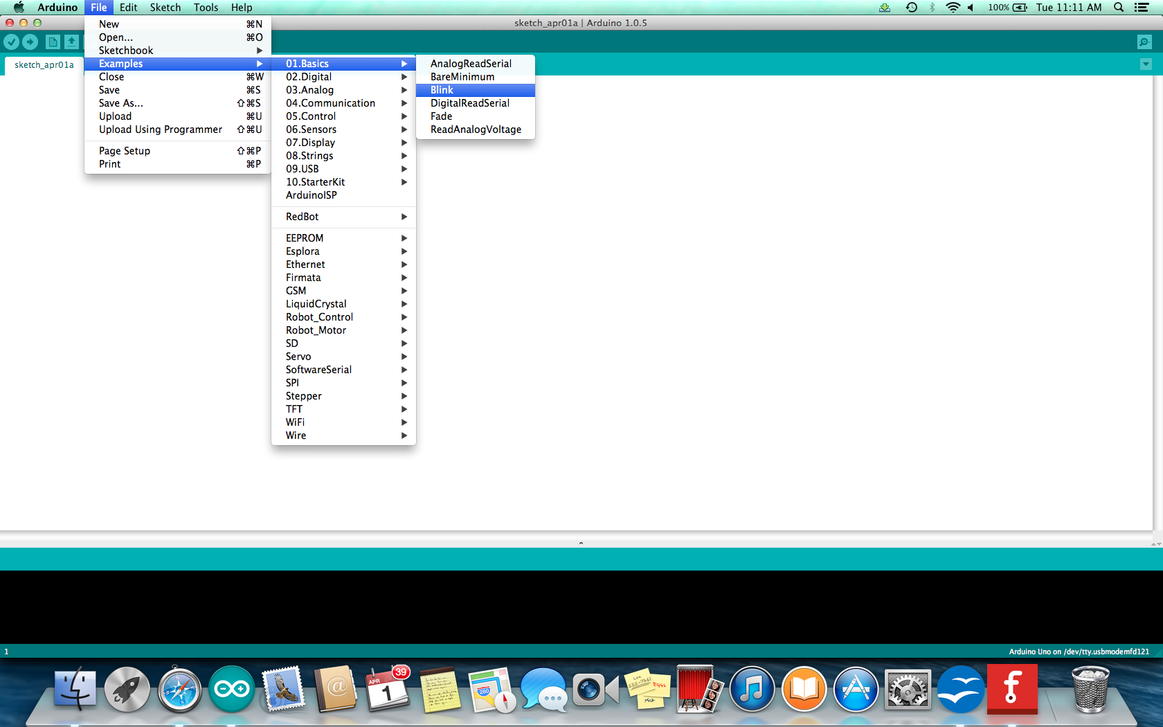
Now our first program, let's open Blink

Slide 19
Some things we can do in Blink
Change the delay
Unequal blinks for a heart beat
Add a pinMode and commands for a traffic light
Add a variable for delay, lets try some variable code....

Slide 20
Let's open the balloon code
Find the NSTA_Boston folder and open it
Open NSTA and open the example sketch: BMP085.ino
We then need to load the code to the Fio

Slide 21
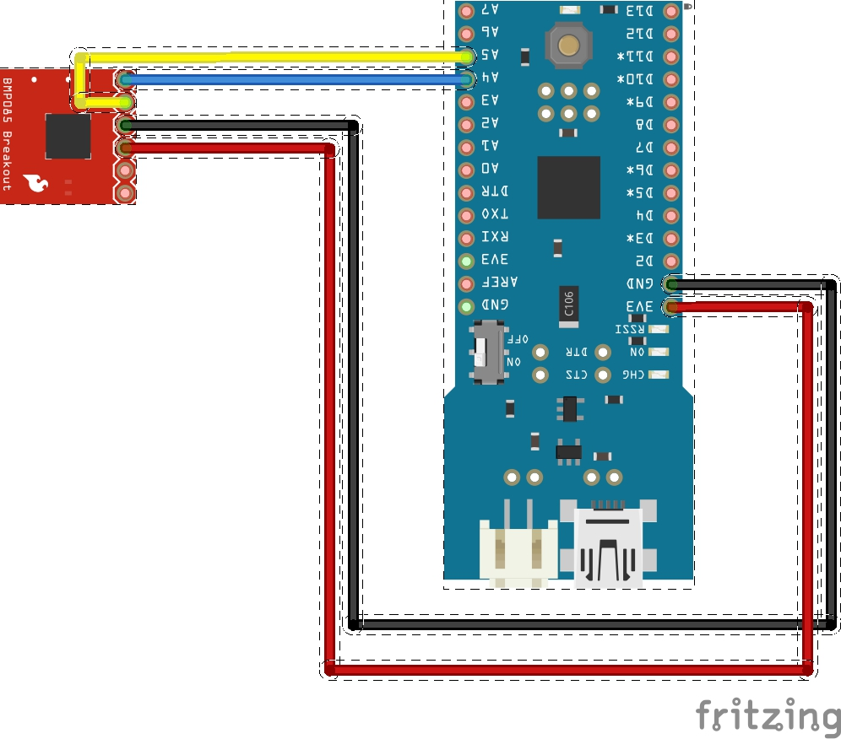
Let's wire up the hardware

Slide 22
Let's check the Serial Data
Open the port and see that your data is flowing
We'll click on the magnifying glass in the upper right corner
We should see four values separated by commas

Slide 23
Time to add wireless
We need to plug the Xbee wireless units into the back of the Fio.
Make sure the orientation matches the outline on the Fio board and be careful getting the pins lined up. If you aren't sure ask one of us
We'll add the Xbee Explorer to the usb port and go to Arduino and look for a port to pull the data from.

Slide 24
Want to learn more about Xbee?
Check out our tutorial on Xciting Xbees based on Rob Faludi’s book: Building Wireless Sensor Networks

Slide 25
Time to fly
Inflate, tether and fly at will!
There are a number of options for logging and displaying the data
The NSTA balloon code is comma seperated values and will load to Excel, Open Office and about any language that takes CSV
For a nice terminal display, use the BMP 085 code

Slide 26
More stuff
Learn.sparkfun.com
jeff.branson@sparkfun.com
Included is the summer camp materials from the University of Colorado, Colorado Springs
There are great balloon resources for the next level here;
http://stilldavid.com/habfaq/

